Slide 1

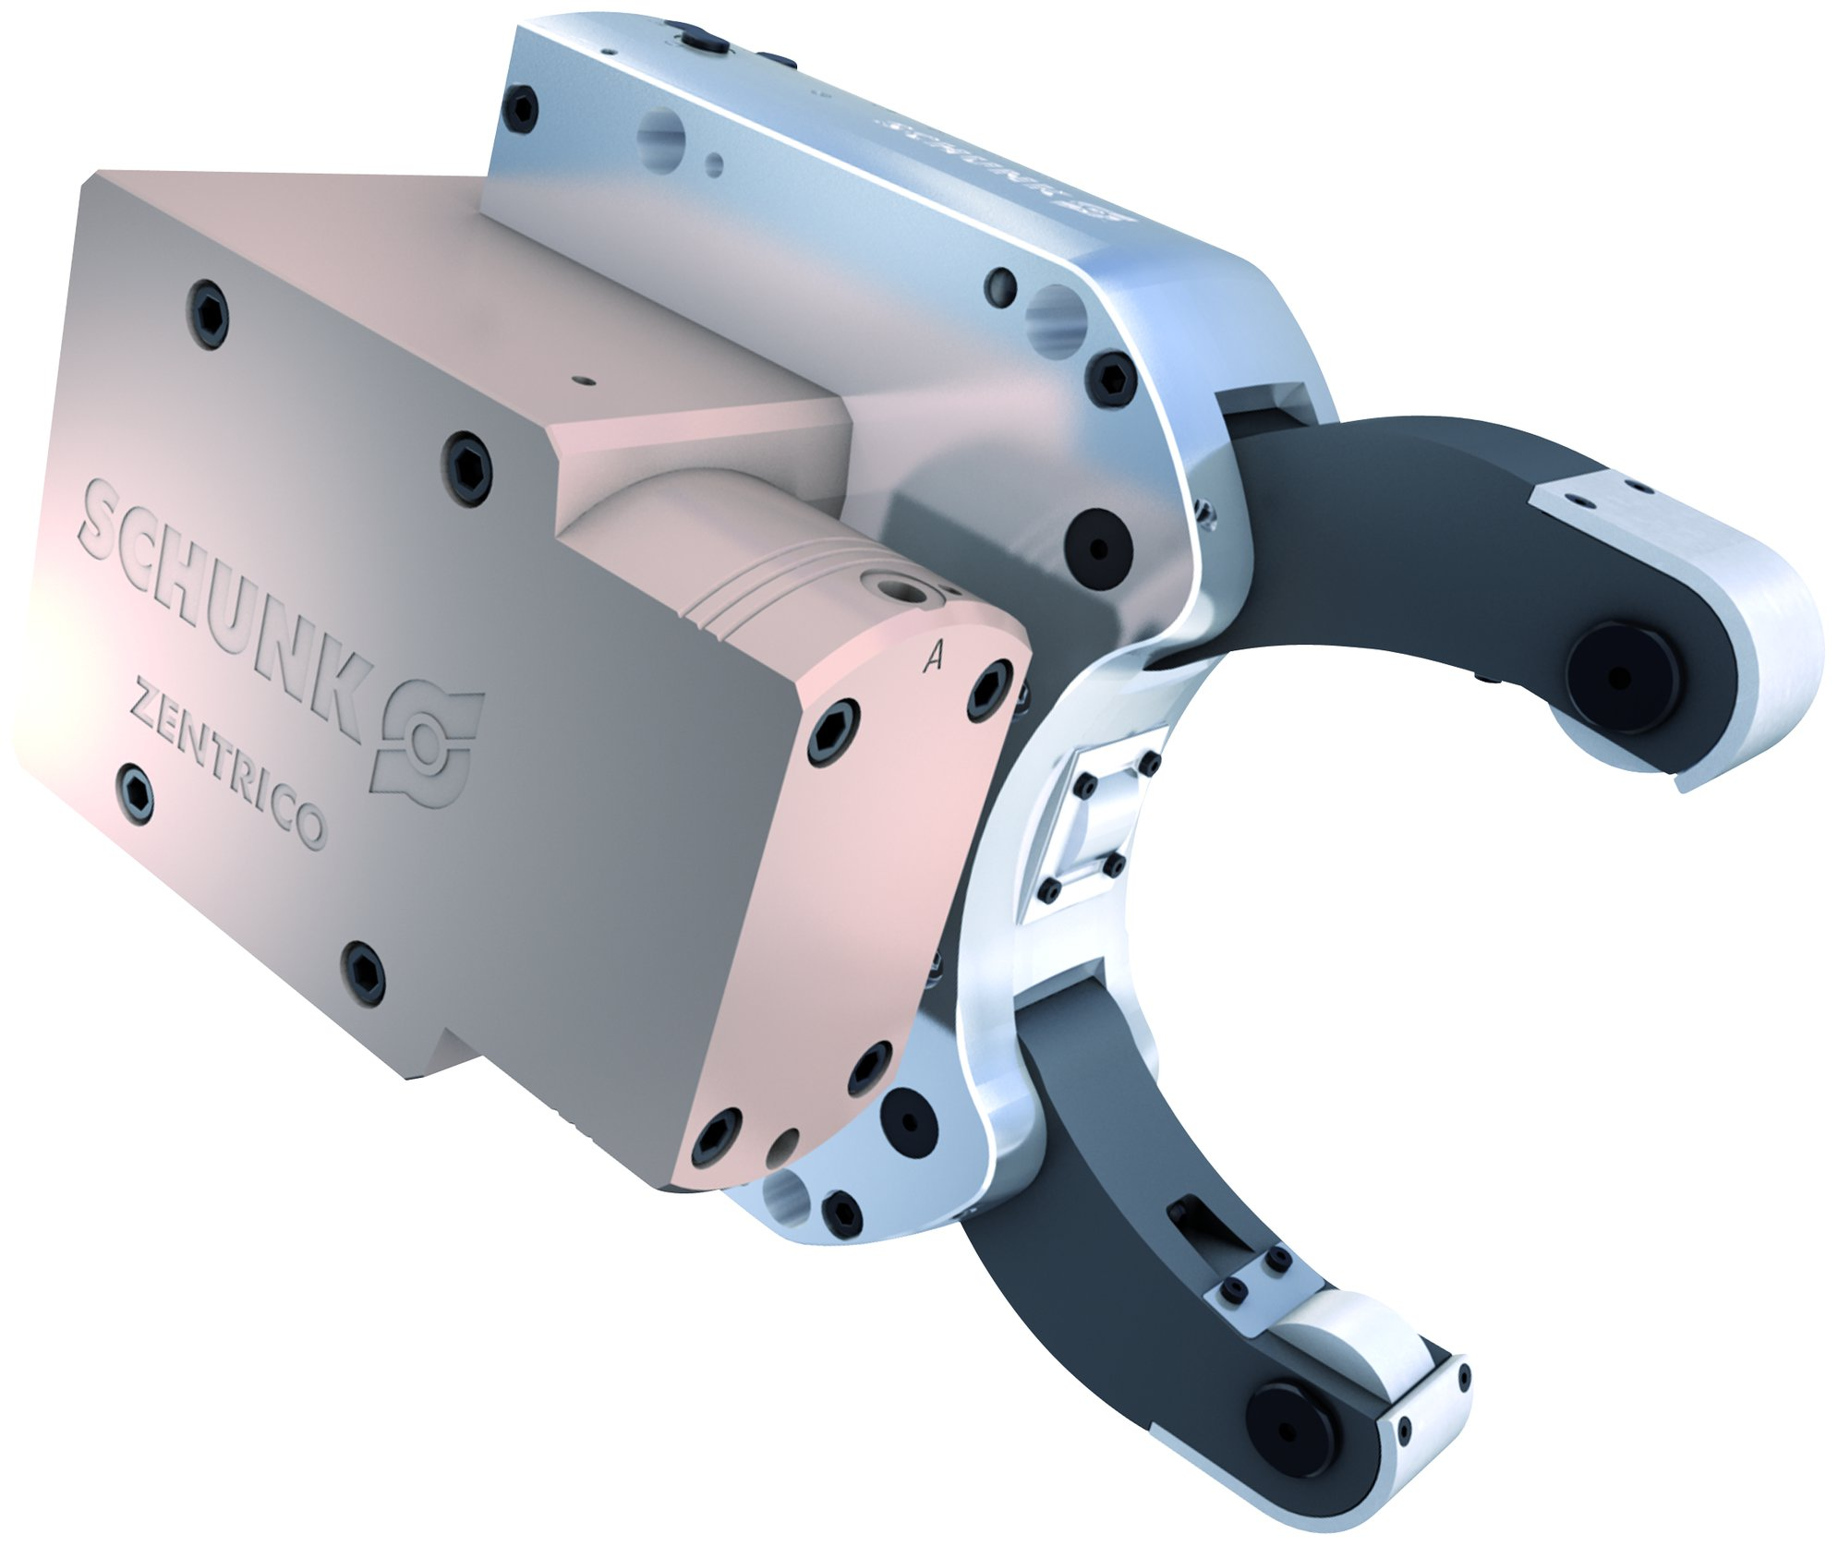
ZENTRICO THL plus
Steady Rests

Slide 2














Product overview
Gripping Systems
Clamping Technology
Chuck Jaws
Stationary Workholding
Lathe Chucks
Toolholders
Hydraulic Expansion Technology
Manual Lathe Chucks
Power Lathe Chucks with Jaw Quick-change System
Power Lathe Chucks with Through-hole
Power Lathe Chucks without Through-hole
Pneumatic Power Chucks
Steady Rests
Quick-change Systems
Customized Solutions

Slide 3
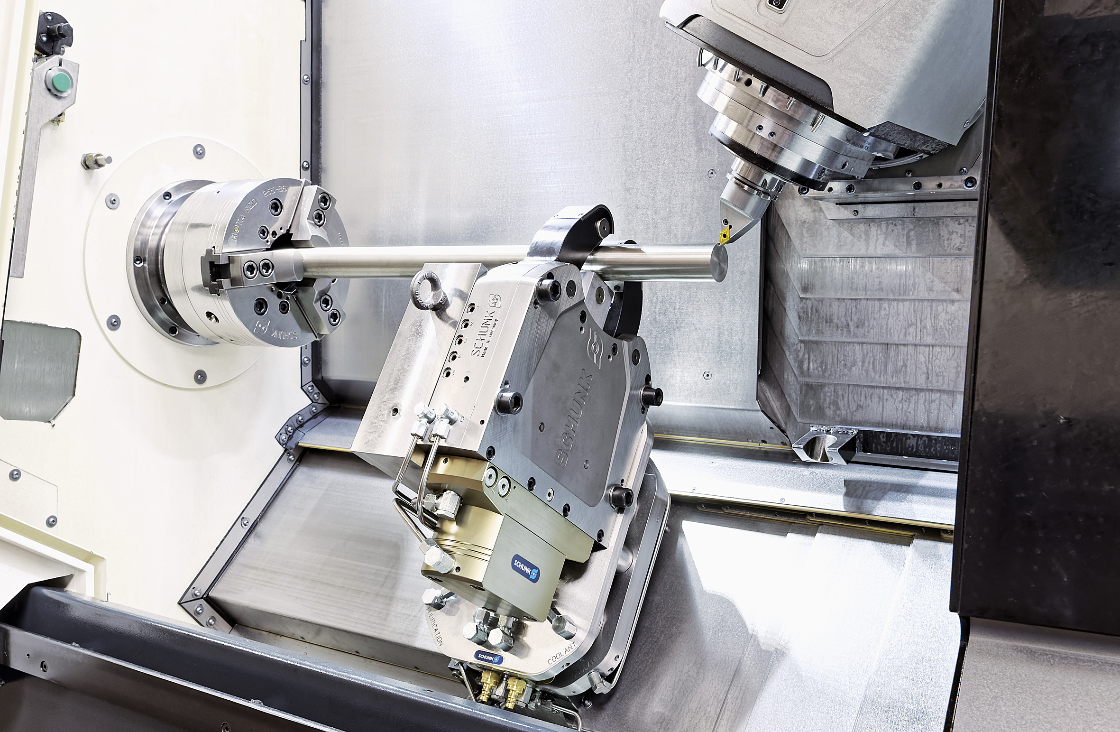
ZENTRICO
Example of application
Clamping device:
THL plus 310 with quick-change system on the basis of VERO-S.
Features/Application:
Support of long, cylindrical workpieces on lathes. Optimum utilization of the machine room and highest flexibility thanks to the quick-change system.

Slide 4
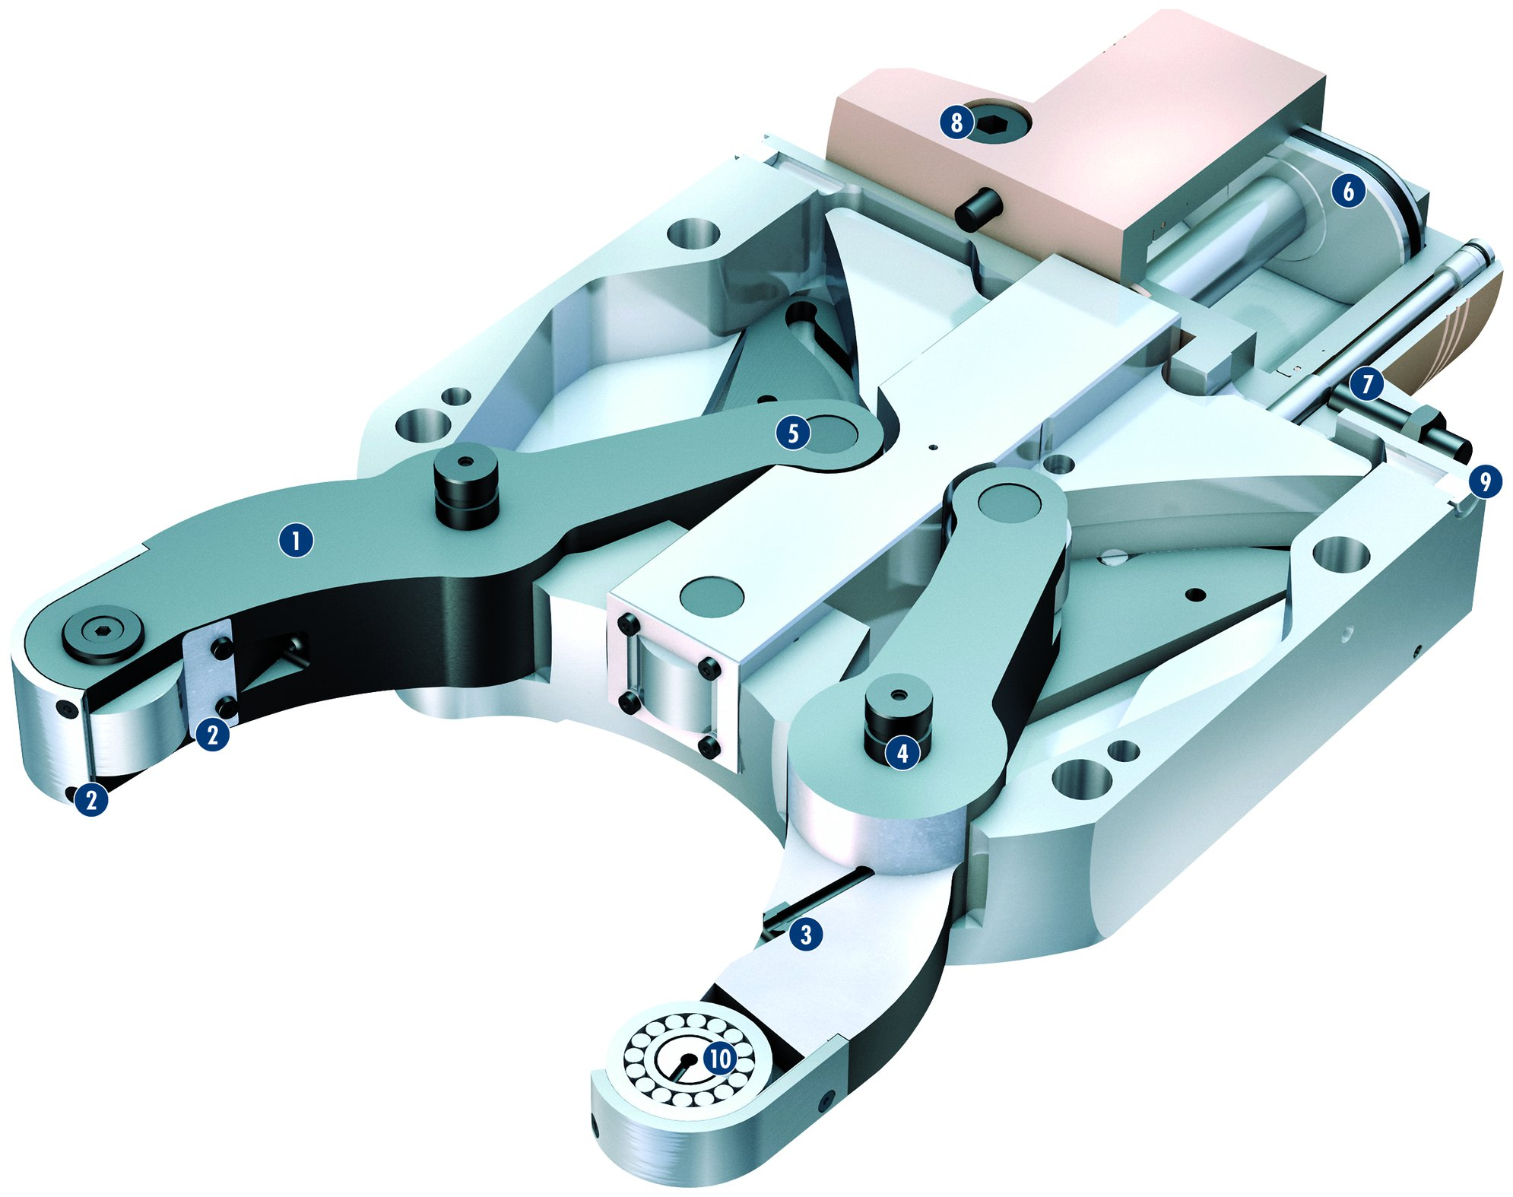
ZENTRICO THL plus
8
1
Lever drive
Sealed with double, extremely robust chip protection
Roller rinsing as standard
Stable lever bearing
Swing-out lever arm
Oval piston cylinder
Standard version ready for installation of piston position monitoring
Safety check valve
Air purge connection
Roller rinsing
6
2
7
3
5
4
9
1
5
6
7
2
4
2
8
3
9
10
10

Slide 5
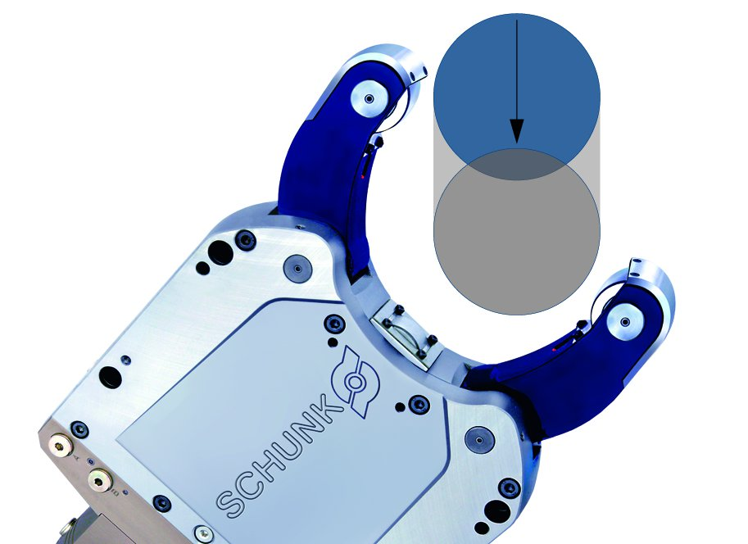
ZENTRICO THL plus
ZENTRICO THL plus with side mounted cylinder
Swing-out lever arm
Cylindric rollers
Spherical rollers

Slide 6
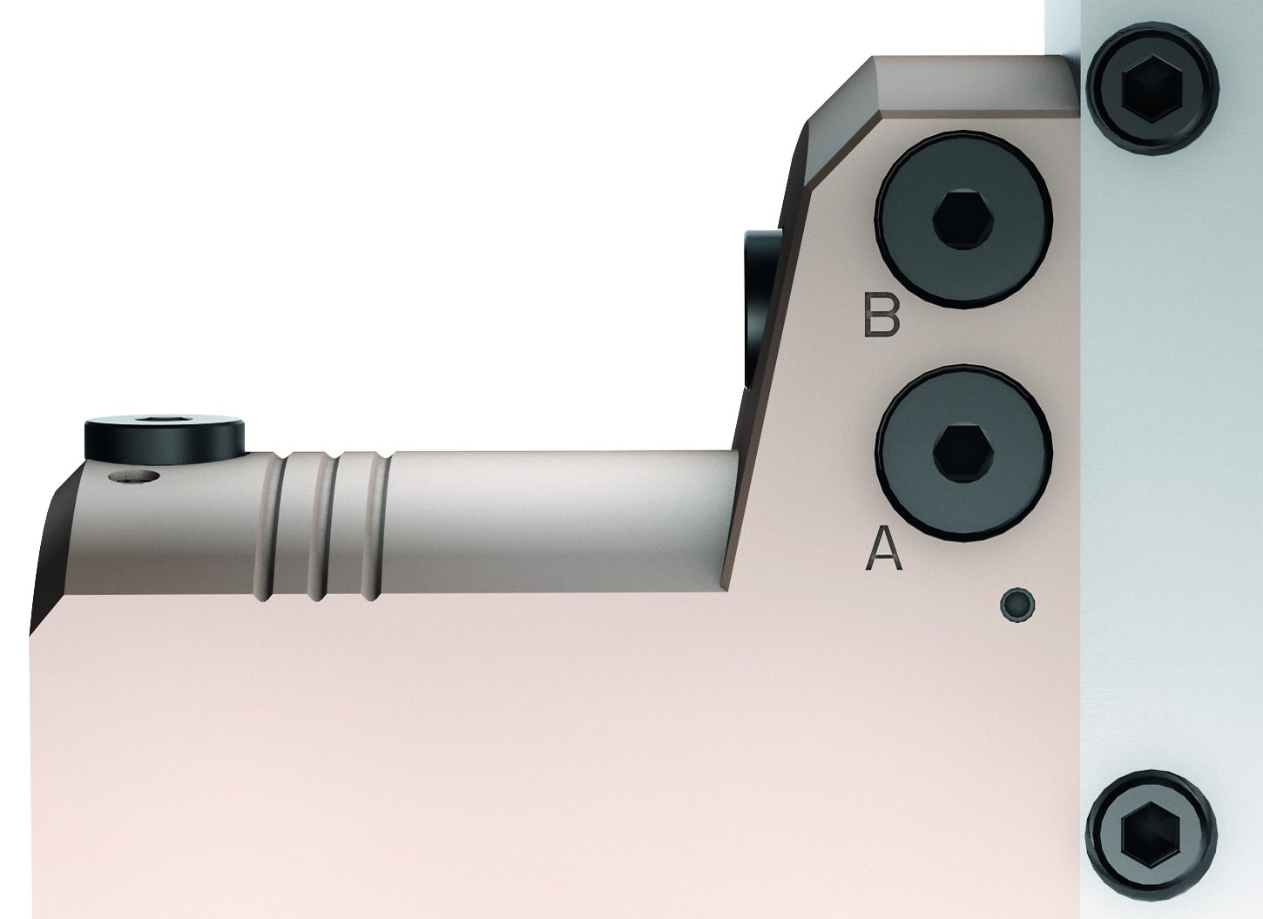
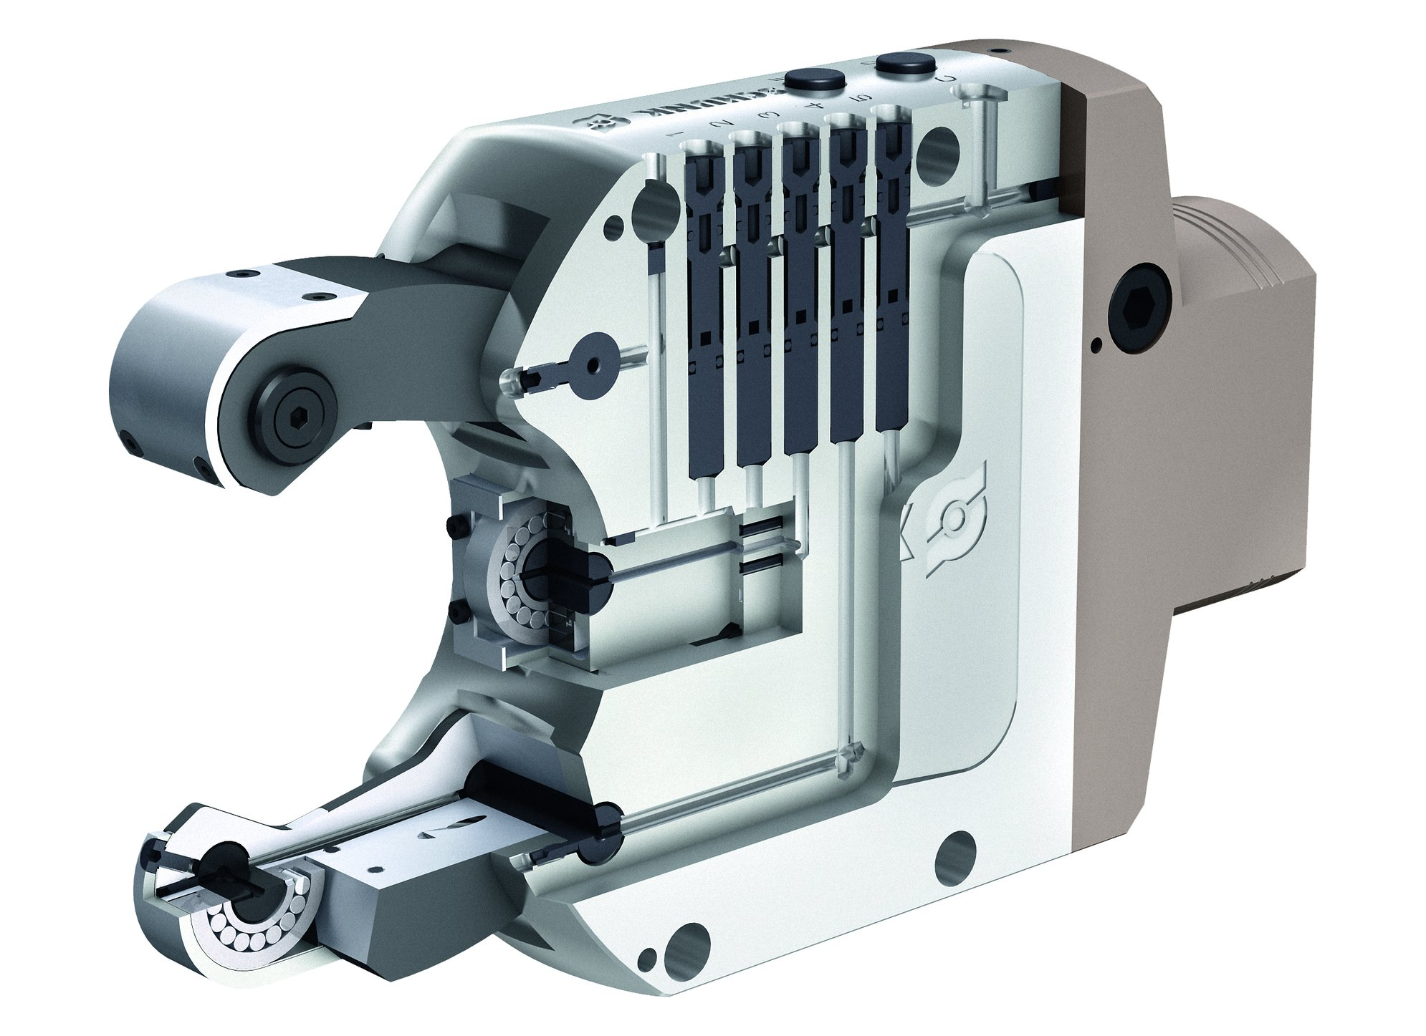
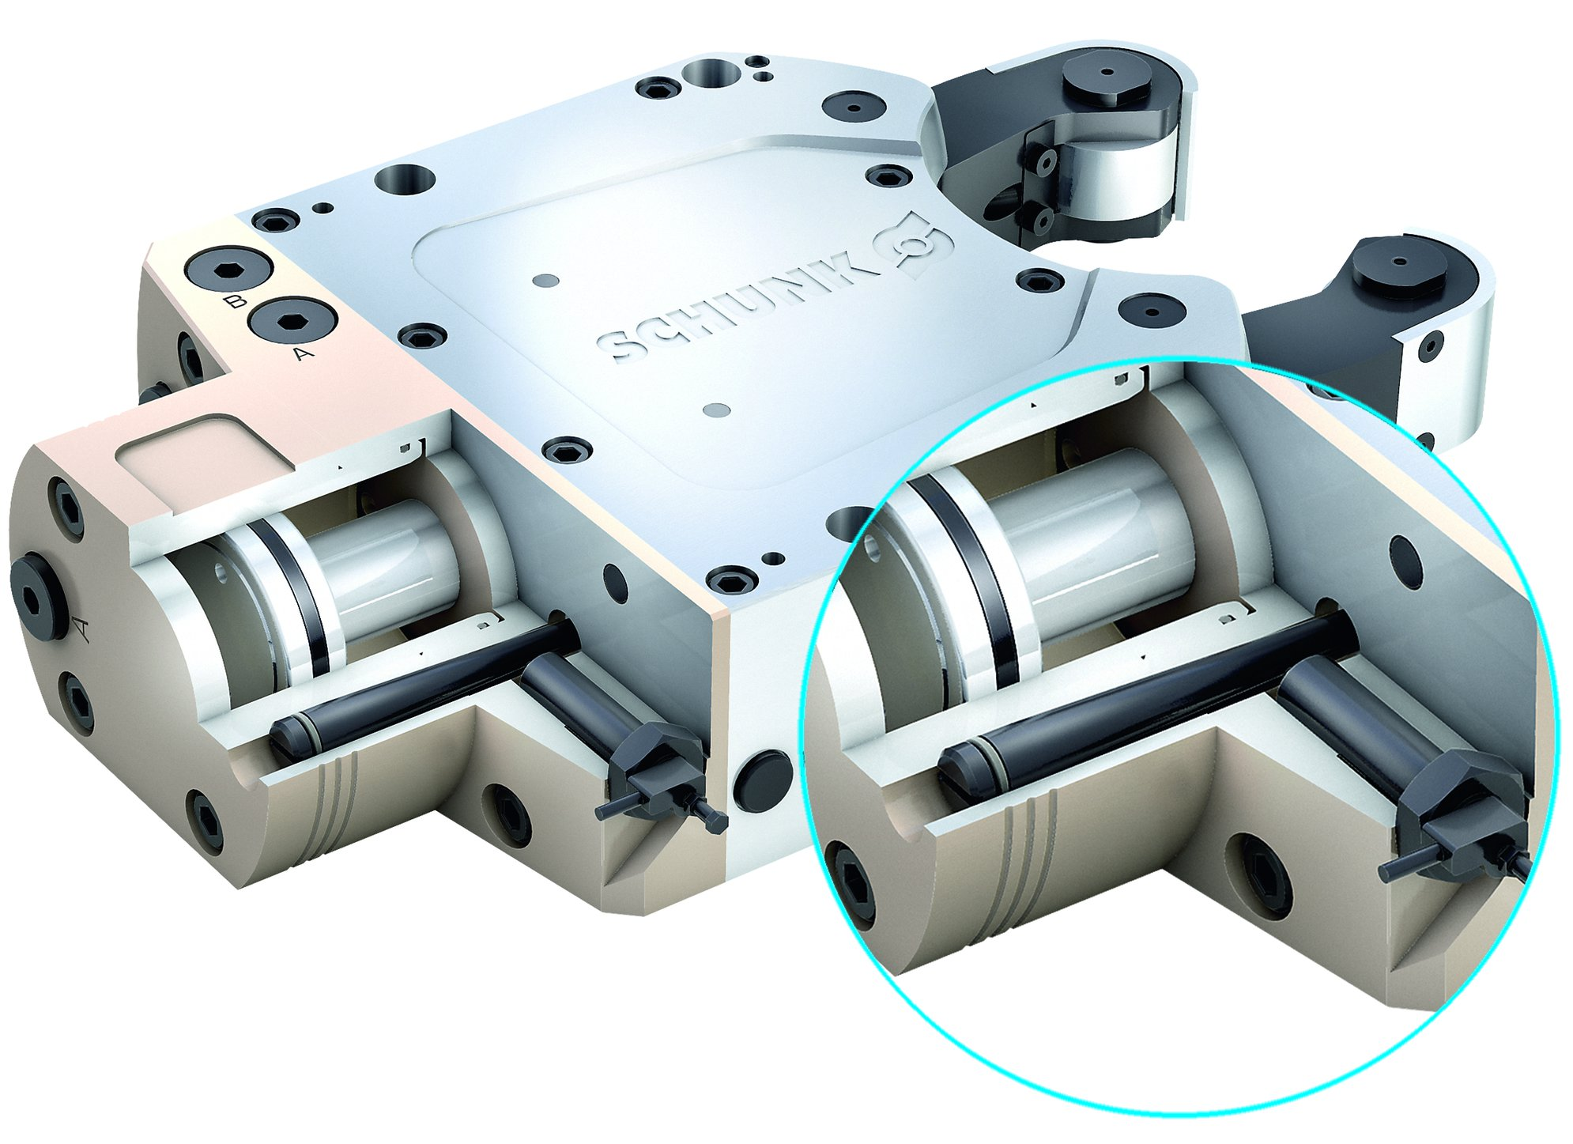
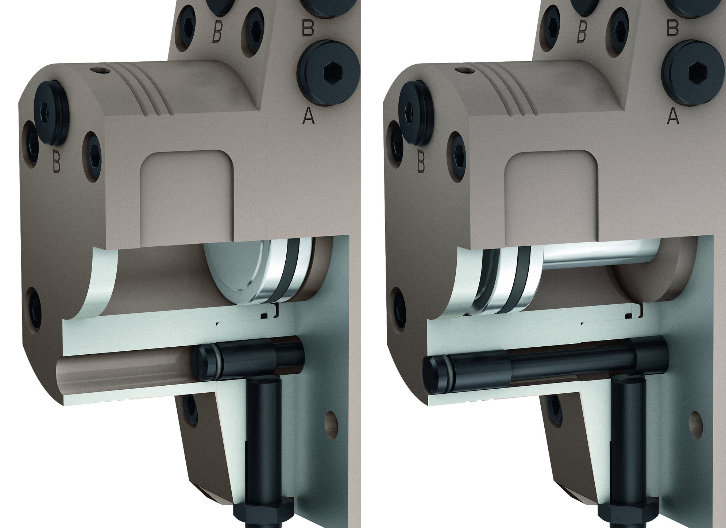
ZENTRICO THL plus
Lateral hydraulic connections
Central lubrication
Stroke measuring system
Distance monitoring

Slide 7
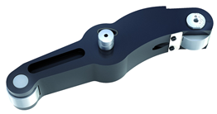
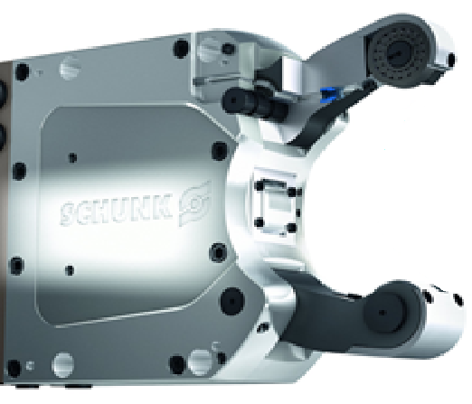
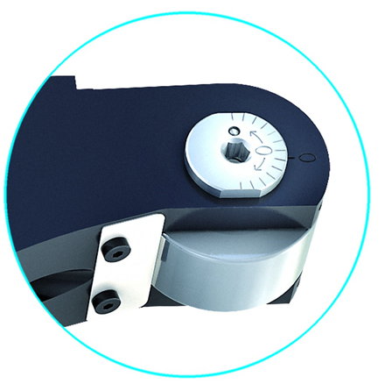
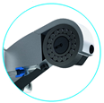
ZENTRICO THL plus
Roller fine adjustment
Roller rinsing

Slide 8
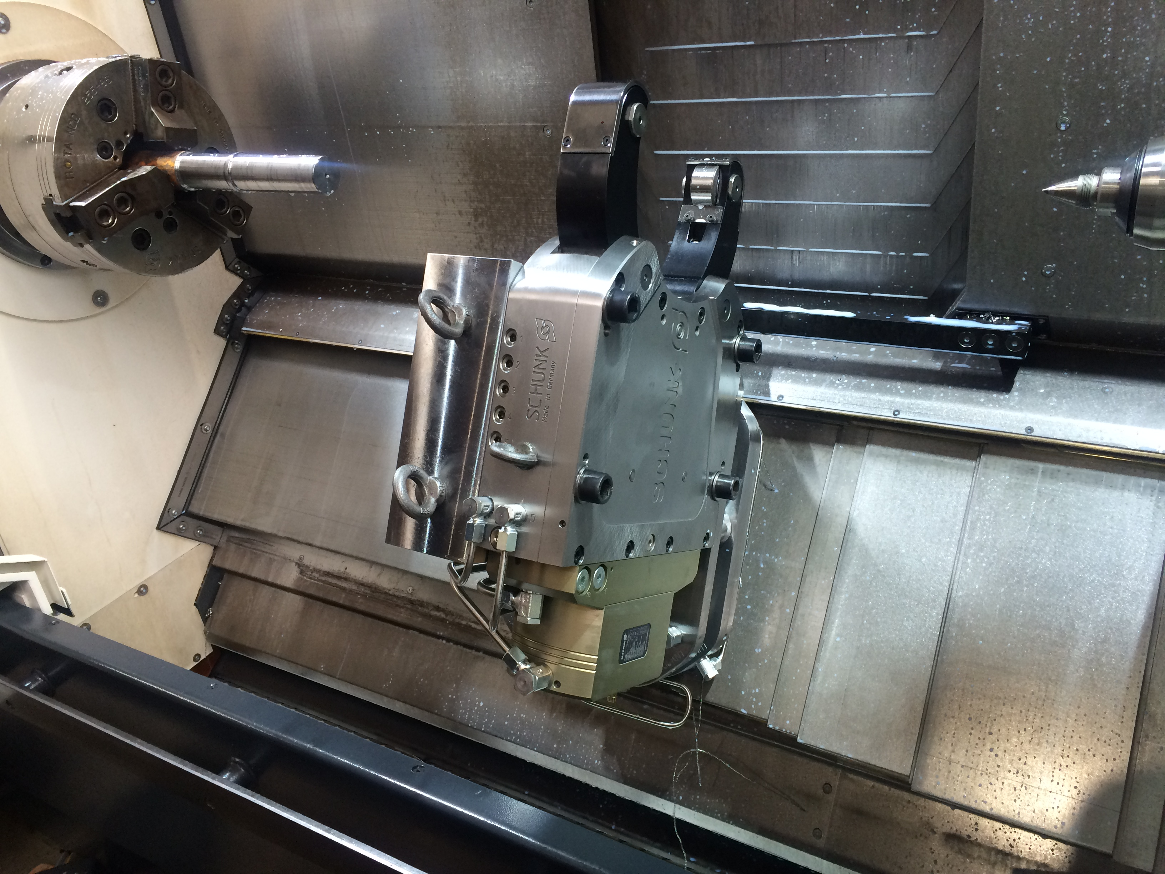
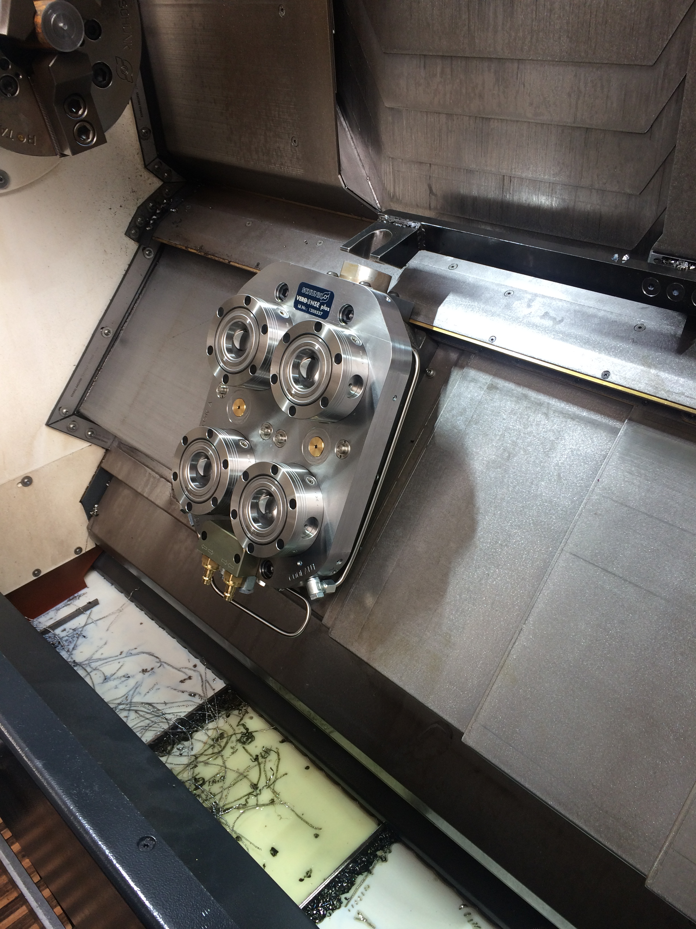
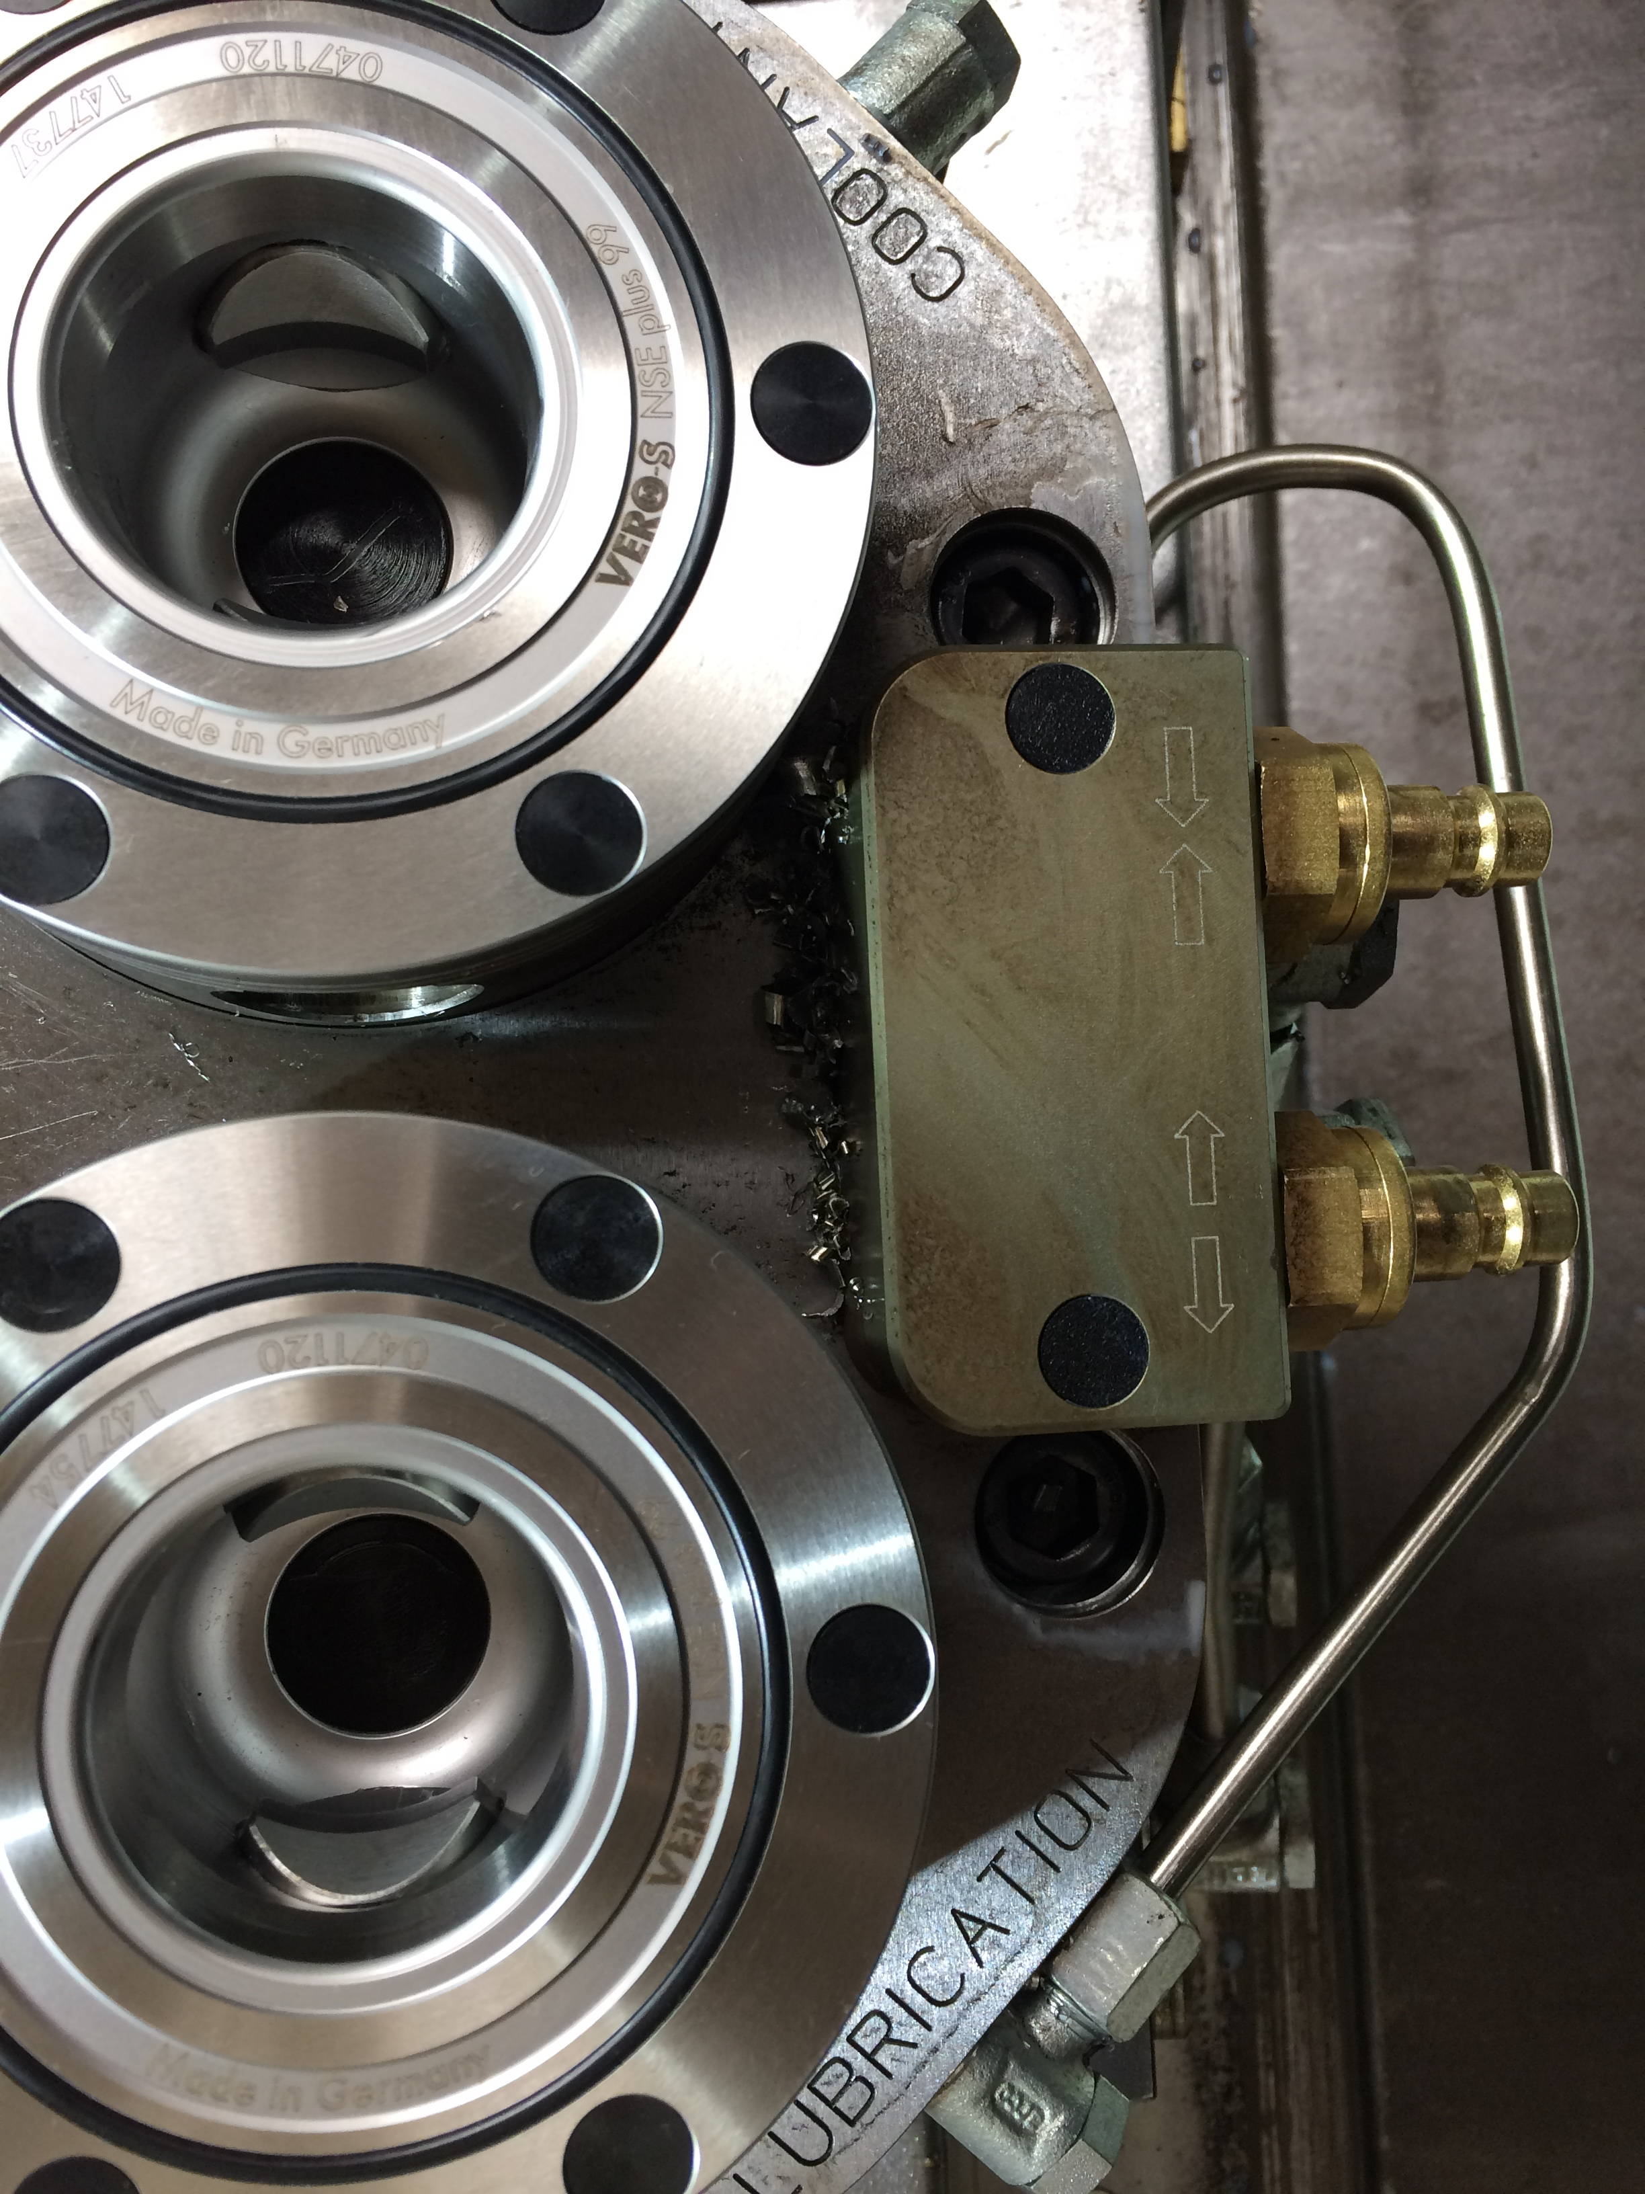
Steady rest quick change system

Slide 9
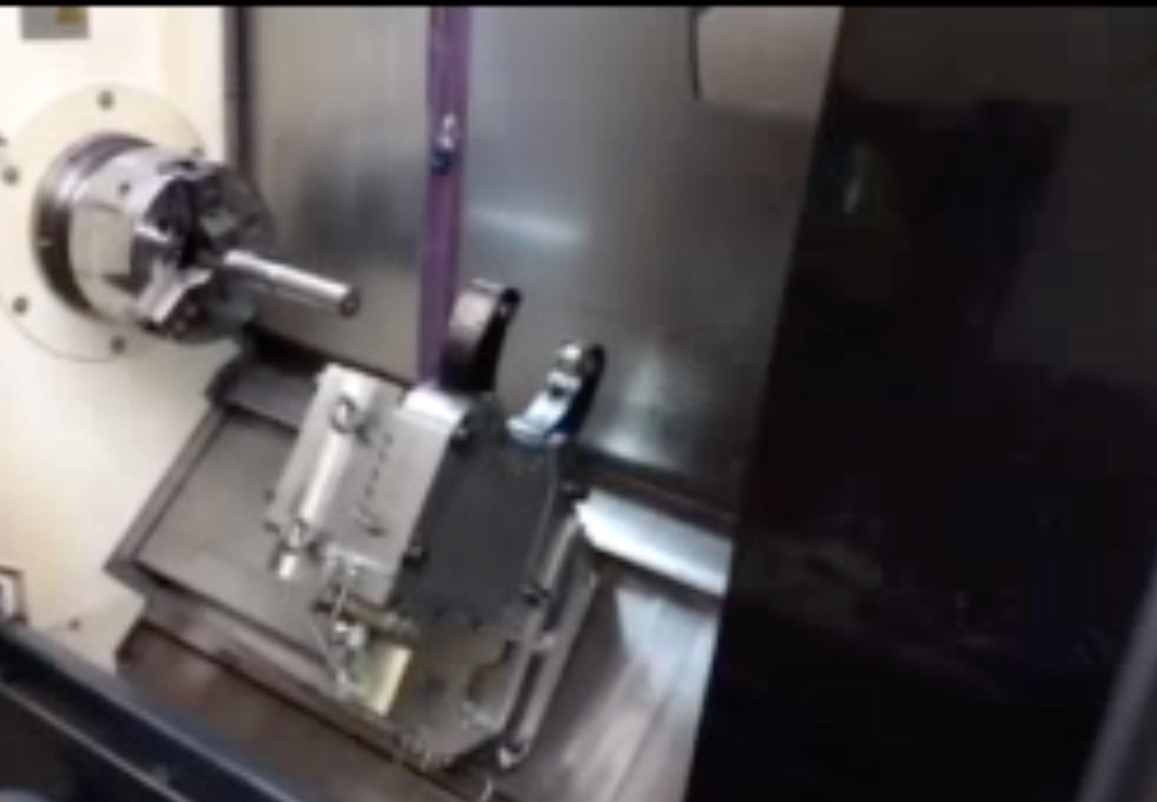
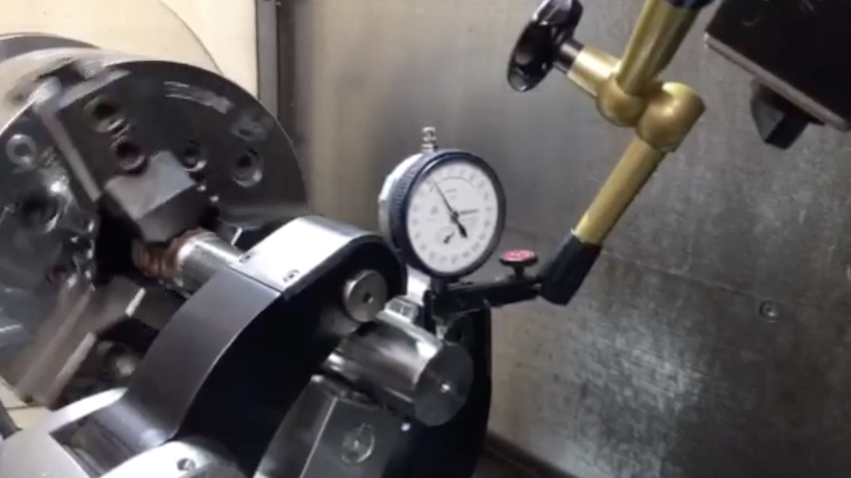
Steady rest quick change system

Slide 10
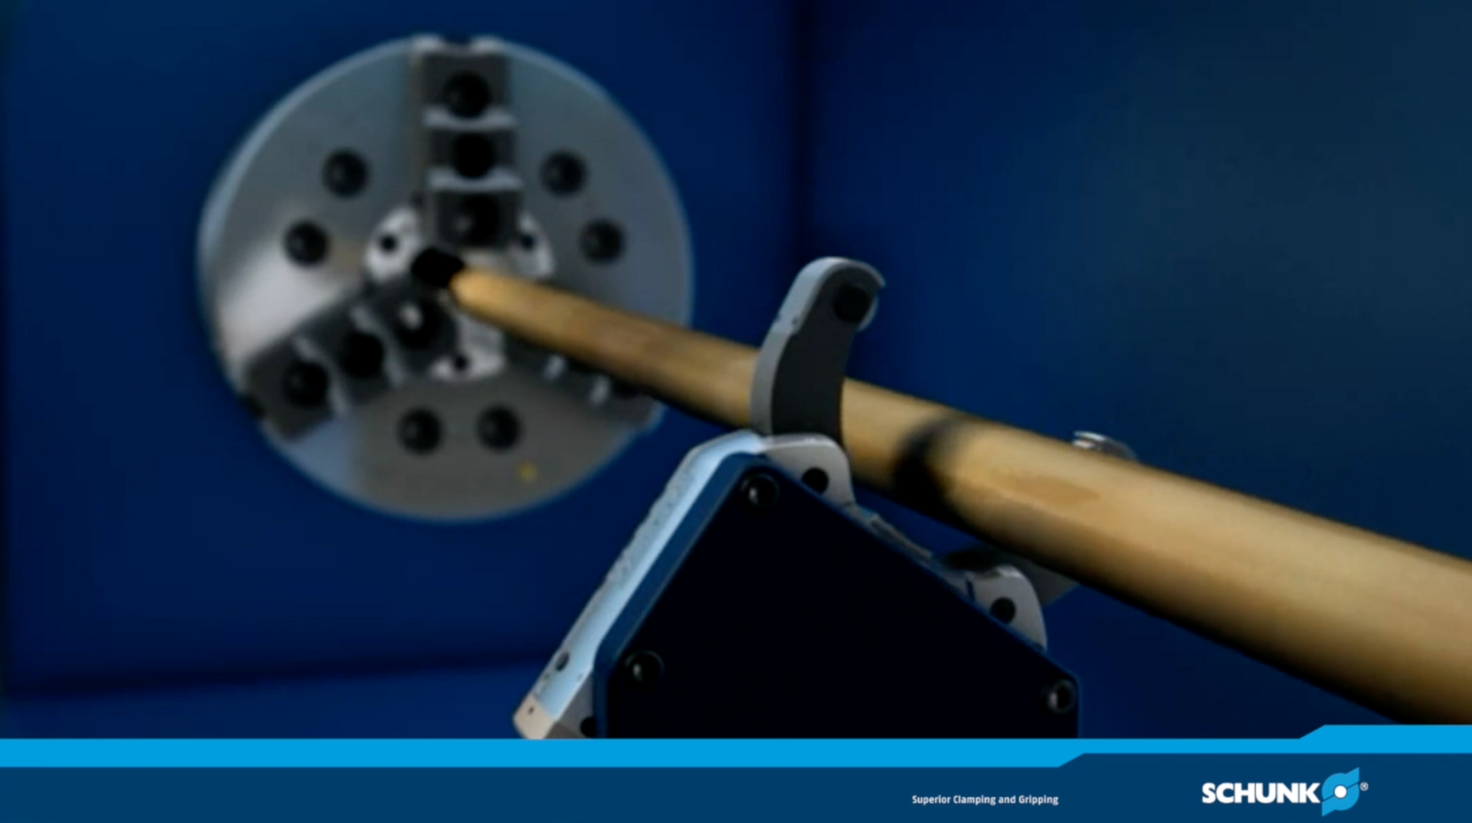
ZENTRICO THL plus

Slide 11
Variants ZENTRICO THL plus
Technische Daten | Clamping range [min⁻¹] | Operating pressure [bar] | Max. clamping force [kN] | Centering accuracy [mm] | Repeat accuracy [mm]
THL plus 100 | 4-66 | 6-50 | 1 | < 0.02 | < 0.005
THL-A plus 100 | 4-52 | 6-50 | 1 | < 0.02 | < 0.005
THL plus 200 | 8-101 | 8-60 | 3.5 | < 0.02 | < 0.005
THL-A plus 200 | 8-80 | 8-60 | 3.5 | < 0.02 | < 0.005
THL plus 300 | 12-152 | 8-60 | 10 | < 0.04 | < 0.007
THL-A plus 300 | 12-130 | 8-60 | 10 | < 0.04 | < 0.007
THL plus 310 | 20-165 | 8-60 | 10 | < 0.04 | < 0.007
THL-A plus 310 | 20-150 | 8-60 | 10 | < 0.04 | < 0.007
THL plus 320 | 50-220 | 8-60 | 10 | < 0.04 | < 0.007
THL plus 400 | 35-245 | 8-60 | 15 | < 0.05 | < 0.01
THL-A plus 400 | 35-220 | 8-60 | 15 | < 0.05 | < 0.01
THL plus 500 | 50-310 | 8-60 | 20 | < 0.06 | < 0.01
THL-A plus 500 | 50-268 | 8-60 | 20 | < 0.06 | < 0.01
THL plus 510 | 85-350 | 8-60 | 20 | < 0.06 | < 0.01
THL plus 600 | 125-460 | 8-60 | 25 | < 0.06 | < 0.005
Size 300, 310, 400, 500, 510 also available with side mounted cylinder.

Slide 12



SCHUNK Services
Engineering
Dimensioning of special plates designed to the manufacturing specifications
Development of special solutions together with the customer
FEM analysis for critical components
Testing
Endurance tests with all new developments
Abrasion checking
Measurement of accuracy
Service
Initial operation of customer´s solution
Inspection and maintenance
Repairs

