Slide 1

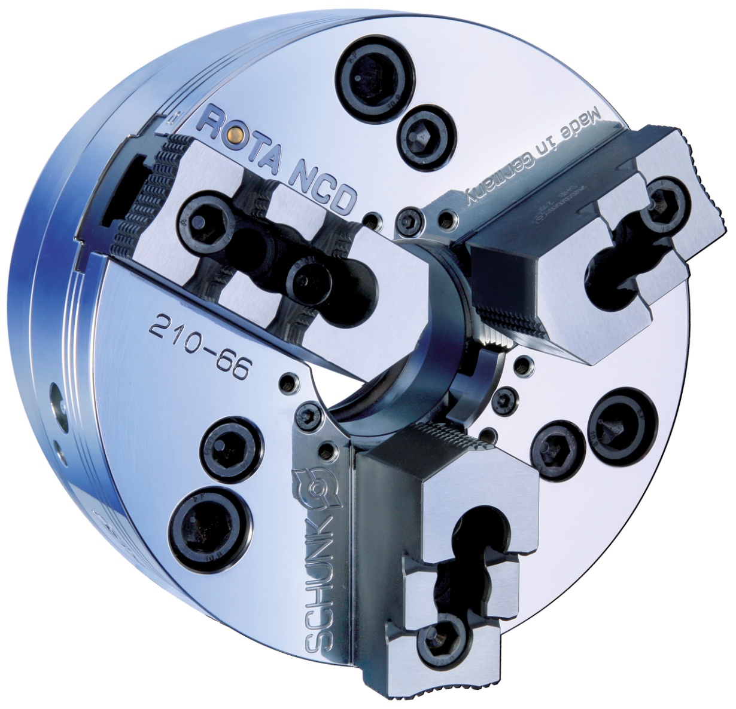
ROTA NCD
Power lathe chucks with through-hole

Slide 2

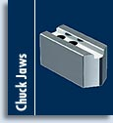
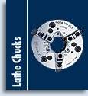


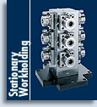
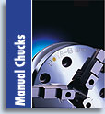
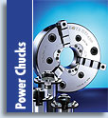
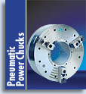
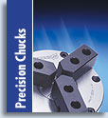
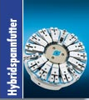
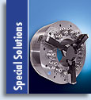
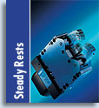
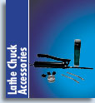
Product overview

Slide 3
ROTA NCD

Slide 4

ROTA NCD
The design of the SCHUNK wedge bar power chuck ROTA NCD is based on
the patented idea of high precision clamping of the smallest workpiece
diameters with SCHUNK collet jaws.
At the same time it is possible to clamp large workpieces with all
conventional top jaws. The continuous T-slot in
the base jaws allows for the highest flexibility in positioning the top jaws.

Slide 5
ROTA NCD
Your advantages | Your benefits
Very large through-hole | Enables machining of large raw material diameters
Extreme rigid clamping | High precision clamping
Clamping smallest diameters | Flexibility for various clamping tasks
Base jaws with fine serration 1,5 mm x 60° and 1/16“ x 90° | High flexibility within the range of the top jaws
Optimum maw support for O.D.- and I.D.-clamping due to the use of very long base jaw guidance | High clamping forces are achieved and maintainted throughout the machine tool‘s lifetime
2 different DIN-threaded connection pitch circles in the chuck body | Fast and direct chuck assembly on all common spindle mountings
All sides of the functioning parts are ground and hardened | High run-out and repeat accuracy

Slide 6
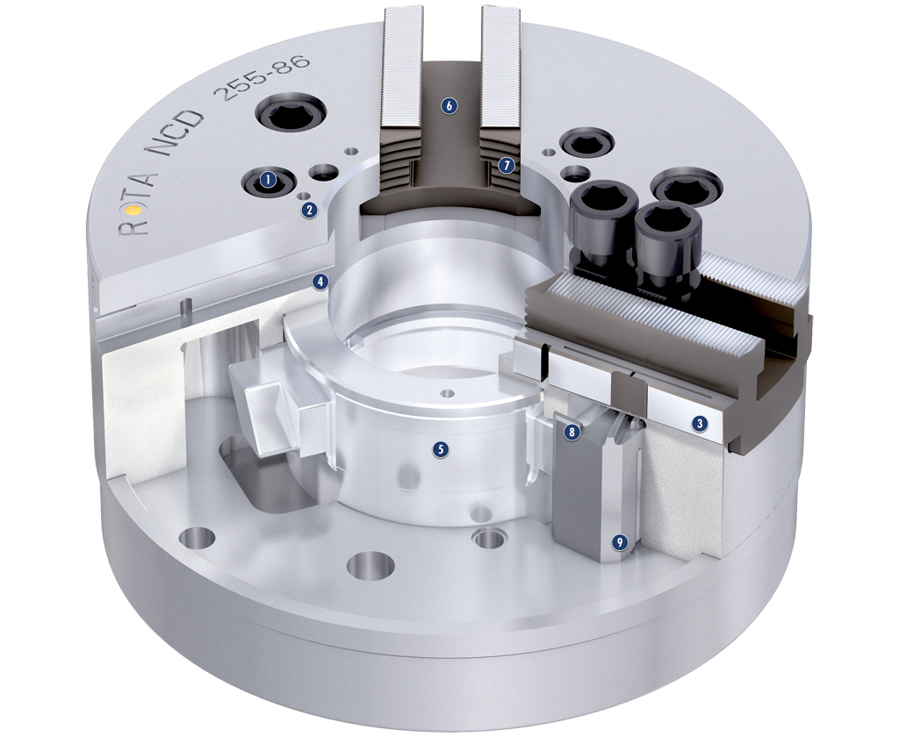
ROTA NCD
Two DIN pitch circles
Mounting threads
long jaw guiding
additional ribbing of the chuck body
the sleeve is deeply implemented into the body
continuous T-slots
radial base jaw serration
wedge bar principle
the wedge bars are positioned tangentially
in the chuck body
1
6
2
7
1
2
3
4
4
5
8
3
5
6
9
7
8
9

Slide 7
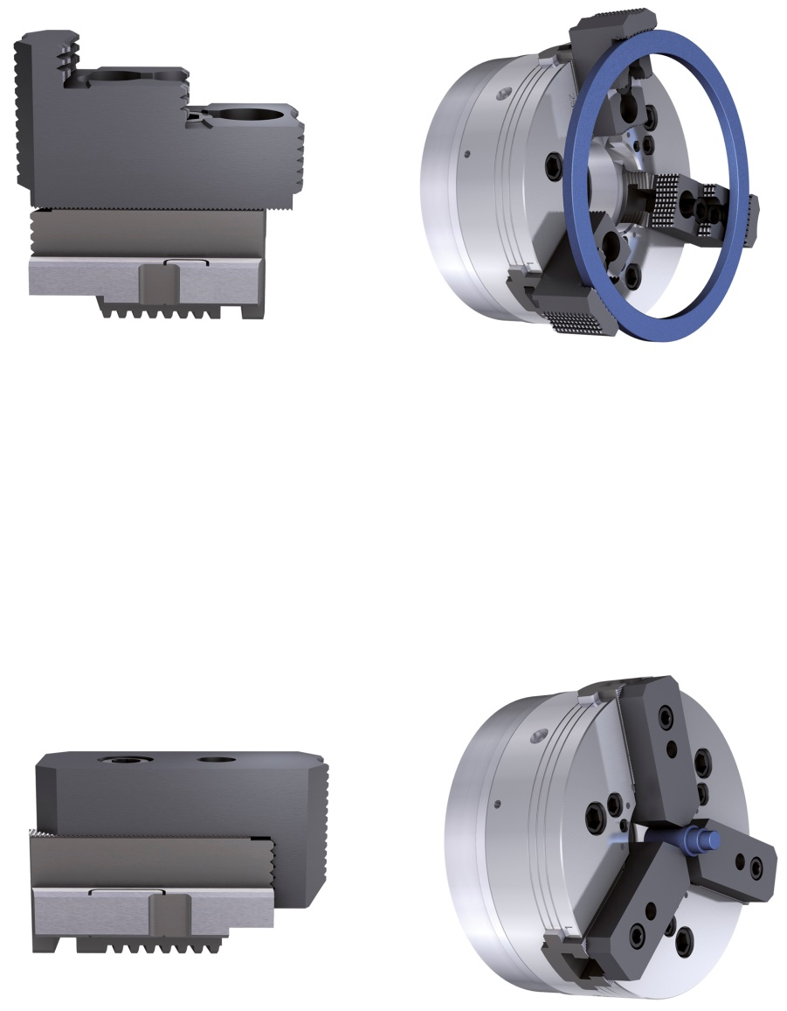
ROTA NCD
Universal for large clamping diameters
Every suitable standard jaw from the wide range of SCHUNK‘s standard chuck jaws can be used.
Application: O.D.-Clamping of large workpiece diameters.
Universal for bar machining
Patented standard collet jaw system from SCHUNK for bar clamping operations similar to a collet chuck
Application: Clamping of very small bar diameters by using collet jaws STD

Slide 8
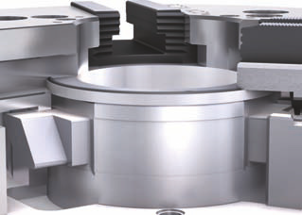
ROTA NCD
Technical highlights
Continuous T-slot
ROTA NCD chuck with a continuous T-slot in the base jaw offers a maximum clamping range of the top jaws. The additionally integrated serration in the front, together with the patented collet jaw system from SCHUNK ensures clamping of the smallest workpieces.

Slide 9
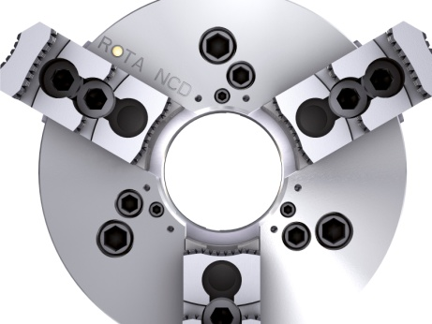
ROTA NCD
Technical highlights
Very large through-hole of the chuck
The very large through-hole ensures maximum use of the spindle capacity. In combination with the patented collet jaw system, the ROTA NCD is a very flexible clamping device even for bar clamping operations similar.

Slide 10
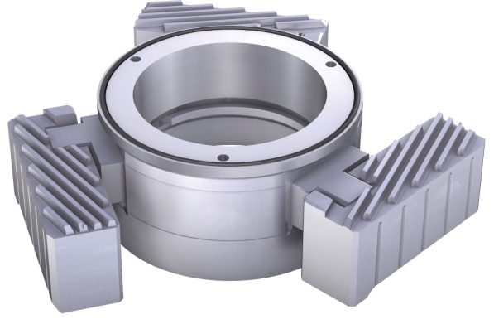
ROTA NCD
Technical highlights
Wedge bar system
Due to the force transmission via wedge bars and the low weight of the base jaws very high RPMs can be achieved with the ROTA NCD.

Slide 11
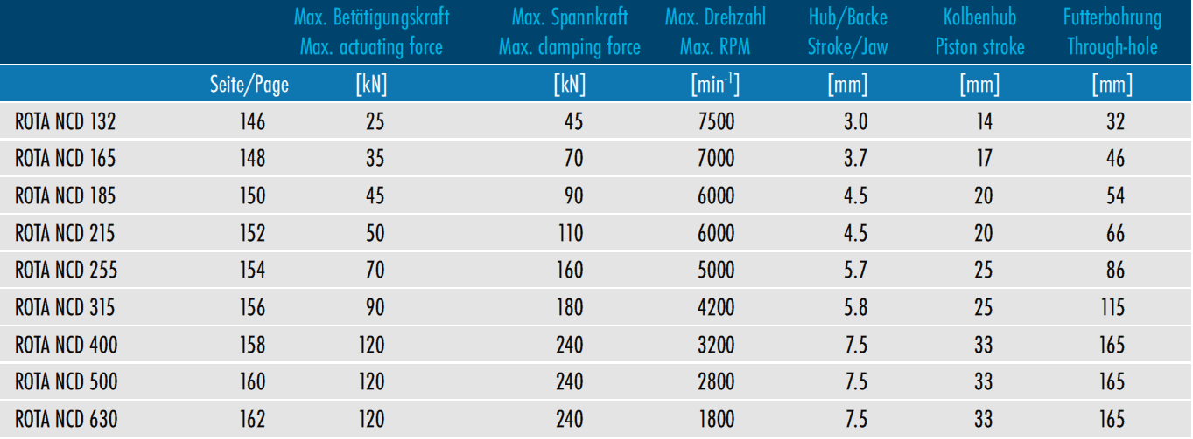
ROTA NCD

Slide 12
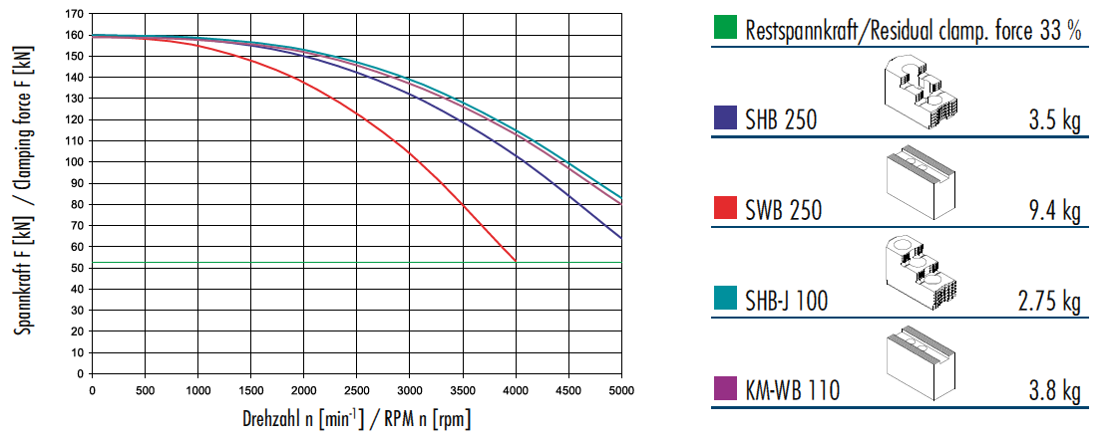
ROTA NCD
Clamping force-RPM-diagram ROTA NCD 255-86

Slide 13
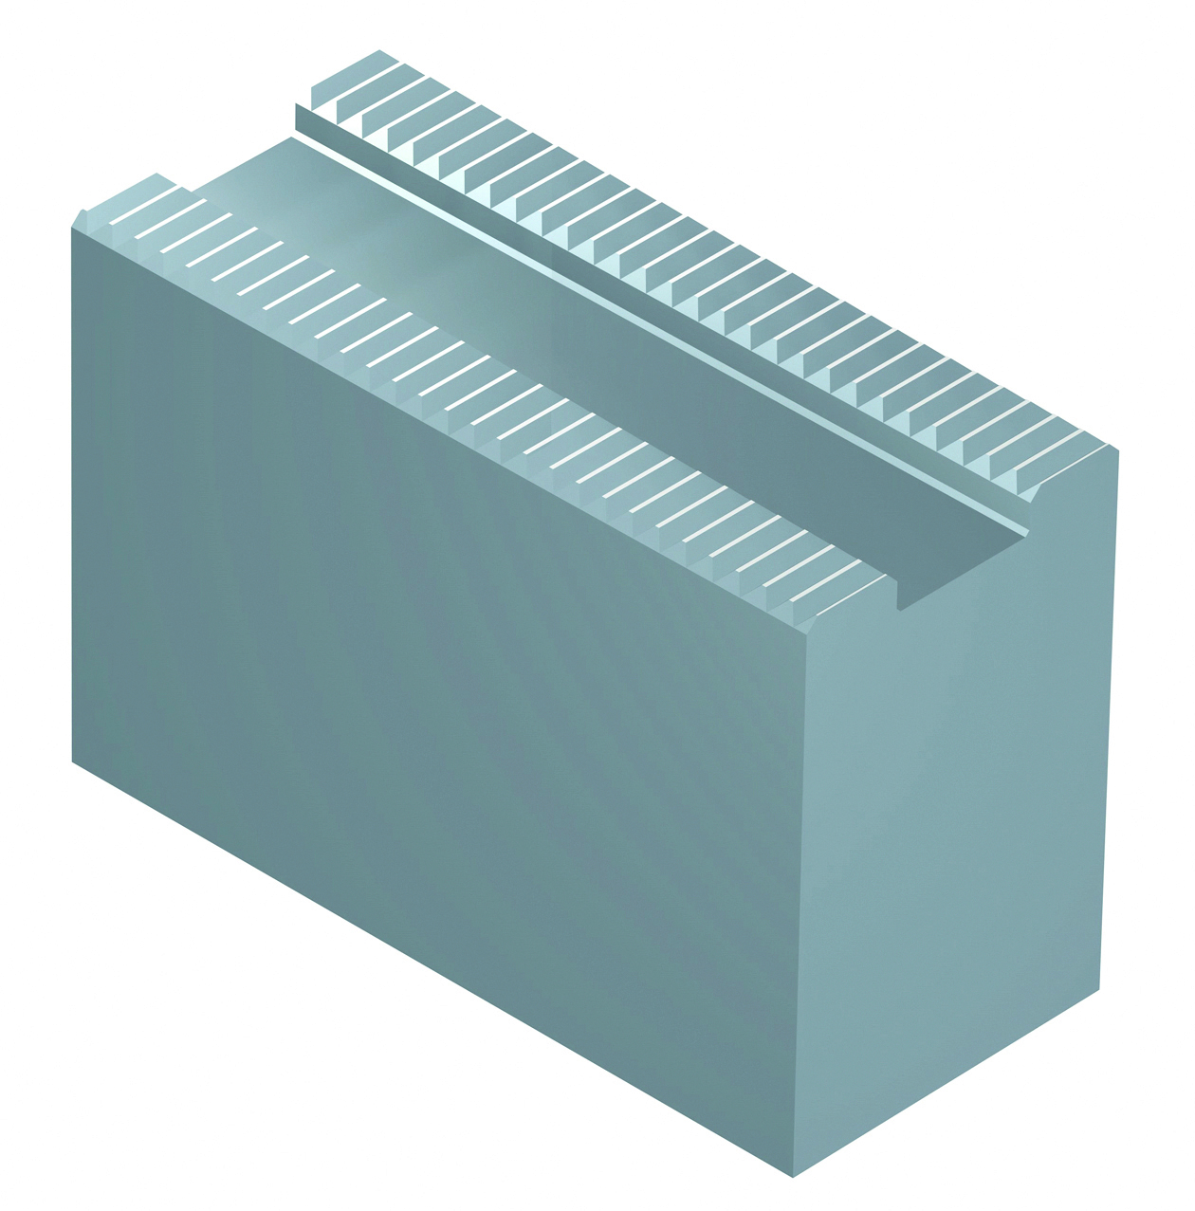
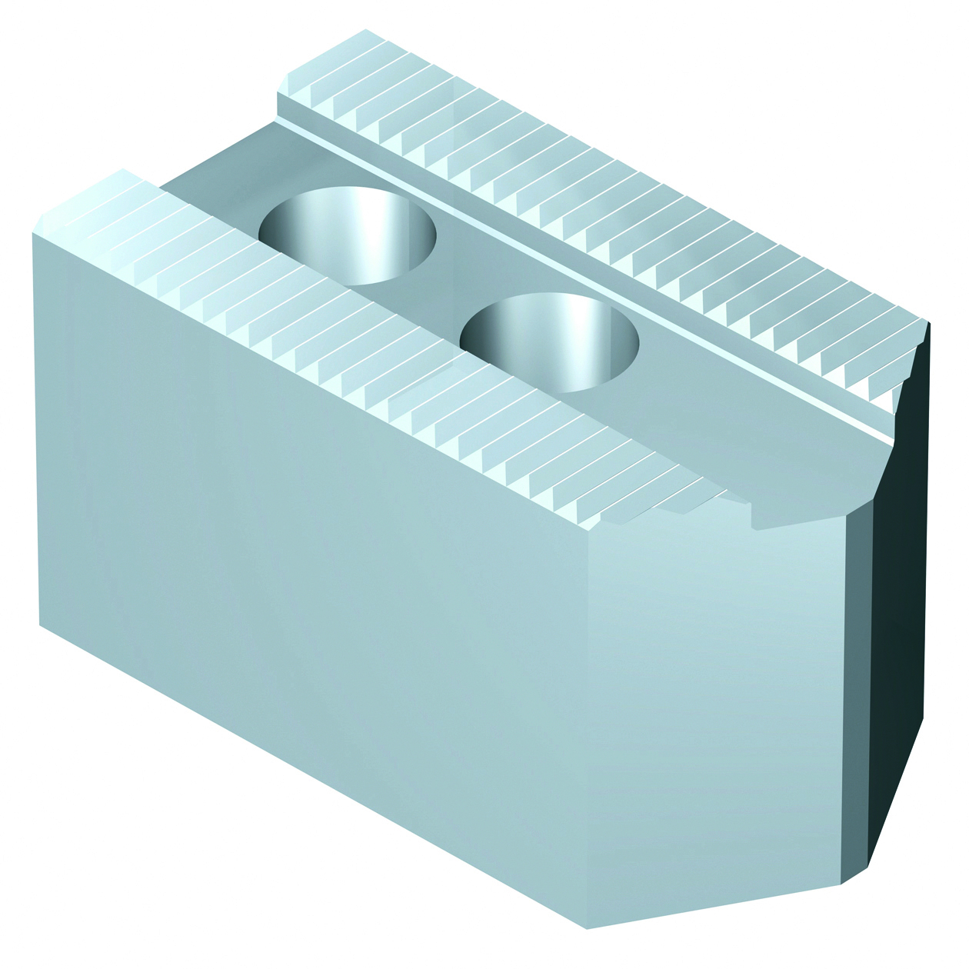
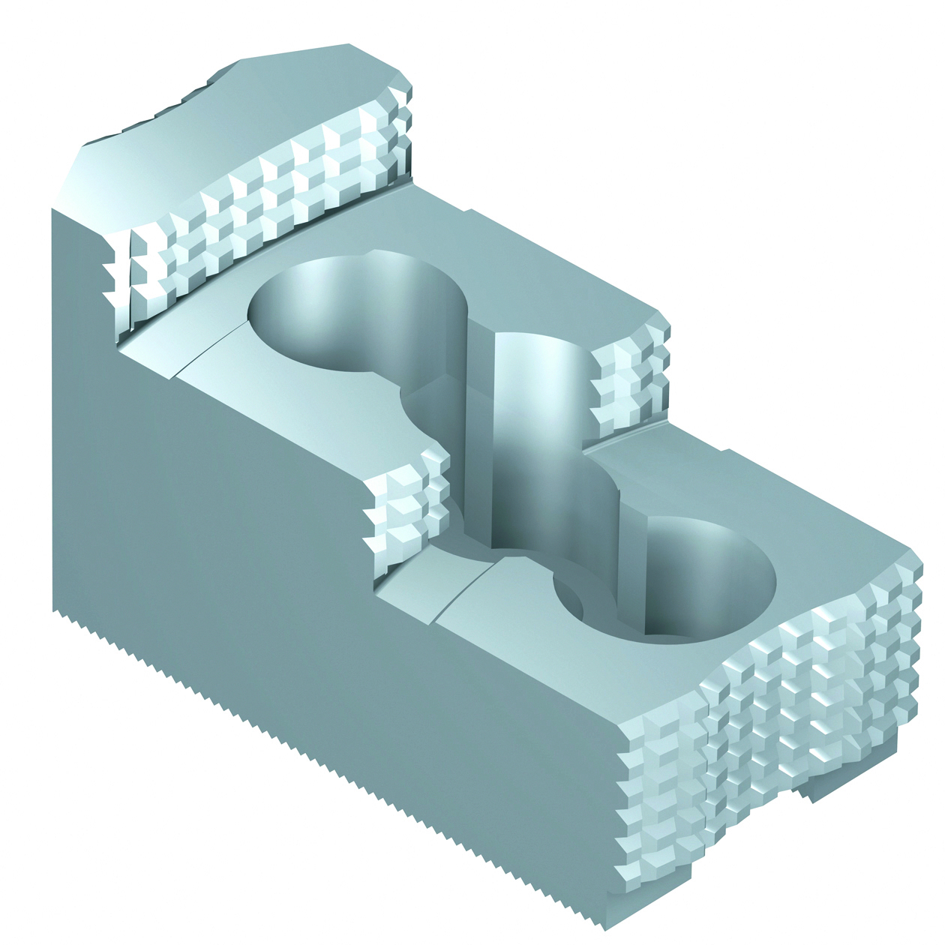
ROTA NCD
soft top jaws, SWB,
SWB-FR and SWB-AL
soft top jaws 120°,
SWB-FR and SWBL
hard to jaws,
SHB and SHB-FR

Slide 14
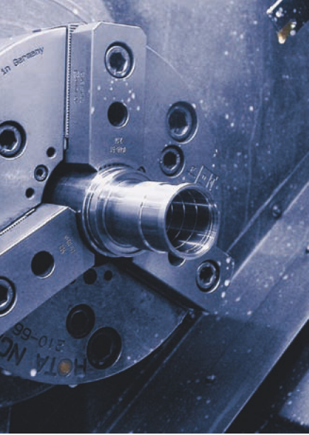
Application examples
ROTA NCD 210-66
With standard SCHUNK collet jaws
Main advantages
utilization of large through-hole
precision clamping by using hard SCHUNK collet
jaws STD-H
low profile collet jaws, allow machining
extremely close to the chuck face

