Slide 1


ROTA NC plus 2 | NCF plus 2
Power Lathe Chucks with Through-hole

Slide 2














Product overview
Gripping Systems
Clamping Technology
Chuck Jaws
Stationary Workholding
Lathe Chucks
Toolholders
Hydraulic Expansion Technology
Manual Lathe Chucks
Power Lathe Chucks with Jaw Quick-change System
Power Lathe Chucks with Through-hole
Power Lathe Chucks without Through-hole
Pneumatic Power Chucks
Steady Rests
Quick-change Systems
Customized Solutions

Slide 3
Challenges
Process dynamics
Technnological
progress
time
time
Energy consumption
time
Requirements on the clamping fixture: efficiency, flexibility and…
heute
zukünftig
ROTA Power Lathe Chucks with Through-hole, Name, Date

Slide 4



ROTA Overview
Power Lathe Chucks with Through-hole
ROTA NCE
ROTA NCA
ROTA NC plus 2/NCF plus 2
ROTA NCD
ROTA NCK plus

Slide 5
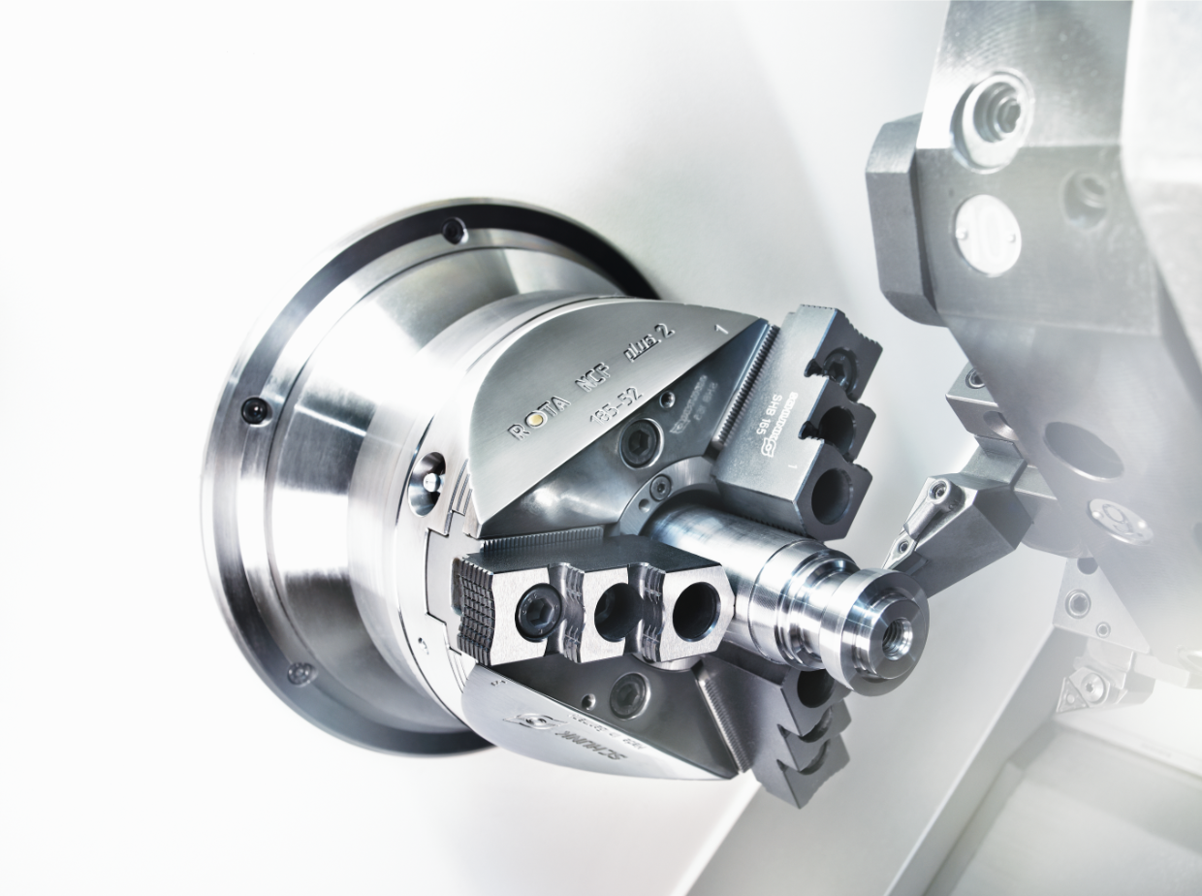
ROTA NC plus 2 / NCF plus 2
Example of application
Clamping device:
ROTA NCF plus 2 185 with hard stepped jaws.
Features/Application:
O.T. clamping of bars in the through-hole with hard stepped jaws. Precise clamping with automated loading via bar loader. Highest dynamics thanks to integrated centrifugal force compensation.

Slide 6
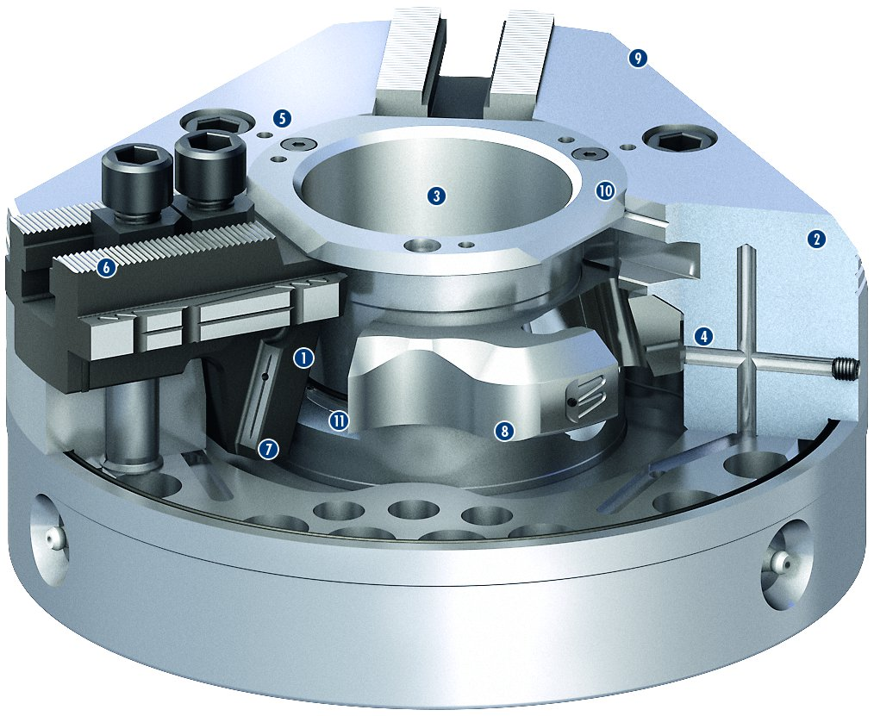
ROTA NC plus 2
9
5
1
Wedge hook drive
Hardened and extremely rigid base body
Large through-hole
Optimized lubrication system
Mounting threads
Base jaw serration
Robust and advanced wedge hook
Innovative piston guidance
Weight-optimized design
Modular center sleeve system
Additional seals
2
3
10
2
3
6
4
4
5
1
6
11
8
7
7
8
9
10
11

Slide 7
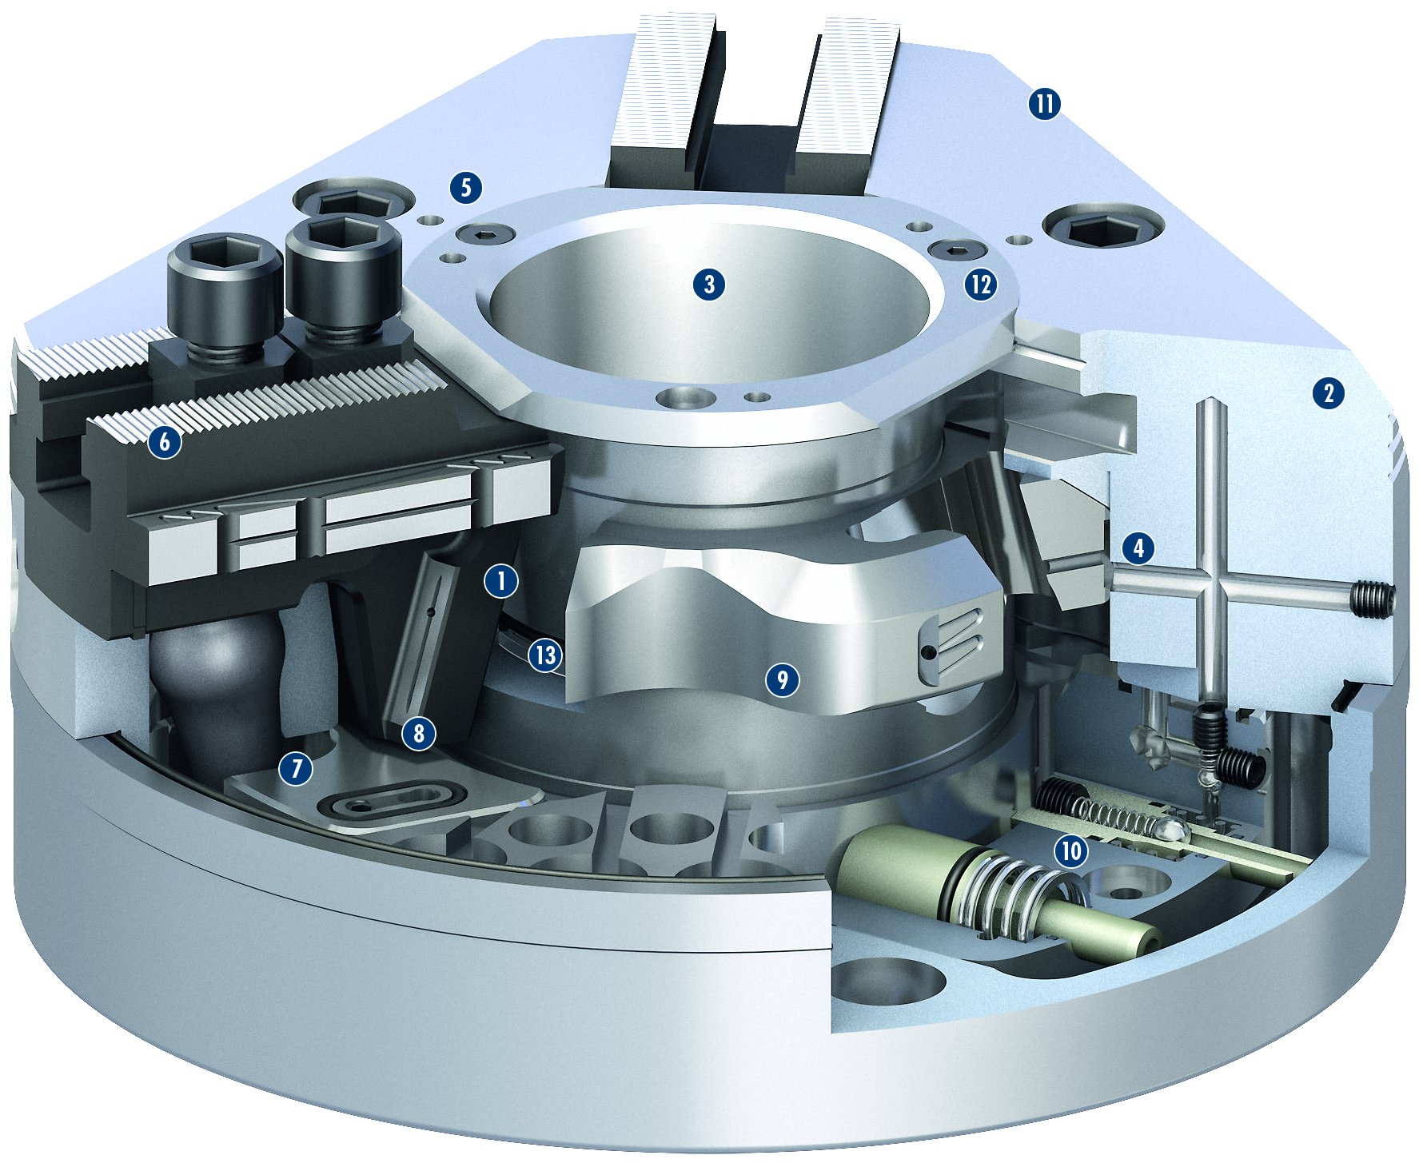
ROTA NCF plus 2
1
Wedge hook drive
Hardened and extremely rigid base body
Large through-hole
Optimized lubrication system
Mounting threads
Base jaw serration
Integrated centrifugal force compensation
Robust and advanced wedge hook
Innovative piston guidance
Integrated, patented grease-pump system
Weight-optimized design
Modular center sleeve system
Additional seals
11
2
5
3
3
12
4
2
5
6
6
1
4
7
13
9
8
8
9
7
10
10
11
12
13

Slide 8
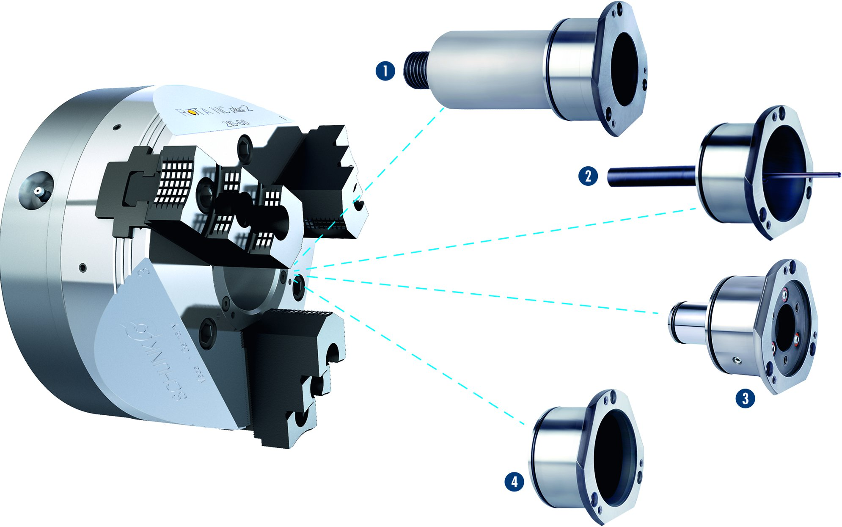
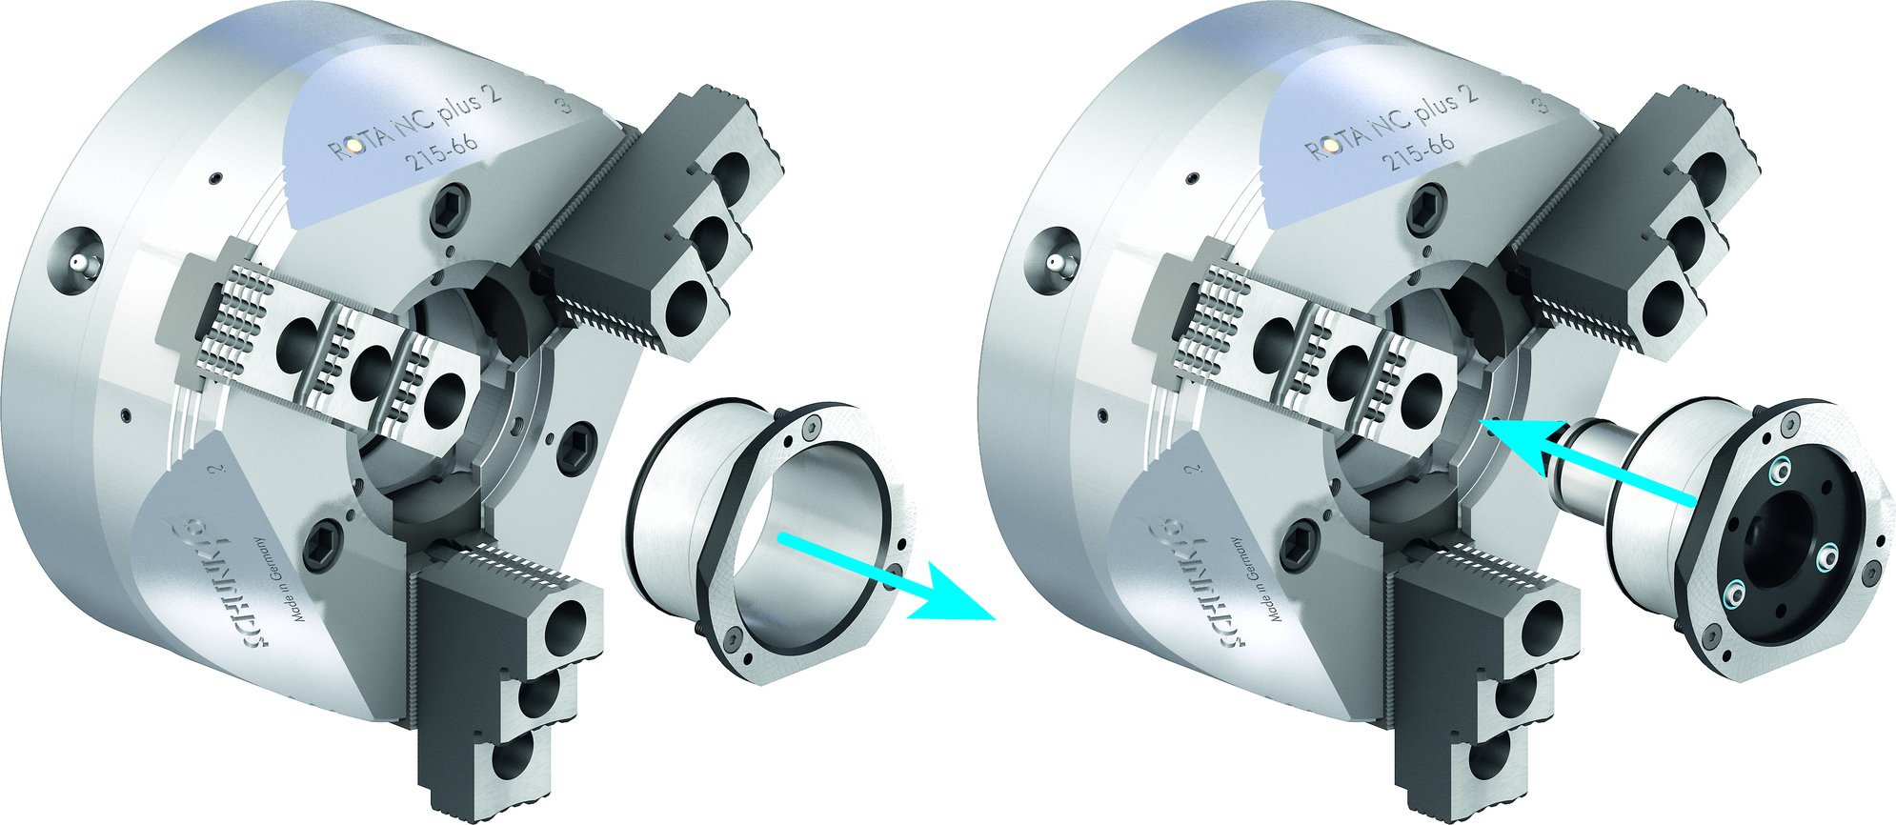
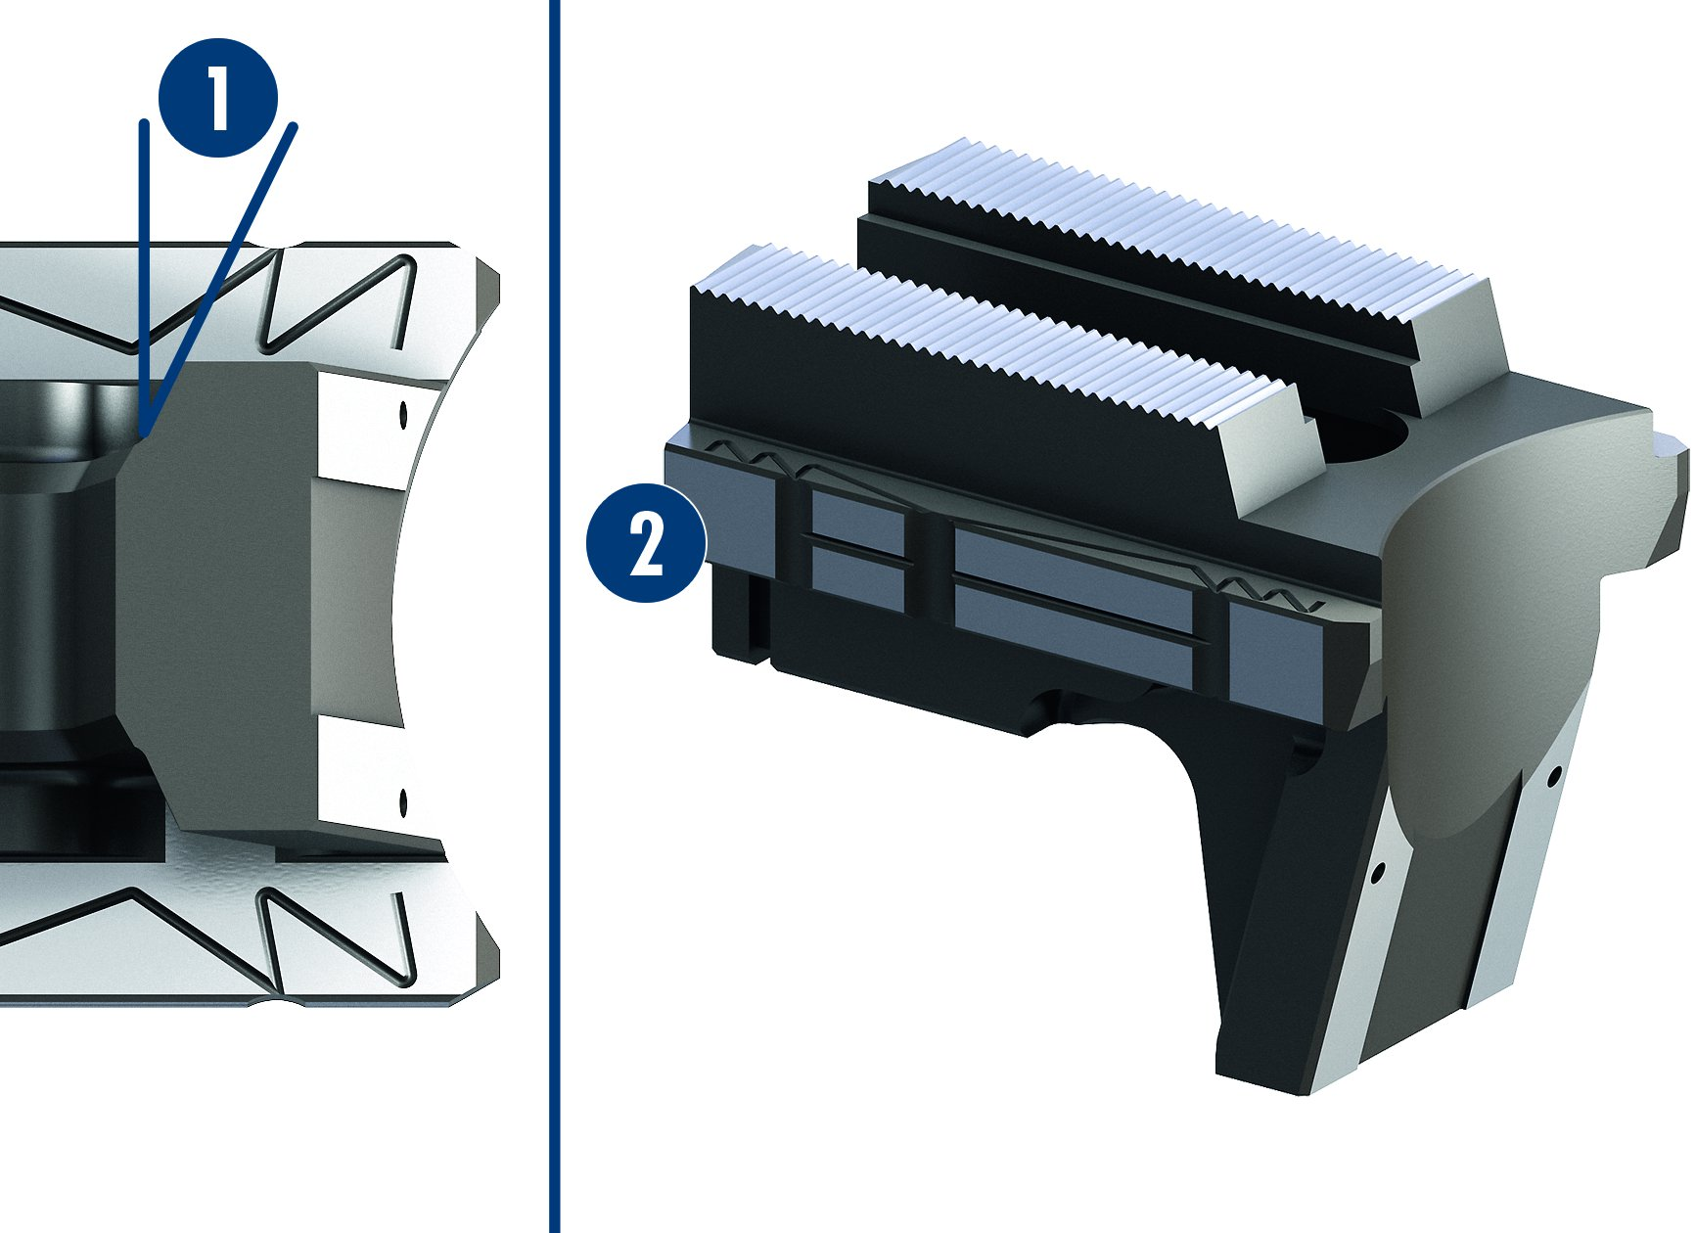
ROTA NC plus 2 / NCF plus 2
Modular Center Sleeve System
Changing the center sleeve
1
Adjustable stop in the center sleeve
Part ejector in the center sleeve
Coolant nozzles in the center sleeve
Closed center sleeve
1
2
2
3
3
4
4
Optimized wedge hook and precision jaw guidance
1
1
Trapezoidal angle
Precision flat guidance
2
2

Slide 9
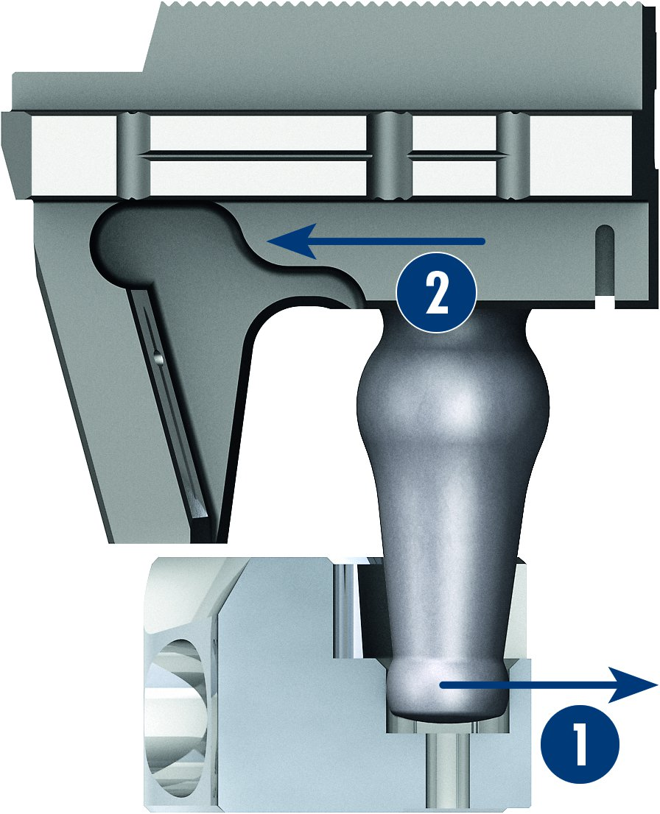
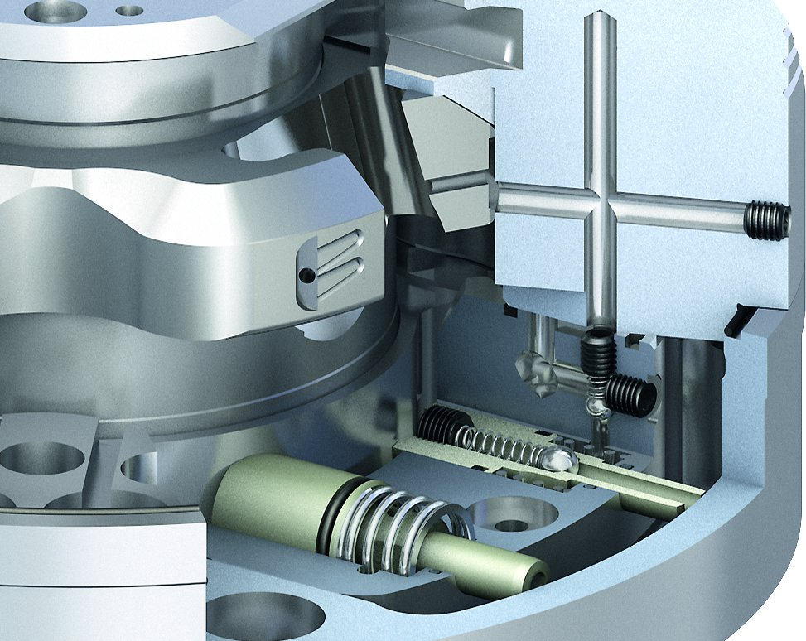
ROTA NCF plus 2
Integrated, patented grease-pump system in the centrifugal force compensation
Integrated centrifugal force compensation
1
Centrifugal force via compensation weight
Clamping force support for
O. D. clamping
2
2
1

Slide 10
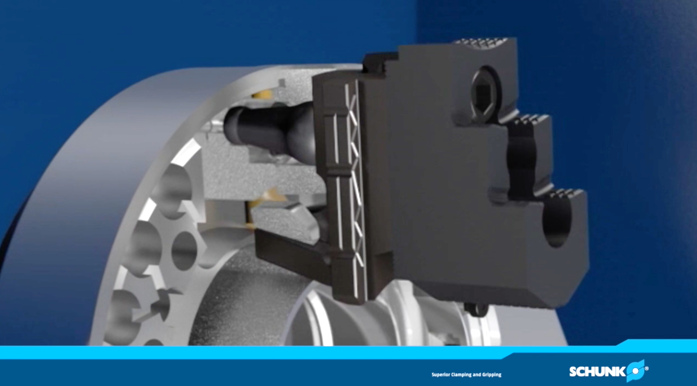
ROTA NCF plus 2

Slide 11
Variants ROTA NC plus 2/NCF plus 2
Technical data | Max. RPM [min⁻¹] | Max. clamping force [kN] | Max. Actuating force [kN] | stroke/jaw [mm] | Through-hole [mm] | Piston stroke [mm]
ROTA NC plus 2 185-52 | 5000 | 72 | 30 | 5.3 | 52 | 20
ROTA NC plus 2 215-66 | 5000 | 100 | 42 | 5.3 | 66 | 20
ROTA NC plus 2 260-86 | 4000 | 140 | 60 | 5.3 | 86 | 20
ROTA NC plus 2 315-104 | 3500 | 160 | 70 | 5.3 | 104 | 20
ROTA NC 400-120 | 2500 | 187.5 | 77 | 8 | 120 | 30
ROTA NC 500-160 | 2000 | 200 | 75 | 8 | 160 | 30
ROTA NC 630-180 | 1800 | 300 | 122 | 11.2 | 180 | 42
ROTA NC 800-230 | 1200 | 370 | 120 | 11.2 | 230 | 42
ROTA NC 1000-350 | 700 | 410 | 180 | 16 | 350 | 50
ROTA NCF plus 2 185-52 | 6000 | 72 | 30 | 5.3 | 52 | 20
ROTA NCF plus 2 215-66 | 6000 | 100 | 42 | 5.3 | 66 | 20
ROTA NCF plus 2 260-86 | 4500 | 140 | 60 | 5.3 | 86 | 20
ROTA NCF plus 2 315-104 | 4000 | 160 | 70 | 5.3 | 104 | 20
ROTA NCF 400-120 | 3300 | 187.5 | 77 | 8 | 120 | 30
ROTA NCF 500-160 | 2200 | 200 | 75 | 8 | 160 | 30
ROTA NCF 630-180 | 1800 | 300 | 122 | 11.2 | 180 | 42

Slide 12



SCHUNK Services
Engineering
Dimensioning of special plates designed to the manufacturing specifications
Development of special solutions together with the customer
FEM analysis for critical components
Testing
Endurance tests with all new developments
Abrasion checking
Measurement of accuracy
Service
Initial operation of customer´s solution
Inspection and maintenance
Repairs

