Slide 1


ROTA HSH
Lever Chucks

Slide 2














Product overview
Gripping Systems
Clamping Technology
Chuck Jaws
Stationary Workholding
Lathe Chucks
Toolholders
Hydraulic Expansion Technology
Manual Lathe Chucks
Power Lathe Chucks with Jaw Quick-change System
Power Lathe Chucks with Through-hole
Power Lathe Chucks without Through-hole
Pneumatic Power Chucks
Steady Rests
Quick-change Systems
Customized Solutions

Slide 3





ROTA Overview
Customized Solutions
ROTA NCM
ROTA NCM-L
ROTA HSA
ROTA DFF
ROTA BEV
ROTA 4B
ROTA HSH

Slide 4
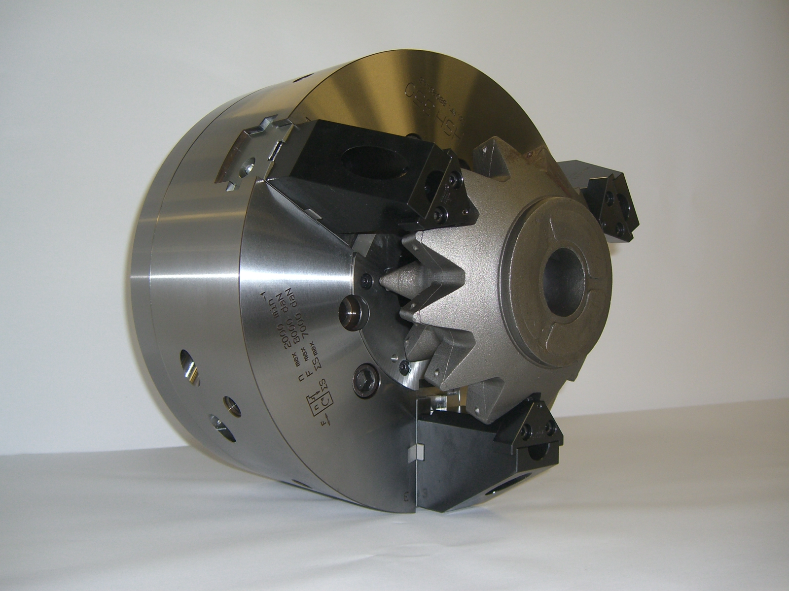
ROTA HSH
Example of application
Clamping device:
HSH 350
Features/Application:
Lever chuck with highest stroke at smallest chuck diameter.
e.g. HSH 350 (O.D.-Diameter 350) with 30 mm stroke/jaw.
Workpiece: drilling head.

Slide 5
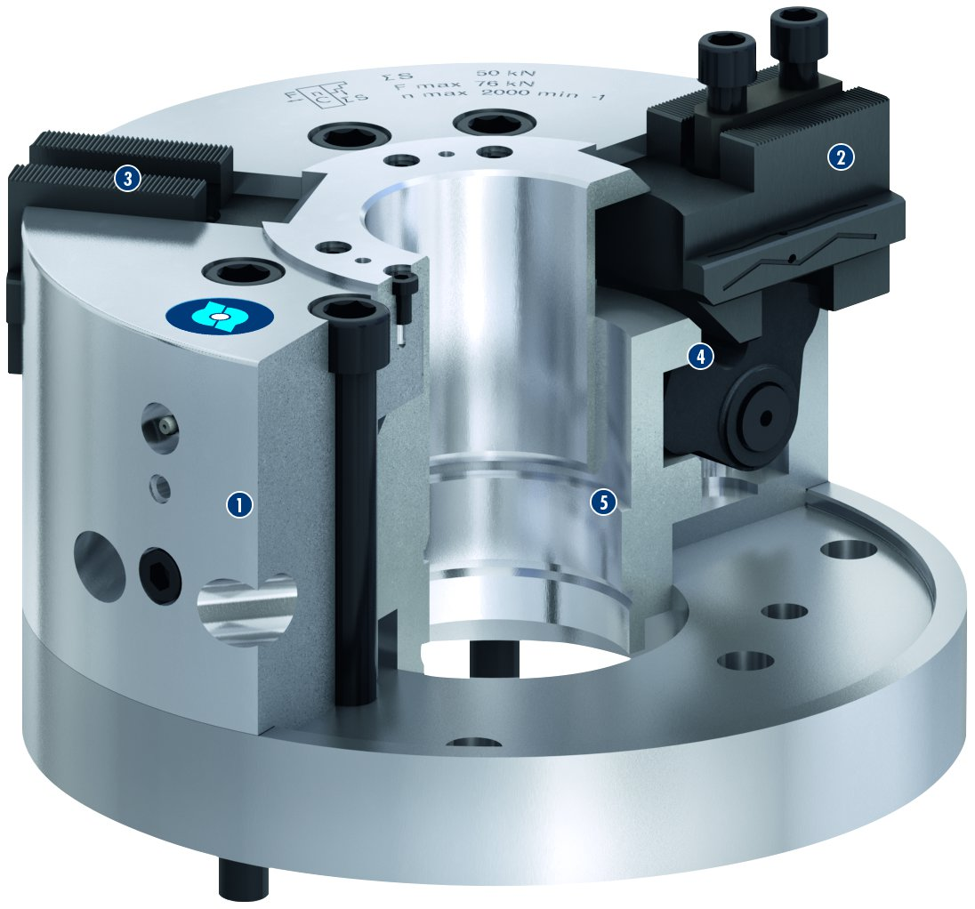
ROTA HSH
3
2
1
Hardened chuck body
Base jaw with long guidance
Base jaw with fine serration
Angle lever for force transmission
Piston
2
4
3
4
1
5
5

Slide 6
Variants ROTA HSH
Technical Data | Max. RPM [min⁻¹] | Max. clamping force [kN] | Actuating force [kN] | Stroke/jaw [mm] | Piston stroke [mm]
ROTA HSH 120 | 5500 | 25 | 18 | 9.5 | 16
ROTA HSH 140 | 4000 | 25 | 20 | 9.5 | 21
ROTA HSH 280 | 2000 | 50 | 76 | 20 | 19
ROTA HSH 315 | 2800 | 76 | 58 | 23 | 32
ROTA HSH 350 | 2000 | 70 | 80 | 30 | 35

Slide 7



SCHUNK Services
Engineering
Dimensioning of special plates designed to the manufacturing specifications
Development of special solutions together with the customer
FEM analysis for critical components
Testing
Endurance tests with all new developments
Abrasion checking
Measurement of accuracy
Service
Initial operation of customer´s solution
Inspection and maintenance
Repairs

