Slide 1


ROTA DFF
Rotary Finger Chucks

Slide 2














Product overview
Gripping Systems
Clamping Technology
Chuck Jaws
Stationary Workholding
Lathe Chucks
Toolholders
Hydraulic Expansion Technology
Manual Lathe Chucks
Power Lathe Chucks with Jaw Quick-change System
Power Lathe Chucks with Through-hole
Power Lathe Chucks without Through-hole
Pneumatic Power Chucks
Steady Rests
Quick-change Systems
Customized Solutions

Slide 3





ROTA overview
Customized Solutions
ROTA NCM
ROTA NCM-L
ROTA HSA
ROTA DFF
ROTA BEV
ROTA 4B
ROTA HSH

Slide 4
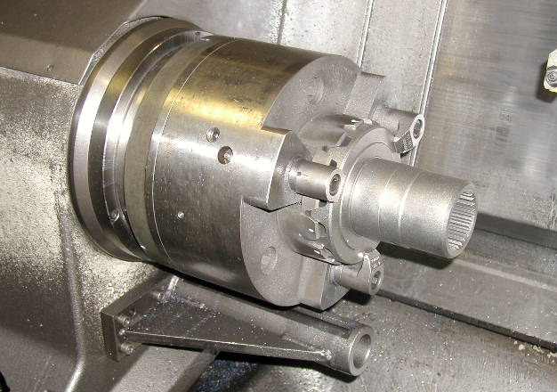
ROTA DFF
Example of application
Clamping device:
DFF 250.
Features/Application:
Centering and back stop of the workpiece is done by a negative interlock that is screwed on the chuck face.
The workpiece is axially clamped via swiveling fingers.

Slide 5
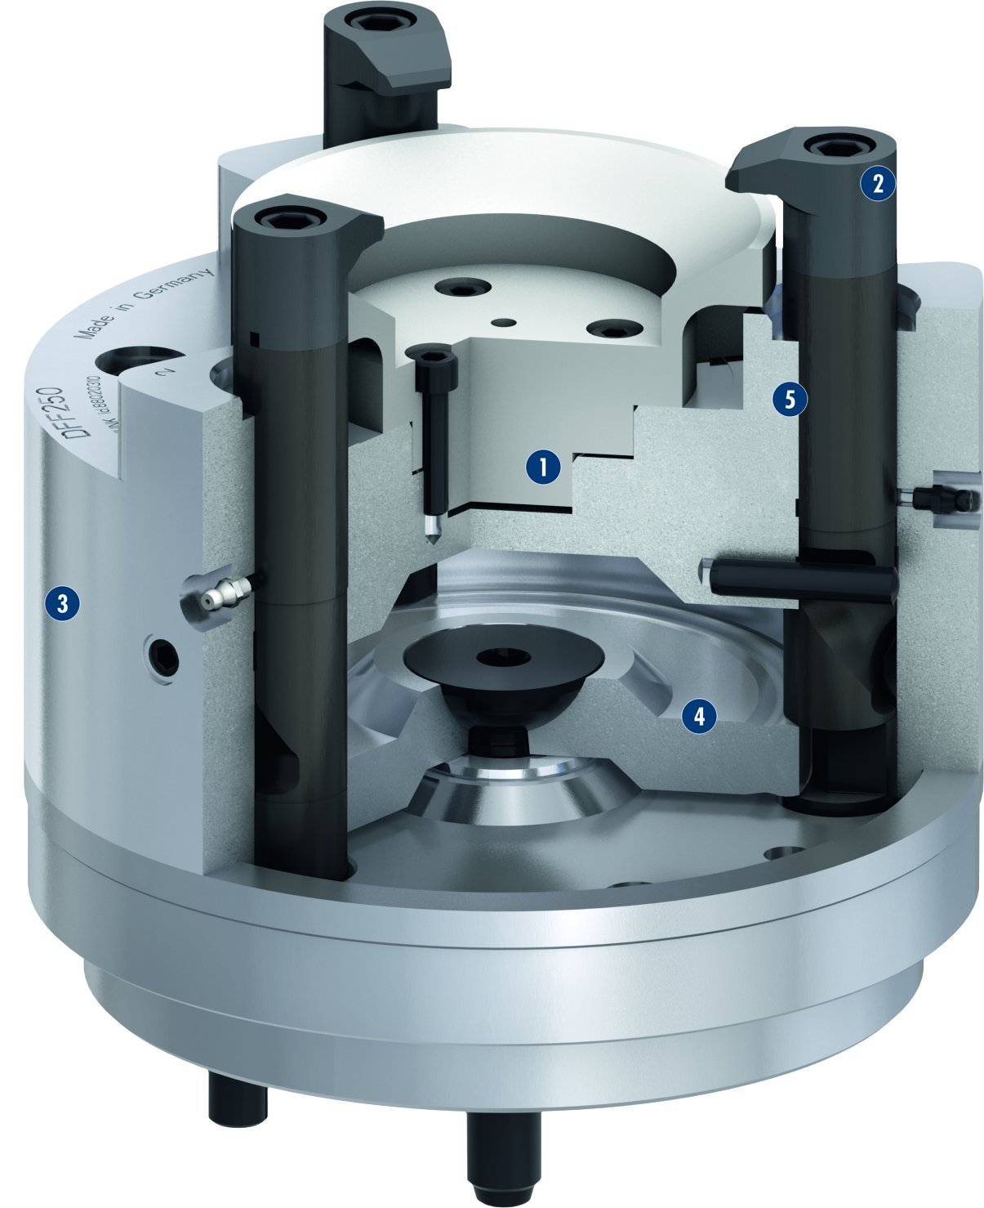
ROTA DFF
2
5
1
Workpiece centering
Clamping finger
Hardened chuck body
Piston
Workpiece stop
1
2
3
3
4
4
5

Slide 6
Variants ROTA DFF
Technical Data | Max. RPM [min⁻¹] | Max. clamping force [kN] | Actuating force [kN] | Piston stroke [mm]
ROTA DFF 140 | 6000 | 20 | 20 | 26
ROTA DFF 180 | 1800 | 15 | 15 | 15
ROTA DFF 260 | 2200 | 30 | 30 | 25
ROTA DFF 400 | 2200 | 60 | 60 | 25
ROTA DFF 500 | 2200 | 30 | 30 | 40

Slide 7



SCHUNK Services
Engineering
Dimensioning of special plates designed to the manufacturing specifications
Development of special solutions together with the customer
FEM analysis for critical components
Testing
Endurance tests with all new developments
Abrasion checking
Measurement of accuracy
Service
Initial operation of customer´s solution
Inspection and maintenance
Repairs

