Slide 1


ROTA 4B
4-jaw Power Chuck

Slide 2














Product overview
Gripping Systems
Clamping Technology
Chuck Jaws
Stationary Workholding
Lathe Chucks
Toolholders
Hydraulic Expansion Technology
Manual Lathe Chucks
Power Lathe Chucks with Jaw Quick-change System
Power Lathe Chucks with Through-hole
Power Lathe Chucks without Through-hole
Pneumatic Power Chucks
Steady Rests
Quick-change Systems
Customized Solutions

Slide 3





ROTA overview
Customized Solutions
ROTA NCM
ROTA NCM-L
ROTA HSA
ROTA DFF
ROTA BEV
ROTA 4B
ROTA HSH

Slide 4
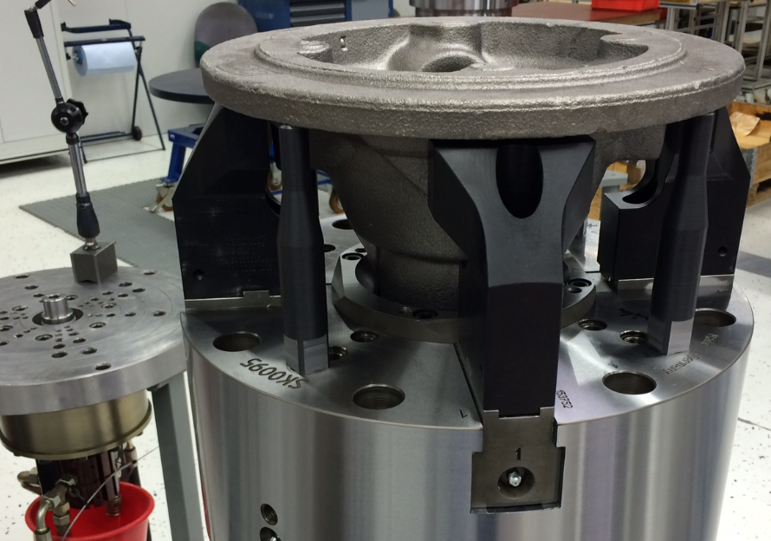
ROTA 4B
Example of application
Clamping device:
4-jaw chuck D 400 (2+2)
Features/Application:
2+2 principle of function:
Jaw pair I (0°+ 180°) and jaw pair II (90° + 270°) clamp the workpiece centrically. The two jaw pairs are connected via equalizer.
Workpiece: transmission case.

Slide 5
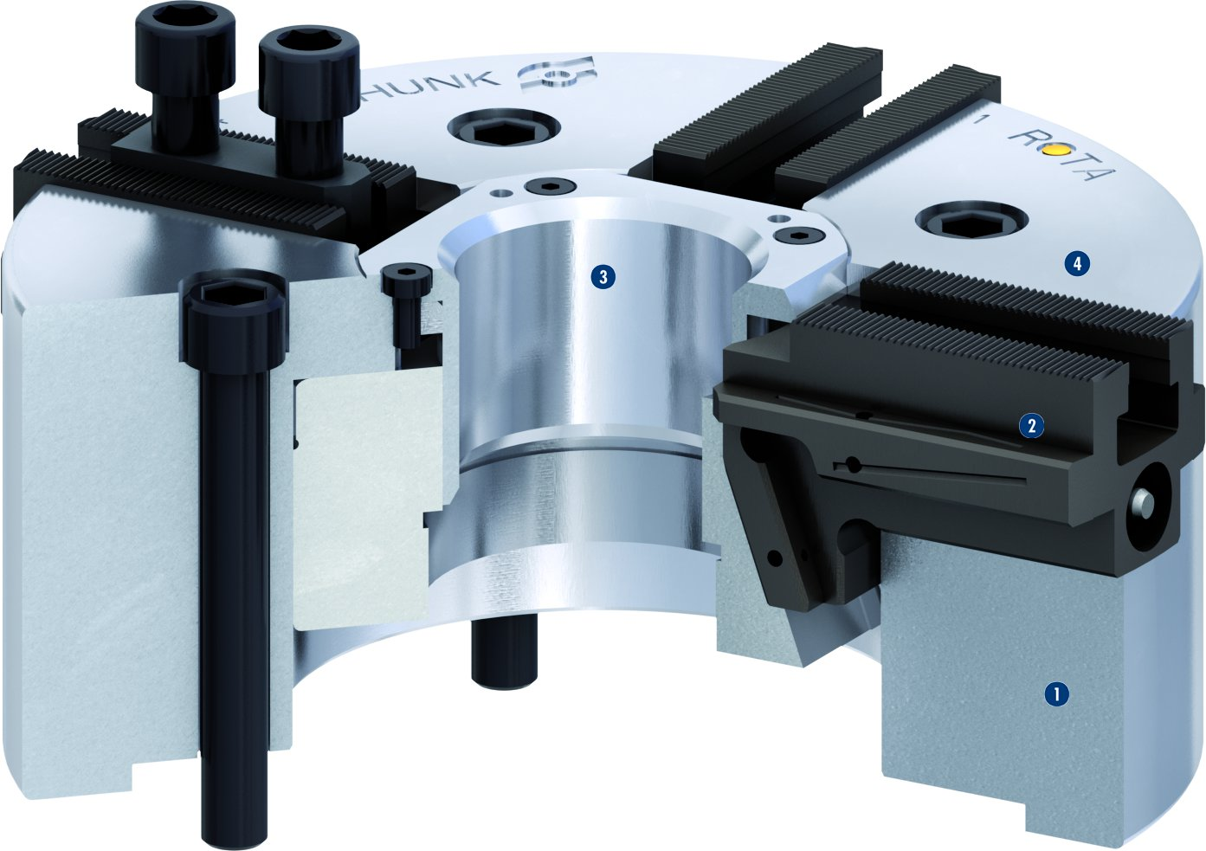
ROTA 4B
3
4
1
Hardened chuck body
Hardened base jaws
Center sleeve
Base jaw with fine serration
2
2
3
4
1

Slide 6
Variants ROTA 4B
Technical Data | Max. RPM [min⁻¹] | Max. clamping force [kN] | Actuating force [kN] | Stroke/jaw [mm] | Piston stroke [mm]
ROTA 4B 250 | 3000 | 137 | 57 | 5.3 | 20
ROTA 4B 315 | 2400 | 150 | 62 | 5.3 | 25
ROTA 4B 400 | 1800 | 187 | 77 | 8 | 30
ROTA 4B 500 | 1500 | 200 | 75 | 8 | 30
ROTA 4B 630 | 1000 | 200 | 84 | 11.2 | 42
ROTA 4B 800 | 800 | 370 | 120 | 11.2 | 42

Slide 7



SCHUNK Services
Engineering
Dimensioning of special plates designed to the manufacturing specifications
Development of special solutions together with the customer
FEM analysis for critical components
Testing
Endurance tests with all new developments
Abrasion checking
Measurement of accuracy
Service
Initial operation of customer´s solution
Inspection and maintenance
Repairs

