Slide 1

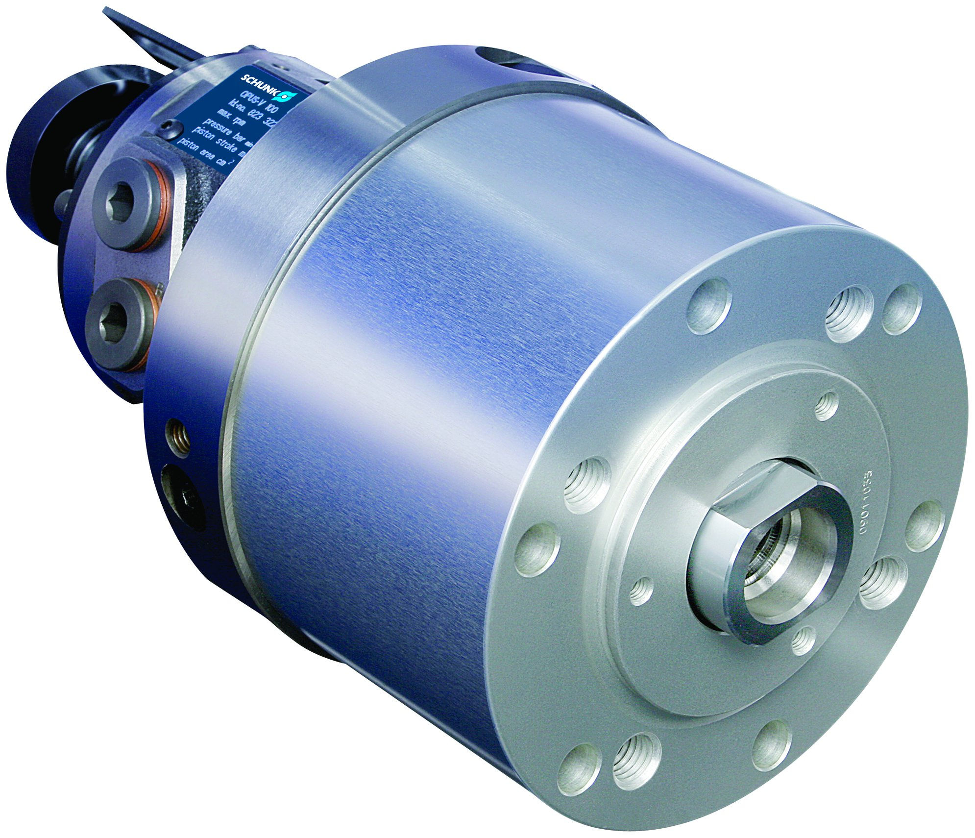
OPUS-V
Closed-Center Cylinders

Slide 2














Product overview
Gripping Systems
Clamping Technology
Chuck Jaws
Stationary Workholding
Lathe Chucks
Toolholders
Hydraulic Expansion Technology
Manual Lathe Chucks
Power Lathe Chucks with Jaw Quick-change System
Power Lathe Chucks with Through-hole
Power Lathe Chucks without Through-hole
Pneumatic Power Chucks
Clamping Cylinder
Steady Rests
Quick-change Systems
Customized Solutions

Slide 3
OPUS
Integrated check valve
Compact design
Large through-bore for open-center hydraulic cylinder OPUS-H
Long actuating stroke
Integrated control cam for stroke monitoring

Slide 4
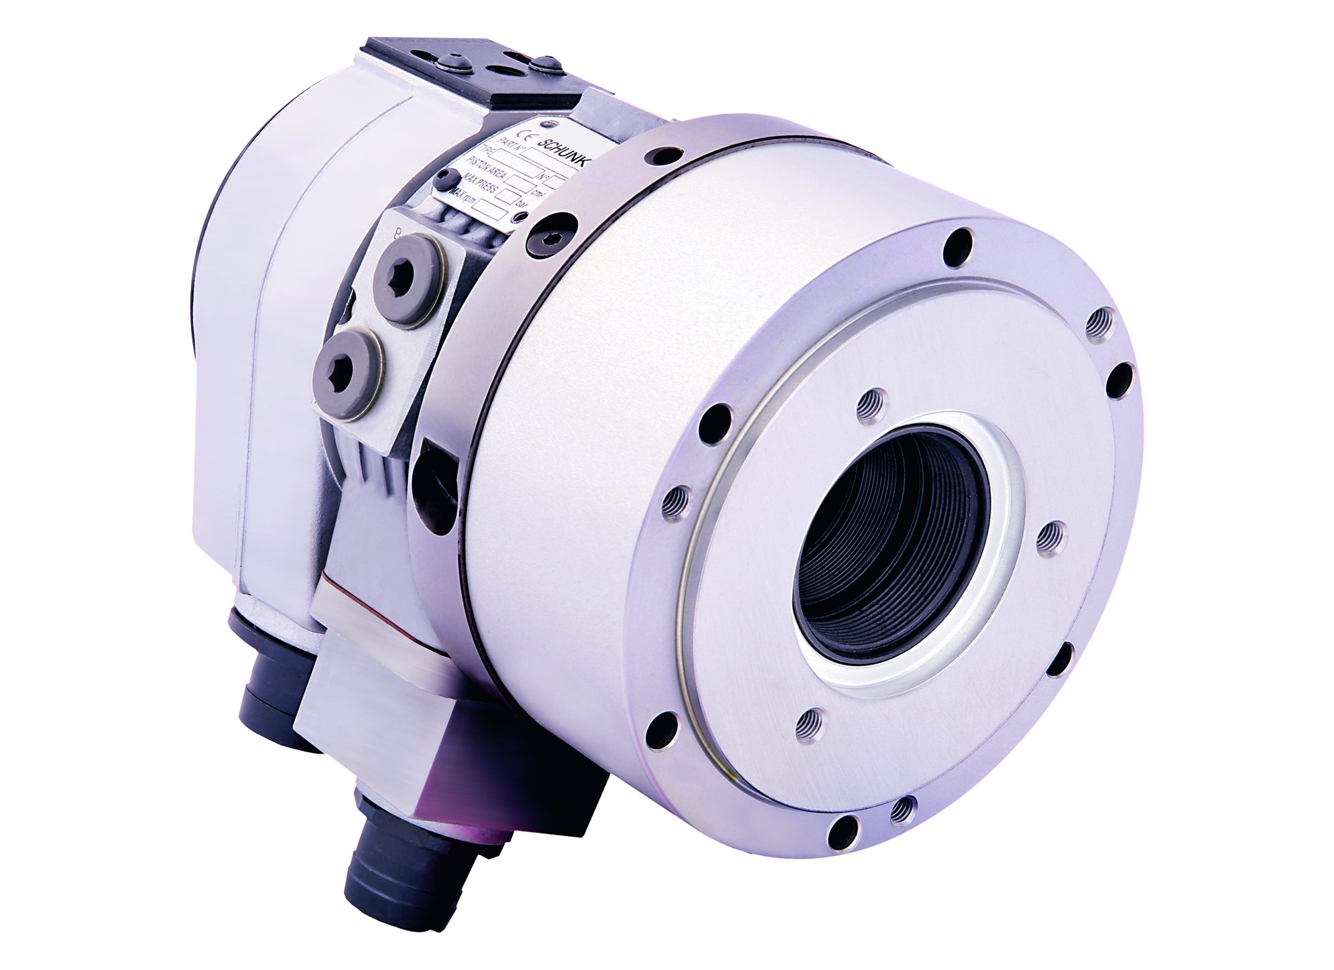
OPUS
OPUS-V Closed-center Cylinder
OPUS-H3 Open-center Cylinder

Slide 5
Variants of OPUS-V
Technical Data | Max. RPM [min⁻¹] | Piston Surface [cm²] | Piston stroke [mm] | Max. pressure [bar] | Pull force at 40 bar [kN] | Oil leakage rate [l/min] | Moment of inertia [kgm²]
OPUS-V 70 | 7000 | 28 | 40 | 70 | 11 | 1.5 | 0.012
OPUS-V 85 | 7000 | 48 | 32 | 70 | 19 | 1.5 | 0.012
OPUS-V 100 | 7000 | 66 | 32 | 70 | 26 | 1.5 | 0.016
OPUS-V 125 | 6000 | 103 | 40 | 70 | 41 | 1.5 | 0.04
OPUS-V 150 | 6000 | 157 | 40 | 70 | 62 | 1.5 | 0.08
OPUS-V 175 | 5000 | 212 | 45 | 70 | 84 | 1.5 | 0.12
OPUS-V 200 | 4000 | 280 | 50 | 70 | 112 | 2 | 0.32
OPUS-V 225 | 2000 | 457 | 60 | 50 | 180 | 2 | 0.92

Slide 6



SCHUNK Services
Engineering
Dimensioning of special plates designed to the manufacturing specifications
Development of special solutions together with the customer
FEM analysis for critical components
Testing
Endurance tests with all new developments
Abrasion checking
Measurement of accuracy
Service
Initial operation of customer´s solution
Inspection and maintenance
Repairs

