Slide 1



The Specialist for Thread Milling

Slide 2
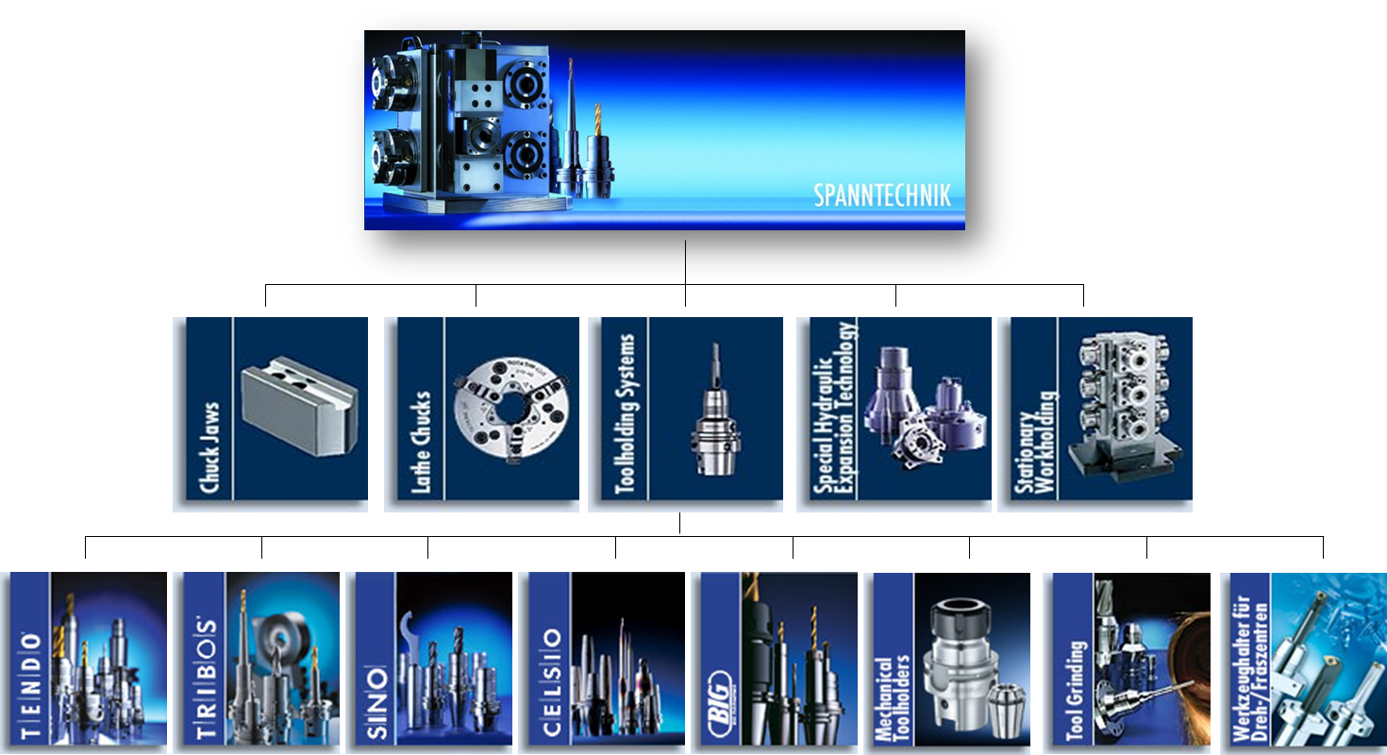
Product overview

Slide 3

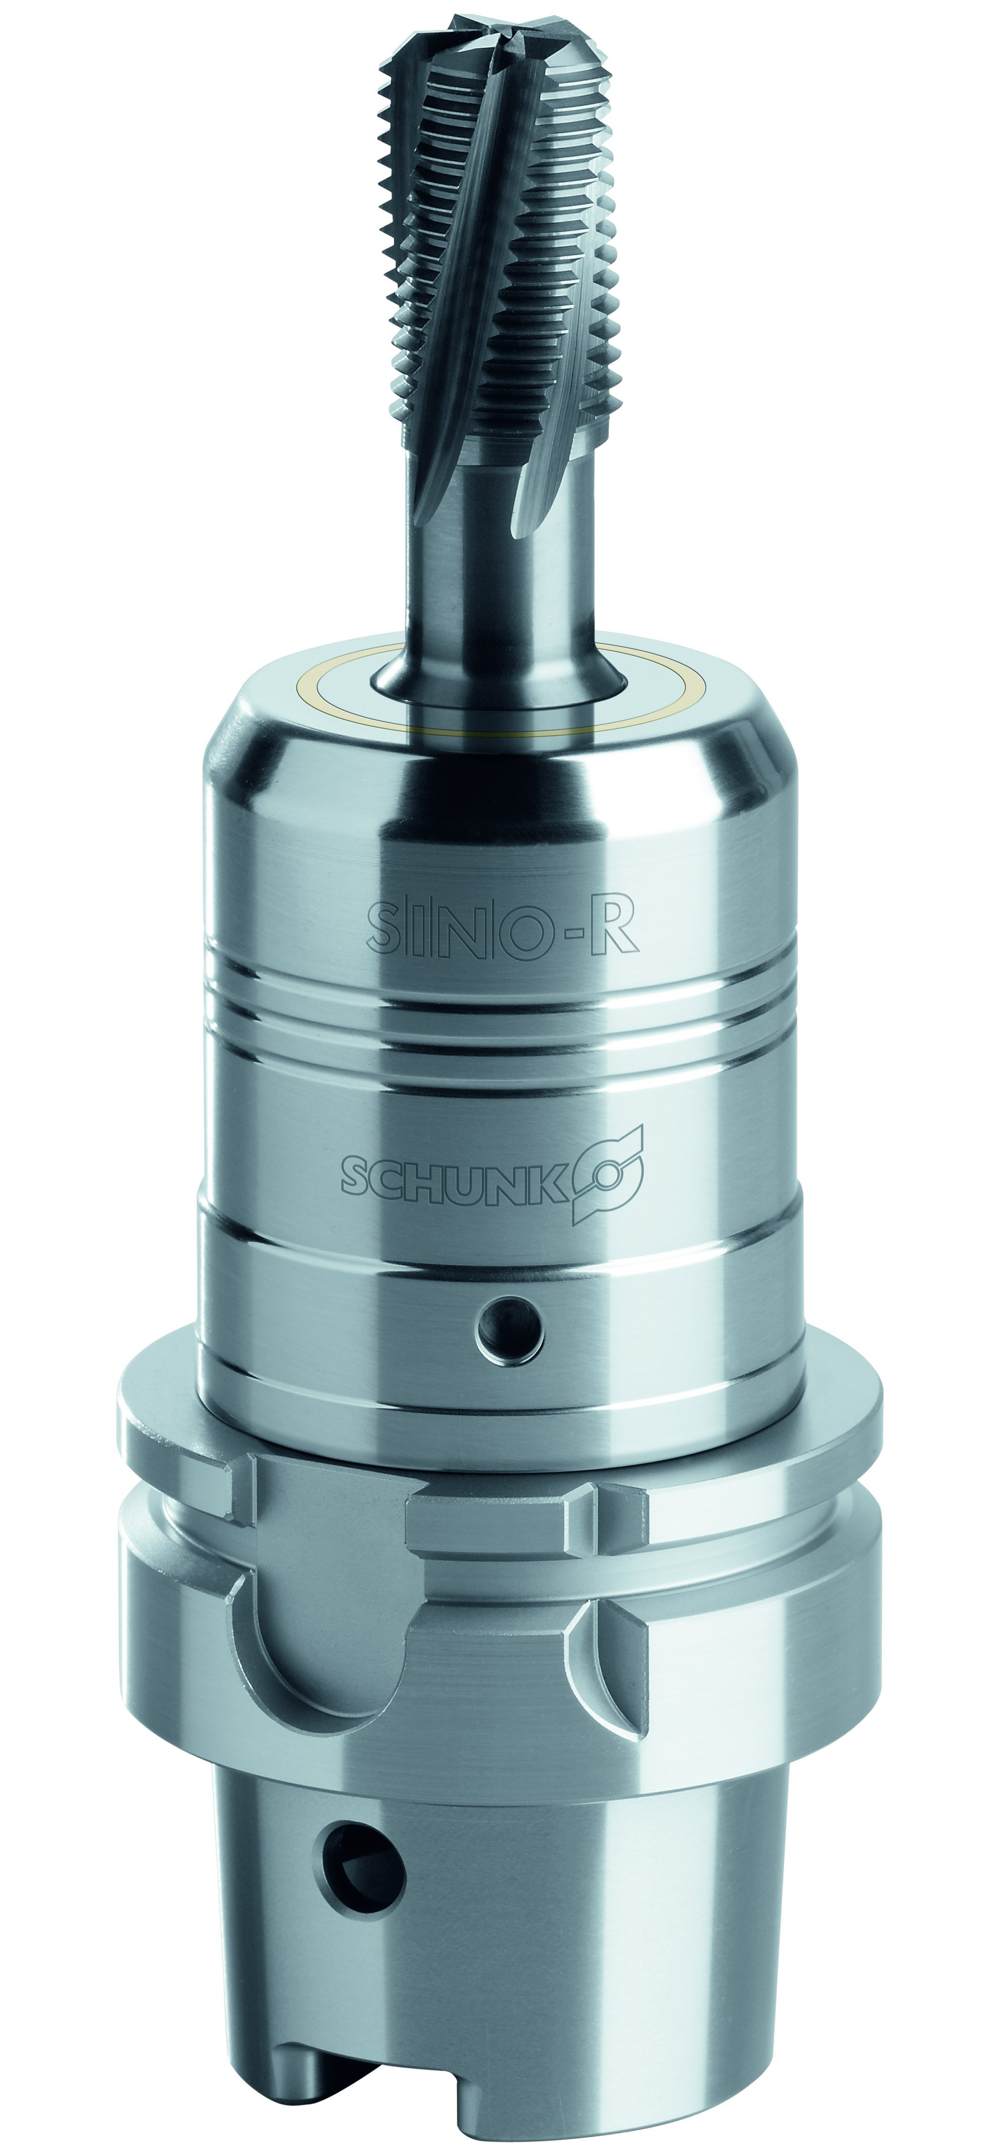
The expansion chuck for thread milling
With SINO-R, SCHUNK offers an expansion toolholder based on expansion toolholding technology. Three features make the SINO-R series unbeatable for thread milling in terms of quality and productivity.
The high radial rigidity:
Prevents the deflection of the tool.
The higher torque transfer:
For full utilisation of the tool capability.
The top vibration damping:
For the best thread surcfaces without chatter marks.
The unbeatable combination of:
a monoblock design
a multi-layer system structure
thicker walls

Slide 4
The expansion chuck for thread milling
The result:
A perfect thread, extremely smooth running, and a long service life without wear.
The benefit:
→Tool service life increased by 100% through avoidance of micro fractures on the cutting edge. This reduces tool costs and makes your production more efficient.

Slide 5
Senken Sie Werkzeugkosten!
Example:
Milling of multiple threads in an Inconel workpiece with Ni base alloy.
The tool:
Example M12 thread cutter. The SINO-R masters the task with just one tool, whereas a Weldon toolholder wears out four cutters for this machining process.
Procurement costs:
Toolholder
Tools
Total costs
SINO-R | Weldon
400,00 € | 100,00 €
350,00 € | 4 x 350,00 €
750,00 € | 1.500,00 €

Slide 6
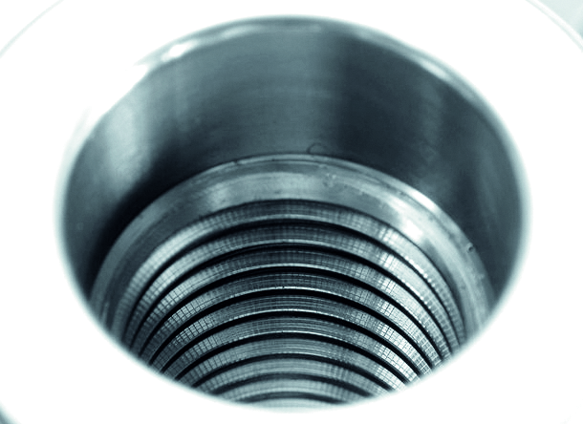

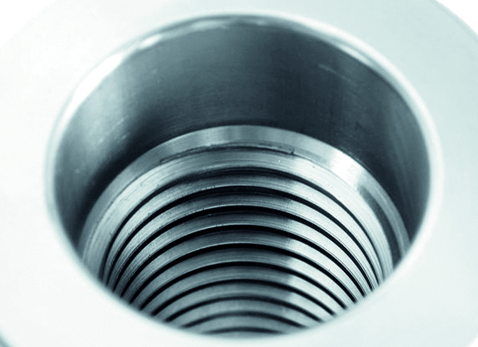

The expansion chuck for thread milling
Conventional machining
Machining with SINO-R

Slide 7
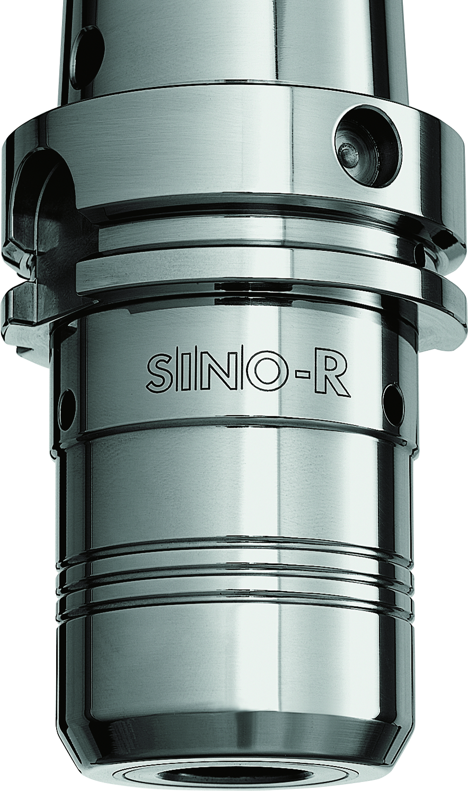
The expansion chuck for thread milling
Monoblock construction of the base body:
For increased stability and rigidity, the base body of the toolholder is produced from a single steel block up to the machine mount

Slide 8
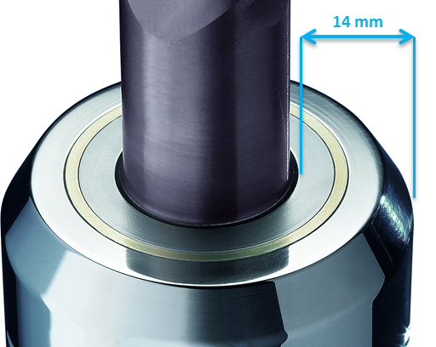
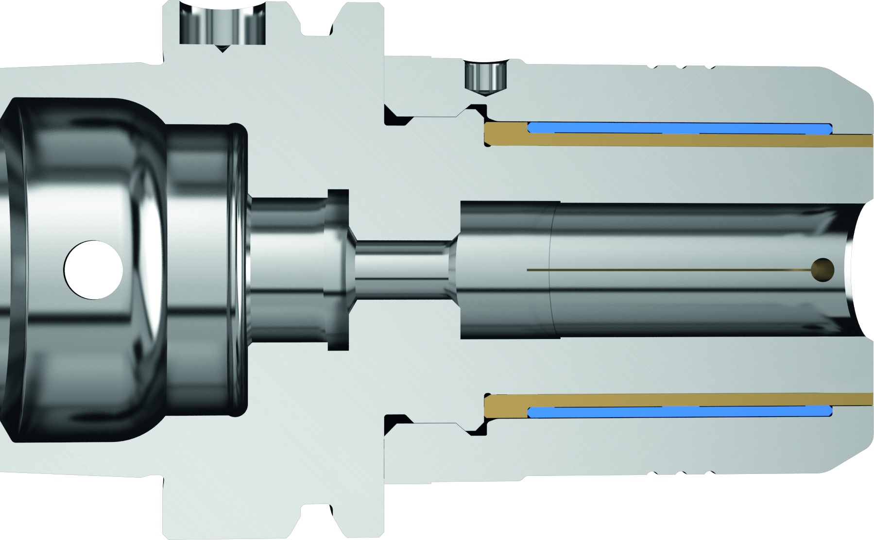
The expansion chuck for thread milling
Multi-layer system:
The structure of various material components combined with various elasticities and uneven geometric dimensions creates unique product characteristics. For the clamping process, the elastic pressure medium expands towards the expansion sleeve and the tool is clamped centrically.
Wall thickness:
of 14mm (with 20 mm clamp diameter)

Slide 9
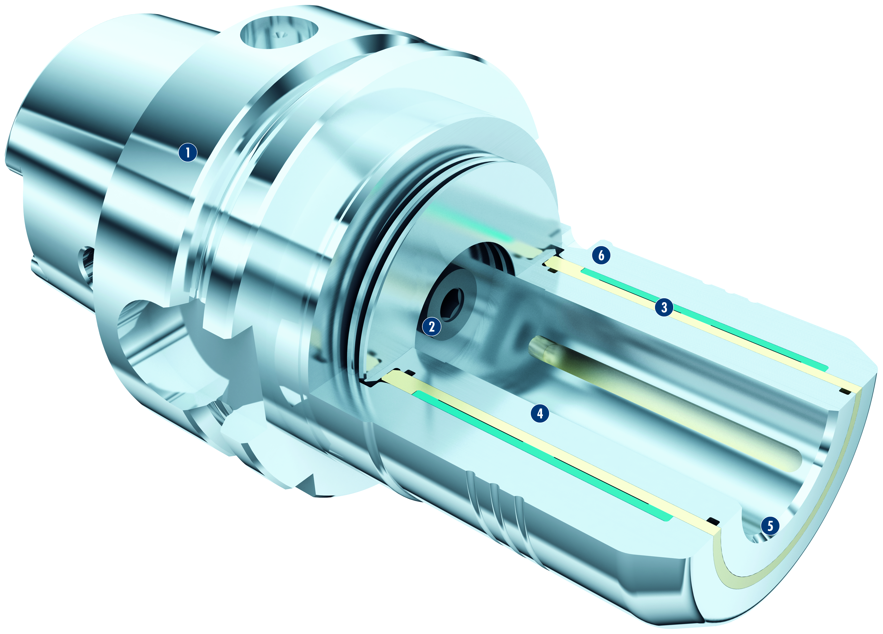
The expansion chuck for thread milling

Slide 10
The expansion chuck for thread milling
Technology:
Base body with machine interface
Thread for the axial length presetting
The axially adjustable stop screw enables quick and simple length presetting.
Expansion chamber with clamping sleeve and high-end elastomer
The innovation: With the innovative SINO-R expansion technology a high-end elastomer is used as a pressure medium. The clamping sleeve is tightened to a stop using a “C” spanner, and the high-end elastomer is clamped around the expansion sleeve. SINO-R does not require any expensive clamping accessories or predefined tightening torques.
Reinforced expansion sleeve
The reinforced expansion sleeve increases radial rigidity. Together with high torques it is ideal for rough machining.
1
2
3
4

Slide 11
The expansion chuck for thread milling
Technology:
Cover sleeve
The cover sleeve together with the reinforced expansion sleeve provides max. torques and prevents dirt intrusion.
Retention bore
For simple clamping with “C“ spanner or spanner wrench.
5
6

Slide 12
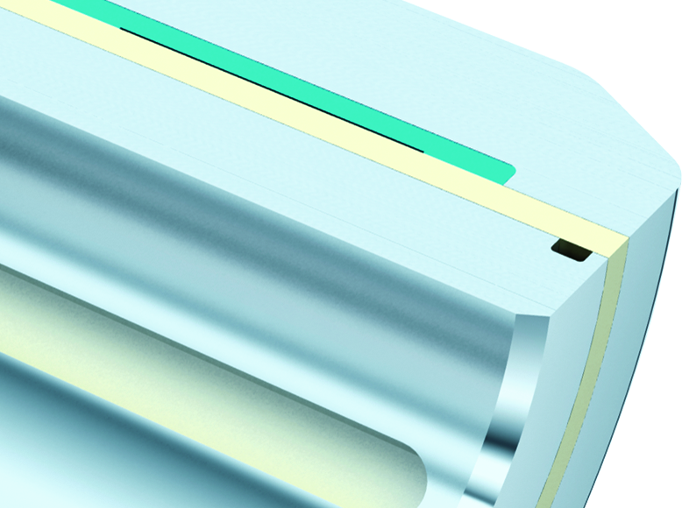
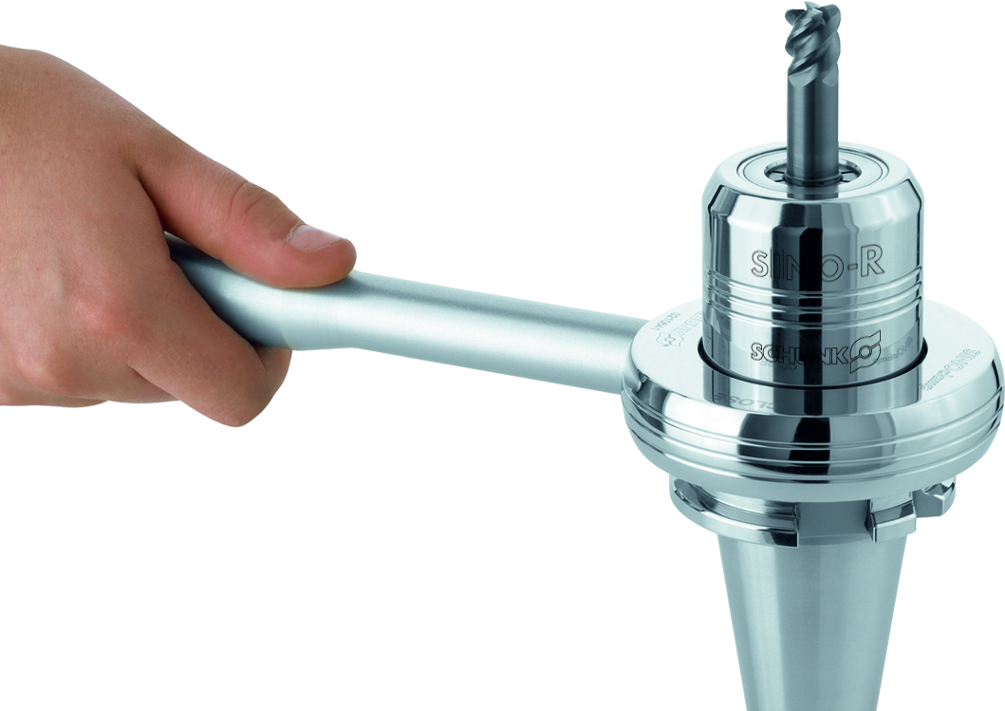
The expansion chuck for thread milling
Technical highlights:
Reinforced expansion sleeve for increased radial rigidity
Developed for the most difficult machining tasks, the SINO-R expansion toolholder has a reinforced expansion sleeve. This measure has improved the radial rigidity, and is resilient against high radial forces.
Easy handling – tool changes in seconds
With the SINO-R spanner wrench or ring-shaped clamping key, the tool is quickly and securely clamped. The quick and easy tool change minimizes unproductive set-up times and machine downtimes.

Slide 13
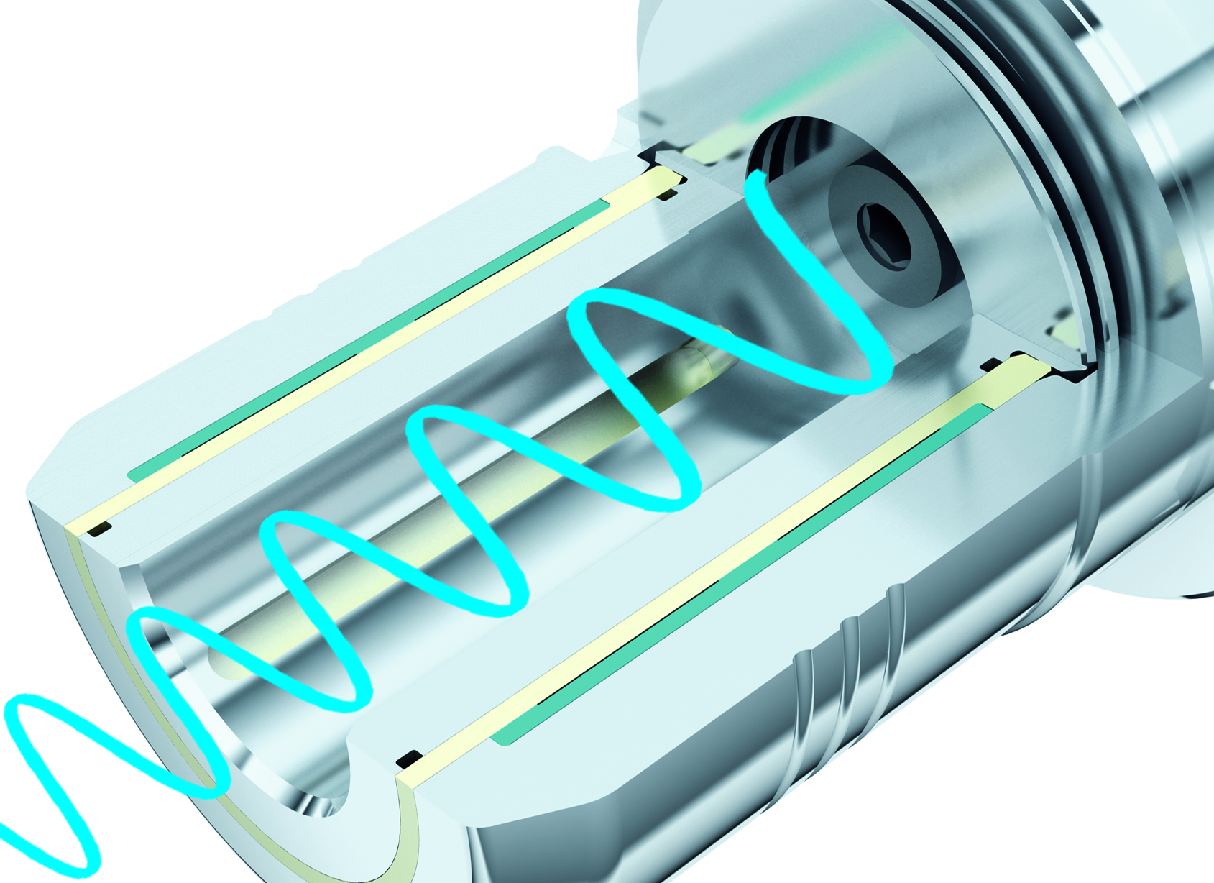
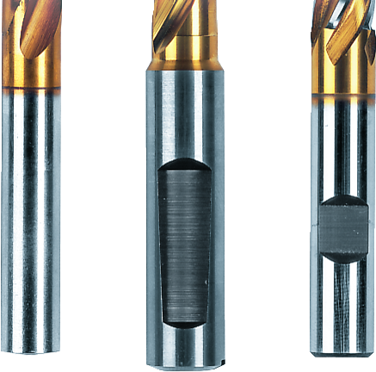
The expansion chuck for thread milling
Technical highlights:
Vibration damping
Excellent vibration damping from SINO-R guarantees optimal workpiece surfaces. Micro-blowouts on the cutting edge of the tool are prevented, the service life of the tool is increased considerably, and the performance of the spindle is enhanced.
Every conventional shank type can be clamped
Tools with both smooth cylindrical shanks in accordance with DIN 6535, Type HA up to Ø 32 mm, and also those with recesses in accordance with:
DIN 1835 Form B, E
DIN 6535 Form HA, HB, HE
can be clamped directly and without the use of an intermediate sleeve.

Slide 14
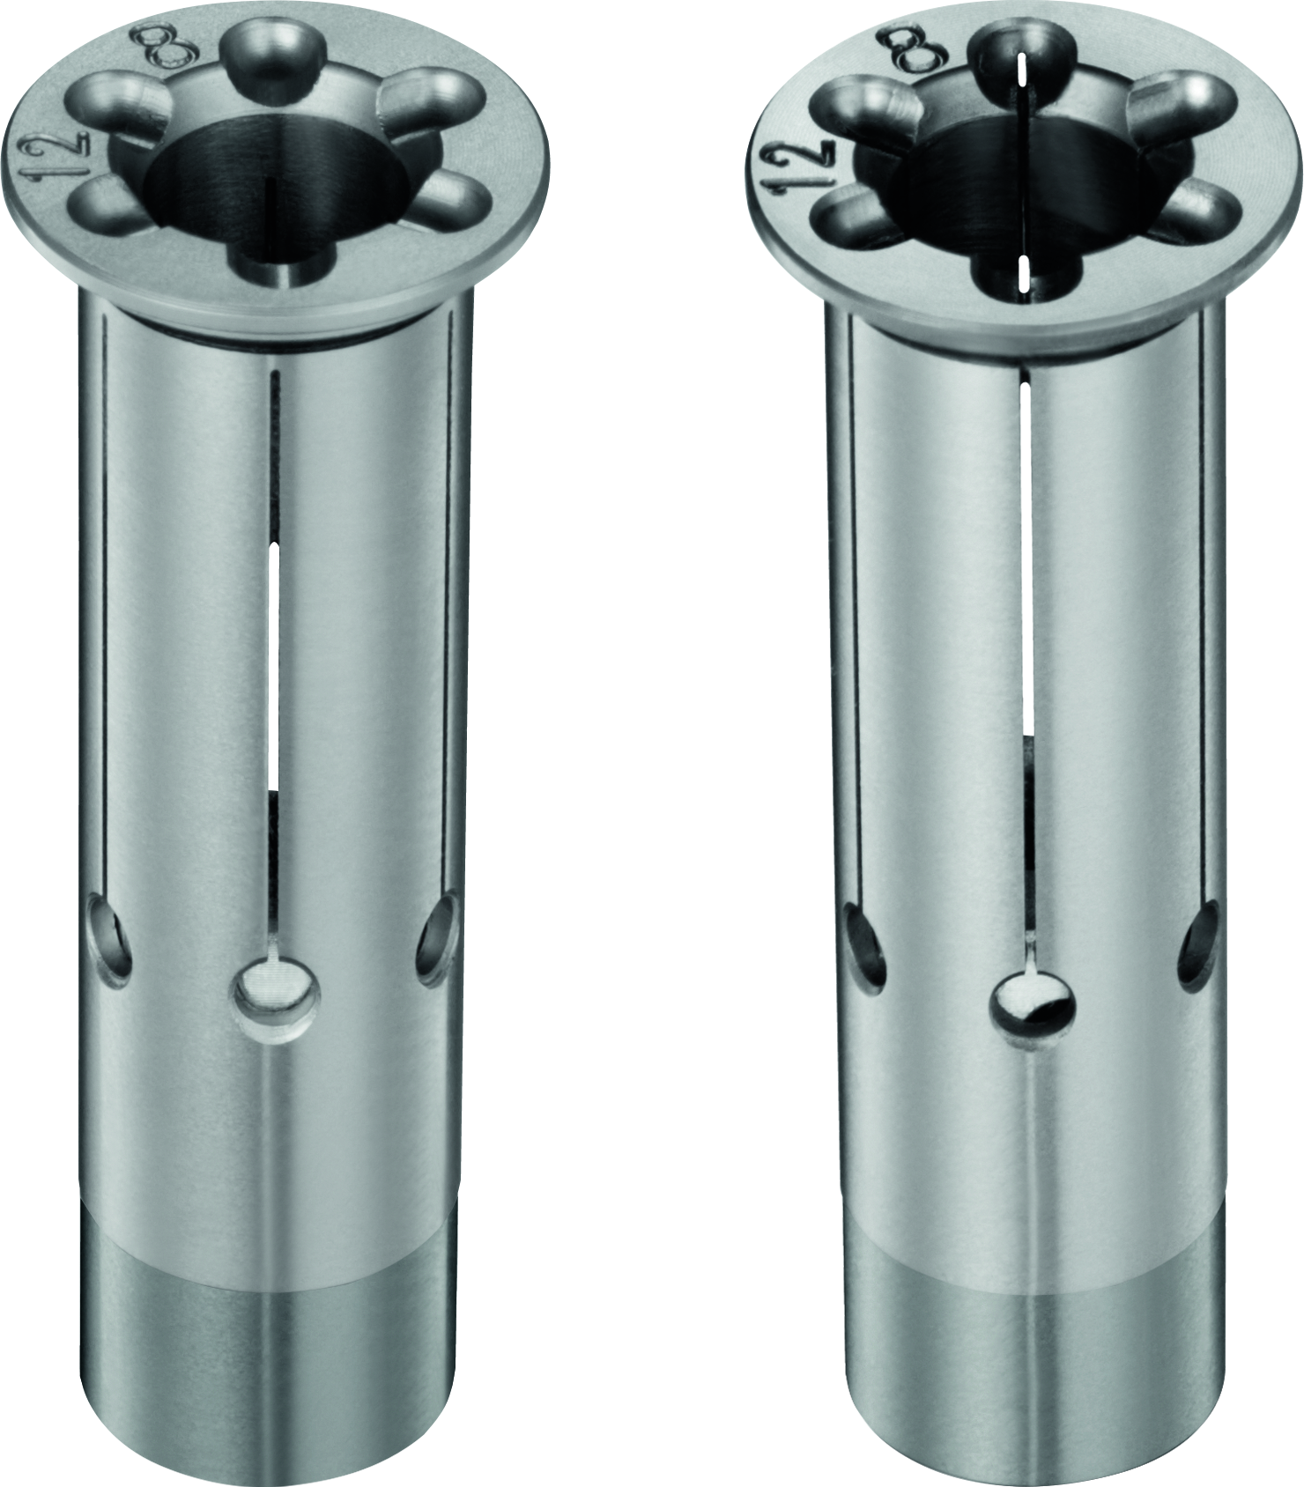
The expansion chuck for thread milling
Technical highlights:
Versatile clamping range due to intermediate sleeves
The application of slotted and coolantproof intermediate sleeves enables clamping of various tool diameters ranging from 3 – 25 mm using the same SINO-R expansion toolholder. Therefore the SINO-R is flexible in use.

Slide 15
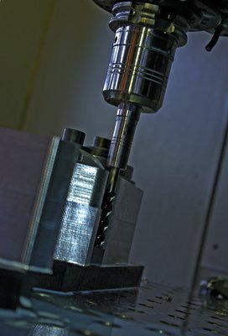
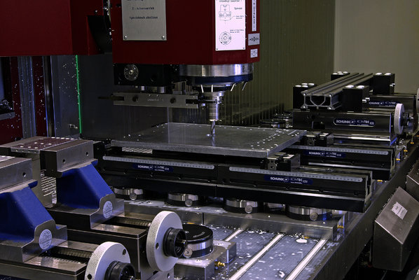
The expansion chuck for thread milling
Application examples:
SINO-R with TRIBOS SVL extension SINO-R at company Allsafe Jungfalk

Slide 16
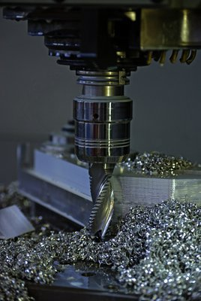
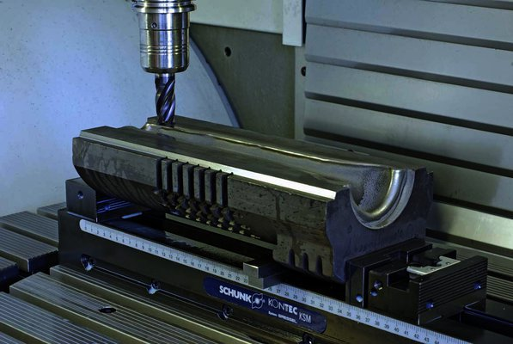
The expansion chuck for thread milling
Application examples:
SINO-R at company Förster SINO-R at company Glaswerk Ernstthal

