Slide 1


Short presentation
ECS
Superior Clamping and Gripping

Slide 2
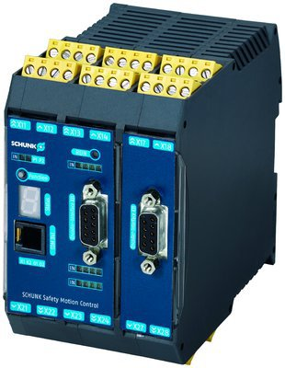
New Product
Sucessor product
New Sizes
ECS
#1: Controller for the first certified SCHUNK Safety Gripping System
Unique Selling Points:
  First certified SCHUNK Safety Gripping System
  SIL 3, PL e
certified functions of SLS, SOS and STO:
STO:Safe Torque Off
  SLS: Safe Limited Speed
  SOS: Sofe Operating Speed
Further Product Features:
Compact housing
Simplest installation
Prefabricated connection cable

Slide 3
New Product
Sucessor product
New Sizes
ECS
#1: Controller for the first certified SCHUNK Safety Gripping System
Cost Effectiveness/ Customer Benefits:
  No software effort is required due to the preprogrammed and preparametered Safety Control
  Can be used with the EGN/EZN
  Turning off gripper during commissioning or maintenance not necessary any more
  Referencing after E-Stop not necessary

Slide 4
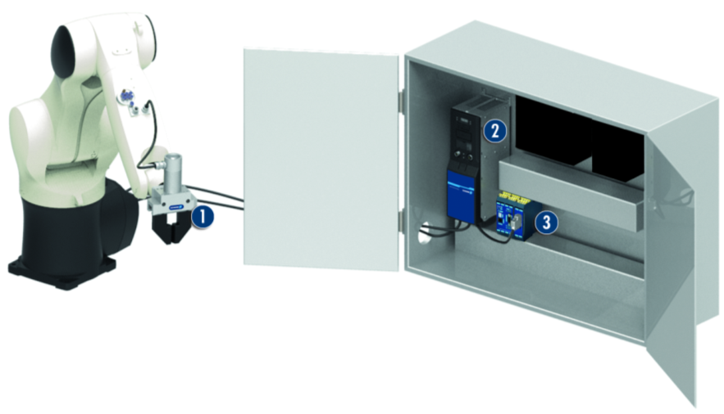
New Product
Sucessor product
New Sizes
ECS
#1: Controller for the first certified SCHUNK Safety Gripping System
Basic Technical Data:
  Safety controller for direct assembly
  Preconfigured cable
  Complementary Products:
  ECM
  EGN
  EZN
1. EGN servo-electric 2-finger parallel gripper
2. ECM controller
3. ECS safety controller

Slide 5




Jens Lehmann, a German goalkeeper legend,
brand ambassador for SCHUNK since 2012
www.schunk.com

