Slide 1


Short presentation
SVH 5-Finger-Hand
Superior Clamping and Gripping

Slide 2
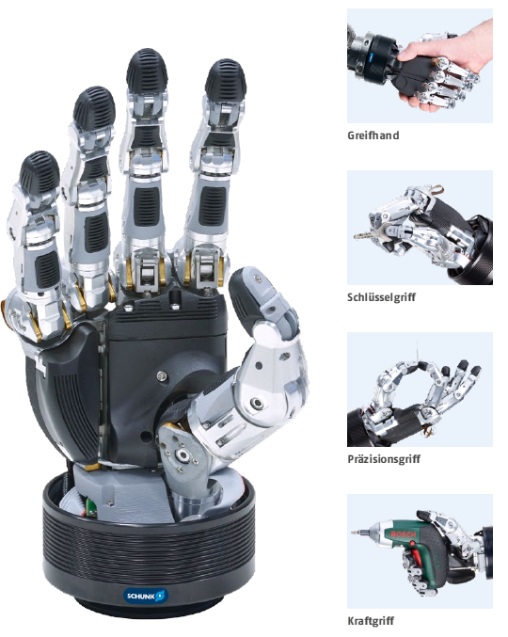
New Product
Successor product
New Sizes
SVH 5-Finger-Hand
#1: The first industrial 5-Finger Hand
Integrated control unit in the wrist
The industrial version of the anthropo morphic SCHUNK SVH 5-finger hand grips nearly as perfectly as the human hand. The electronics are completely integrated
into the wrist, which allows the 5-finger hand to simulate nearly all human hand movements. Due to the moving parts with a total of nine drives, various gripping operations can be executed with high ensitivity.

Slide 3
New Product
Successor product
New Sizes
SVH 5-Finger-Hand
#1: The first industrial 5-Finger Hand
1. Distal index finger drive for
controlling two axes
2. Proximal index finger drive is
DC motor with spindle drive
3. Slip-resistant elastic gripping surface
made of rubber for secure holding
4. Integrated electronics for direct
mounting on the robot arm
5. Thumb with two degrees of
freedom for bending and
pivoting the thumb

Slide 4




Jens Lehmann, a German goalkeeper legend,
brand ambassador for SCHUNK since 2012
www.schunk.com

