Slide 1

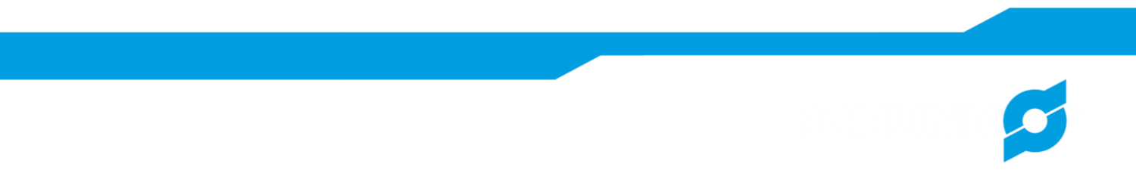
Short presentation
Pillar Assembly System
Superior Clamping and Gripping

Slide 2
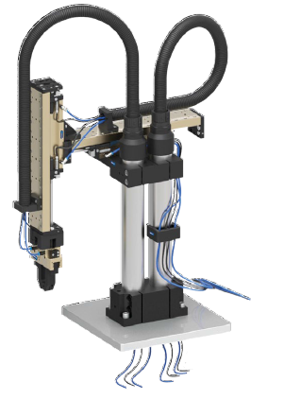
New Product
Successor product
New Sizes
Pillar Assembly System
#1: New modules for the pillar assembly system for greater flexibility and easy adjustment of handling units
Unique Selling Points:
  Complete column mounting system for modular assembly automation with stiff and precise columns and attachment elements, including elements for media feed through
Further Product Features:
  Ground and hard-chromium plated steel pillars
  Precise shape and positional tolerances
  Three pillar diameters O 20, 35, and 55 mm
  Many elements for all pillar diameters
  With the new elements the system is cheaper since the flexibility and precision don‘t have to be built into the customers machineFor pillar diameters O 35 and 55 mm
  The elements have threads on the side to offer higher flexibility in assembly. Custsomers can use these to attach holders, cables, hoses, etc.
  The clip for the media feed through (MFC) can be easily clipped onto the columns, to easily feed through hoses and cables

Slide 3
New Product
Successor product
New Sizes
Pillar Assembly System
#1: New modules for the pillar assembly system for greater flexibility and easy adjustment of handling units
Cost Effectiveness/ Customer Benefits:
  Flexible pillar mounting system for the fast assembly for modular assembly systems
  Easy and modular and therefore lower cost, as opposed to welded frames
  Ground and chrome harded steel pillars for high stiffness and vibration free movement
  Precise tolerances for high accuracy with long columns
  Different pillar diameters for a reduced interferring contour of the complete system
  Many standard attachment elements offeringing many combinations
  The new elements are lower cost allowing for a more economical solution compared to a welded frame

Slide 4
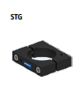


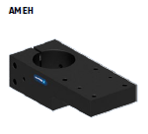
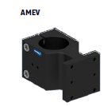
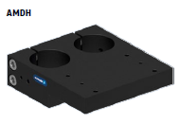
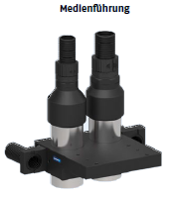
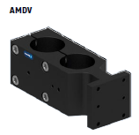
New Product
Successor product
New Sizes
Pillar Assembly System
#1: New modules for the pillar assembly system for greater flexibility and easy adjustment of handling units
Basic Technical Data:
for pillar diameters: 35 mm and 55 mm
Form and position tolerances:
Parallelism of screw-on surface to the column: 0.02 mm
Perpendicularity of screw-on surface to the column: 0.02 mm
Assembly element material: High-strength anodised aluminium
Pillar material: Steel, hard-chrome plated and ground
After the first expansion for Motek 2014, the modular system has been expanded further with the VEH adjusting unit and the ADPA axial double mounting plate.
VEH adjusting unit
The adjusting unit is designed for easier mechanical adjustment of complete handling systems. Each axis (linear unit) can normally be adjusted in the direction of movement. So the customer can, for instance, precisely adjust the gripper centre. With a 2-axis system the customer can optimally adjust two axes with just the linear module. However, since there are three axes in the 'space', the third axis can not be adjusted in this manner.
APDA – mounting plate, double, axial
For compact assemblies, even directly above the column. For the double column

Slide 5




Jens Lehmann, a German goalkeeper legend,
brand ambassador for SCHUNK since 2012
www.schunk.com

