Slide 1


Short presentation
Drive-Cliq
Superior Clamping and Gripping

Slide 2
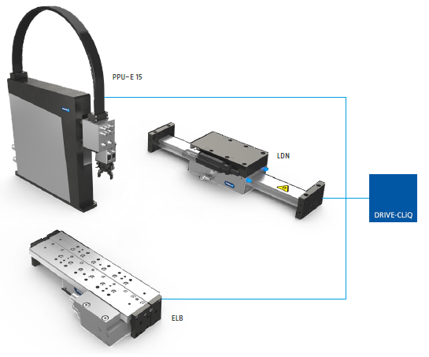
New Product
Successor product
New Sizes
Drive-Cliq
#1: The most modular encoder system for linear direct drives
Unique Selling Points:
Standardized sensor housing suitable for LDx, PPU-E 15, ELB
Enables direct connection of axes to SIEMENS controllers
Further Product Features:
Standardized M12 connector
Motor temperature line is fed to sensor line via SCHUNK cable harnesses

Slide 3
New Product
Successor product
New Sizes
Drive-Cliq
#1: The most modular encoder system for linear direct drives
Cost Effectiveness/ Customer Benefits:
Elimination of an additional sensor system controller (Siemens SME)
Major simplification of axis integration in SIEMENS controllers
Now four sensor types can be chosen by customers:
    SSI (SIEMENS)
    Hiperface (BOSCH, SCHNEIDER etc.)
    Drive-Cliq (SIEMENS)
    Incremental (BOSCH, SIEMENS...)

Slide 4
New Product
Successor product
New Sizes
Drive-Cliq
#1: The most modular encoder system for linear direct drives
Basic Technical Data:
Sensor interface: SIEMENS Drive-Cliq
Complementary Products:
LDx
PPU-E
ELB
Vss transducer
SSI transducer
Hiperface transducer
Drive-Cliq transducer
Short-stroke axis with linear motor drive and junction roller guide

Slide 5




Jens Lehmann, a German goalkeeper legend,
brand ambassador for SCHUNK since 2012
www.schunk.com

