Slide 1

Product presentation
AGE-Z 2
Compensation unit Z

Slide 2
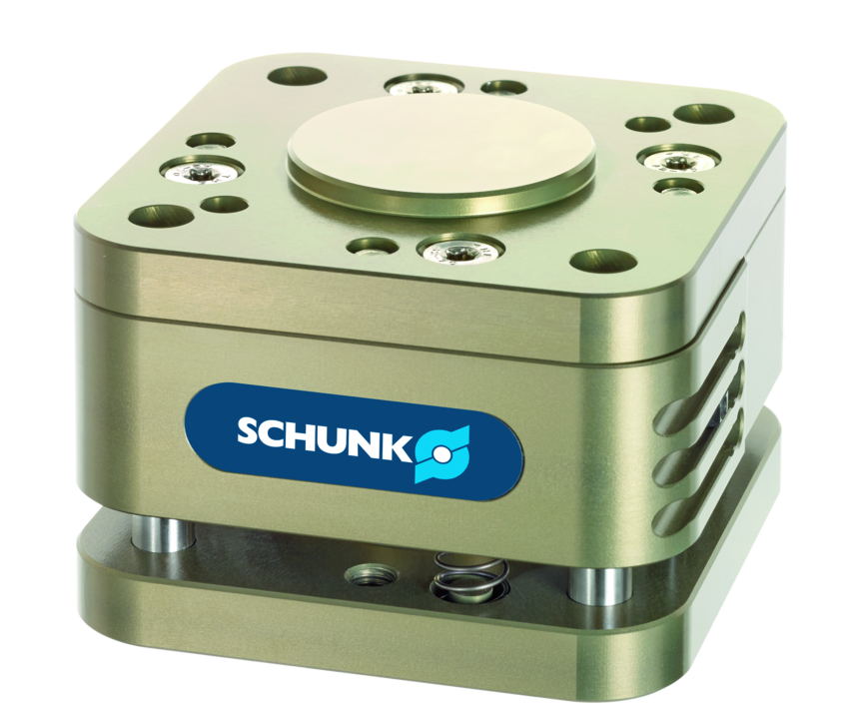
Compensation unit Z
Compensation unit compensating in Z-direction
Compact compensation unit with position fixation
Up to 10 mm compensation path in Z-direction

Slide 3

Compact. Compliant. Productive.

Slide 4
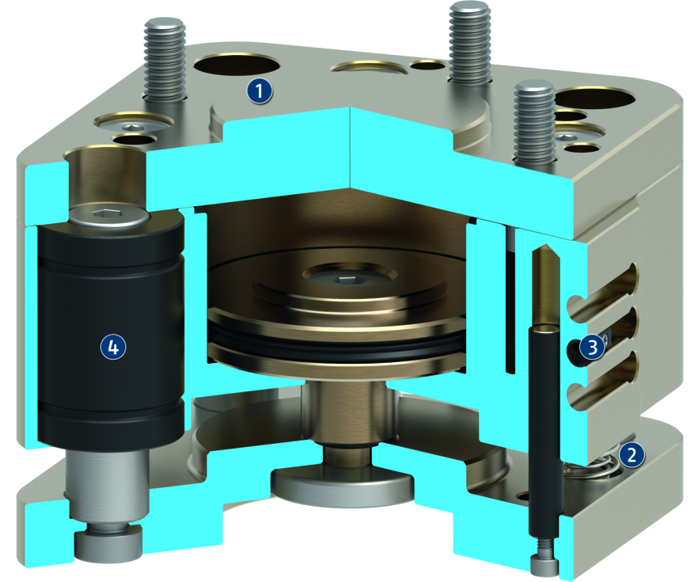
Principle of function
Functional description
The compensation unit AGE-Z 2 allows for Z-compensation of different collection and deposition positions. The compensation unit runs on a ball-guide that is free from play. Pressure springs determine the rigidity of the AGE-Z 2. It can be increased by additionally actuating the pneumatic cylinder.
The cylinder also ensures the unit to be locked in the event of dynamic movements. Monitoring of the retracted and the extended position is done by a magnetic switch.
1
Housing
2
Pressure springs
3
Monitoring groove
4
Scope-free ball bearings

Slide 5
Advantages – Your benefits
ISO mounting pattern for easy assembly to most types of robots without needing additional adapter plates
Locking for switching the unit rigidly in a defined, extended or retracted position
Compact design for minimum installation height
Can be combined with AGE-XY without additional adapter plate {Nutzen7}

Slide 6
Technical data
Technical data overview
Size | Compensation Z | Recommended handling weight | Locking force retracted at 6 bar | Locking force extended at 6 bar | Min. spring force | Max. spring force | Min. operating pressure | Max. operating pressure | Weight
 | [mm] | [kg] | [N] | [N] | [N] | [N] | [bar] | [bar] | [kg]
50 | 8 | 5 | 280 .. 300 | 500 | 20 .. 40 | 40 .. 60 | 2.5 | 6 | 0.55
63 | 8 | 9 | 750 .. 800 | 900 | 40 .. 60 | 60 .. 100 | 2.5 | 6 | 0.8
80 | 10 | 12 | 1450 | 1500 | 70 .. 90 | 100 .. 120 | 2.5 | 6 | 1.7

