Slide 1

Product presentation
ECM
Accessories

Slide 2
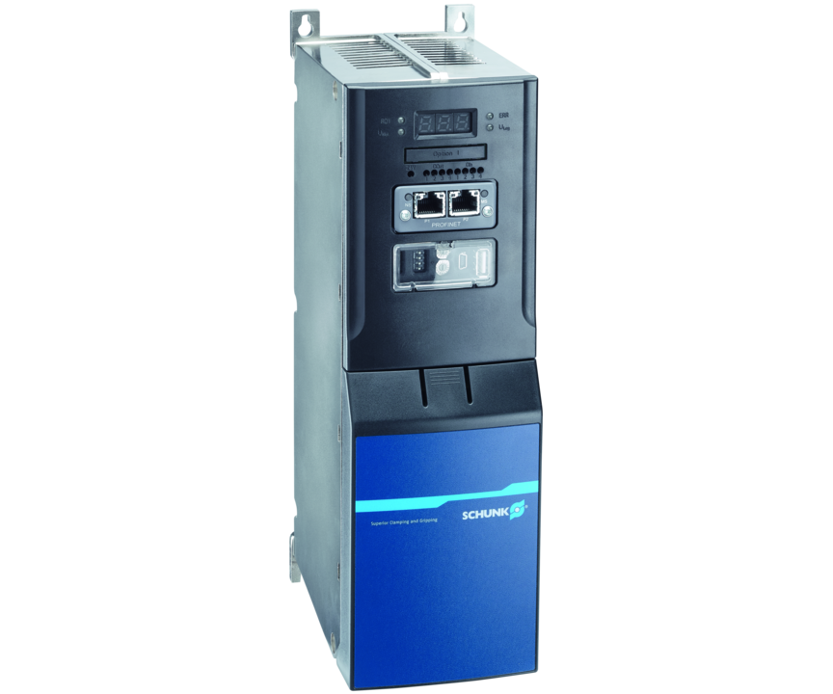
Accessories
Electrical controllers are used to control/regulate mechatronic modules and systems without integrated electronics. They are offered by SCHUNK for EGN and EZN grippers.
With 24 V/48 V input voltage

Slide 3

Powerful. Easy. Bus capable.

Slide 4
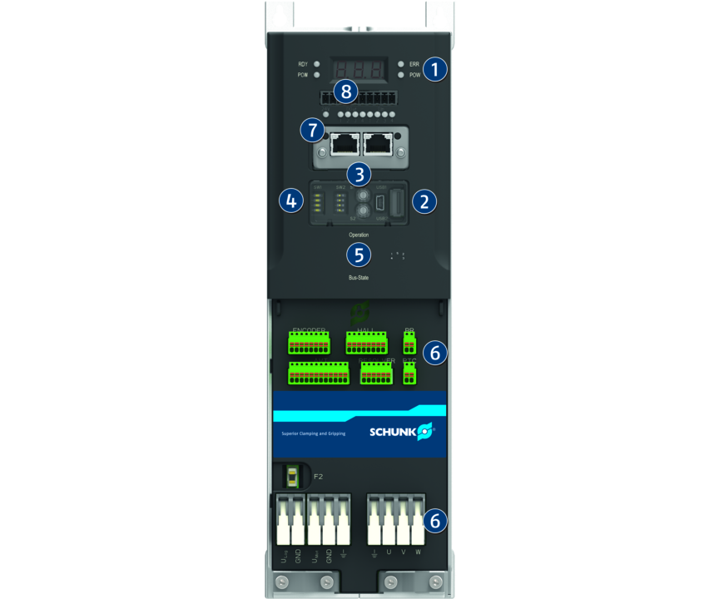
Principle of function
Functional description
The ECM controller is an electronic module, which is used to control/ regulate the mechatronic modules.
1
Status display
2
Service interfaces
3
Rotary encoding switch
4
DIP switch
5
M12 plug-in technology for PROFIBUS/CAN communication
6
Spring clamp and plug connector
7
Standard RJ45 plug for PROFINET communication

Slide 5
Advantages – Your benefits
High accuracy and flexibility for positioning processes with, for example, accurate positioning or exact force/torque control
SCHUNK MTS Motion Tool commissioning software to support parameterization, commissioning and function tests
Communication interface PROFINET, PROFIBUS-DP und CAN for flexible integration
USB service interfaces for easy and quick parameterization via USB stick and commissioning via PC
Standard connector technology and spring clamps for convenient and industry-suitable commissioning
Rotary encoding switch and DIP switch for manual fieldbus addressing, baud rate setting and service functions
digital I/O available as an option

Slide 6
Technical data
Technical data overview
Description | Length | Width | Height | Number of digital inputs | Number of digital outputs | Weight
 | [V] | [V] | [A] | [mm] | [mm] | [mm]
ECM-EGN | 144 | 98 | 310 | 4 | 4 | 1.9
ECM-EZN | 144 | 98 | 310 | 4 | 4 | 1.9

