Slide 1

Product presentation
EGM

Slide 2
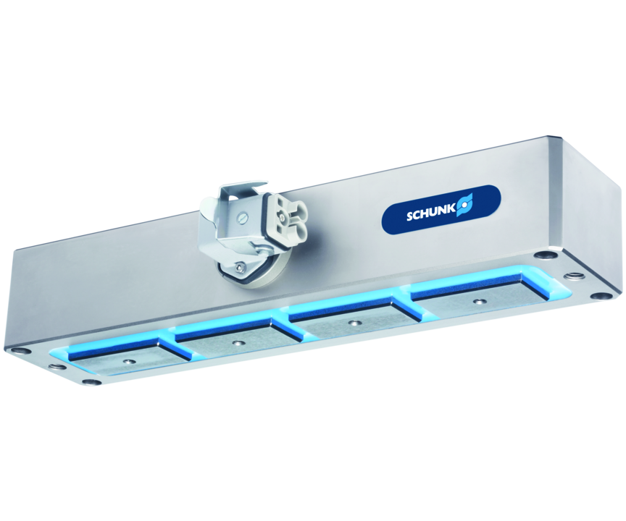
Electro-permanent magnetic gripper for energy-efficient handling of ferromagnetic workpieces
Maximum holding force in confined spaces.
Up to 118 kg workpiece weight

Slide 3

Strong. Simple Control. Compact.

Slide 4
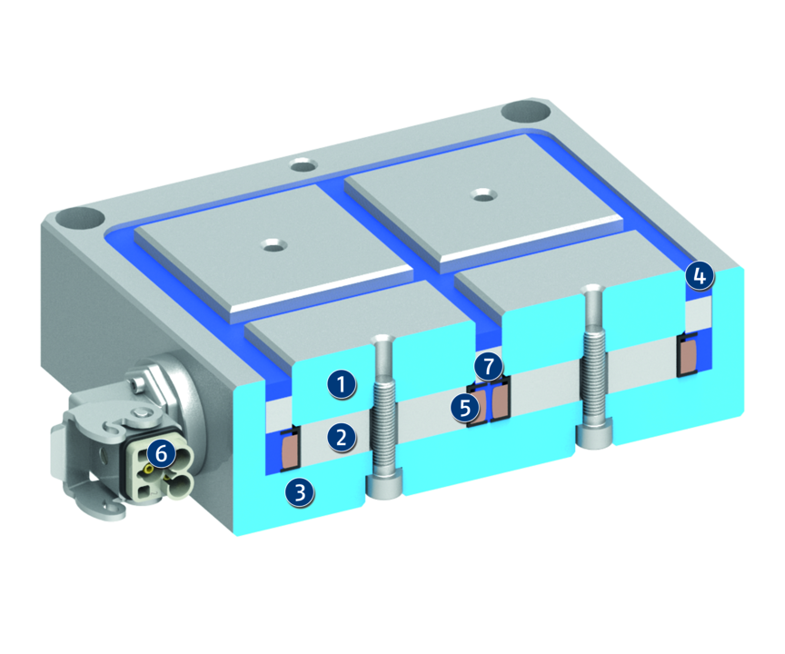
Principle of function
Functional description
The function of the magnetic gripper bases on the combination of AlNiCo and neodymium magnets. The magnetic flux of the AlNiCo magnets passes the neodymium magnet in the deactivated state, and closes the magnetic circuit over the gripper base body made of steel. To activate the system, an electric current pulse is conducted through the coil, which reverses the polarity of the AlNiCo magnets accordingly.
The magnetic flux can not pass the Neodym magnets anymore and has to pass via the workpiece into the opposite pole, creating a holding force.
1
Steel poles with bore
2
Polarity reversible AlNiCo-magnet
3
One-piece base body made of steel
4
Potting compound of synthetic resin
5
Copper coil
6
Cable connector of Harting
7
Non-pole reversing neodymium permanent magnets

Slide 5
Advantages – Your benefits
High holding forces at lowest space for reliable part handling in compact machines
Low weight for high dynamics in challenging applications
Reliable holding force maintenance to ensure process reliable operation even in scenarios with emergency stop
Energy efficiency: electricity is only required for magnetization and demagnetization for an economic and careful managment of resources
Variable number of magnetic poles and adaptation possibilities to any common robot to ensure the optimum adaption to each application
Workpiece accessibility from five sides free from interfering contours by unnecessary gripper fingers

Slide 6
Technical data
Technical data overview
Size | Weight | Number of poles | Magnet area | Minimum workpiece thickness | Max. activations/minute
 | [kg] |  | [cm²] | [mm] | [1/min]
B-L | 6.5 .. 11.5 | 2 .. 4 | 36 .. 72 | 8 | 15 .. 20
B-Q | 5.5 .. 25 | 2 .. 4 | 50 .. 196 | 12 .. 18 | 8 .. 20
M-L | 1 .. 3.1 | 2 | 12 .. 36.9 | 3 .. 10 | 12 .. 16
M-Q | 1.3 .. 7.1 | 2 | 18.4 .. 98.1 | 6 .. 16 | 6 .. 20

