Slide 1

Product presentation
EGN
Universal gripper

Slide 2
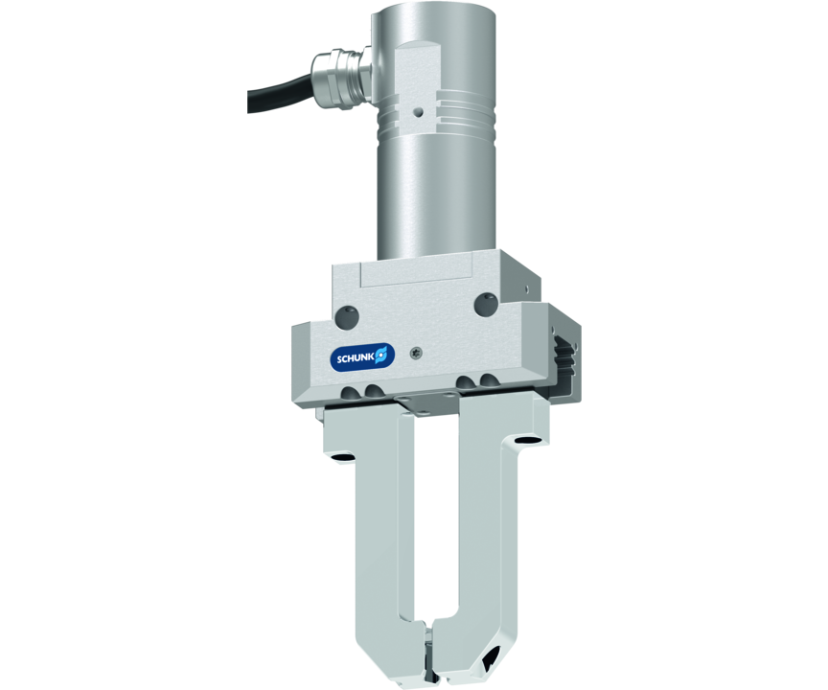
Universal gripper
Servo-electric 2-finger parallel gripper with high gripping force and moment loads due to the multi-tooth guidance
The first electric 2-finger parallel gripper with multi-tooth guidance.
Up to 1,000 N gripping force

Slide 3

Robust. Flexible. Strong.

Slide 4
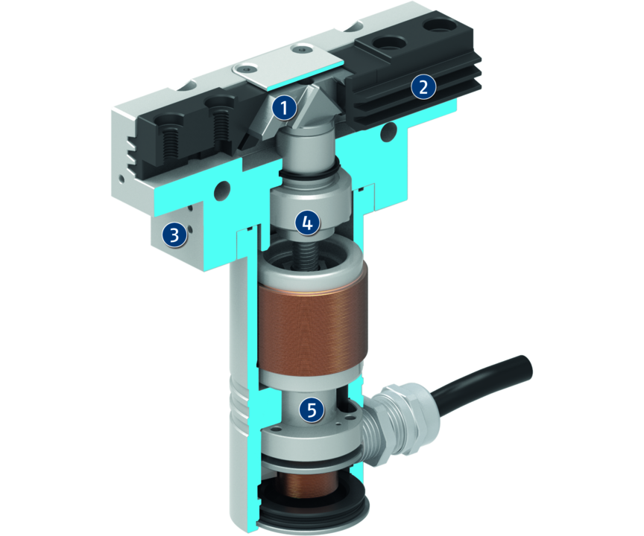
Principle of function
Functional description
The spindle nut which is mounted on bearings, transfers the rotary motion of the servomotor into an axial motion.
The angled active surfaces of the wedge-hook produce a synchronized, parallel jaw motion.
1
Wedge-hook design
2
Multi-tooth guidance
3
Housing
4
Spindle nut
5
Drive

Slide 5
Advantages – Your benefits
Drive design of servomotor for flexible use
With external electronics for simple integration into existing servo-controlled concepts via PROFINET, PROFIBUS or CAN
Pre-positioning capability to reduce cycle times through a short working stroke
Robust multi-tooth guidance for precise handling
High maximum moments possible suitable for using long gripper fingers
Mounting from two sides in three screw directions for universal and flexible gripper assembly

Slide 6
Technical data
Technical data overview
Size | Stroke per jaw | Min. gripping force | Max. gripping force | Max. permissible finger length | Recommended workpiece weight | Weight | Nominal voltage
 | [mm] | [N] | [N] | [mm] | [kg] | [kg] | [V DC]
80 | 8 | 170 | 400 | 100 | 2 | 0.84 .. 0.94 | 24
100 | 10 | 170 | 720 | 125 | 3.6 | 1.35 .. 1.53 | 24
160 | 16 | 250 | 1000 | 220 | 5 | 3 .. 3.4 | 24

