Slide 1

Product presentation
EGP
Gripper for small components

Slide 2
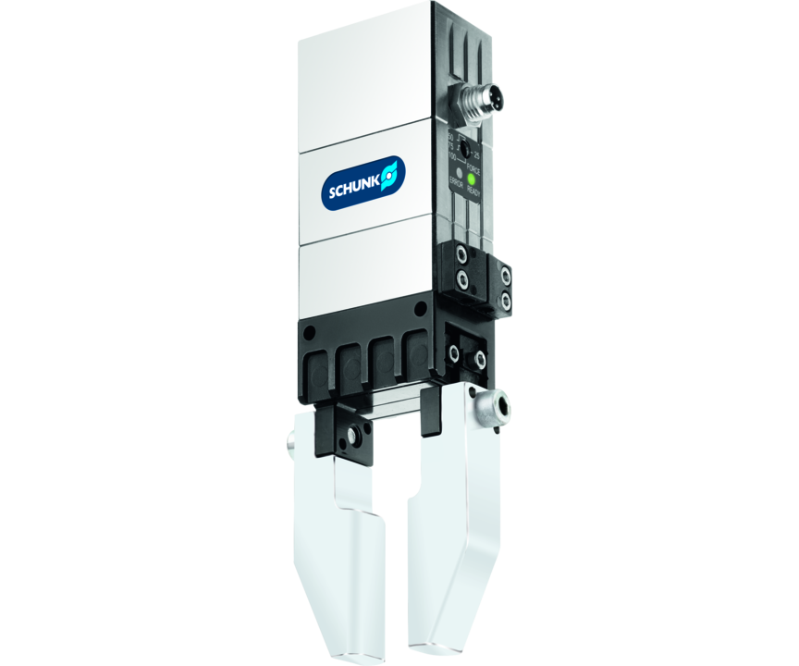
Gripper for small components
Electric 2-finger parallel gripper with smooth-running base jaws guided on roller bearings
The electric gripper for small components with the highest power density on the market.
Up to 300 N gripping force at a weight of 0.8 kg

Slide 3

High Performance Density. Fast. Compact.
New variant with IO-link interface
Flexible gripping force adjustment software-controlled
Variable position adjustment for pre-positioning the gripper fingers
Position detection over the entire range of stroke due to integrated sensor system
Maintenance and diagnostics reporting via IO-link interface

Slide 4
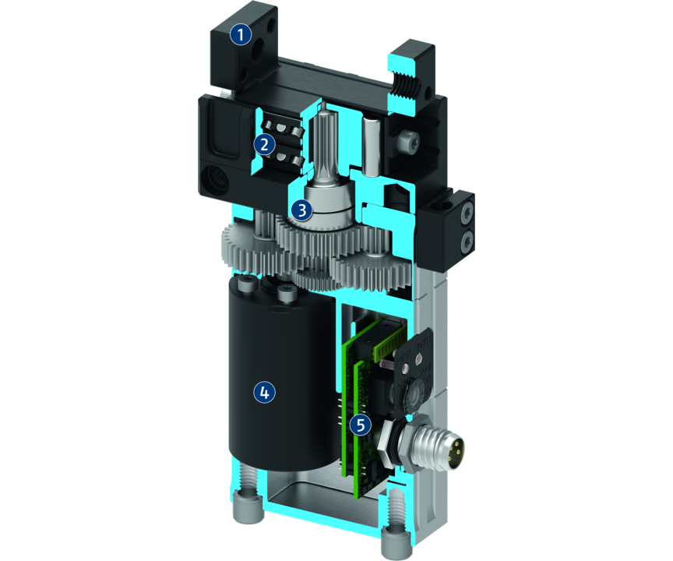
Principle of function
Functional description
The brushless servomotor drives the base jaw via the gear mechanism.
The jaw stroke is synchronized by means of rack and pinion kinematics.
1
Base Jaw
2
Cross roller guidance
3
Gear
4
Drive
5
Control electronics

Slide 5
Advantages – Your benefits
Highest performance density for the use of smaller grippers sizes
Control via digital I/O for easy commissioning and rapid integration into existing systems.
Two to four stage adjustable gripping force for simple adaption to sensitive workpieces
Backlash-free, pre-loaded cross roller guide for precise gripping with nearly constant force for all permissible finger lengths
Very high maximum cycles per minute for highest productivity
Compact dimensions for minimal interfering contours in the application
Proven a thousand times MPG-plus basis for equal gripping forces and strokes with identically high efficiency
Brushless DC servomotor for almost wear-free use and a long service life
Control via IO-Link Enables pre-positioning of the gripper finger and evaluation of the gripper condition as well as the adjustability of special gripping modes.

Slide 6
Technical data
Technical data overview
Size | Stroke per jaw | Min. gripping force | Max. gripping force | Recommended workpiece weight | Max. permissible finger length | Weight
 | [mm] | [N] | [N] | [kg] | [mm] | [kg]
25 | 3 | 12 .. 20 | 12 .. 40 | 0.07 .. 0.2 | 32 | 0.11 .. 0.12
40 | 6 | 30 .. 35 | 30 .. 140 | 0.15 .. 0.7 | 50 | 0.3 .. 0.34
50 | 8 | 54 | 215 | 1.05 | 64 | 0.51 .. 0.55
64 | 10 | 75 | 300 | 1.25 | 80 | 0.8 .. 0.83

