Slide 1

Product presentation
eGRIP
Digitisation

Slide 2
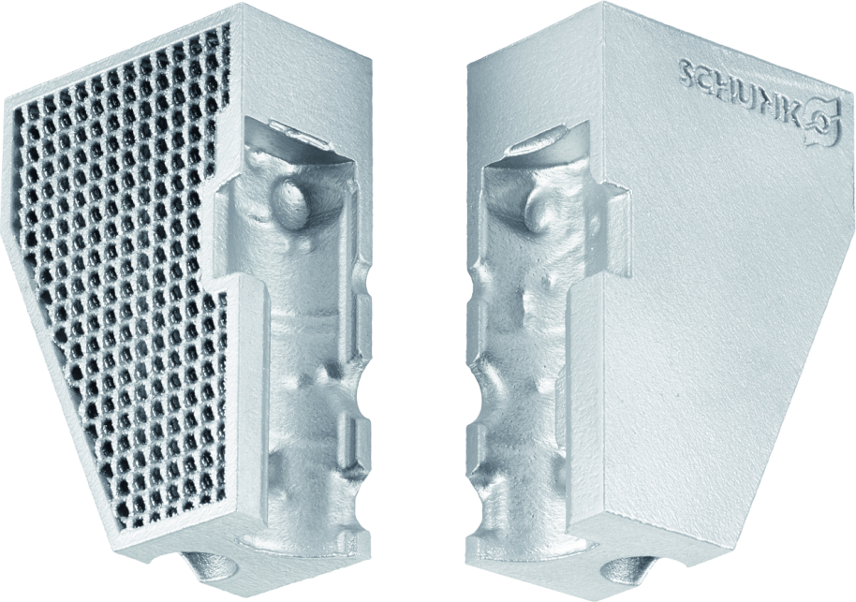
Gripper fingers at the press of a button
Online software tool, which automatically generates the contours of top jaws for the particular workpiece. Now new with parametric fingers for contour-optimized design
First web shop with a configurator for automatic generation and ordering of individual gripper fingers

Slide 3
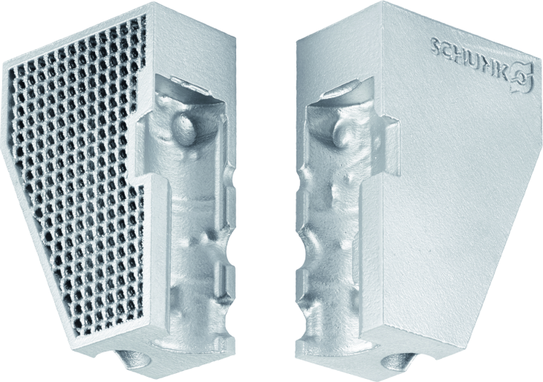
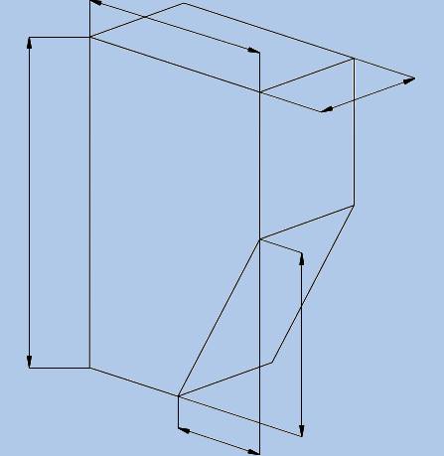

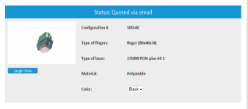
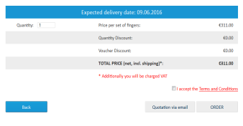
Innovative. Fast. Versatile.
Fingers made of plastic (PA12), aluminum or stainless steel
Lightweight design
Additively manufactured gripping contour
NEW! Parametric gripper fingers
Direct output of price and delivery time

Slide 4

Your advantages and benefits
Metal fingers can now be manufactured and configured; so far, the gripper fingers are 80-90% steel or aluminum.
→ Time-proven material
Lightweight design reduces the finger weight by up to 50% with no change in the strength properties
→ Gripper and drive (robot, gantry) can
be designed with smaller dimensions
The additive manufacturing process enables the use of (gripping) contours that are not possible or only very difficult to achieve with conventional machining processes
→ All workpieces can be gripped with form-fit
clamping, which reduces the required force
and results in no clamping marks
→ Fast and easy design + production
of fingers for complex workpieces
The tool reduces design time enormously (takes only about 15 minutes.)
→ Time savings
→ Customer can focus on the construction of his
system
Direct output of price and delivery time for the fingers and offer via e-mail
→ No waiting for an offer Full text
→ document available for forwarding to Purchasing
Fast availability of parts (5 days – 14 days for metal)
→ Short lead time for the customers
→ Fast replacement is possible
Parametric Gripper fingers
→ for even better contour-optimization

Slide 5




Jens Lehmann, a German goalkeeper legend,
brand ambassador for SCHUNK since 2012
www.schunk.com

