Slide 1

Product presentation
EGS
Parallel Gripper Swivel Module

Slide 2
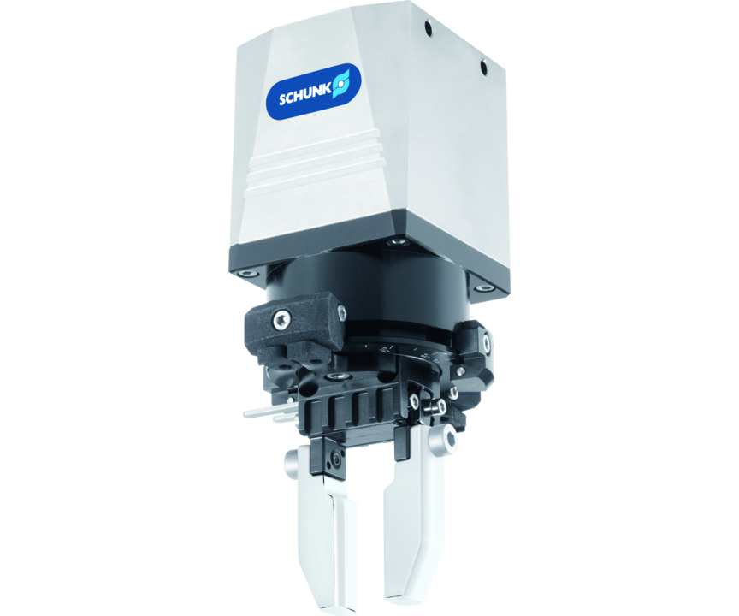
Parallel Gripper Swivel Module
Electric, 2-finger, parallel gripper swivel module with smoothly running base jaws guidance on roller bearings
0.18 s / 180° swivel time

Slide 3

Easy. Fast. Compact.

Slide 4
Principle of function
Functional description
The gripper swivel module has two stationary brushless servomotor drives. The outer motor rotates the gripper. The inner motor drives the base jaw of the gripper. The jaw stroke is synchronized by a rack and pinion kinematic.
1
Base Jaw
2
Cross roller guidance
3
Sensor system
4
Drives
5
Control electronics
6
Patented gear coupling

Slide 5
Advantages – Your benefits
Control via digital I/O for easy commissioning and rapid integration into existing systems.
Almost no wear parts for high machine uptime and low operating costs
Small required space as the rotary drive and gripper are merged in one compact module
Two to four stage adjustable gripping force for simple adaption to sensitive workpieces
Four stage adjustable rotational speed for high flexibility in cycle times
Very high maximum cycles per minute for highest productivity
Backlash-free, pre-loaded cross roller guide for precise gripping with nearly constant force for all permissible finger lengths
Standardized mounting bores for numerous combinations with other components from the modular system

Slide 6
Technical data
Technical data overview
Size | Stroke per jaw | Min. gripping force | Max. gripping force | Nominal torque | Min. angle of rotation | Max. angle of rotation | Recommended workpiece weight | Max. permissible finger length | Max. mass moment of inertia | Repeat accuracy for gripping | Repeat accuracy for swiveling | Weight
 | [mm] | [N] | [N] | [Nm] | [°] | [°] | [kg] | [mm] | [kgmm²] | [mm] | [°] | [kg]
25 | 3 | 15 | 30 | 0.04 | 30 | 270 | 0.15 | 32 | 50 | 0.02 | 0.5 | 0.45
40 | 6 | 35 | 140 | 0.115 | 30 | 270 | 0.55 | 50 | 180 | 0.02 | 0.5 | 1.2

