Slide 1

Product presentation
ELB
Linear axis

Slide 2
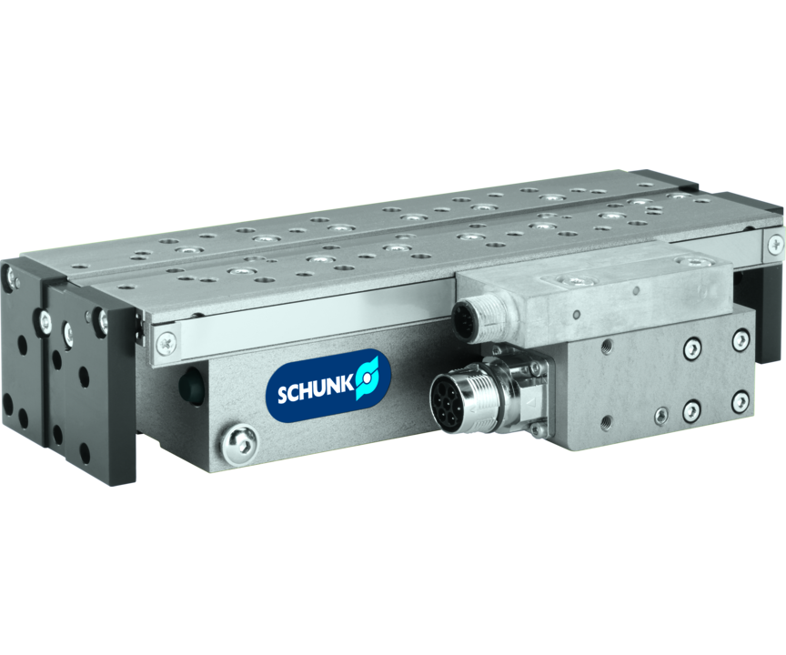
Linear axis
Short stroke linear direct drive with cross roller guidance
The fastest electric linear module for assembly automation.
100 m/s2 acceleration

Slide 3

Precise. Reliable. Flexible.

Slide 4
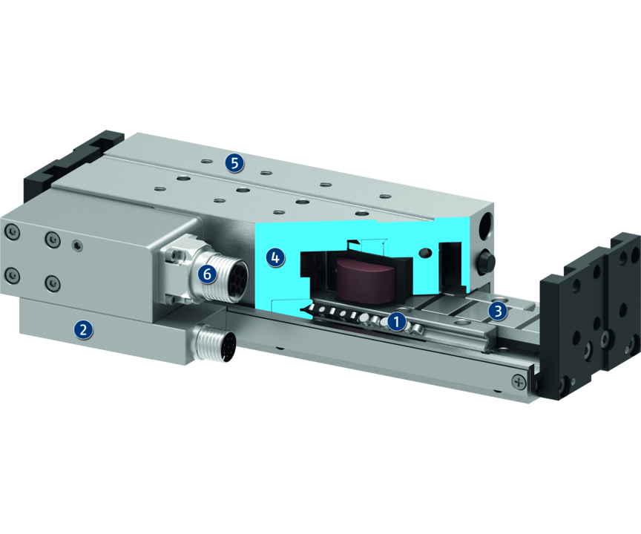
Principle of function
Functional description
The electric drive consists of a primary part (motor coil) and a secondary part (permanent magnets). Inside the controller the phase and amplitude of the applied electric current are controlled. This sets the profile, which is fitted with magnets, in motion.
1
Cross roller guidance
2
Stroke measuring system
3
Integrated secondary parts
4
Base body
5
Mounting pattern
6
Motor plug

Slide 5
Advantages – Your benefits
Integrated motor and measuring system in the axis minimizes interfering contours and space requirements
Can be fitted with absolute stroke measuring system Less programming effort and time saving when commissioning and in operation
High dynamics for shorter cycle times therefore a high productivity is achieved
Almost no wear parts for a long service life
Pretensioned junction rollers That means absolutely scope-free
Standardized mounting bores for numerous combinations with other components from the modular system
Optional pneumatic or electric holding brake as rod lock for process reliability during system downtime
Optionally certified safety devices according to SIL2/PLd with the HIPERFACE® and DRIVE-CliQ interfaces for applications with high standards in the area of machine safety

Slide 6
Technical data
Technical data overview
Size | Stroke | Max. driving force | Nominal force | Max. useful load (horizontal) | Max. acceleration | Weight
 | [mm] | [N] | [N] | [kg] | [m/s²] | [kg]
70 | 50 .. 125 | 150 | 40 | 3 .. 6 | 100 | 2 .. 3.12

