Slide 1

Product presentation
EZN
Centric Grippers

Slide 2
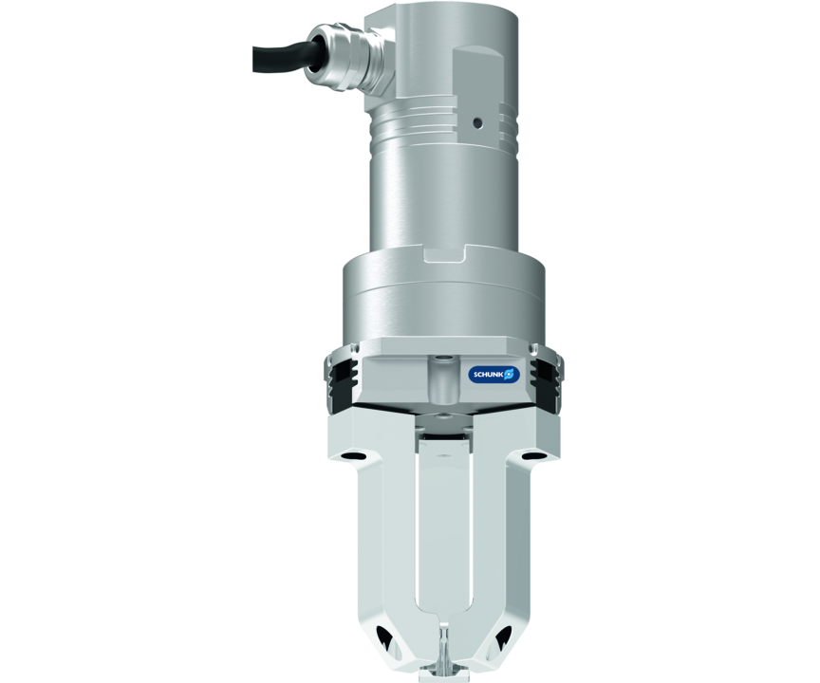
Centric Grippers
Servo-electric 3-finger centric gripper with high gripping force and high maximum moment due to multi-tooth guidance
The only electric 3-finger centric gripper with multi-tooth guidance.

Slide 3

Robust. Flexible. Strong.

Slide 4
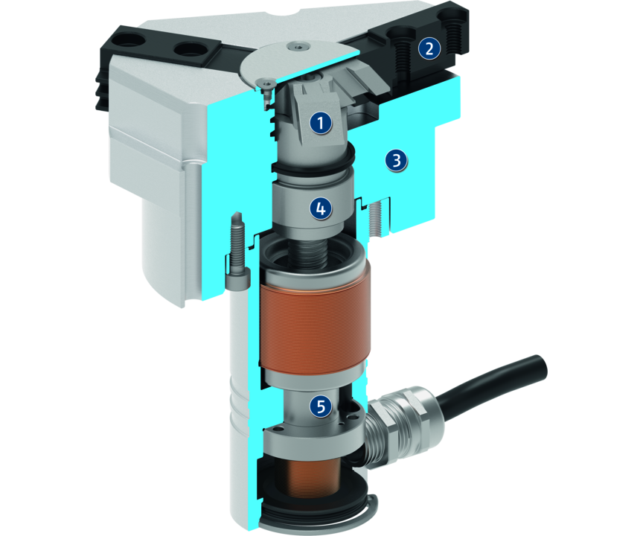
Principle of function
Functional description
The spindle nut which is mounted on bearings, transfers the rotary motion of the servomotor into an axial motion.
The oblique surfaces of the wedge-hook generate a synchronous jaw movement.
1
Wedge-hook design
2
Base Jaw
3
Housing
4
Spindle nut
5
Drive

Slide 5
Advantages – Your benefits
Drive design of servomotor for flexible use
With external electronics for simple integration into existing servo-controlled concepts via PROFINET, PROFIBUS or CAN
Pre-positioning capability to reduce cycle times through a short working stroke
Robust multi-tooth guidance for precise handling
High maximum moments possible suitable for using long gripper fingers
Fastening at one gripper side in two screw directions for universal and flexible gripper assembly

Slide 6
Technical data
Technical data overview
Size | Stroke per jaw | Min. gripping force | Max. gripping force | Max. permissible finger length | Recommended workpiece weight | Weight | Nominal voltage
 | [mm] | [N] | [N] | [mm] | [kg] | [kg] | [V DC]
64 | 6 | 140 | 500 | 80 | 2.5 | 0.98 .. 1.08 | 24
100 | 10 | 300 | 800 | 125 | 4 | 2.3 .. 2.48 | 24

