Slide 1


Short presentation
Hybridkcable for PPU-E
Superior Clamping and Gripping

Slide 2
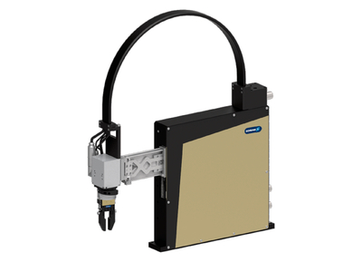
Hybridcable for PPU-E
#1: First hybrid cable for torque motor and gripper for pick & place units
New Product
Sucessor product
New Sizes
Unique selling points:
Transfer of power, encoder signals, sensor
signals and pneumatics (for a torque motor
and a gripper)
Other product features:
Smooth surface
Flat and wide construction
Direct conventioned with the matching
motor connector for ERD and MRD-S

Slide 3
Hybridcable for PPU-E
#1: First hybrid cable for torque motor and gripper for pick & place units
New Product
Sucessor product
New Sizes
Cost Effectiveness / Customer Benefits :
Wide and flat design and therefore the cables and hoses won’t bend like with
traditional hose and cable solutions. This guarantees higher process
reliability.
The individual cables are molded together guaranteeing no abrasion or wear.
Smooth surface guaranteeing that no dust can collect on the surface.
All-in-one solution, power and encoder signals from the torque motors, two
pneumatic hoses and two sensors can be transferred. Two or three cables are
not required.

Slide 4
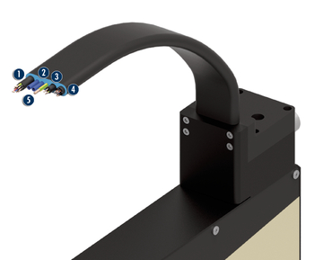
Hybridcable for PPU-E
#1: First hybrid cable for torque motor and gripper for pick & place units
New Product
Sucessor product
New Sizes
  Basic technical data:
Sizes: for PPU-E 15, 30 und 50
Feed-through: 1 x motor power, 1 x encoder line, 2 x sensor signals (incl. Supply), 2 x air
Max. stroke of the Pick & Place Unit 280 x 150 mm
  Complementary products:
  ERD, MRD-S, PPU-E, MPG-plus
Motor line
Pneumatics hose
Sensor line
Encoder line
central ground wire

Slide 5




Jens Lehmann, a German goalkeeper legend,
brand ambassador for SCHUNK since 2012
www.schunk.com

