Slide 1

Product presentation
LEG
Long-stroke gripper

Slide 2
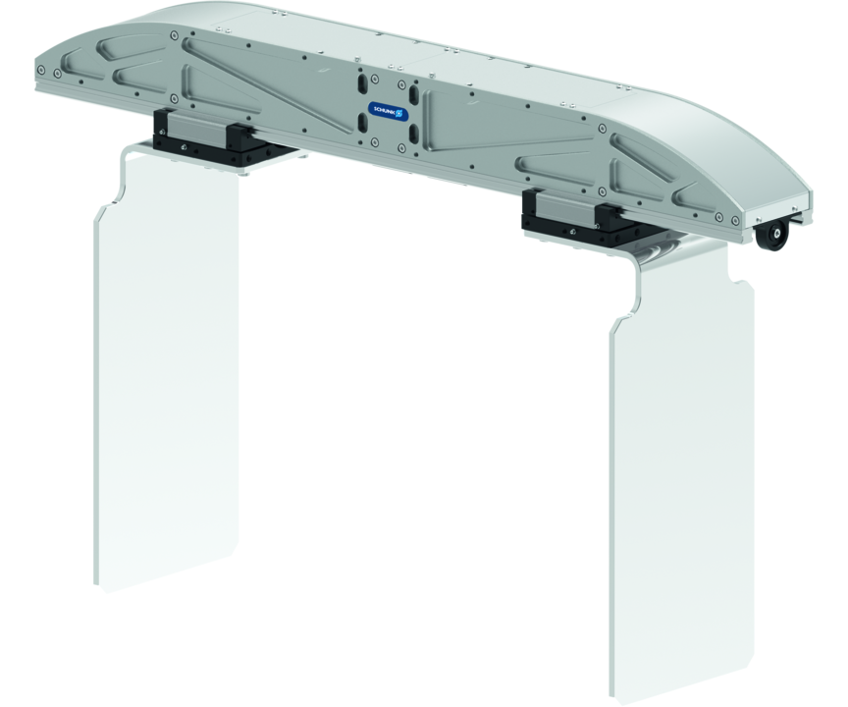
Long-stroke gripper
Electric 2-finger parallel gripper with lightweight profile rail guide and adaptable servomotor
Lightweight gripper, weight-optimized with variable finger movement, and long stroke.
Variable stroke up to 281 mm

Slide 3

Flexible. Light. Productive.

Slide 4
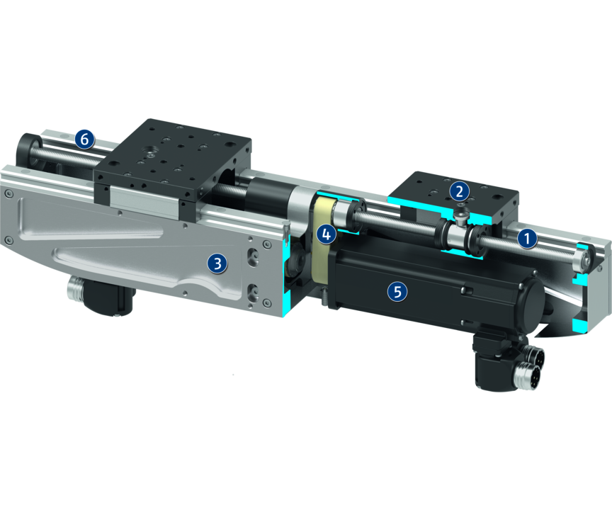
Principle of function
Functional description
The two ball-screw spindle drives, which move the base jaw, are driven by one or two servomotors via a toothed belt.
With two drives every jaw can be moved individually from each other. During the actuation with a servomotor, a coupling synchronizes the right-to-left and the left-to-right spindle with each other.
1
Recirculating ball bearing guide
2
Base Jaw
3
Housing
4
Kinematics
5
Motor installation space
6
Linear guide

Slide 5
Advantages – Your benefits
High moments due to double profiled rail guide suitable for using long gripper fingers
Extremely narrow design for minimal interfering contours
Adaptable drive motor for versatile approach and easy integration into existing control concepts
Position and torque-controlled movement of the gripper For very flexible gripping of various geometries and types of components
Synchronized but also asynchronous moving of the fingers for various gripping applications
Safety functions such as STO and SLS can be realized by the use of a suitable drive motor and controller
Available for standard robot adaptations according to ISO 9409

Slide 6
Technical data
Technical data overview
Size | Stroke per jaw | Min. gripping force | Max. gripping force | Recommended workpiece weight | Max. permissible finger length | Weight
 | [mm] | [N] | [N] | [kg] | [mm] | [kg]
400 | 101 | 300 | 1050 .. 1500 | 5.25 .. 7.5 | 600 | 5.4
520 | 161 | 300 | 1050 .. 1500 | 5.25 .. 7.5 | 600 | 6.4
760 | 281 | 300 | 1050 .. 1500 | 5.25 .. 7.5 | 600 | 7.9

