Slide 1


Short presentation
MMS-A
Superior Clamping and Gripping

Slide 2
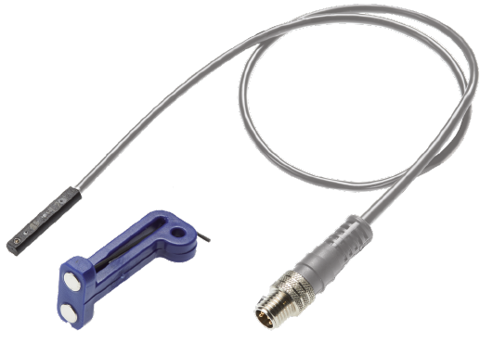
MMS-A
#1: The first and smallest, teachable analog sensor for the C-slot
New Product
Sucessor product
New Sizes
Unique selling points:
Analog miniature magnetic sensor for the C-slot
Easy to teach and optimally tailored to SCHUNK grippers for high accuracy
Identical design to MMS-PI1/2
Compatibility with SCHUNK modules and force/torque sensor system controller FPS-F5
Further product features:
Continuous output signal over the entire gripper stroke
Electronics already integrated
2 LEDs for the teaching process and status display
IP 67 protection class
Output voltage between 0-10 V DC
Miniature magnetic sensor with two Hall elements
Cable outlet with M8 connection plug or open wire strand

Slide 3
MMS-A
#1: The first and smallest, teachable analog sensor for the C-slot
New Product
Sucessor product
New Sizes
Cost Effectiveness/ Customer Benefits :
Instead of multiple switches, a sensor with analog signal for the exact detection of several different sized components
Different magnetic fields can be quickly and easily linearized due to the integrated algorithm
The compact design allows installation of the sensor without additional interfering contour
Integrated electronics remove the need for additional components
Compatibility with FPS for detection of 5 states, such as on, off, and 3 different-sized components
Direct feedback on the status of the sensor during operation and the teaching process by means of LED
Sturdy housing for industrial application
Sensor with cable outlet for maximum flexibility when integrating into the system

Slide 4
MMS-A
#1: The first and smallest, teachable analog sensor for the C-slot
New Product
Sucessor product
New Sizes
Basic technical data:
Dimensions: d= 4 mm, l=22 mm
Stroke measuring area: max 40 mm
Resolution: < 0.05 mm
Operating voltage: 10 … 30 V
Output voltage: 0-5V, 0-10V
Cable length: 30, 200 cm
Number of wires: 4
Protection class: IP67
Variants: with connection plug, open wire strands
Complementary products:
Initially MPG-plus and PGN-plus, later all actuators that could previously also be used with MMS-P 22

Slide 5




Jens Lehmann, a German goalkeeper legend,
brand ambassador for SCHUNK since 2012
www.schunk.com

