Slide 1


Short presentation
PR2 / PDU2 / PSM2
Superior Clamping and Gripping

Slide 2
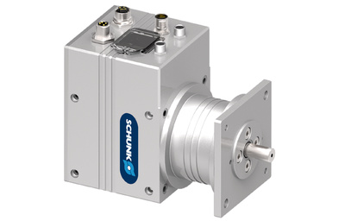
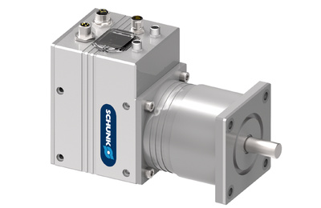
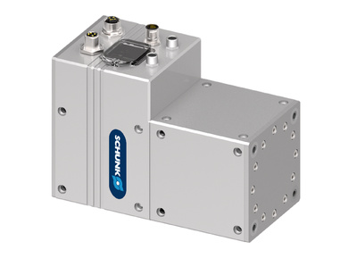
PR 2/ PDU 2 / PSM 2
#1: Modular electric rotary module/ drive with integrated electronics
New Product
Sucessor product
New Sizes
Unique selling points:
Unique concept: Modular robotics (rotary units, grippers)
High compact performance
Harmonic Drive gear with three gear reduction stages
per module size (PR2/PDU2)
Further product features:
Parameterization and setup software MTS
Standard connection elements and universal control concept
Fieldbus: Profibus or CAN-Bus, 2 digital inputs
Service interface: USB host, USB device
Status indication via 4 LEDs
Brushless DC servo motor
Complete electronic system is integrated → adjustability of position, speed, and torque
Incremental encoder
Integrated holding brake

Slide 3
PR 2/ PDU 2 / PSM 2
#1: Modular electric rotary module/ drive with integrated electronics
New Product
Sucessor product
New Sizes
Cost Effectiveness/ Customer Benefits :
Standard components for the implementation of any application
Comfortable firmware updates via USB stick
High torques for heavy payloads
Due to the integration of the control and power electronics, no additional, external
controllers and cabling
Industrial plug-in technology for a user-friendly assembly
Testing and commissioning functions via DIP switch without a programmer possible
Clear status display and error analysis via LEDs

Slide 4
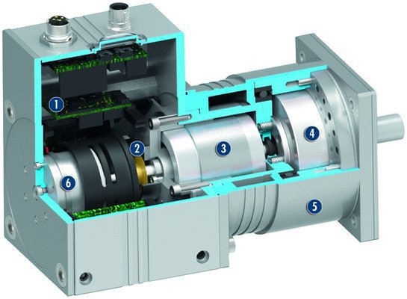
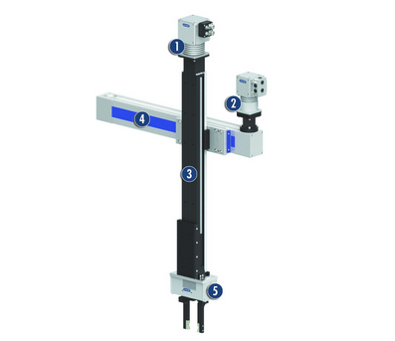
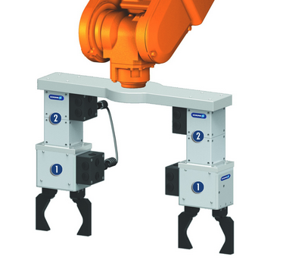
PR 2/ PDU 2 / PSM 2
#1: Modular electric rotary module/ drive with integrated electronics
New Product
Sucessor product
New Sizes
  Basic technical data e.g. PR 2:
Sizes: 70/ 90/ 110
Peak torque: 16 - 184 Nm
Angular velocity: 150 – 468 °/s
Max. admissible mass
moment of inertia: 0,14 - 9,5 kgm²
Repeat accuracy: 0,03- 0,08 °
Dead weight: 2,0- 5,9 kg
Protection class: IP40
Operating voltage: 24 V DC
  =>Mechanism identical to previous models
PSM2(1)/PDU2 (2):
PR2(2) with PG (1):
Complementary products:
Standard connection element PAM
Servo electric 2-finger gripper PG

Slide 5




Jens Lehmann, a German goalkeeper legend,
brand ambassador for SCHUNK since 2012
www.schunk.com

