Slide 1


Short presentation
RVK
Superior Clamping and Gripping

Slide 2
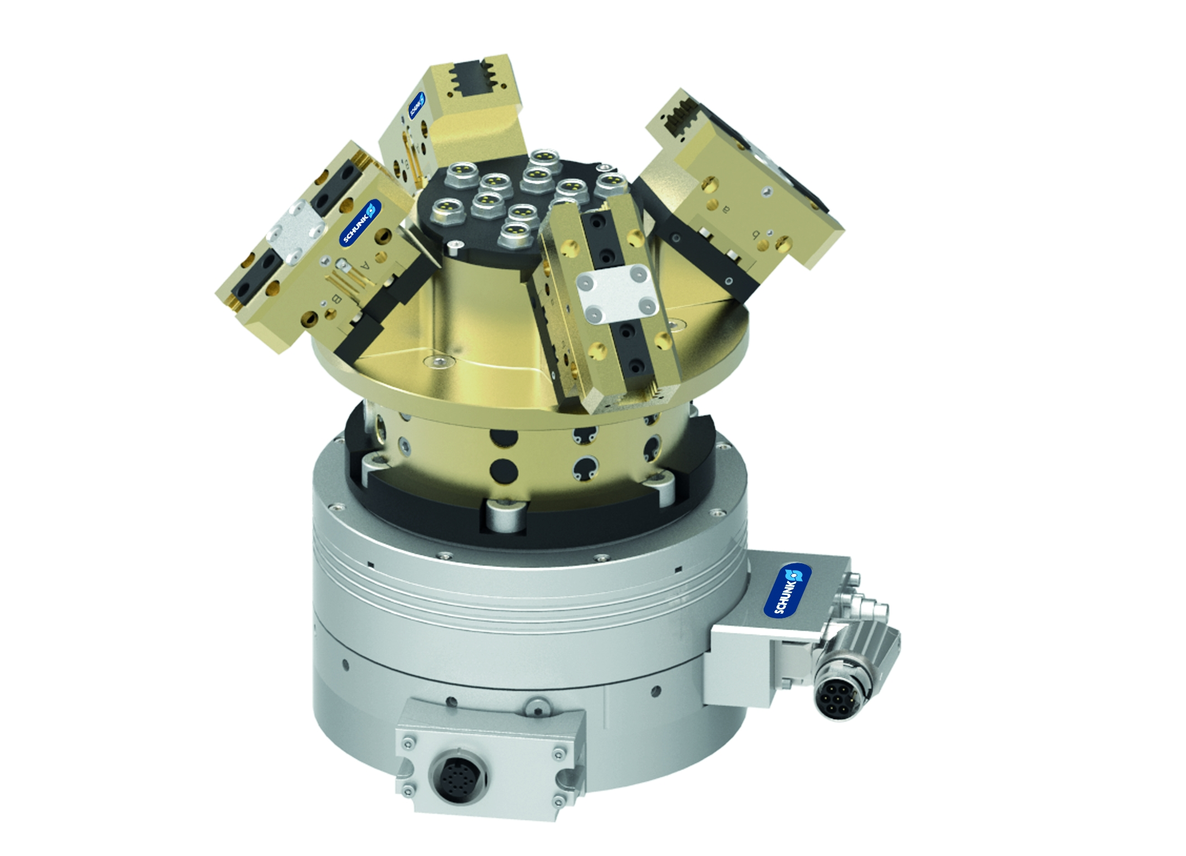
RVK
#1: The Revolving Unit reduces travel distances and minimizes cycle times by utilizing the Collect & Place principle
New Product
Sucessor product
New Sizes
Unique selling points:
“Collect & Place” applications are easily achieved
Can be fitted to the ERS 135, ERS 170 or RST-D 087 as a
standard
Can be optionally fitted onto a robot or rotary unit which
has a center bore
Two versions available for either 4 or 6 grippers
Pneumatic and electric feed-through
The gripper which is in the working position can be
operated independently from the other grippers
The grippers which are not in the working position remain
in the gripped state
All of the grippers can always be monitored via sensors
In an E-stop situation it’s easy to remove all of the
workpieces from all of the grippers via an additional air
connection
Further product features:
In applications where
space is an issue, it may
be possible to replace a
quick change gripper
system with an RVK

Slide 3
RVK
#1: The Revolving Unit reduces travel distances and minimizes cycle times by utilizing the Collect & Place principle
New Product
Sucessor product
New Sizes
Cost Effectiveness/ Customer Benefits :
Pick & Place systems have a higher productivity thanks to the Collect & Place
principle
Compact machine and system design is possible due the compact design of the
RVK
Integrated valve technology for operating the grippers leads to fewer valves
required for the complete machine
Integrated pneumatic and electric feed-throughs to operate the grippers and
for the sensors to monitor the state of the grippers

Slide 4
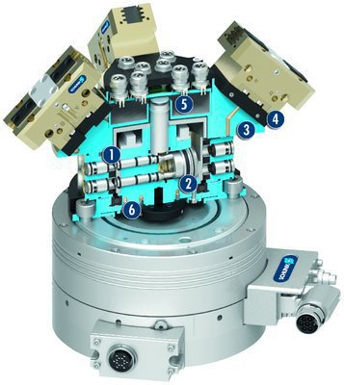
RVK
#1: The Revolving Unit reduces travel distances and minimizes cycle times by utilizing the Collect & Place principle
New Product
Sucessor product
New Sizes
  Basic technical data:
Size: 100
Mass: 1,9… 2,0 kg; without RST-D, ERS or grippers
Actuation time: 0,1 s
Operating pressure: 4 …8 bar
Max. Rotations per Minute: 240 [1/min]
Number of electric feed-throughs: 14
Active gripper position
Actuation Piston
Passive gripper position
Flexible gripper adaption
Electrical feed-through
Robust bearing

Slide 5




Jens Lehmann, a German goalkeeper legend,
brand ambassador for SCHUNK since 2012
www.schunk.com

