Slide 1

Product presentation
SDV-P
Accessories

Slide 2
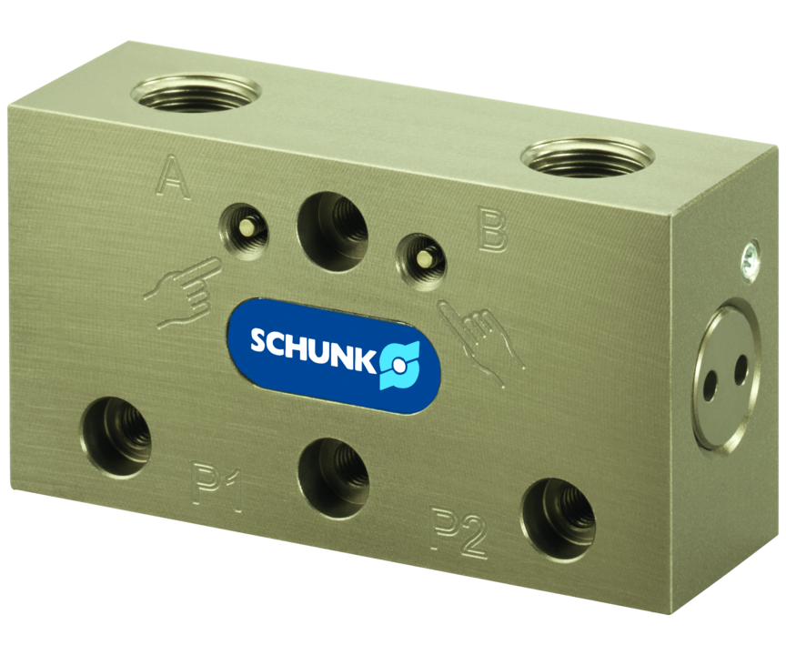
Accessories
In case of pressure failure, venting of the module will be prevented by the pressure maintenance valve. Therefore a temporary force or position maintenance can be implemented via different actuators. This is particularly suitable for grippers which cannot be equipped with a mechanical gripping force maintenance.
10 ms switching time

Slide 3

Reliable. Compact. Safe.

Slide 4
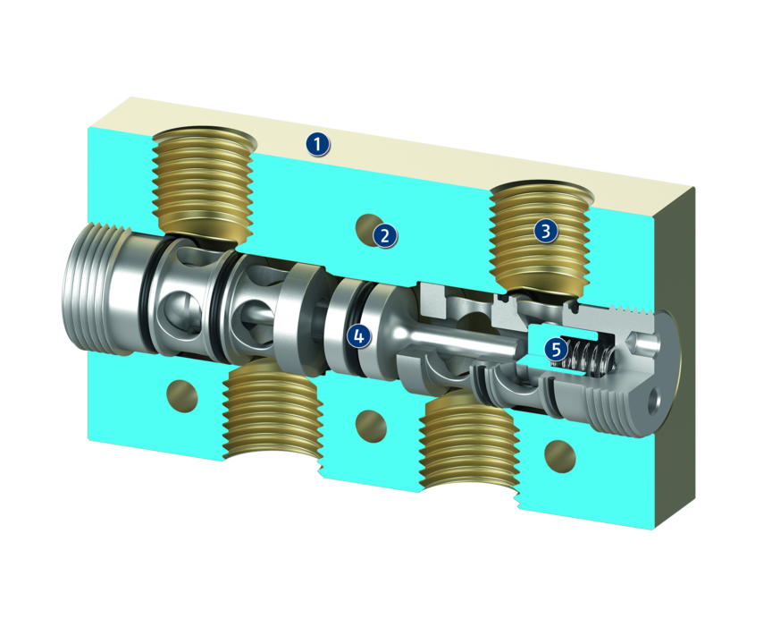
Principle of function
Functional description
Two check valves are parallely switches, and automatically open and ventilate the return flow direction on alternating sides. In the event of a pressure failure, the supply lines close the return flow valves and prevent a loss in pressure.
1
Housing
2
Mounting option
3
Thread for pneumatic connection
4
Piston
5
check valve

Slide 5
Advantages – Your benefits
Prevention of pressure drop in the pneumatic actuator in the case of pressure failure of the entire system for greater operational safety when pneumatic components are used
well-proven in industrial automation
Robust design for long term reliable applications
Universally applicable can be combined with almost any pneumatic actuator
Variant with manual venting for greater operating comfort
Variant for direct mounting on parallel grippers as a result, space-saving and no additional fastening is necessary

Slide 6
Technical data
Technical data overview
Size | Manual quick ventilation | Rate of flow | Flow rate, hose Ø 6mm | Flow rate, hose Ø 8mm | Flow rate, hose Ø 10mm | Valve switching time | Weight
 |  | [l/min] | [l/min] | [l/min] | [l/min] | [ms] | [kg]
4 | 0 .. 1 |  | 200 | 250 | 340 | 15 | 0.1
7 | 0 .. 1 |  | 350 | 500 | 600 | 10 | 0.2
10 | 1 |  | 400 | 1000 | 1400 | 10 | 0.4
64 | 1 | 150 |  |  |  | 10 | 0.12
80 | 1 | 150 |  |  |  | 20 | 0.16
100 | 1 | 180 |  |  |  | 20 | 0.23
125 | 1 | 200 |  |  |  | 30 | 0.33

Slide 7
Jens Lehmann, German goalkeeper legend, SCHUNK brand ambassador since 2012 for safe, precise gripping and holding.
schunk.com/Lehmann

