Slide 1

Product presentation
SRM
Universal swivel unit

Slide 2
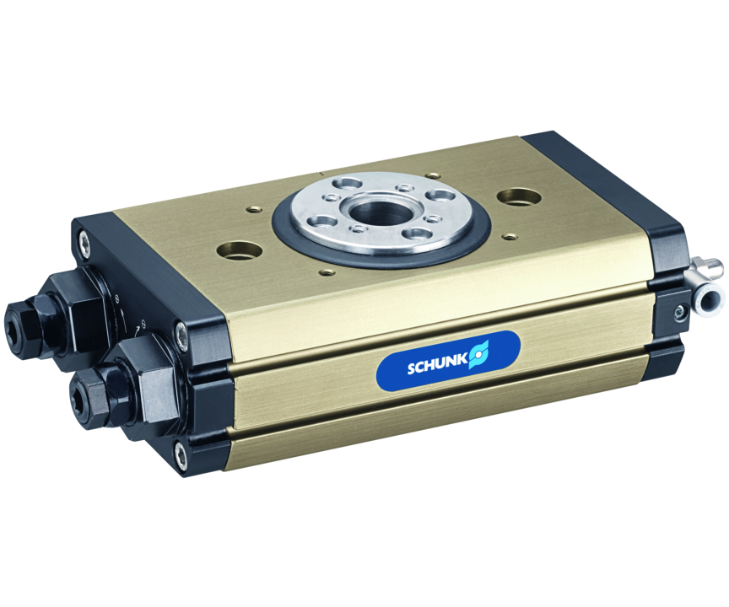
Universal swivel unit
Universally usable unit for pneumatic swivel and turning movements
The most robust swivel module with the highest power density on the market
25% higher torque

Slide 3

Robust. Fast. High Performance.
Largest center bore also in version with media feed-through
Pre-adjusted shock absorber stroke
Density, play-free pre-loaded bearing
Modular design and can be combined in any way with options
Equipped with FKM seals as standard

Slide 4
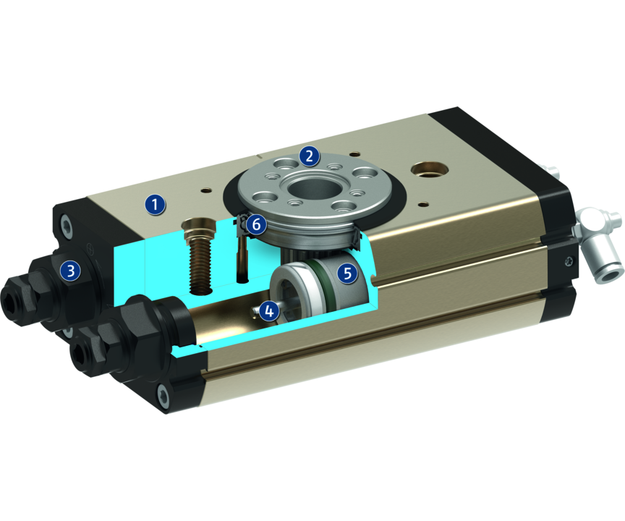
Principle of function
Functional description
When subjected to pressure, the two pneumatic pistons move their end faces in a straight line in their respective bores thus turning the pinion by means of the serrations on their sides.
1
Housing
2
Pinion
3
Swivel angle adjustment
4
Damping
5
Drive
6
Bearing

Slide 5
Advantages – Your benefits
Finely graded series with a steady increase in torque for multiple cases of application, the correct size as a standard product is available
Large center bore for feed-through of cables and hoses with the same unit height
Pre-adjusted shock absorber stroke for fast and easy commissioning
Swivel angle can be selected as either 90° or 180° complete flexibility in selecting the angle of rotation, application-specific angles possible on request
Selectable end position adjustability either small or large for flexible adjustability of the swivel angle
Optionally attachable fluid feed-through and electrical feed-through for permanently safe feed-through of gases, vacuum, and electrical sensor and actuator signals
Modular attachment to various options for individual adjustment to various cases of application
Choice of electronic magnetic sensors or inductive proximity sensors for absolute variability of position monitoring

Slide 6
Technical data
Technical data overview
Size | Torque | Swivel angle | Mass moment of inertia | Weight
 | [Nm] | [°] | [kgm²] | [kg]
10 | 0.45 .. 0.5 | 90 .. 180 | 0.0008 .. 0.0014 | 0.252 .. 0.37
12 | 0.75 .. 0.8 | 90 .. 180 | 0.0025 .. 0.0072 | 0.392 .. 0.49
14 | 1 .. 1.15 | 90 .. 180 | 0.005 .. 0.014 | 0.41 .. 0.72
16 | 1 .. 1.47 | 90 .. 180 | 0.08 | 0.62 .. 1.25
20 | 2.1 .. 3.6 | 90 .. 180 | 0.054 .. 0.16 | 1.15 .. 2.93
25 | 4 .. 5.95 | 90 .. 180 | 0.16 .. 0.5 | 1.71 .. 4.23
32 | 8 .. 12 | 90 .. 180 | 1.5 | 3.16 .. 5.71
40 | 20.7 .. 23.7 | 90 .. 180 | 7 | 5.93 .. 9.74

