Slide 1


Short presentation
VEH/APDA
Superior Clamping and Gripping

Slide 2
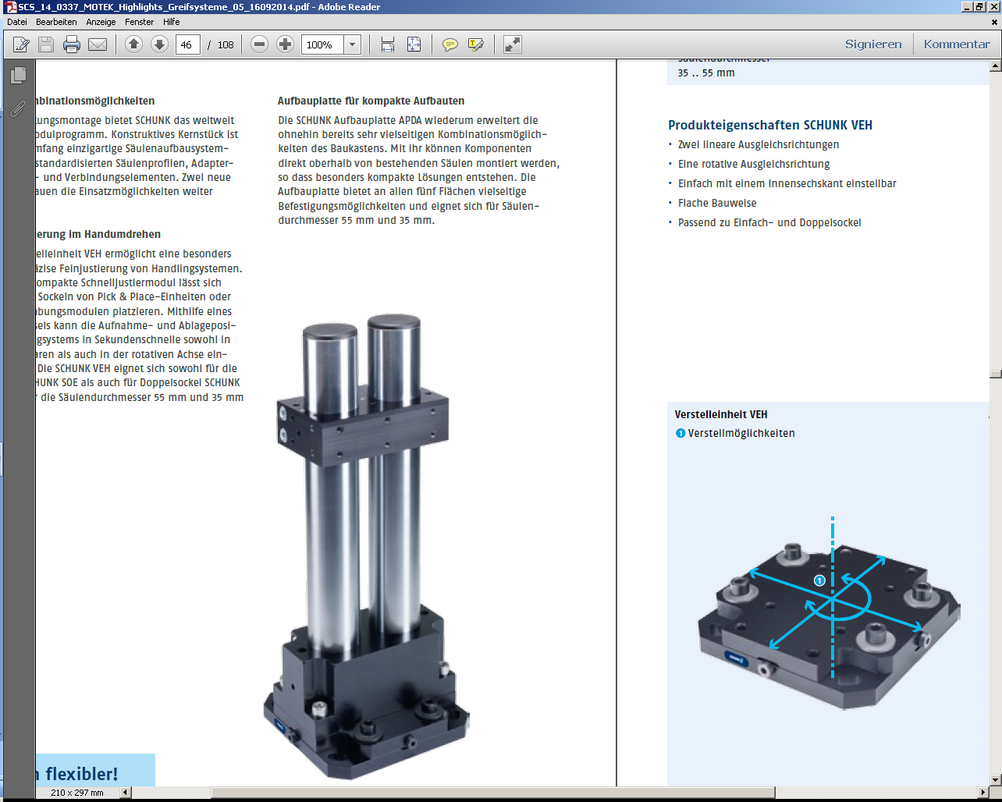
VEH/APDA
#1: New modules for the pillar assembly system for more flexibility and easy adjustment of the handling units
New Product
Sucessor product
New Sizes
Unique selling points:
Easy adjustment of pick and place
positions used in handling systems
Further product features:
Ground and hard-chrome plated steel columns
Precise shape and positional tolerances
Assembly- and centering bores
One module for all directions
VEH – adjustment unit
Two linear compensation directions
One rotating compensation direction
Can be adjusted simply using one hexagon socket wrench
Low-profile design
Suitable for single and double bases
APDA mounting plate axial
Further clamping element for the compact structure of complete
handling systems
Further structure can now be attached directly above the pillars
APDA
VEH

Slide 3
VEH/APDA
#1: New modules for the pillar assembly system for more flexibility and easy adjustment of the handling units
New Product
Sucessor product
New Sizes
Cost Effectiveness / Customer Benefits:
Flexible pillar assembly system for rapid construction of frames, e.g. for handling modules
Simple and modular, thus having less design time and effort (as opposed to welded frames)
Ground and hard-chrome plated steel pillars
for a high degree of rigidity and low-vibration
Precise shape and positional tolerances
for high accuracy even with long pillars
Several pillar diameters
for minimum interfering contours in the entire system
Many clamping elements
standardized, with a large variety of combinations possible
Assembly and centering bore holes
Reproducible, precisely angled assembly of the elements

Slide 4
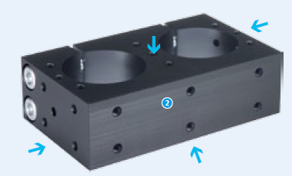
VEH/APDA
#1: New modules for the pillar assembly system for more flexibility and easy adjustment of the handling units
New Product
Sucessor product
New Sizes
Basic technical data VEH:
Pillar Ø: 35 mm and 55 mm
Compatible modules: SOE (single base) and
SOD (double base)
Compensation directions: 2 x linear, 1 x rotating
Basic technical data APDA:
Pillar Ø: 35 mm and 55 mm
Compatible modules: SLH (pillar),
Attention linear modules from the portfolio do not fit directly here
Five attachment surfaces

Slide 5




Jens Lehmann, a German goalkeeper legend,
brand ambassador for SCHUNK since 2012
www.schunk.com

