Slide 1


Short presentation
WSG 25
Superior Clamping and Gripping

Slide 2
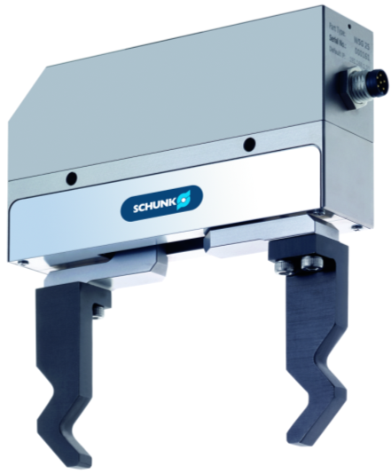
New Product
Successor product
New Sizes
WSG 25
#1: The smallest intelligent gripper with ethernet TCP/IP
Unique Selling Points:
Controls via Ethernet TCP/IP
Integrated webserver for configuring and diagnosis
Very delicate gripping
Extremely compact
Further Product Features:
Integrated control electronics
Standard, industrial connector
Remote maintenance
(i.e. Firmware update via the internalet)
Expandable functionality through a scripting interface
Planned as of 07/2014

Slide 3
New Product
Successor product
New Sizes
WSG 25
#1: The smallest intelligent gripper with ethernet TCP/IP
Cost Effectiveness / Customer Benefits :
Short cycle times due to high speeds and integrated workpiece detection
Integrated webserver for configuring and diagnosing via a standard web browser and therefore very easy to program and commission without having to install software.
Ethernet TCP/IP interface offers easy flexibility and integration into the complete system
Intelligent gripper commands relieve customers from having to control the processes
Energy efficient

Slide 4
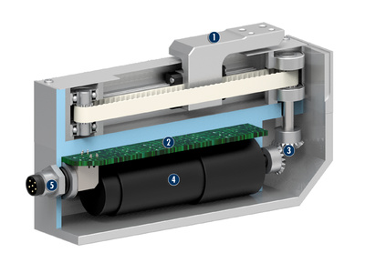
New Product
Successor product
New Sizes
WSG 25
#1: The smallest intelligent gripper with ethernet TCP/IP
Basic Technical Data:
Sizes: 25, 32, 50
Stroke per finger: 32 mm,34 mm, 55 mm, 105 mm
Gripping force: 5 N...20 N, 50N … 80 N
Work piece weight: 0.12 kg, 0.25 kg, 0.4 kg
Operating voltage: 24 V
Weight: 0.3kg, 0.55 kg, 1.2 kg, 1.6 kg
Repeatability : 0,013 mm
  Complementary Products:
  ERS
  ERD
  LDN, LDM, LDT, LDK, LDH, LDF
Base jaw
Control electronics
Transmission
BLDC Servomotor
M8 plug

Slide 5




Jens Lehmann, a German goalkeeper legend,
brand ambassador for SCHUNK since 2012
www.schunk.com

