Slide 1


Short presentation
EGN/ EZN Safety
Superior Clamping and Gripping

Slide 2
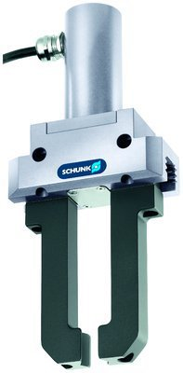
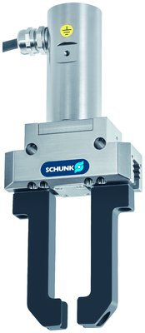
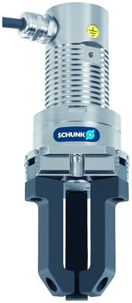
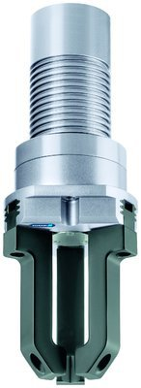
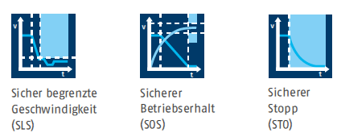
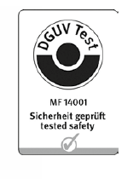
New Product
Sucessor product
New Sizes
EGN/ EZN Safety
#1: The first certified Safety Gripping Systems
Unique Selling Points:
Modular gripper concept
Certified functionalities SLS, SOS and STO
Performance Level d-SIL 3 in combination with SCHUNK controller ECM and a safety module
Brushless Servo Motor

Slide 3
New Product
Sucessor product
New Sizes
EGN/ EZN Safety
#1: The first certified Safety Gripping Systems
Cost Effectiveness/ Customer Benefits:
Certified according to EN ISO 13849
High gripping speed along with high force
Simple commissioning and parameterization via PC, USB stick, or rotary encoding switch
Safe holding of the workpiece even when the process is interrupted by an emergency shut-off
Immediate return to the regular operating mode avoids restarting of the system

Slide 4
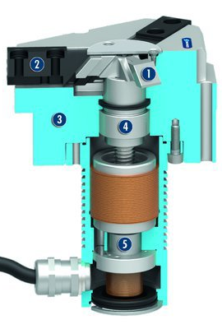
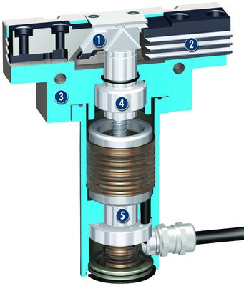
New Product
Sucessor product
New Sizes
EGN/ EZN Safety
#1: The first certified Safety Gripping Systems
Basic Technical Data:
Size: 80 .. 160
Mass: 0,84 kg .. 3,0 kg
Gripping force: 400 N .. 1000 N
Stroke per finger: 8 .. 16 mm
Workpiece weight: 2,1 .. 5,4 kg
  Complementary Products:
  Modular Assembly Automation System
  PPU-E
  OAS - Optical distance and presence sensor

Slide 5




Jens Lehmann, a German goalkeeper legend,
brand ambassador for SCHUNK since 2012
www.schunk.com

