Slide 1
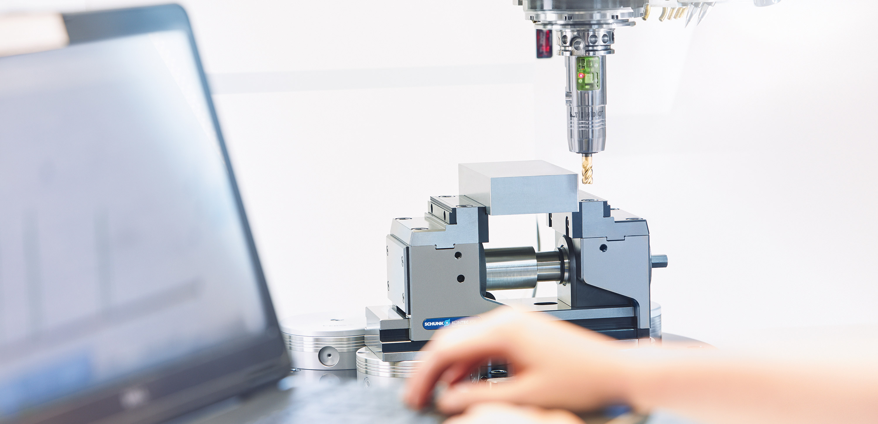
SCHUNK highlights clamping technology 2013
SCHUNK training for customers MB NAKLO, Slovenia, 03.- 04.04.2013  Dipl.-Ing. Uwe Weil

Slide 2
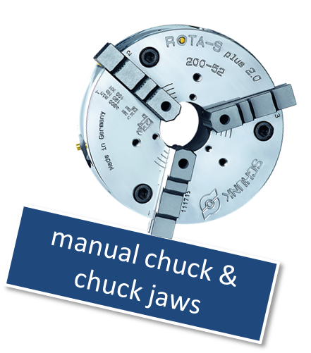
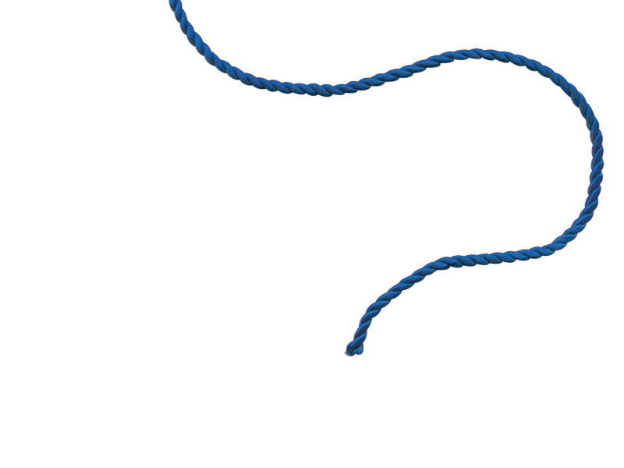
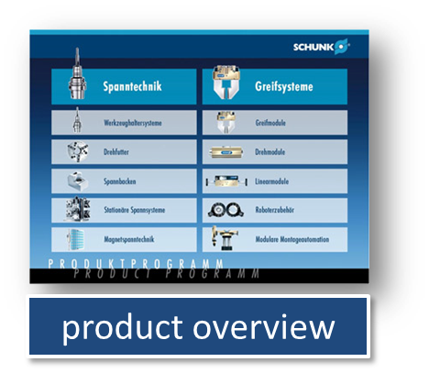

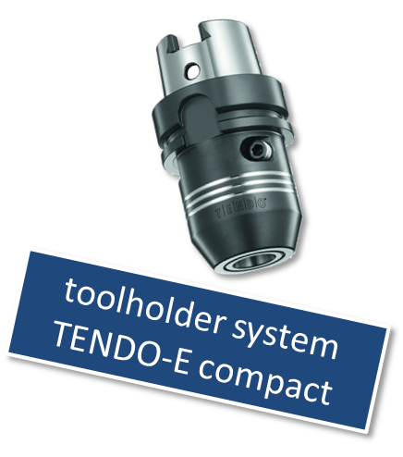
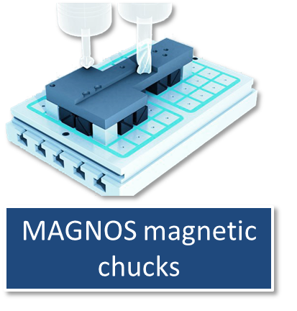
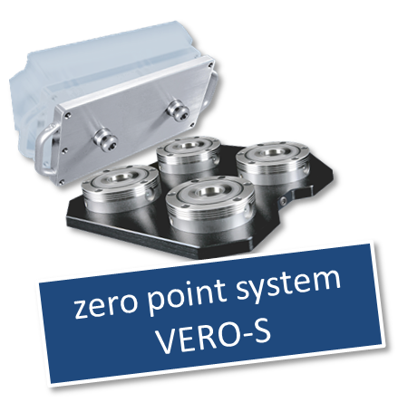
blue thread

Slide 3
blue thread

Slide 4
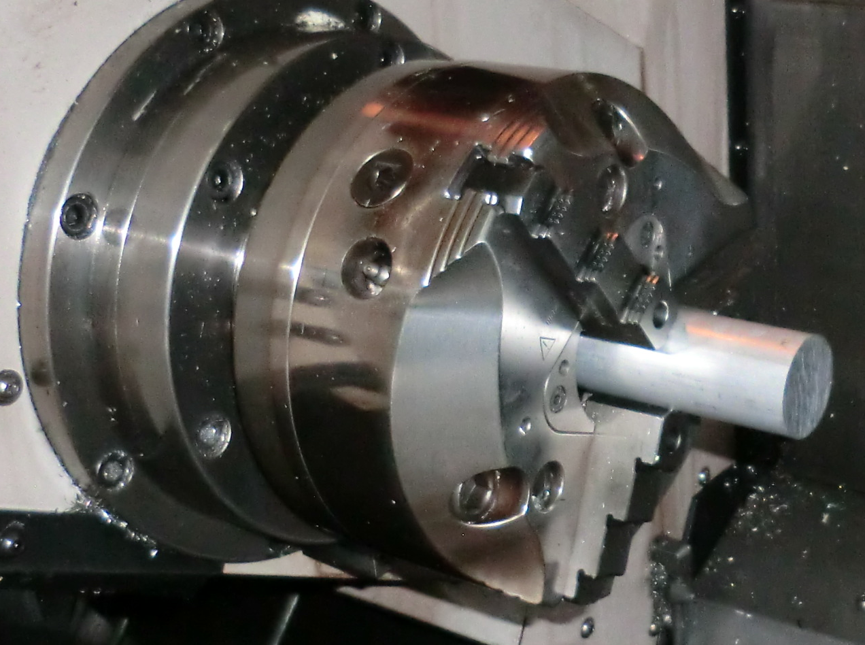
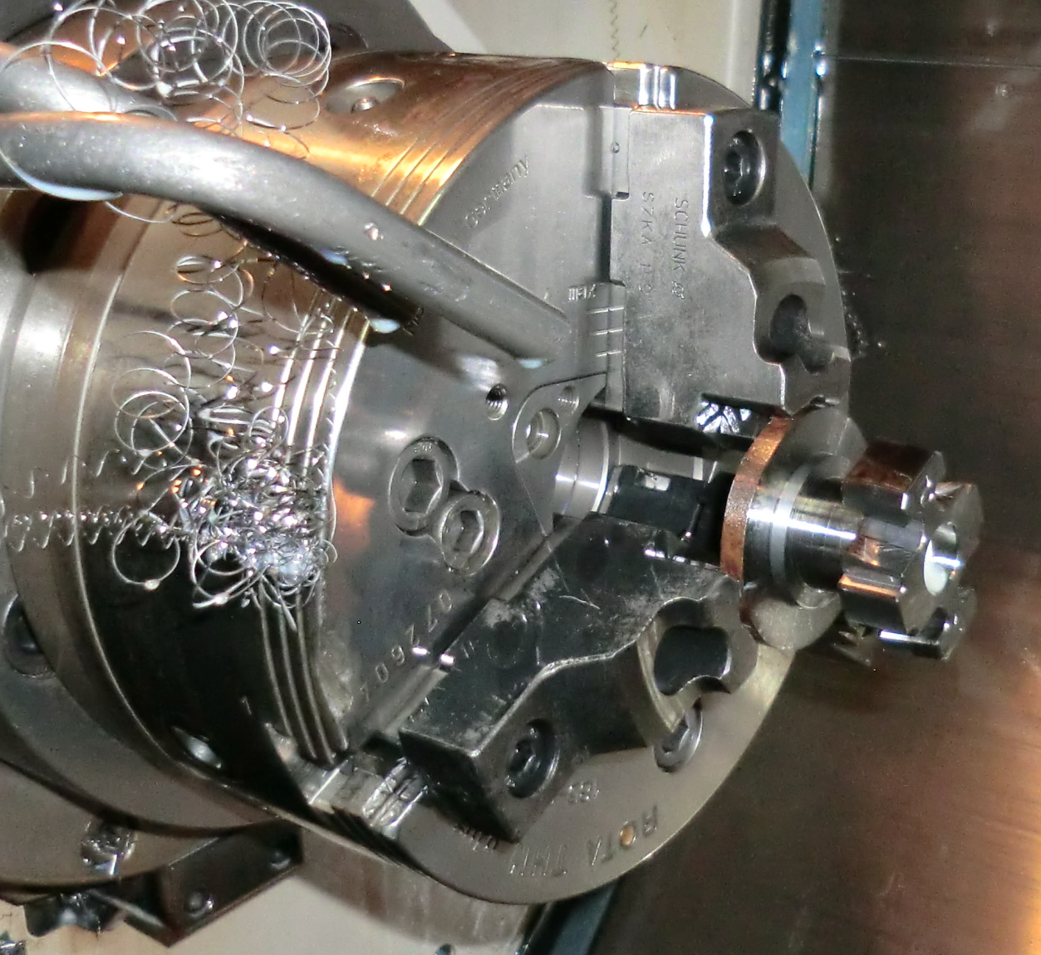
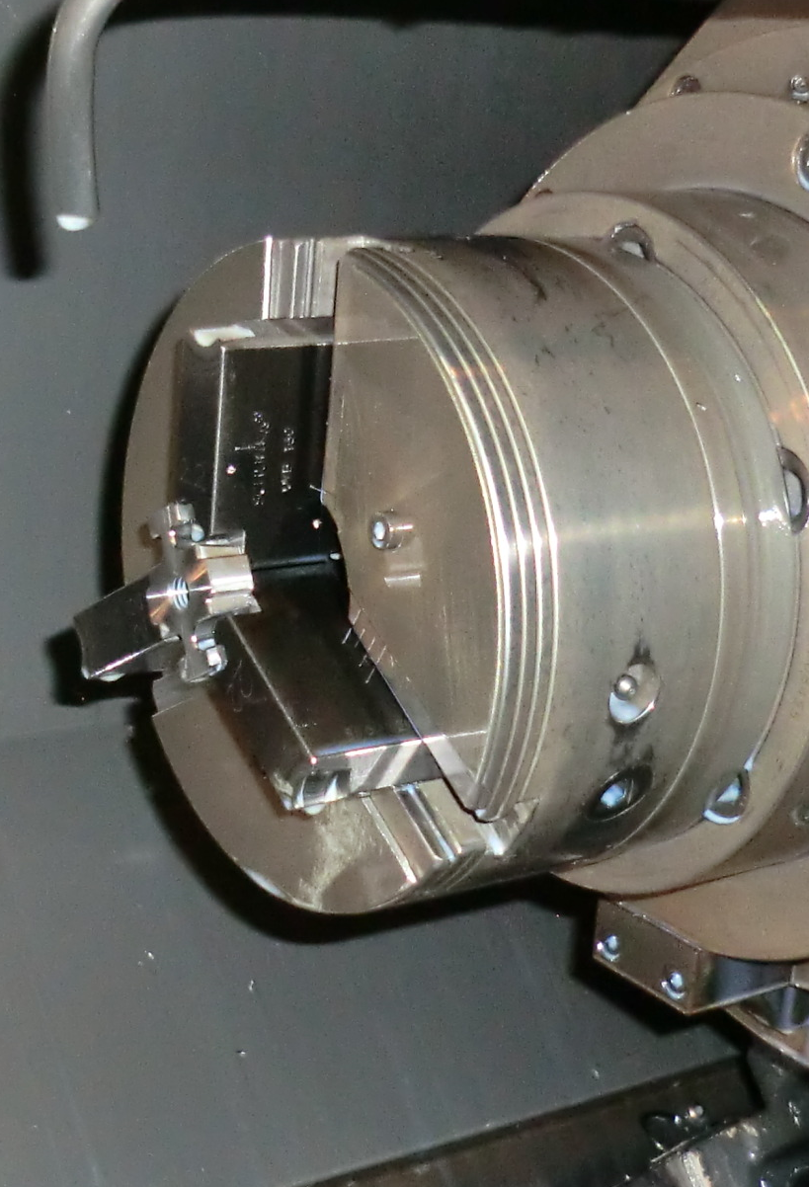
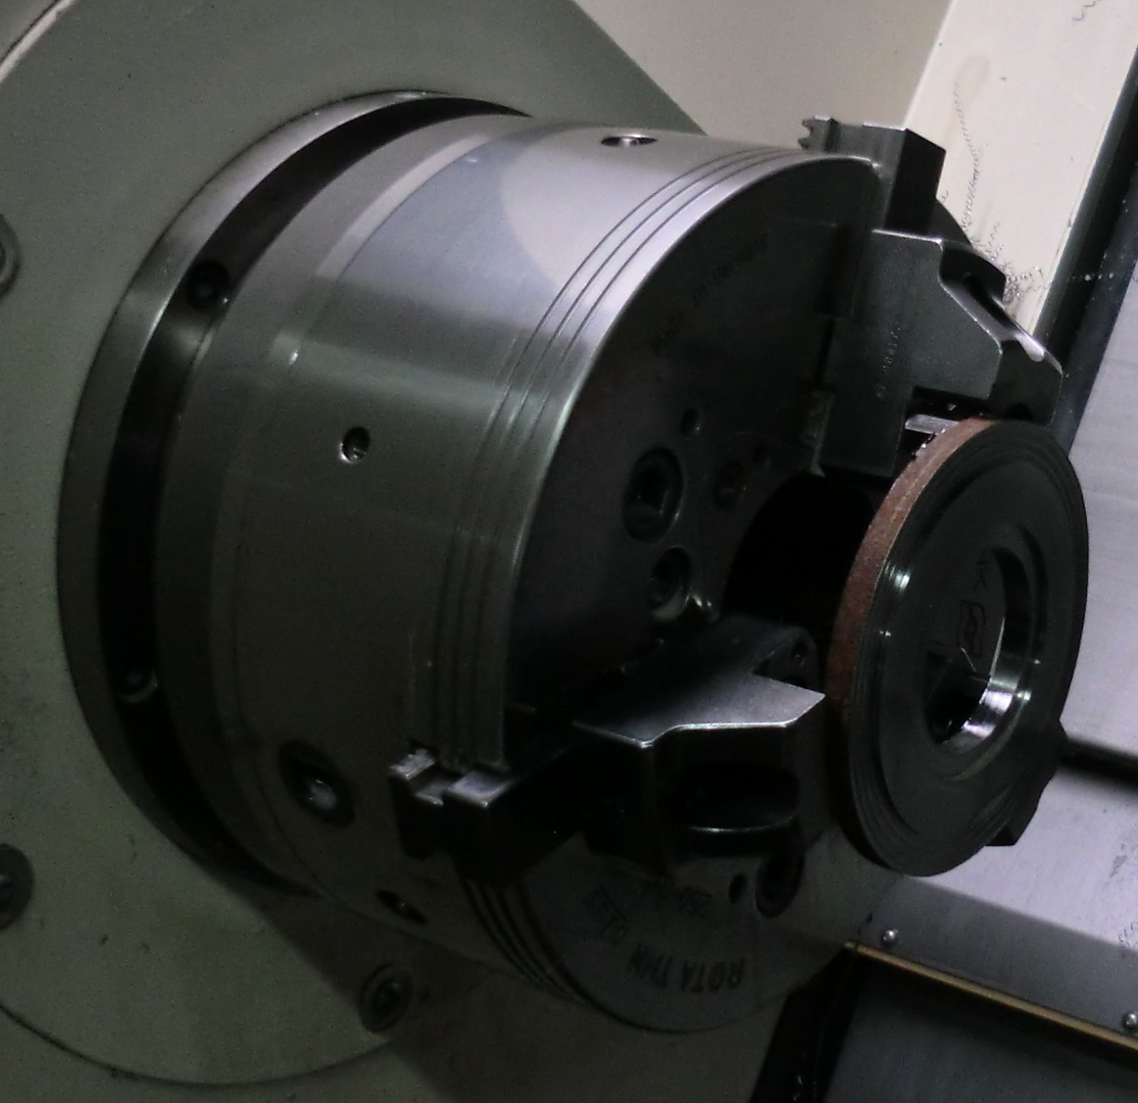
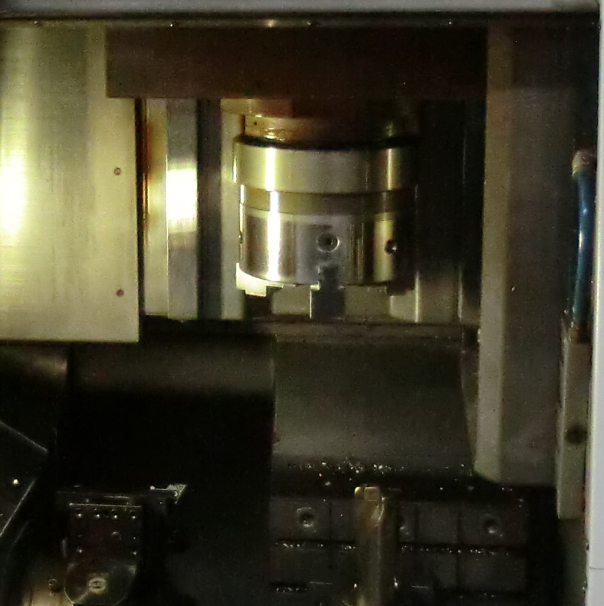
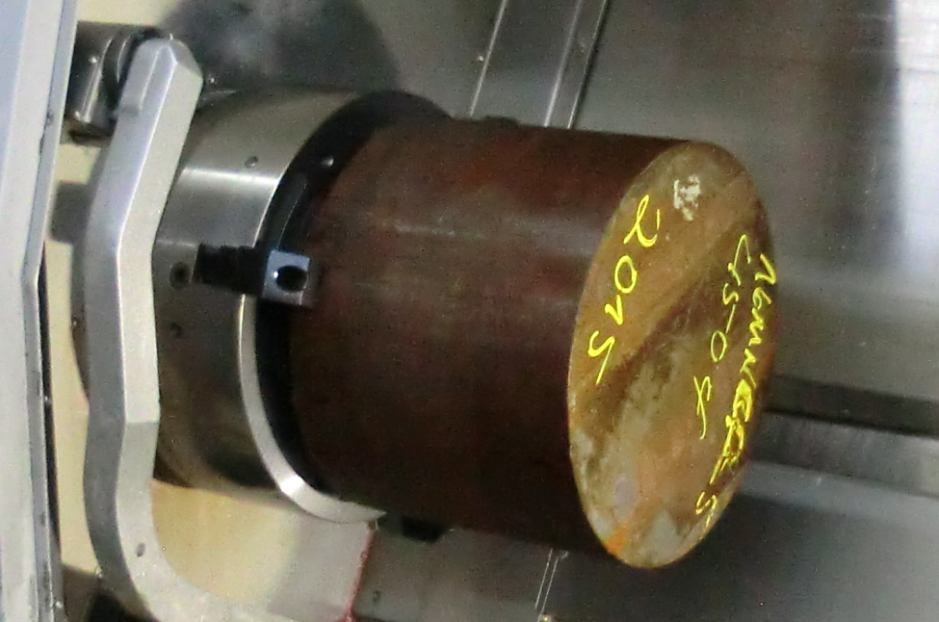
SCHUNK lathe chucks & chucks jaws…

Slide 5
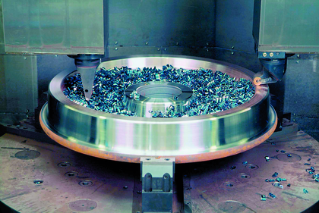
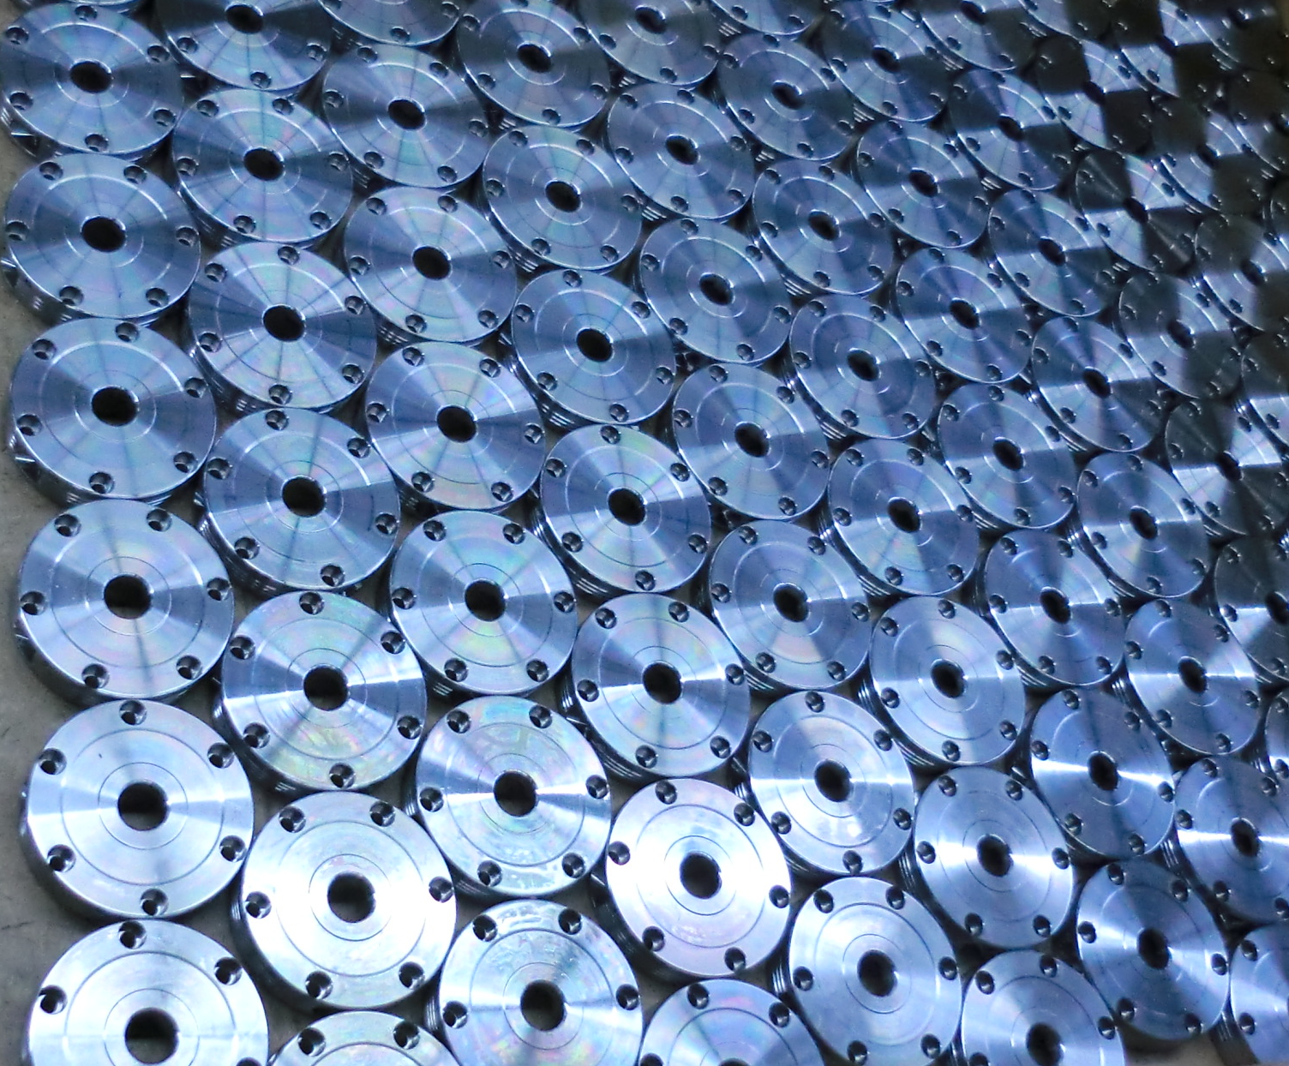
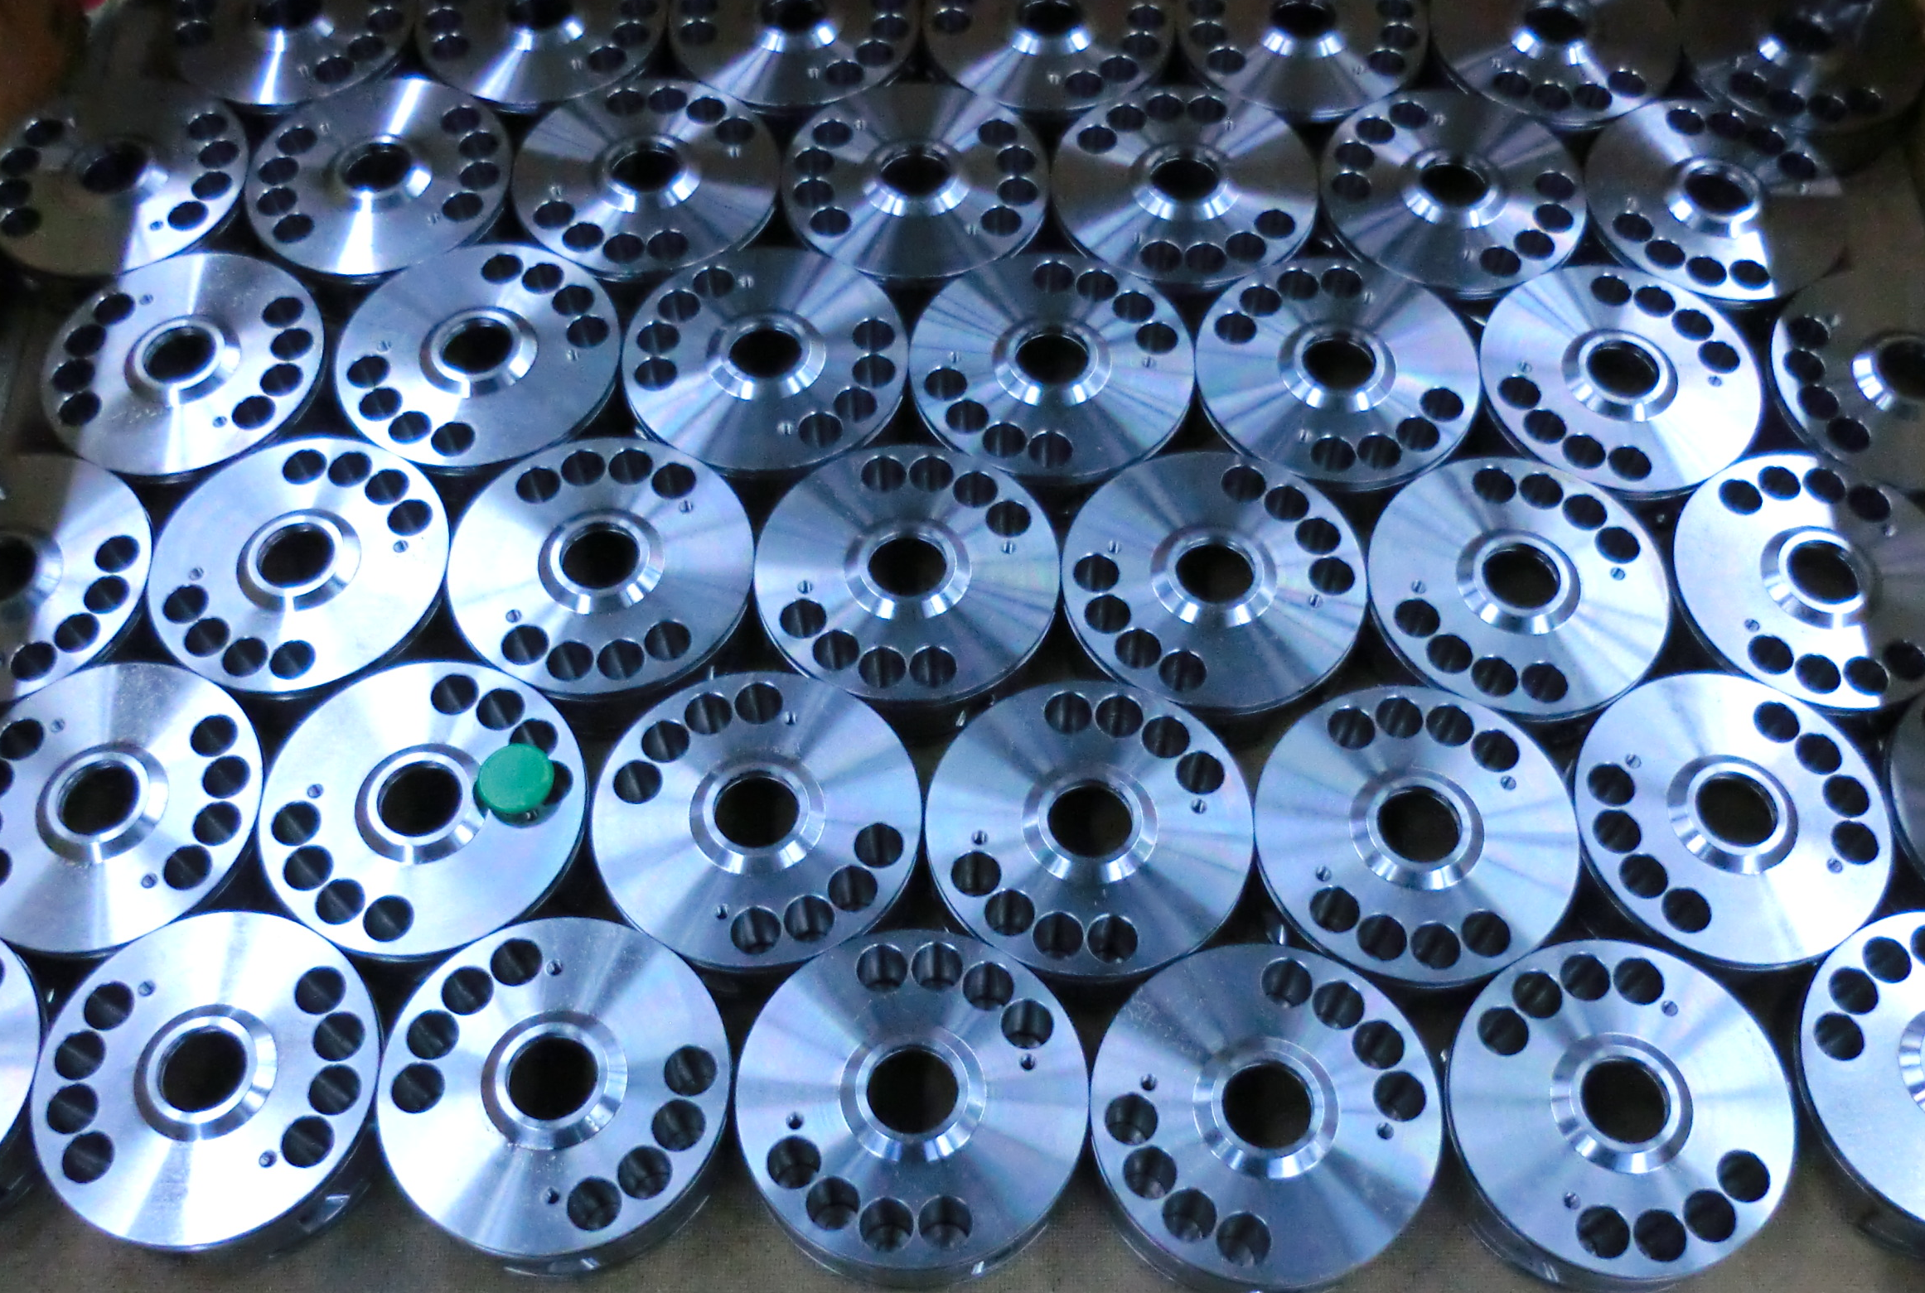
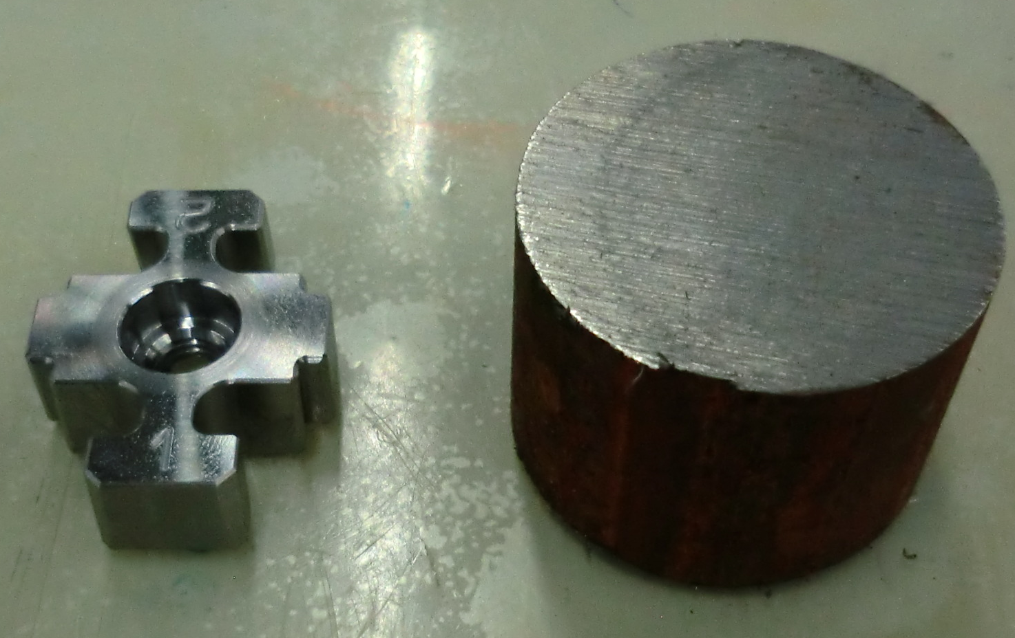
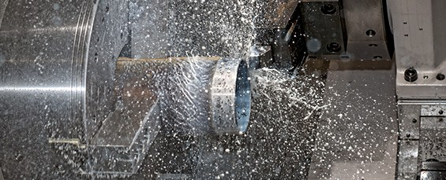
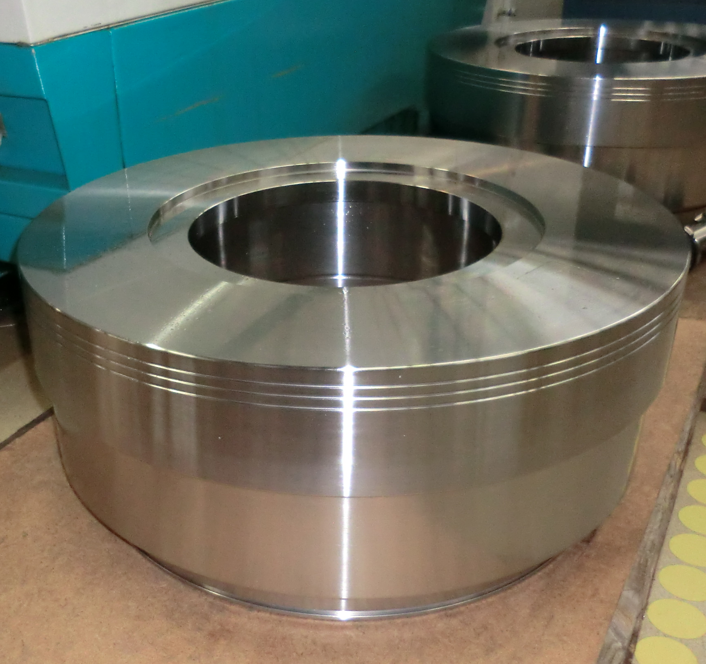
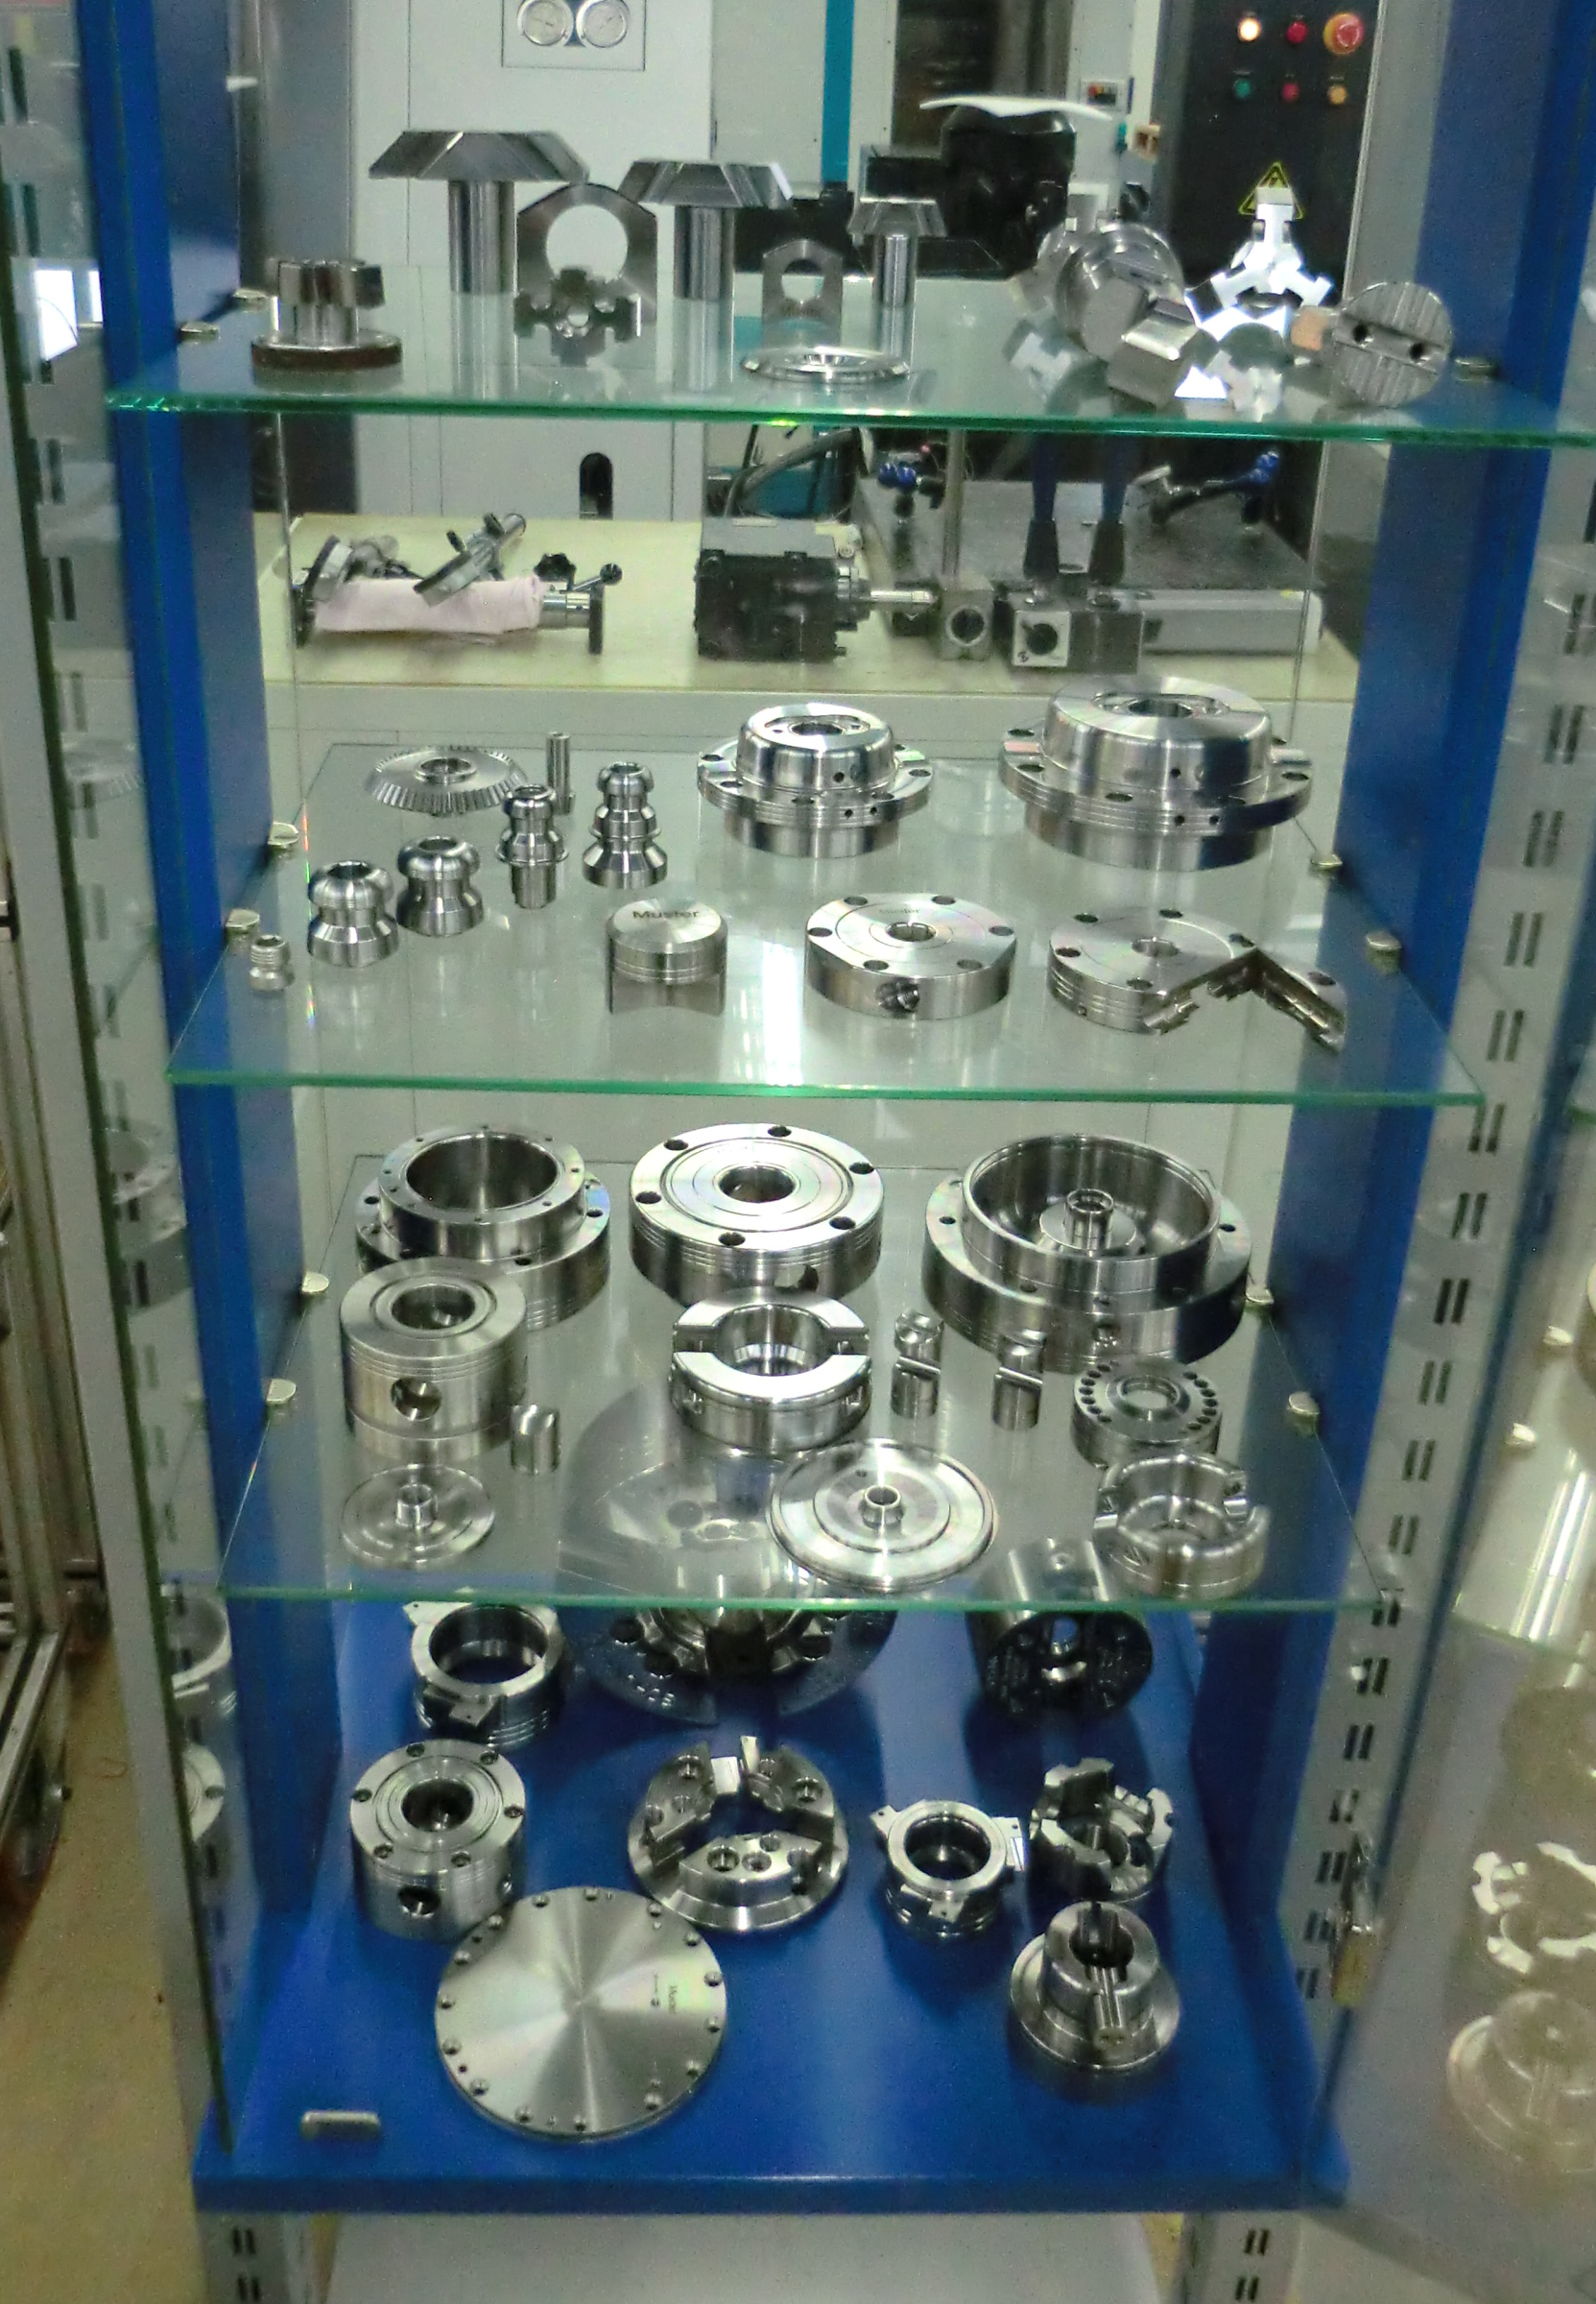
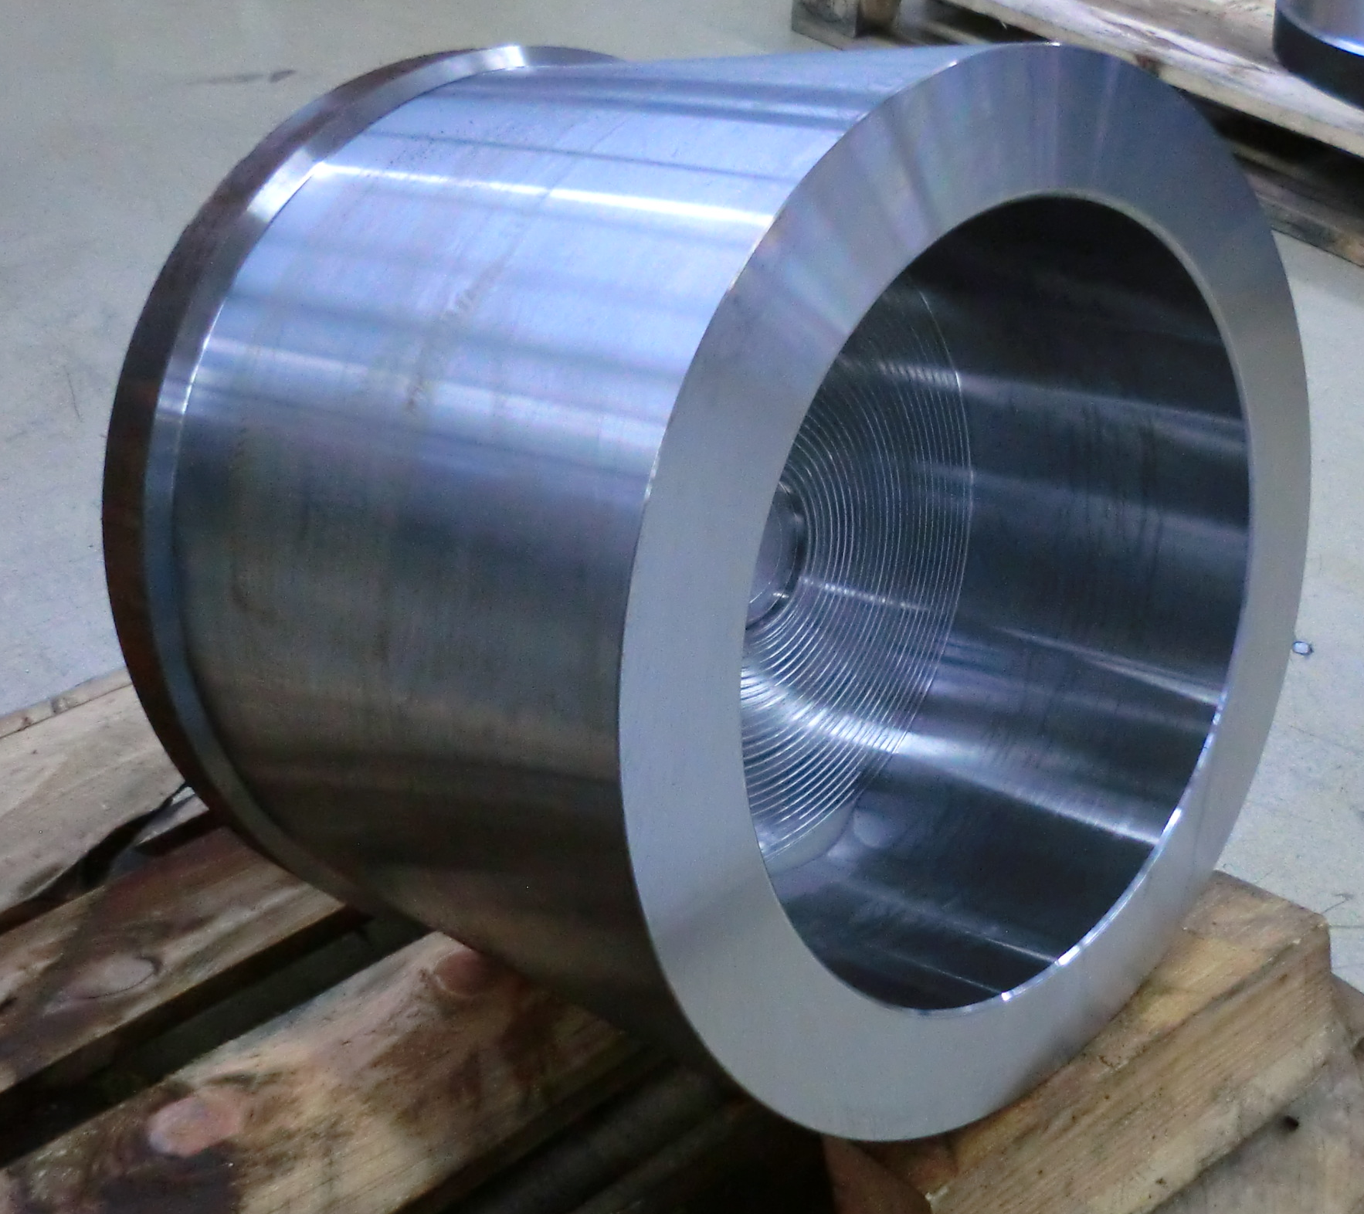
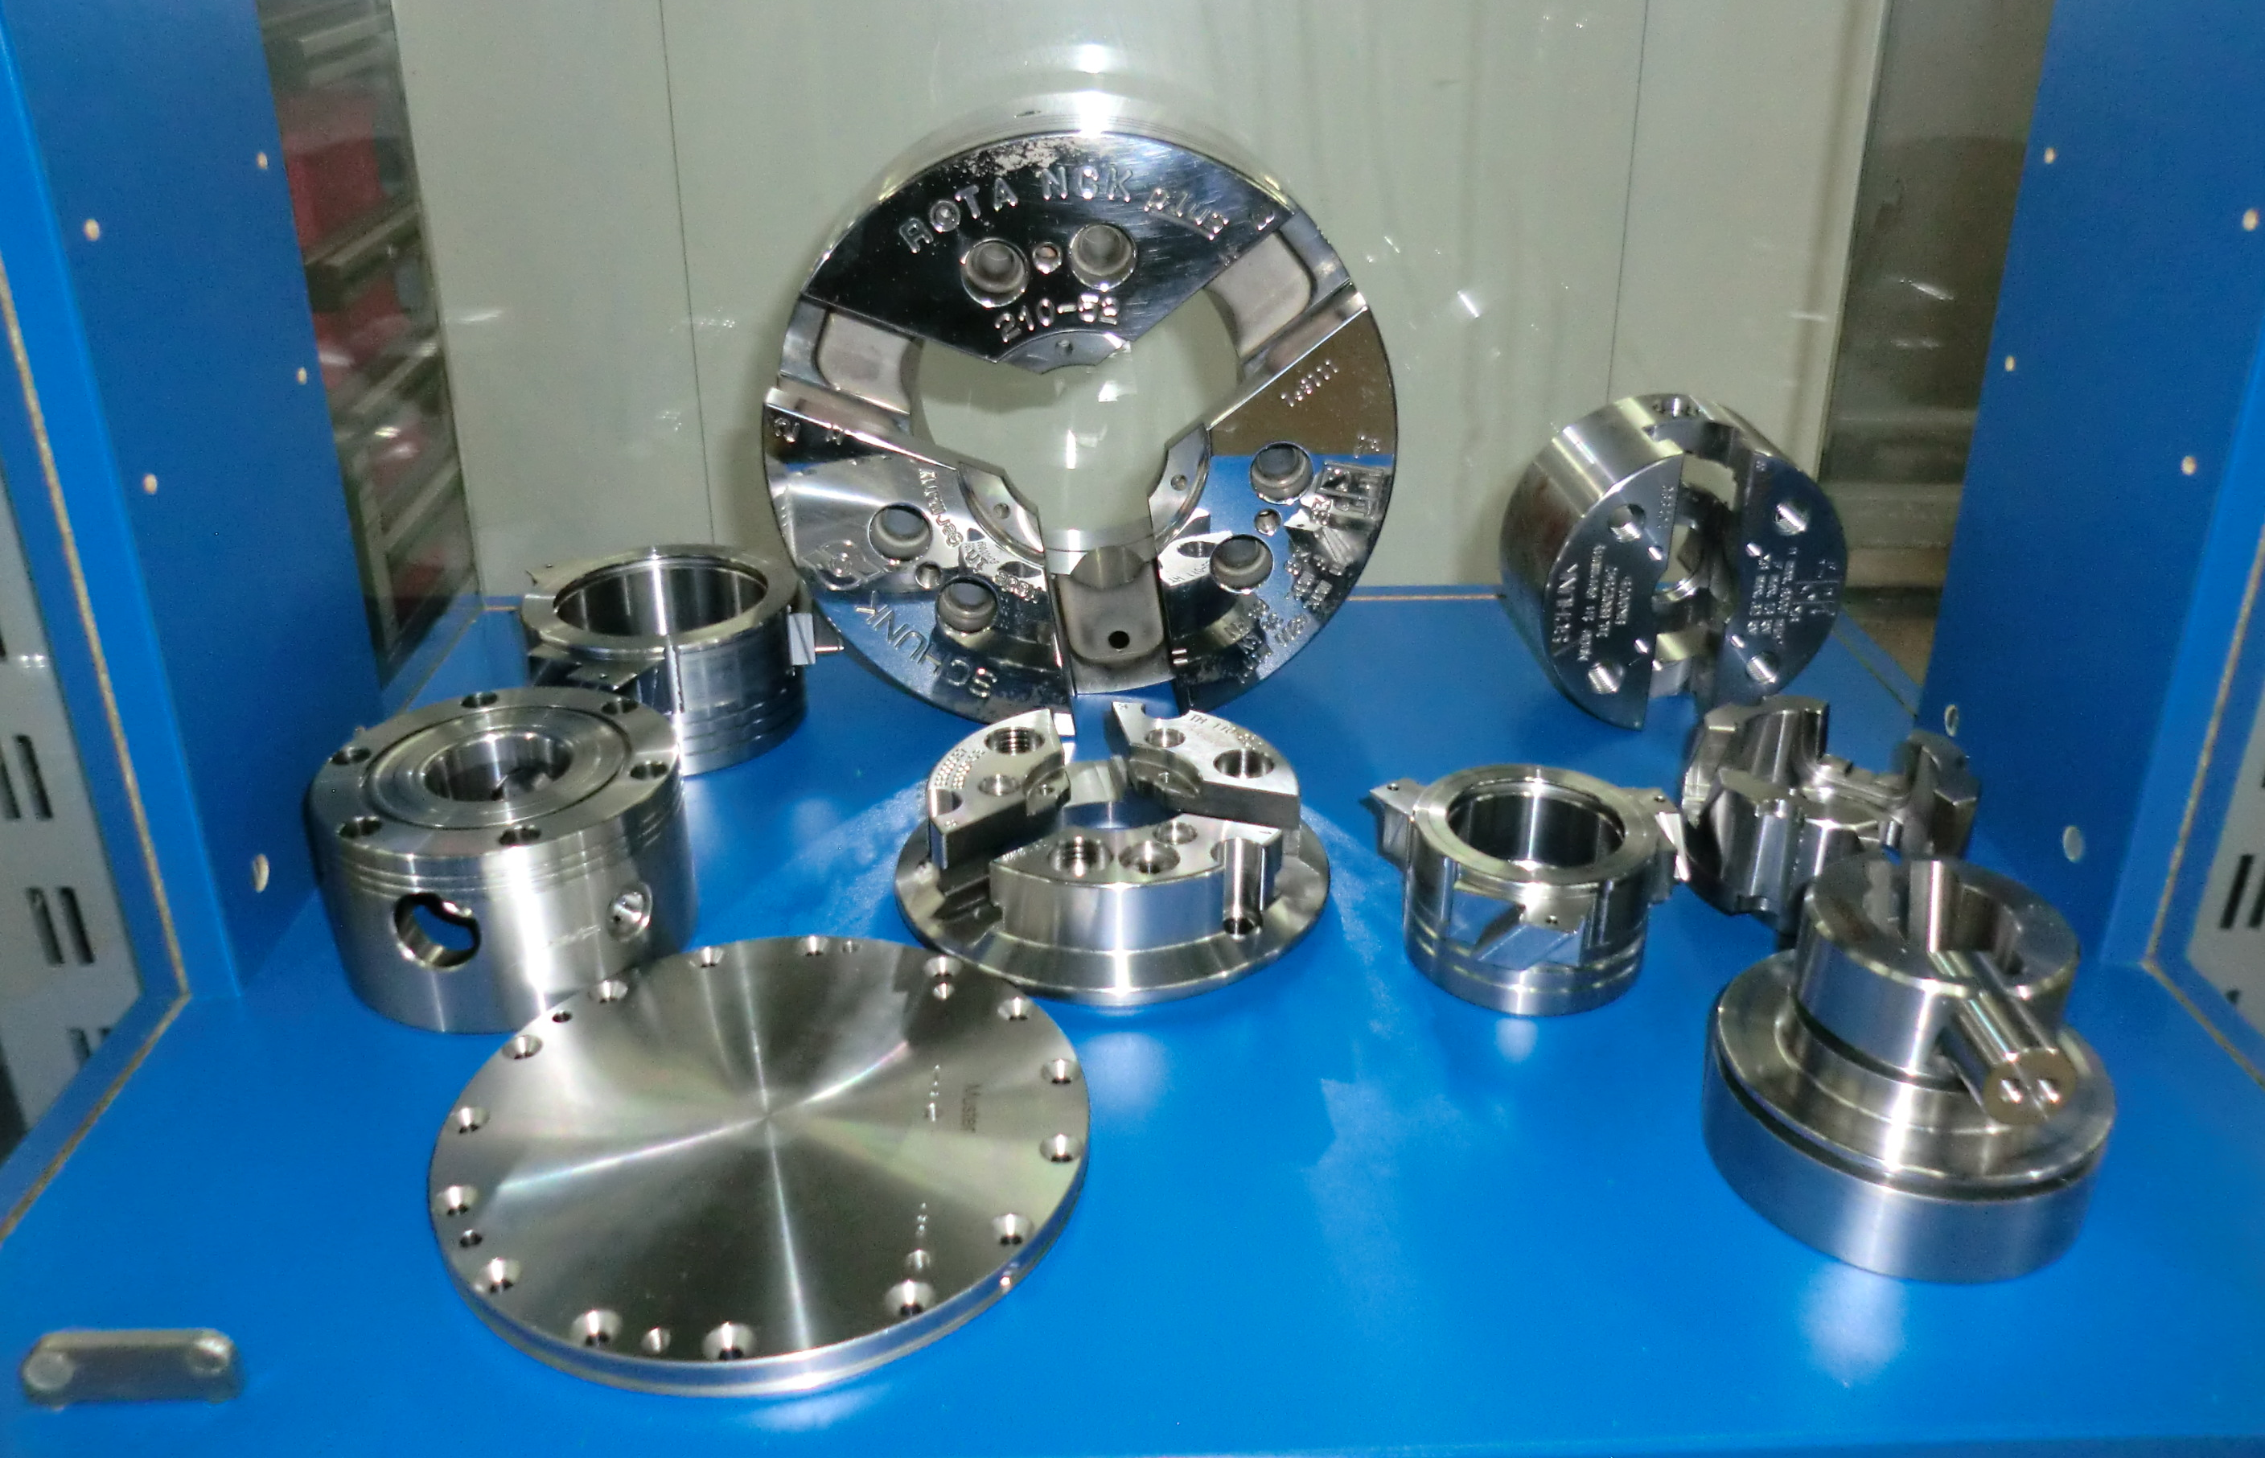
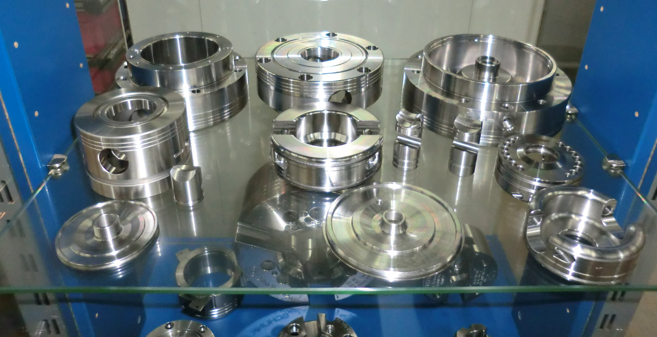
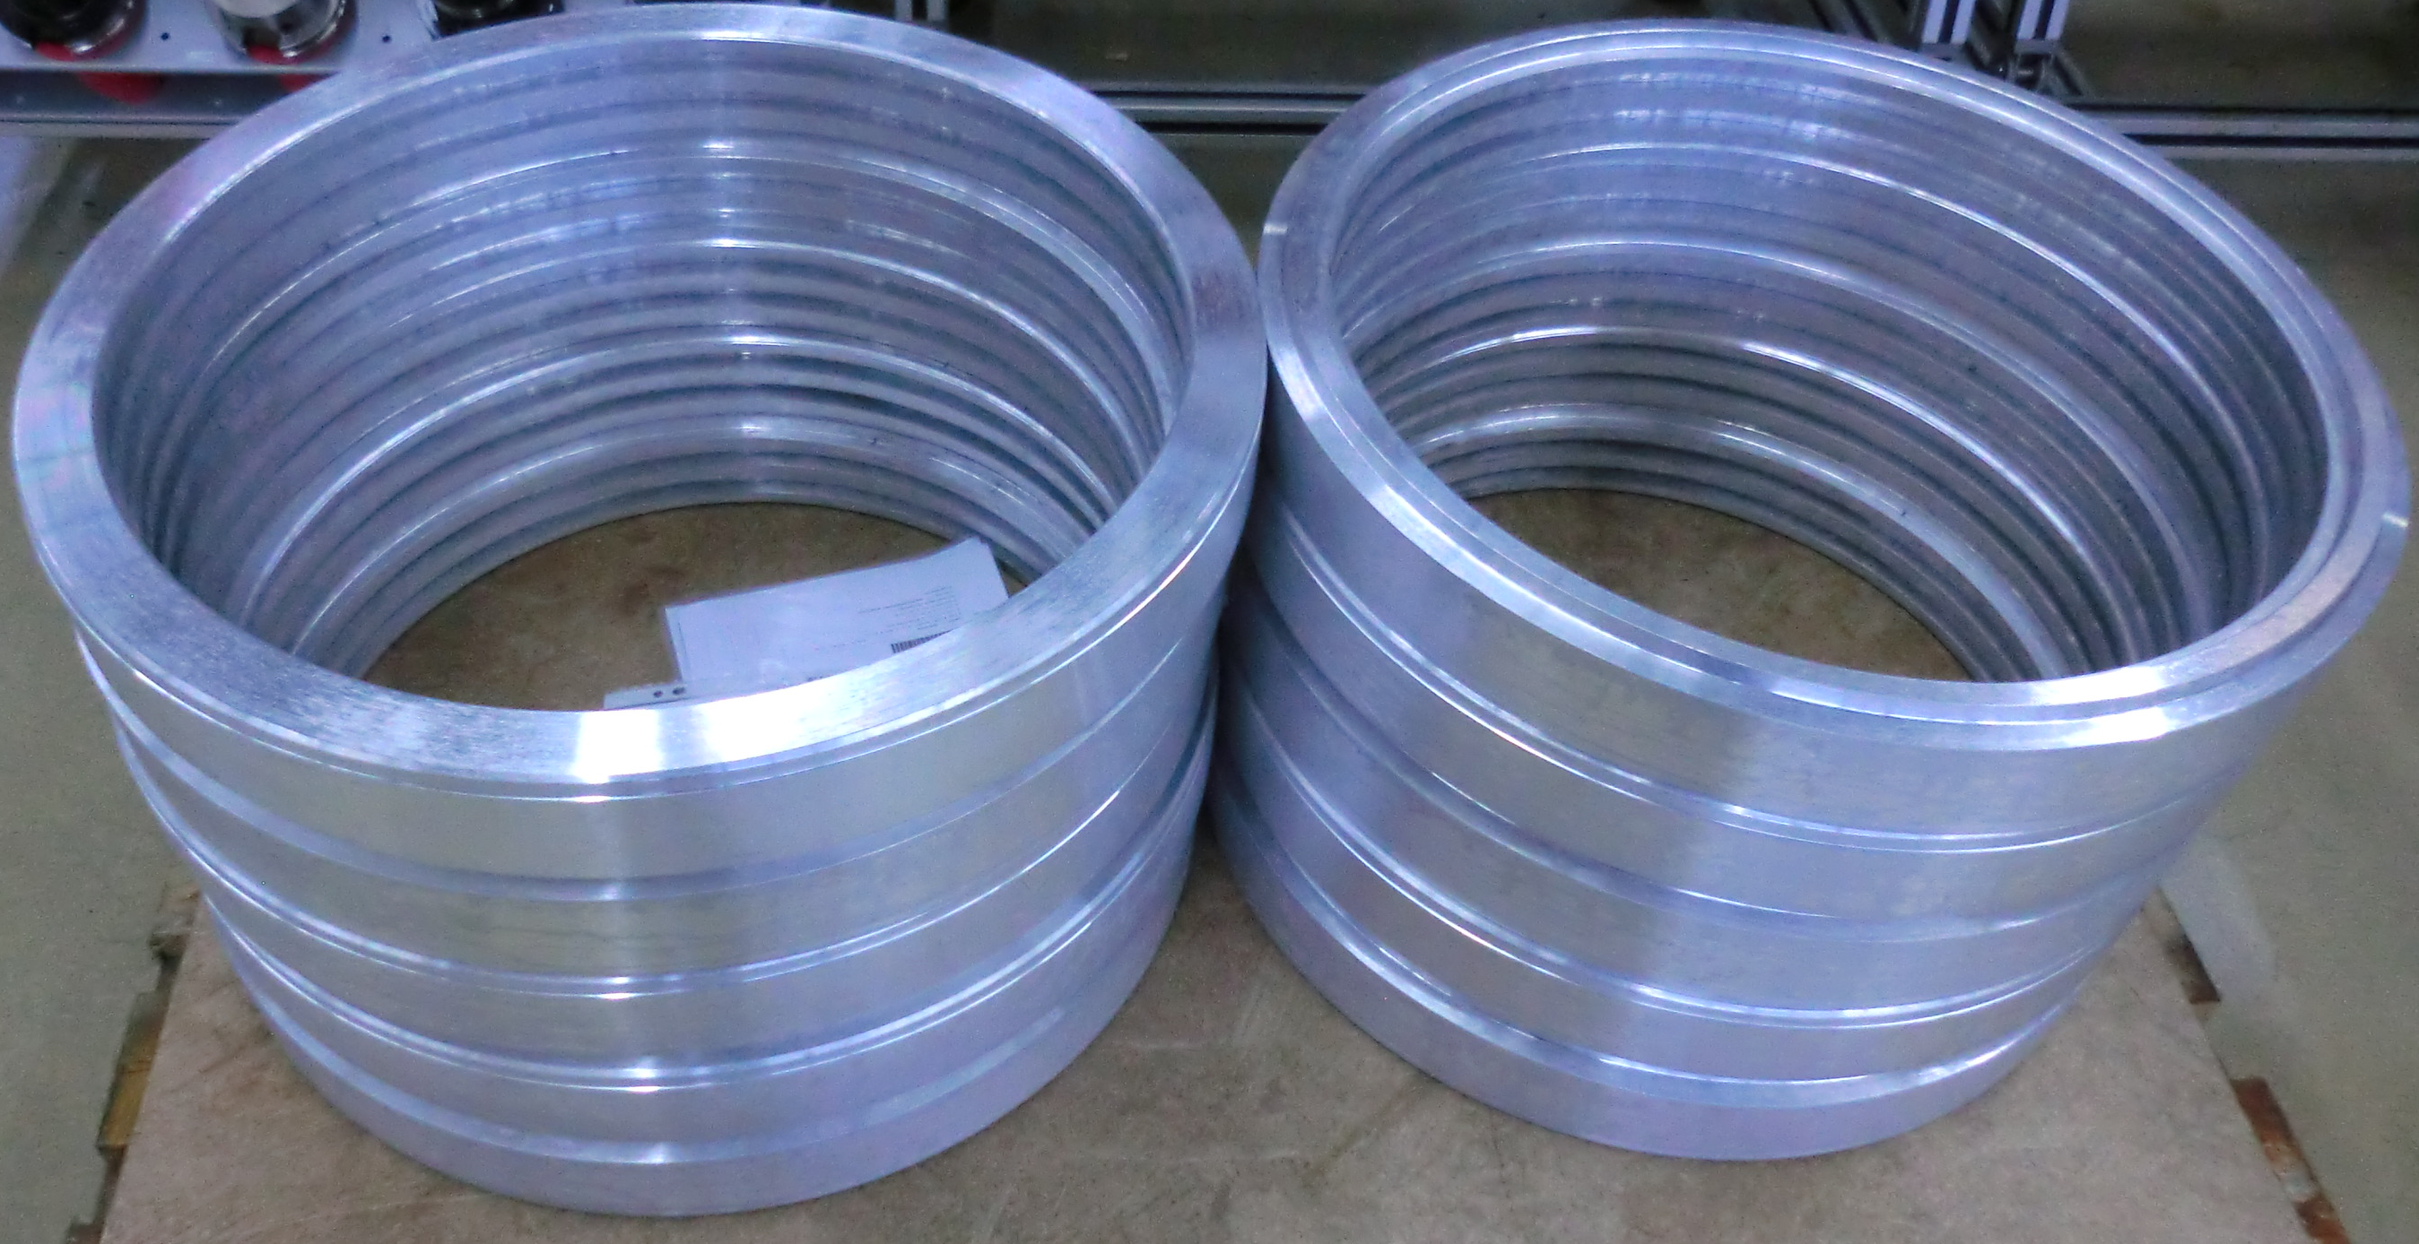
…for all types of workpieces…

Slide 6
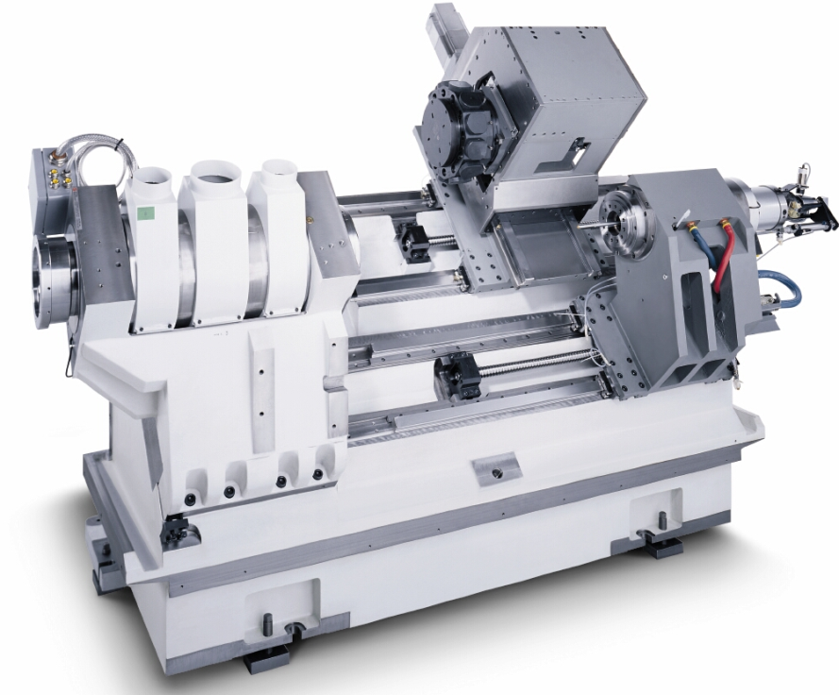
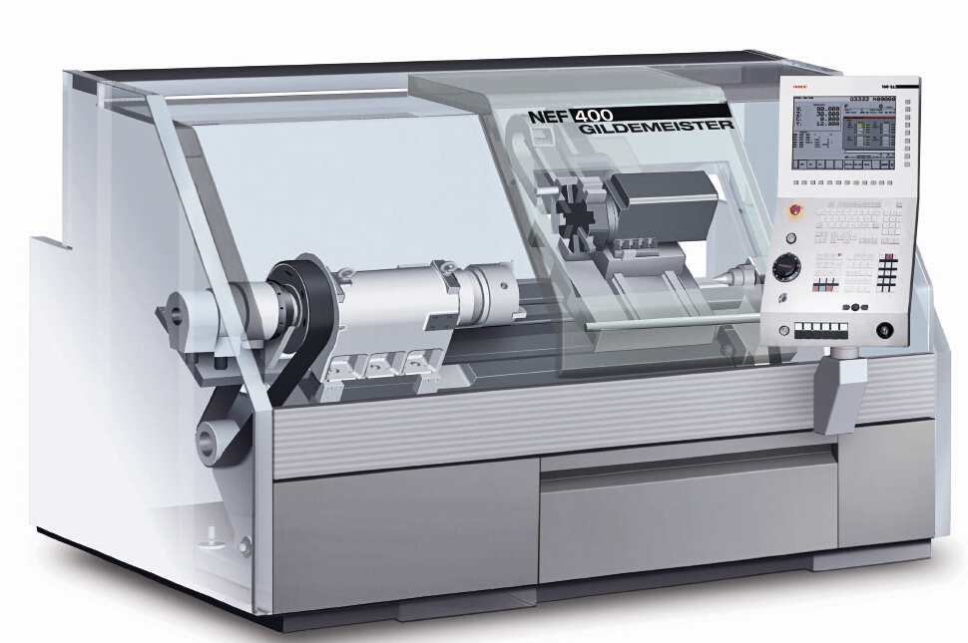
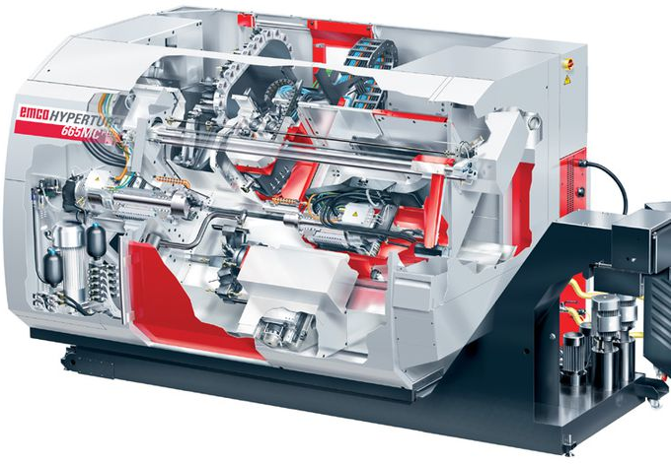
…and all types…

Slide 7
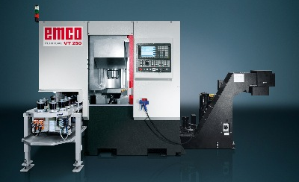
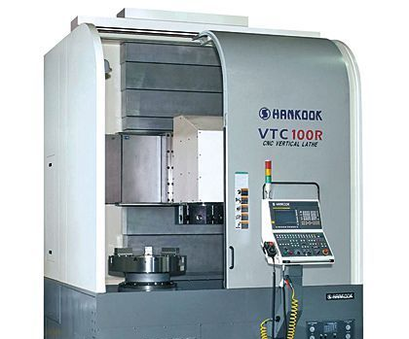
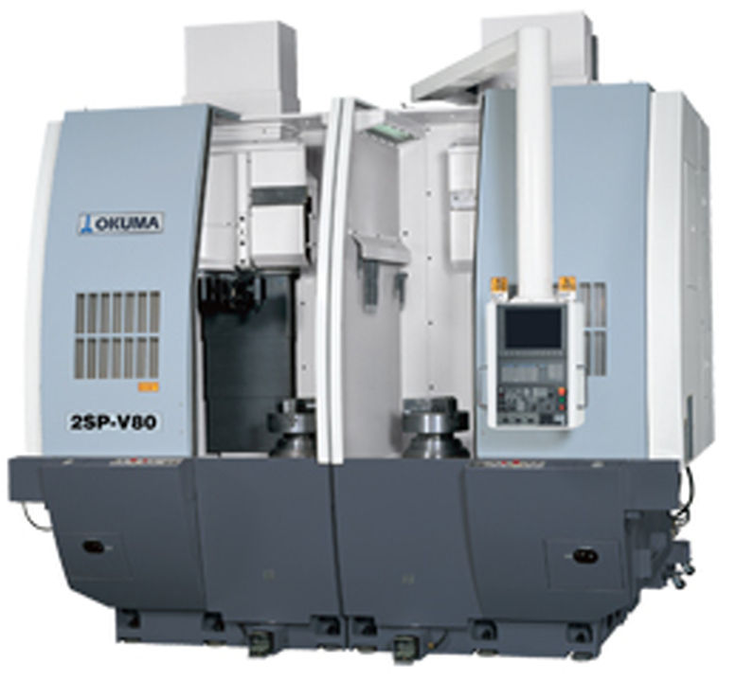
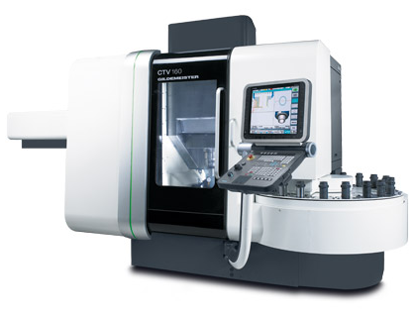
…of machines

Slide 8
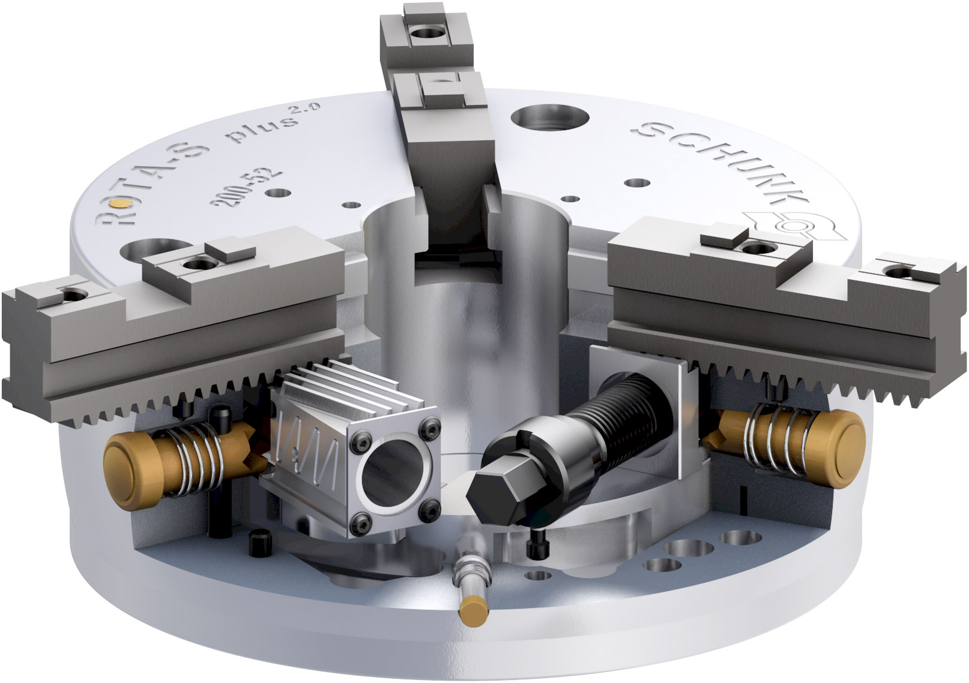
wedge bar manual chuck
ROTA-S plus 2.0

Slide 9
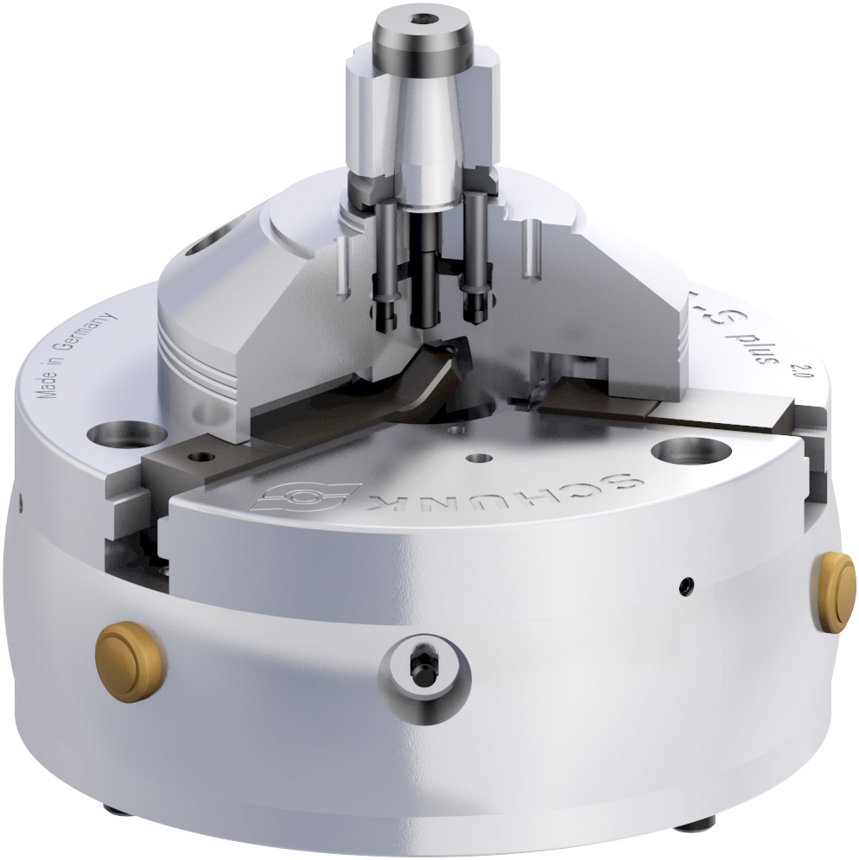
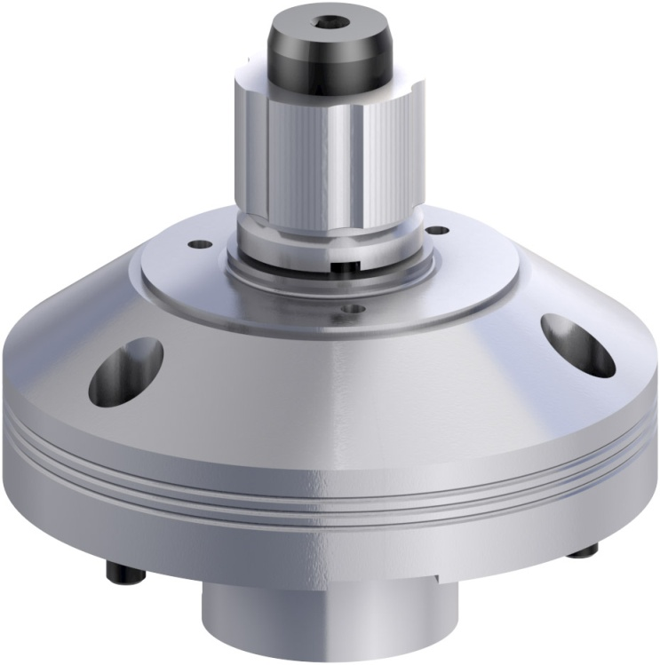
SCHUNK wedge bar manual chuck
ROTA-S plus 2.0

Slide 10
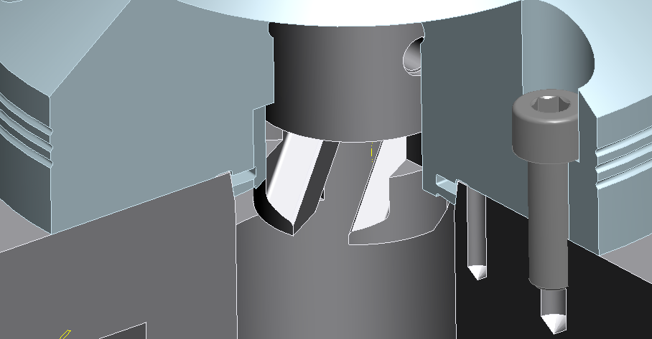
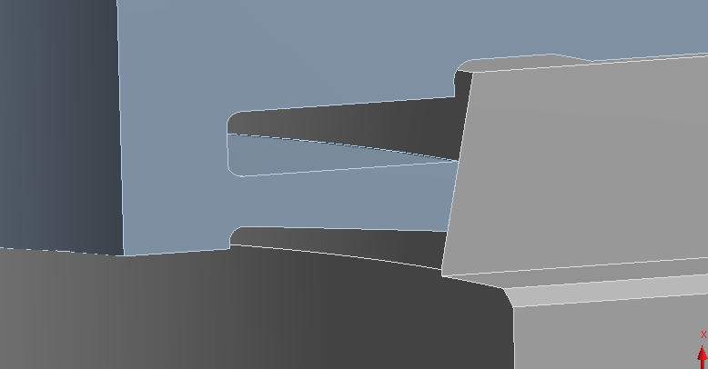
SCHUNK wedge bar manual chuck
ROTA-S plus 2.0
Functionality centering of arbor
The matchable cone at the arbor-body is flexible in axial direction.
This allows a flat surface location of the arbor in a high concentricity. → patented by SCHUNK
Rework on standard chuck body is necessary, (matchable cone)

Slide 11
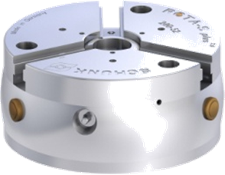
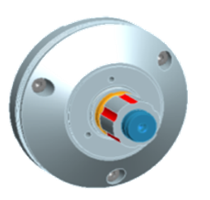
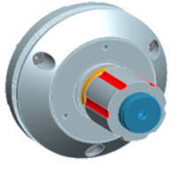
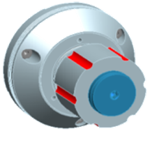
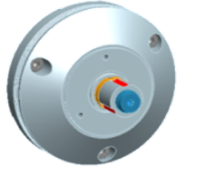
SCHUNK wedge bar manual chuck
ROTA-S plus 2.0
Attention:
Rework of chuck body is necessary!
arbor D0
clamping-Ø: 20-28mm
clamping force radial: 42kN
arbor D1
clamping-Ø: 26-38mm
clamping force radial: 42kN
arbor D2
clamping-Ø: 36-54mm
clamping force radial: 85kN
arbor D3
clamping-Ø: 50-80mm
clamping force radial: 105kN
(nur 250 & 315)
SCHUNK highlights clamping technology 2013

Slide 12
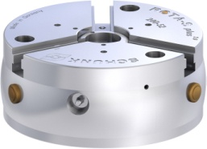
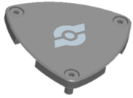
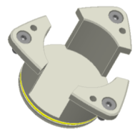
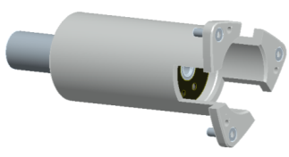
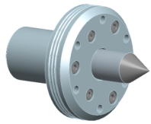
SCHUNK wedge bar manual chuck
ROTA-S plus 2.0
ROTA-S plus 2.0
clamping with arbor
SFG cover plate
closed center sleeve
adjustable workpiece stop
center point
SCHUNK highlights clamping technology 2013

Slide 13
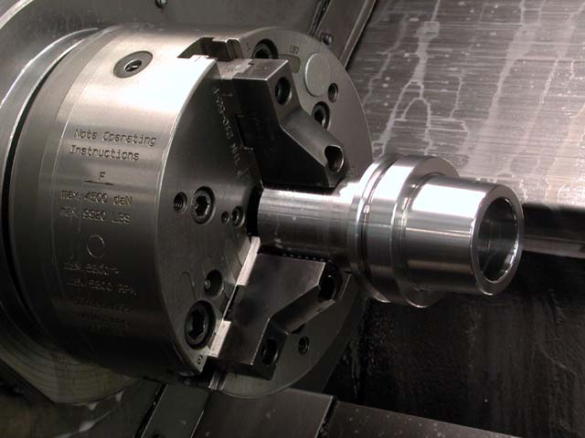
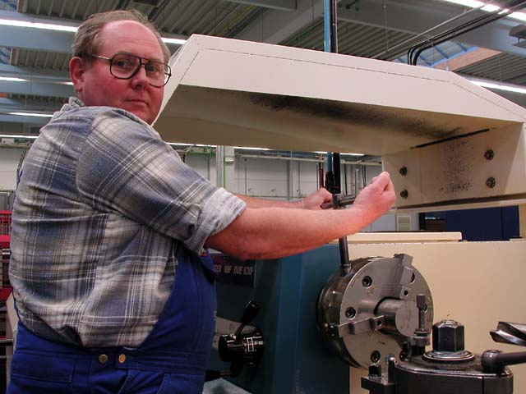
The world´s biggest program of standard chuck jaws from SCHUNK for…
power chucks
manual chucks

Slide 14
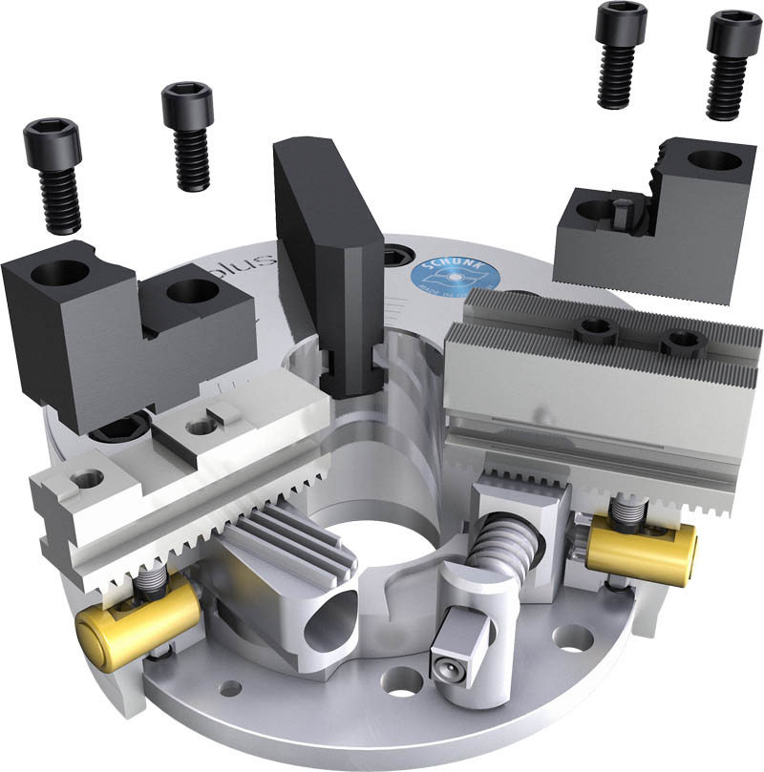
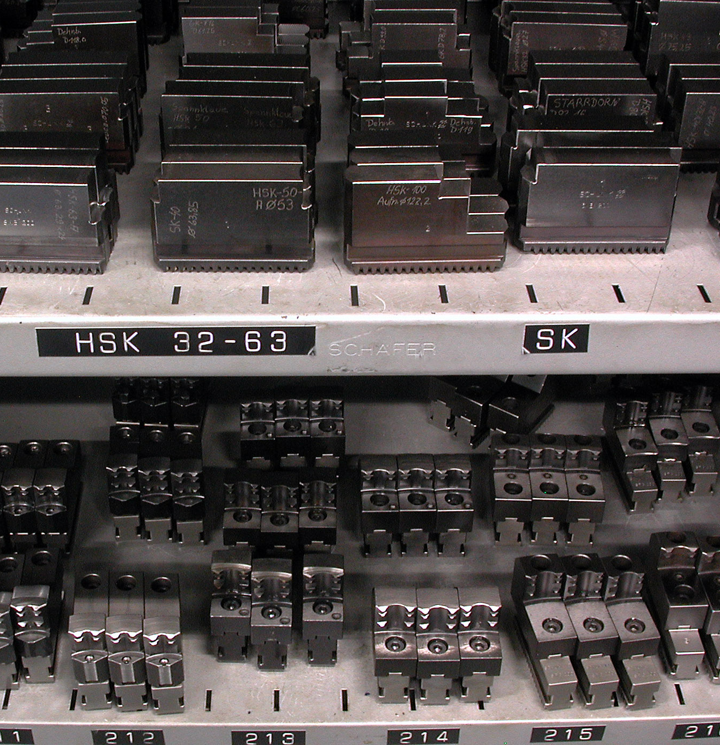
The highest flexibility with standard chuck jaws from SCHUNK for your chuck type

Slide 15



SCHUNK standard claw jaws for perfect raw material clamping

Slide 16




SCHUNK specialized jaws = standard jaws, on stock

Slide 17

SCHUNK special jaws (here: pendulum jaws) = standard jaws , on stock

Slide 18




SCHUNK special jaws

Slide 19



SCHUNK special jaw solutions

Slide 20



SCHUNK special jaw solutions

