Slide 1
Short presentation Gamma

Slide 2
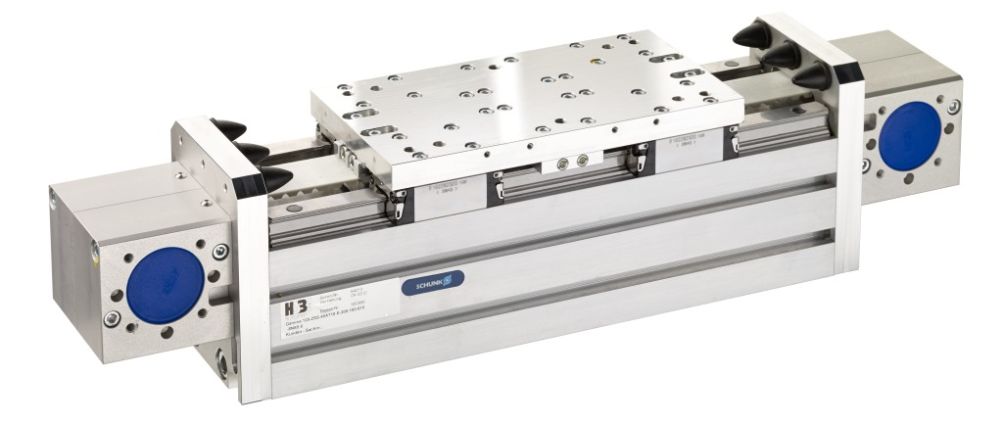
Gamma 90
#1: Axis for high load capacities
New Product
Sucessor product
New Sizes
Unique selling points:
Larger size, rounds off the successful Gamma series at the lower end (smaller size), profile width 90 mm
  Available in all variants CAS ZSSD, AZSH, and AZSS
ZSS: Toothed belt drive with one slide
ZSSD: Toothed belt drive with two independently movable slides
AZSS: Rack and pinion axis horizontal
AZSH: Rack and pinion axis stroke version
Choice of toothed belt or rack and pinion drive
Closed basic profile for maximum rigidity, no additional support necessary
Double profiled rail guide for high load rating
Further product features:
Specific to the rack and pinion drive:
Dirt-resistant
Sturdy
Several slides can be attached on a profile, and can be controlled independently of each other
Specific to the belt drive:
High process speeds are possible

Slide 3
Gamma 90
#1: Axis for high load capacities
New Product
Sucessor product
New Sizes
Cost Effectiveness/ Customer Benefits :
New smaller size G90 requires less installation space
Closed basic profile, thus high load capacities in self-supporting engineering designs. Additional support designs are not required
Rail clamping element available for level control provides greater process reliability and protects the system
Consistent modular design, which means simple configuration to customer requirements. Less time spent in the engineering design and project planning
Differentiated product range and choice of toothed belt or rack and pinion drive which means optimal sizes for each application can be selected (no overdimensioning)
Double profiled rail guide for high load rating and precision
Expansion technology according to customer requirements can mostly be implemented economically and within a short period of time - Solutions à la carte

Slide 4
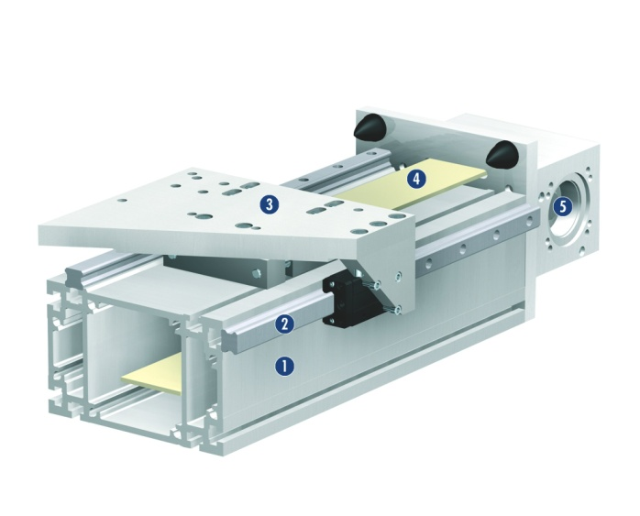
Gamma 90
#1: Axis for high load capacities
New Product
Sucessor product
New Sizes
Basic technical data:
  Sizes: G90, G120, G160,G220, G280
  Maximum stroke: up to 7650 mm
  Repeat accuracy: +/- 0,05 mm
  Maximum speed: up to 5 m/s
  Maximum acceleration: up to 60 m/s²
  Moment load 1,200 Nm to 16,000 Nm
Complementary products:
ERM
EGA
ERS
PGN+
PHL
1. Aluminium profile
2. Profiled rail guide
3. Slides
4. Toothed belt
5. Motor connection

Slide 5
