Slide 1

Product presentation
OPR
Collision and overload sensor OPR

Slide 2
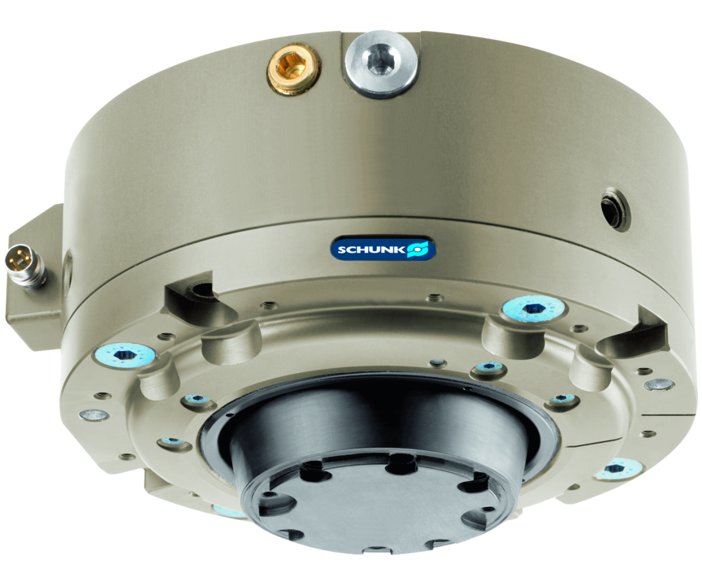
Collision and overload sensor OPR
Collision and overload protection with automatic reset for protecting robots and handling units against damage resulting from collisions or overload conditions.
Mechanical flexibility in the case of collision and self-resetting, as well as integrated monitoring
From a deflection force of 24 N

Slide 3

Compliant. Highly responsive. Automatic reset.

Slide 4
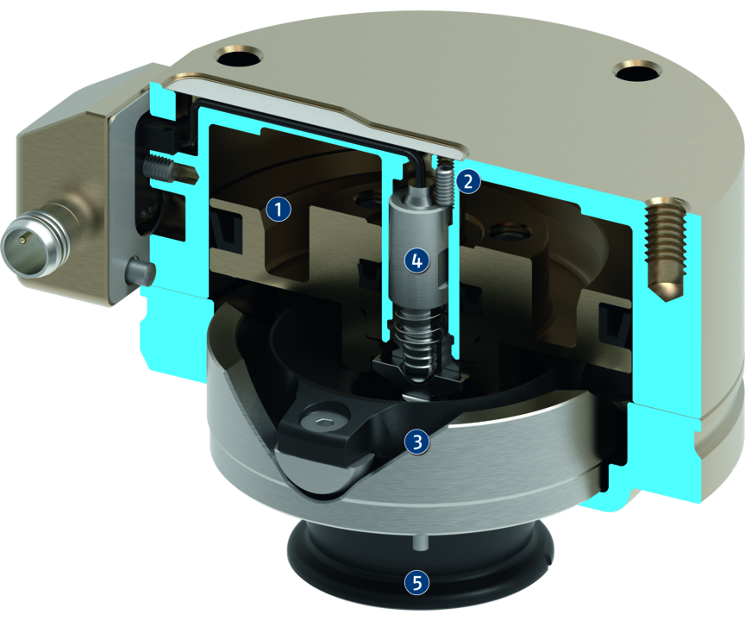
Principle of function
Functional description
In case of a collision, the mounting flange will be deflected. This simultaneously actuates a sensor whose signal triggers the system’s emergency stop mechanism.
The OPR automatically returns to zero position when the gripper moves away from the collision object. Production can continue immediately as manual resetting is not necessary.
1
Pneumatic pistons
2
Adjustment screw
3
Bearing
4
Monitoring
5
Mounting flange

Slide 5
Advantages – Your benefits
Automatic reset for faster production restart after a collision
Triggering force and torque can be adjusted via the operating pressure for optimal protection of your robots and components
Integrated monitoring for signal transmission without delay in case of collisions so that the robot can be stopped immediately
ISO adapter plates as an option for easy assembly to most of robot types without any manufacturing costs/work
On option also with integrated springs for maintaining the position in the event of pressure loss
Mechanical flexibility in the event of collisions for compensation of the robot's reaction pathway in the event of a collision or overload

Slide 6
Technical data
Technical data overview
Size | Axial deflection | Angular deflection | Deflection rotatory | Responsiveness | Weight
 | [mm] | [°] | [°] | [mm] | [kg]
48 | 5.1 | 13 | 20 | 0.5 | 0.24 .. 0.25
61 | 5.6 | 11 | 20 | 0.5 | 0.32 .. 0.33
81 | 8.6 | 13 | 25 | 0.5 | 0.58 .. 0.6
101 | 10 | 12 | 25 | 0.5 | 1.2 .. 1.3
131 | 11.5 | 10 | 20 | 0.5 | 2.3 .. 2.4
176 | 16 | 10 | 20 | 0.5 | 5.4 .. 5.5
221 | 16 | 8 | 20 | 0.5 | 11.4 .. 11.7

