Slide 1
Short presentation
EWS

Slide 2
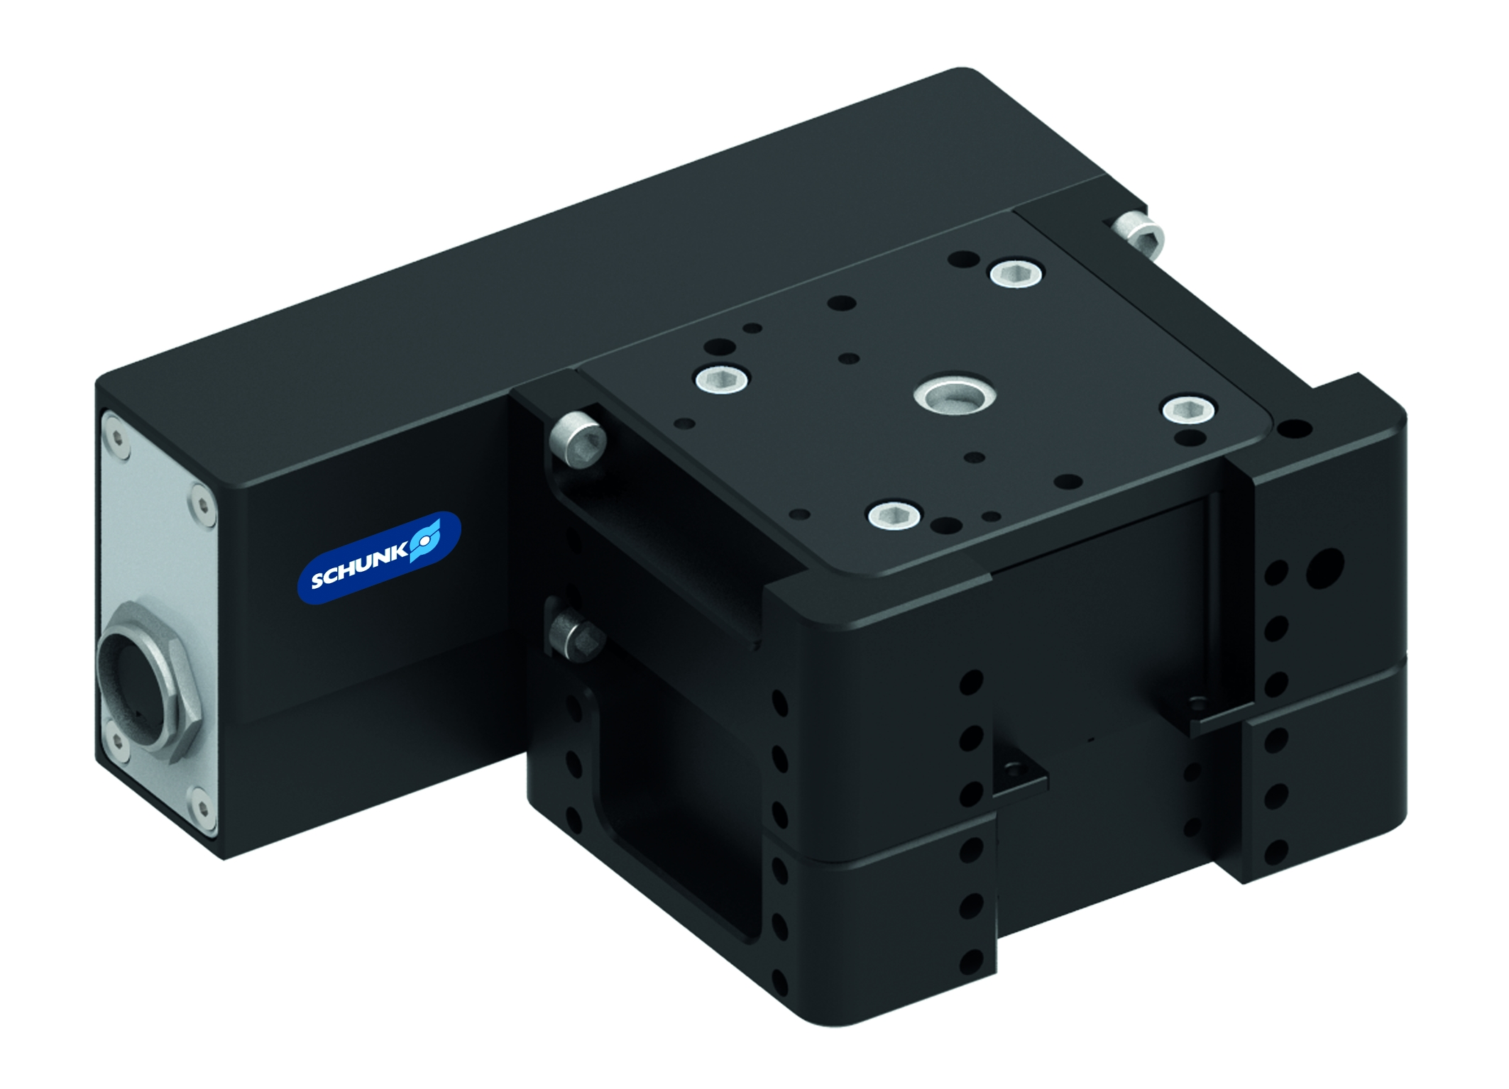
EWS
#1: The first electric, automatic robot change system
New Product
Sucessor product
New Sizes
Unique selling points:
Very flat design
Patented self-retaining locking system
Direct pneumatic alternative
Easy digital control
Wear-free servo motor
Further product features:
Housing material made of aluminium-andonized
Available as of February 2014
Price on request

Slide 3
EWS
#1: The first electric, automatic robot change system
New Product
Sucessor product
New Sizes
Cost Efficiency/Customer Benefits:
Predestined for robot types, where many tool changes are required
Patented self-retaining locking system for a secure connection between quick
change head and quick-change adapter
Integrated electric drive for secure locking and unlocking without air
Compact and cost-effective piston stroke monitoring via drive motor possible →
safe processes
Brushless motors are maintenance-free, and have a high efficiency
High locking speed at a simultaneously high force

Slide 4
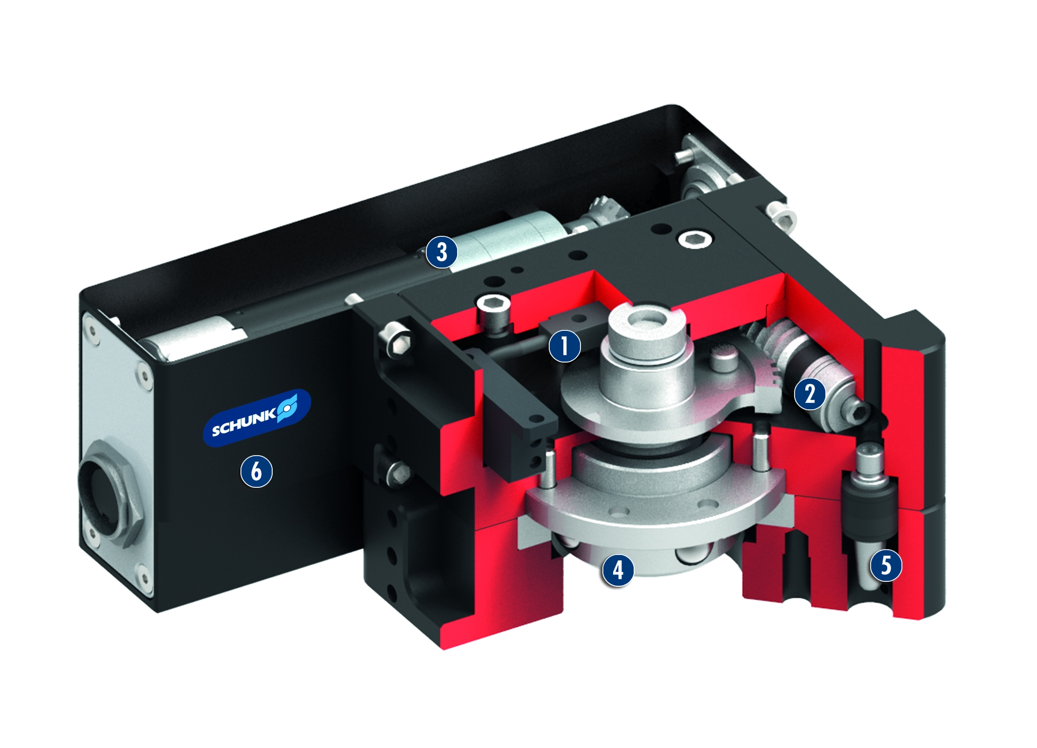
EWS
#1: The first electric, automatic robot change system
New Product
Sucessor product
New Sizes
  Basic technical data:
Size: 018
Handlings weight: 18 kg
Moment load Mx, My: 186 Nm
Electric feed-through: Optional via E
modules

Slide 5


