Slide 1
Short presentation SRU-mini-Speed

Slide 2
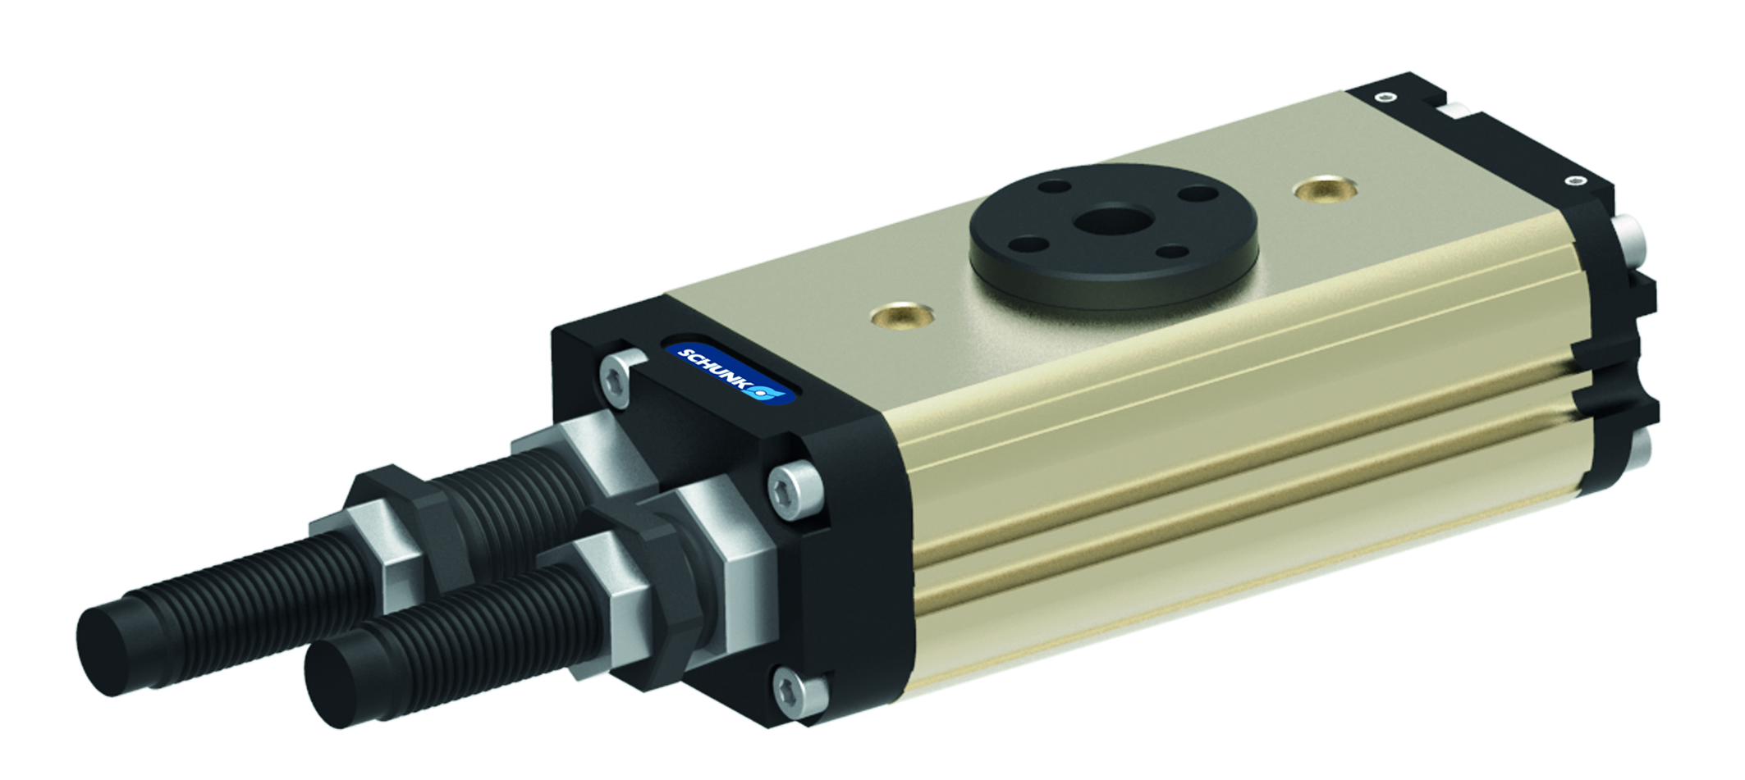
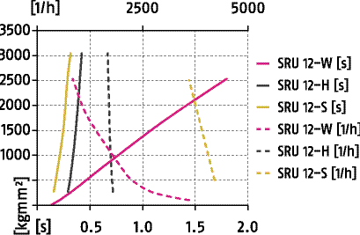
SRU-mini Speed
#1 Shortest cycle times at maximum frequency. The new benchmark for rotary units in terms of cycle time and frequency
New Product
Sucessor product
New Sizes
Unique selling points:
Patented shock absorber-elastomer-damper as a new
benchmark for rotary units
Matching variant design in minimally altered outside
dimensions for optimal use in any application
Universal modularity
Further product features:
Tried and tested hydraulic high-performance shock
absorber combined with elastomer
Faster cycle time and the highest rate in the same loading
Higher energy absorption then previous shock absorbers
Higher compact performance with regard to loading, cycle
time, and cycle per hour

Slide 3
SRU-mini Speed
#1 Shortest cycle times at maximum frequency. The new benchmark for rotary units in terms of cycle time and frequency
New Product
Sucessor product
New Sizes
Cost Effectiveness/ Customer Benefits :
More compact plant design, since a higher load at the
same installation space is possible
Higher plant productivity due to reduced cycle times,
and higher number of cycles per hour

Slide 4
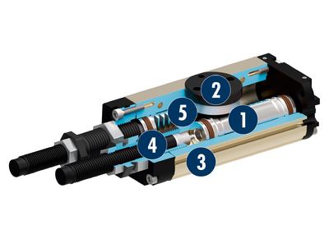
SRU-mini Speed
#1 Shortest cycle times at maximum frequency. The new benchmark for rotary units in terms of cycle time and frequency
New Product
Sucessor product
New Sizes
Basic technical data:
Sizes: 10, 12, 14
Mass: 0.2 – 0.5 kg
Axial force: 255 N – 330 N
Torque: 0,28 – 1,15 Nm
Bending moment: 2.5 – 4.5 Nm
Cycles per hour
    for SRU-mini 14 bis 4200
    for SRU-mini 12 bis 4200
    for SRU-mini 10 bis 3700
    Swiveling times
    for SRU-mini 14 ab 0,21 (s)
    for SRU-mini 12 ab 0,16 (s)
    for SRU-mini 10 ab 0,16 (s)
Drive
Pinion
Housing
Damping
Kinematics

Slide 5


