Slide 1

Product presentation
Delta

Slide 2
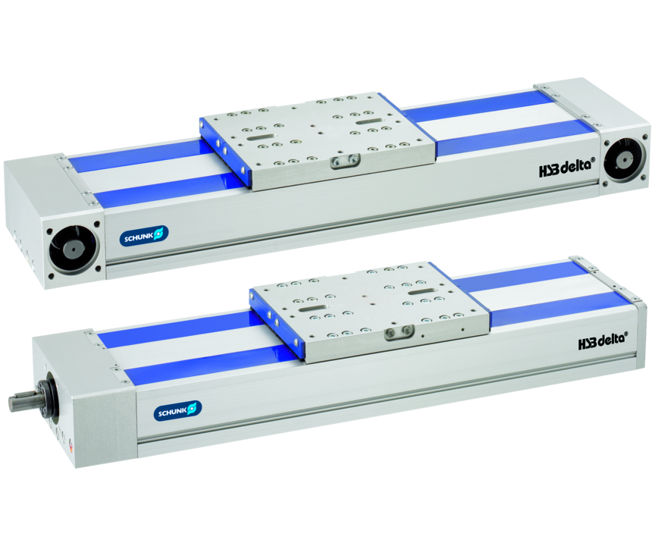
Flat linear module with either toothed belt drive or spindle drive
The most comprehensive modular system for linear axes.
Up to 12,000 N driving force

Slide 3

Flat. Modular. Loadable.

Slide 4
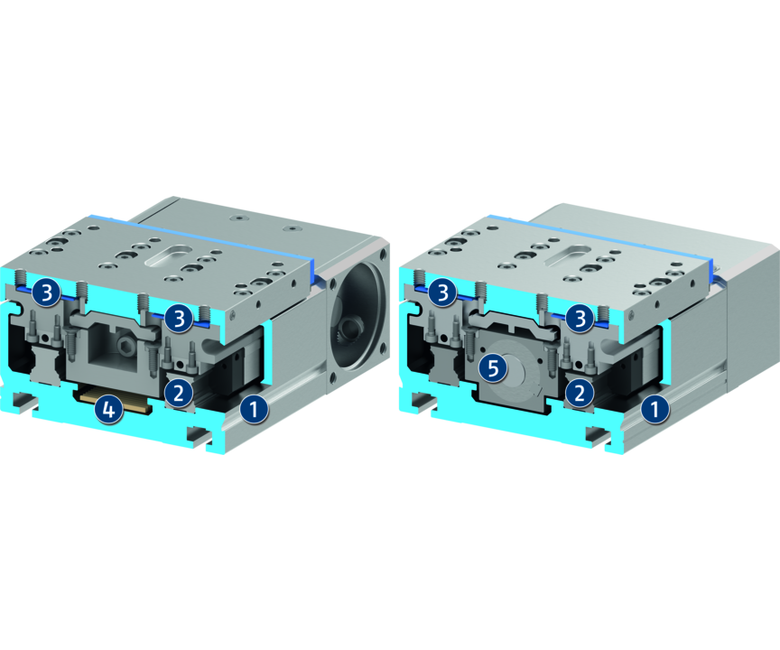
Principle of function
Functional description
The slide is driven by a toothed belt or a ball screw spindle and is precisely guided by a roller or (double) profiled rail guide. The cover band runs through the slide and covers the drive and guidance. The servomotor is connected to the profile via the drive shaft.
1
Aluminum profile
2
Profiled rail guide
3
Covering tape made of plastic
4
Toothed belt
5
Spindle

Slide 5
Advantages – Your benefits
Extremely flat design for minimal interfering contours
Double-profiled rail guide for highest rigidity and precision in the application
Optional belt or spindle driven for the optimum drive for your application
Various guide options for optimal adaption to your application
Adaptable drive motor for versatile approach and easy integration into existing control concepts
Integrated cover tape for versatility and a long tool life
Fixing via T-nuts or slot nut possible for flexibility in the integration

Slide 6
Technical data
Technical data overview
Size | Max. driving force | Max. stroke | Max. acceleration
 | [N] | [mm] | [m/s²]
90 | 800 .. 1000 | 1245 .. 3720 | 20 .. 30
110 | 1100 .. 2000 | 5370 .. 7820 | 20 .. 40
145 | 2000 .. 4000 | 5300 .. 7760 | 20 .. 40
200 | 6000 .. 10000 | 1520 .. 1620 | 20 .. 60
240 | 3800 .. 12000 | 5400 .. 7540 | 20 .. 60

