Slide 1


ROTA-S flex
Manual Lathe Chucks

Slide 2














Product overview
Gripping Systems
Clamping Technology
Chuck Jaws
Stationary Workholding
Lathe Chucks
Toolholders
Hydraulic Expansion Technology
Manual Lathe Chucks
Power Lathe Chucks with Jaw Quick-change System
Power Lathe Chucks with Through-hole
Power Lathe Chucks without Through-hole
Pneumatic Power Chucks
Steady Rests
Quick-change Systems
Customized Solutions

Slide 3
Challenges
Variants
Required accuracy
Time
Time
Demand
Time
Flexibility and und set-up time optimization
heute
zukünftig

Slide 4

ROTA Manual Lathe Chucks
heute
zukünftig

Slide 5

ROTA overview
Manual Lathe Chuck
ROTA-S plus 2.0
ROTA-S flex
SPK
6

Slide 6
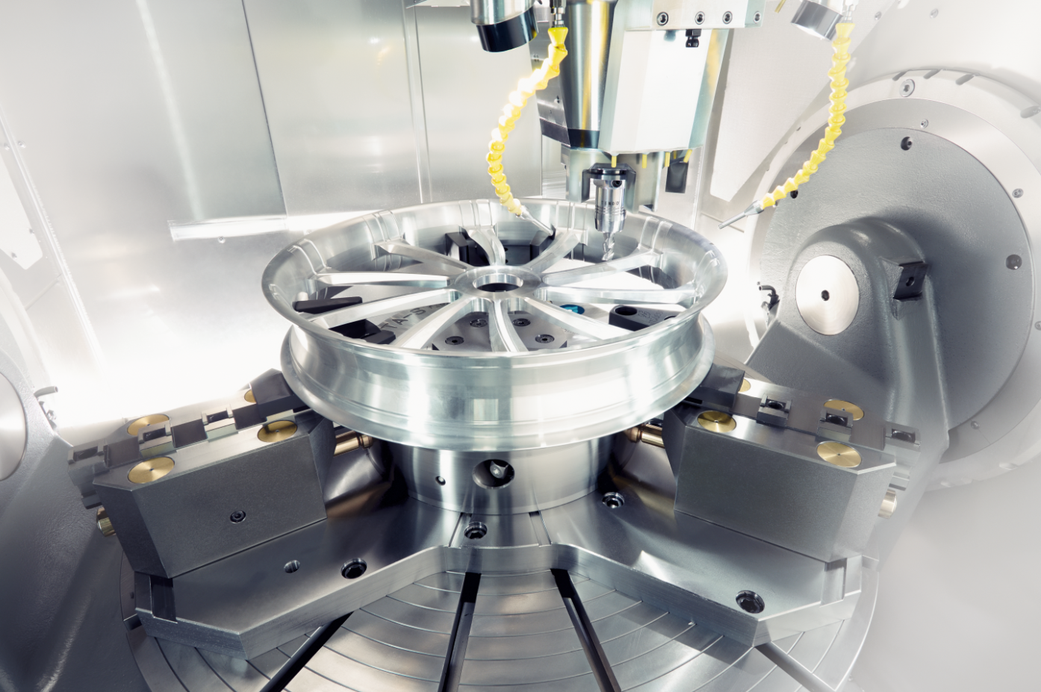
ROTA-S flex
Example of application
Clamping device:
ROTA-S flex 1200 on a milling machine with turning option.
Features/Application:
I.D. clamping of aluminium rim for finishing on a mill/turn machine. Highest flexibility and best accessibility for driven tools at a minimum own weight.

Slide 7
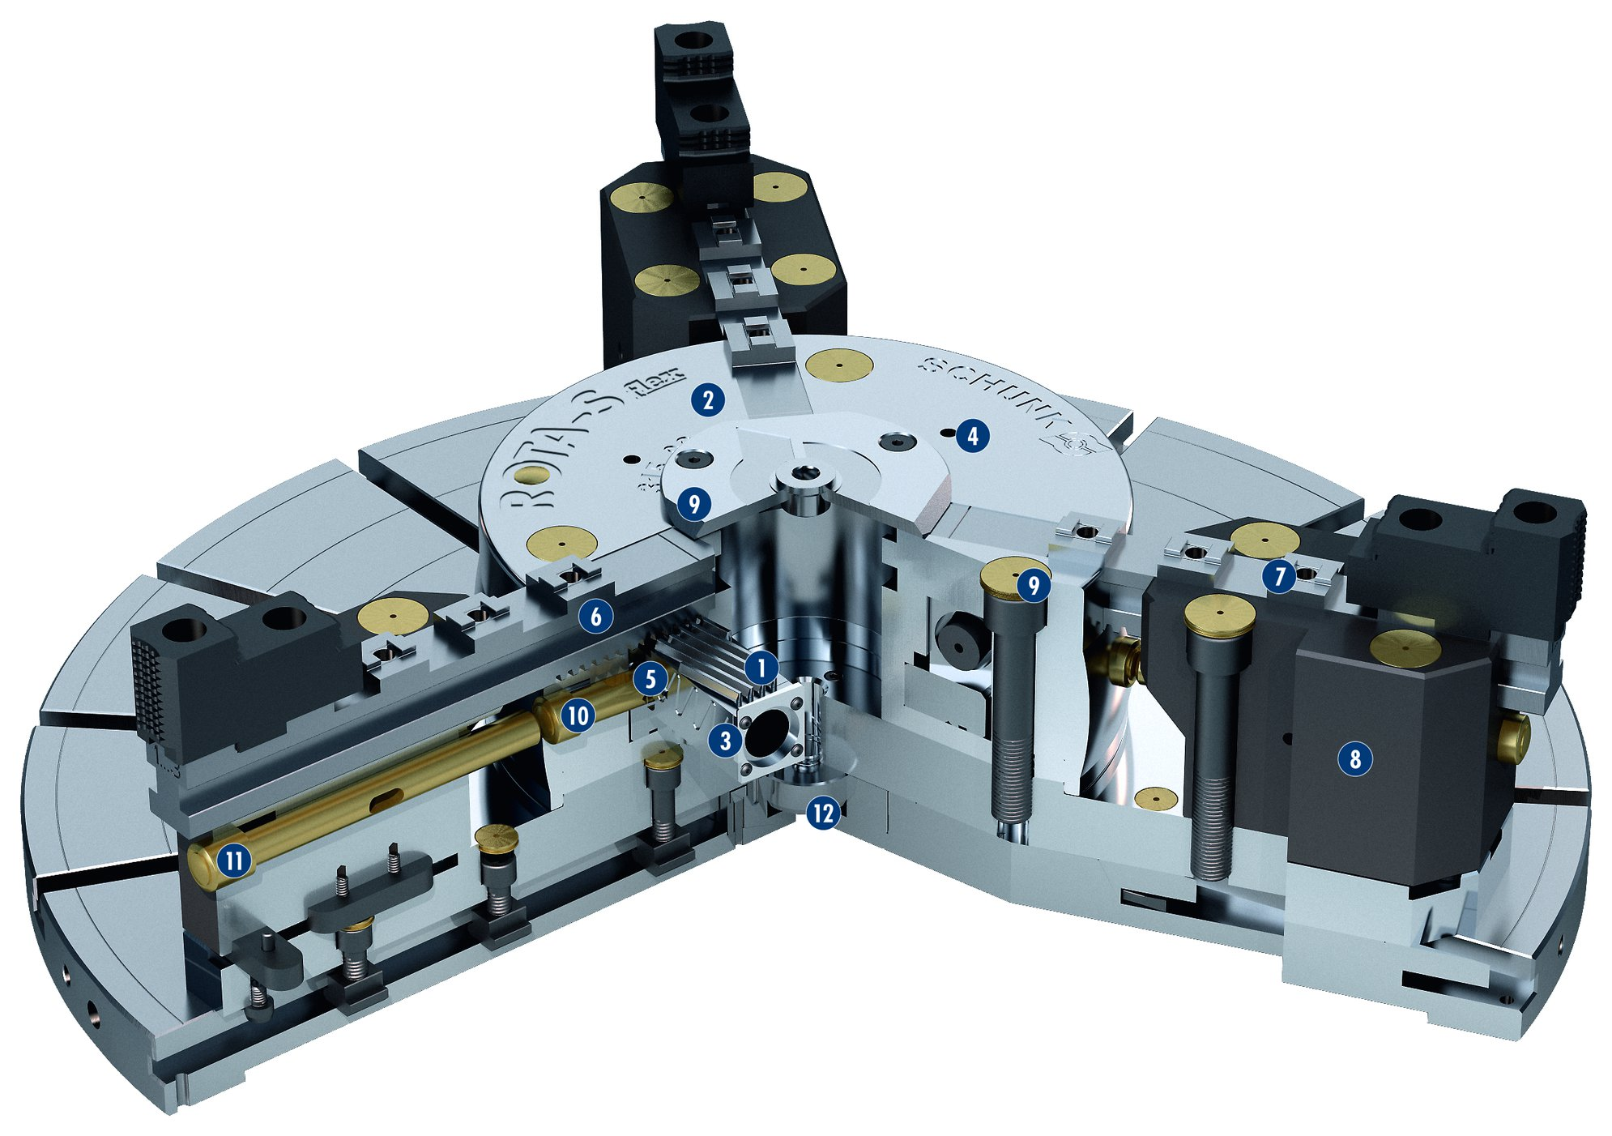
ROTA-S flex
1
Wedge bar actuation system
Hardened and extremely rigid base body
Optimized lubrication system
Mounting threads
Jaw quick-change system
Base jaws with angled serration (SFG)
Standard chuck jaw interface
Exchangeable guideway extension
Dirt-resistant design
Push button for jaw change
Push button extension
Centering pin
2
3
4
2
4
5
9
6
9
7
6
5
1
7
10
3
8
8
12
9
11
10
11
12

Slide 8
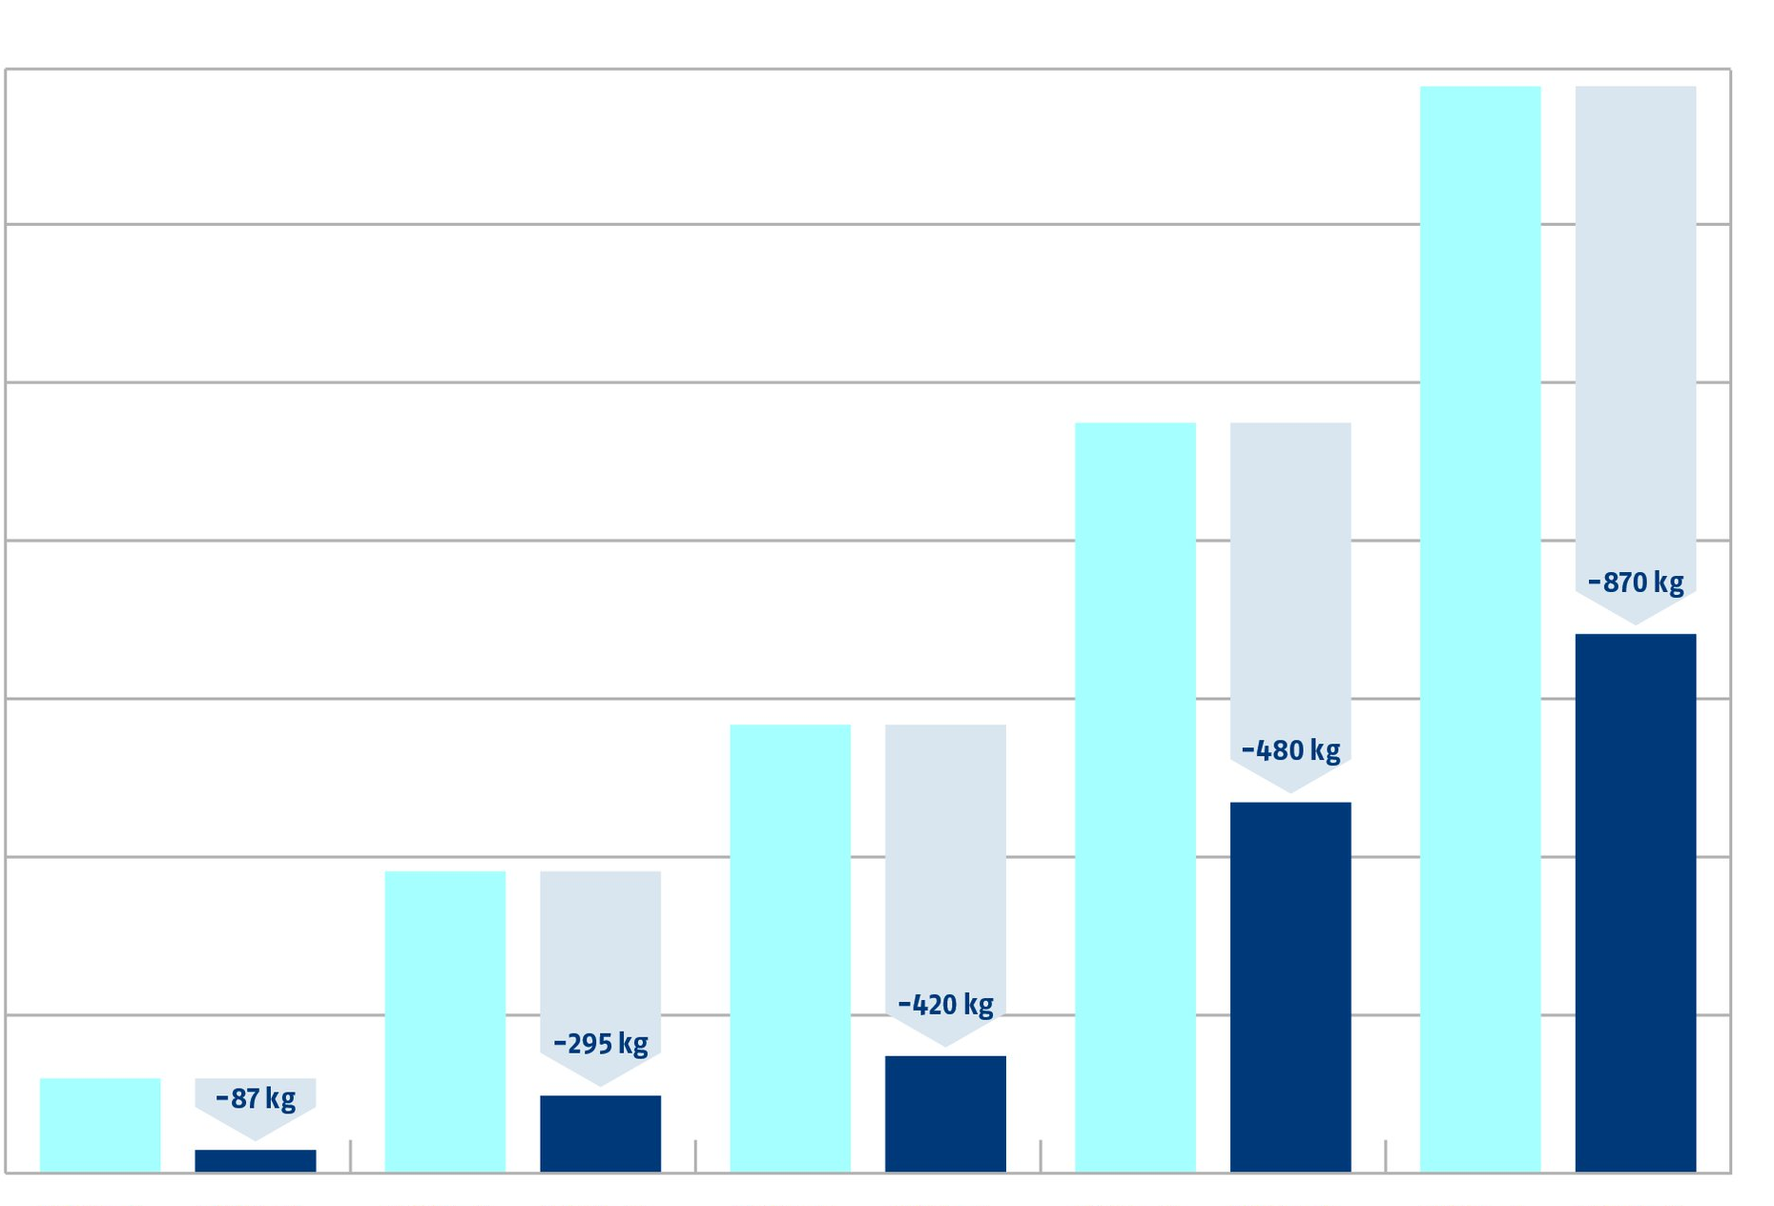
ROTA-S flex
Weight Reduction by ROTA-S flex compared to ROTA-S plus
1750
1500
1250
1000
Weight [kg]
750
500
250
ROTA-S plus 500
ROTA-S flex
550
ROTA-S plus 800
ROTA-S flex
700
ROTA-S plus 1000
ROTA-S flex
1000
ROTA-S plus 1200
ROTA-S flex
1200
ROTA-S plus 1400
ROTA-S flex
1400

Slide 9
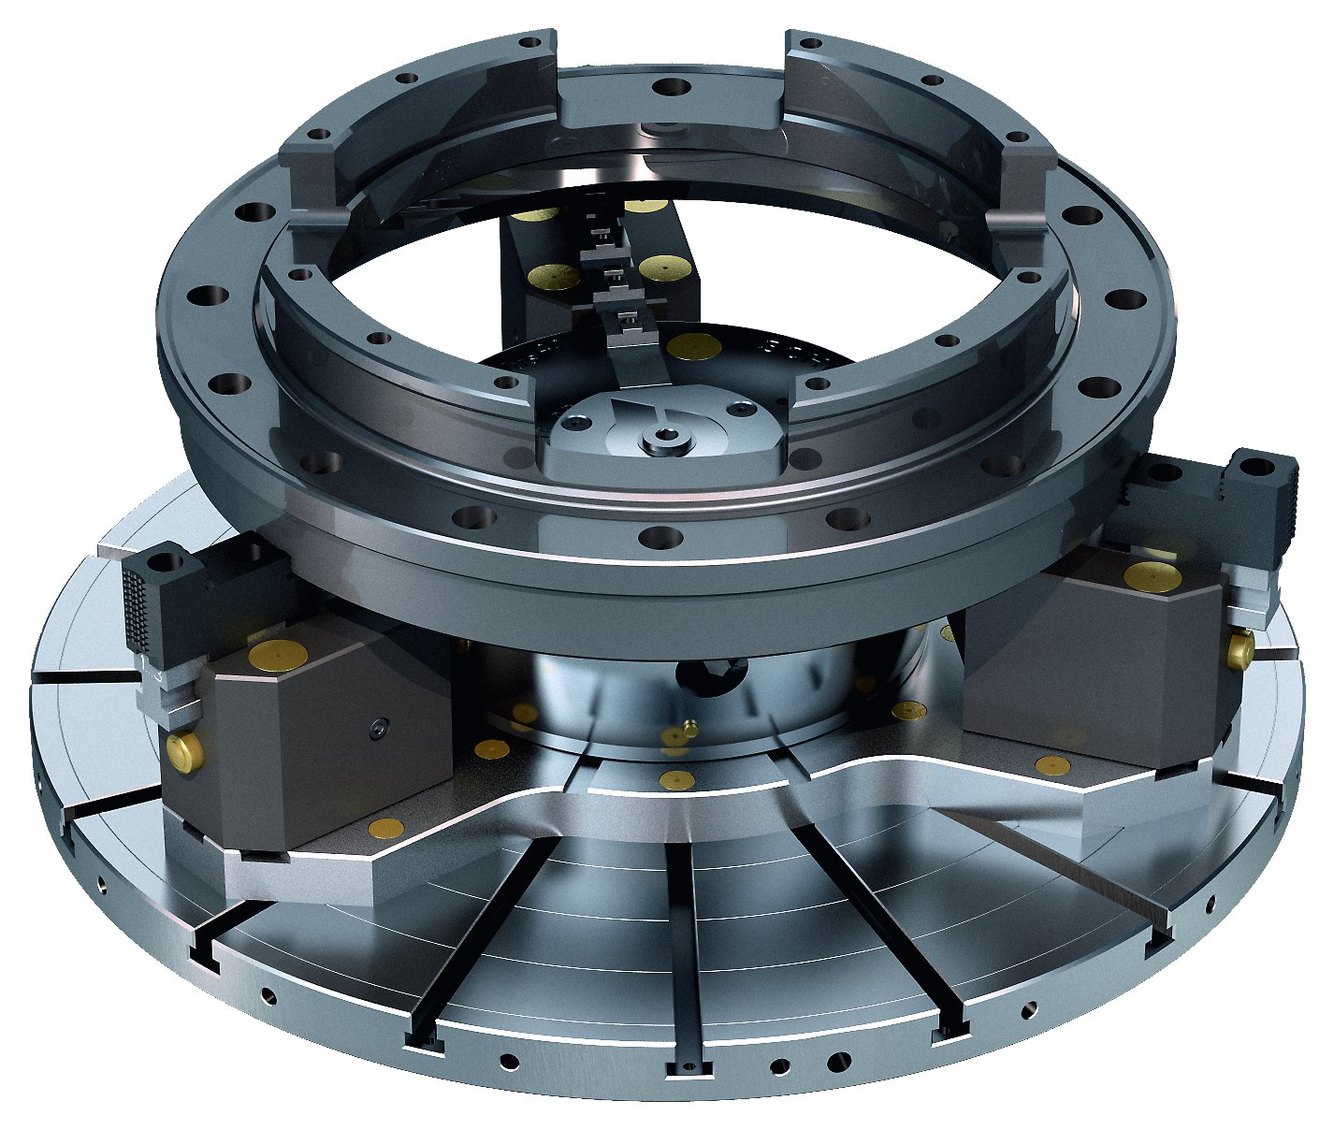
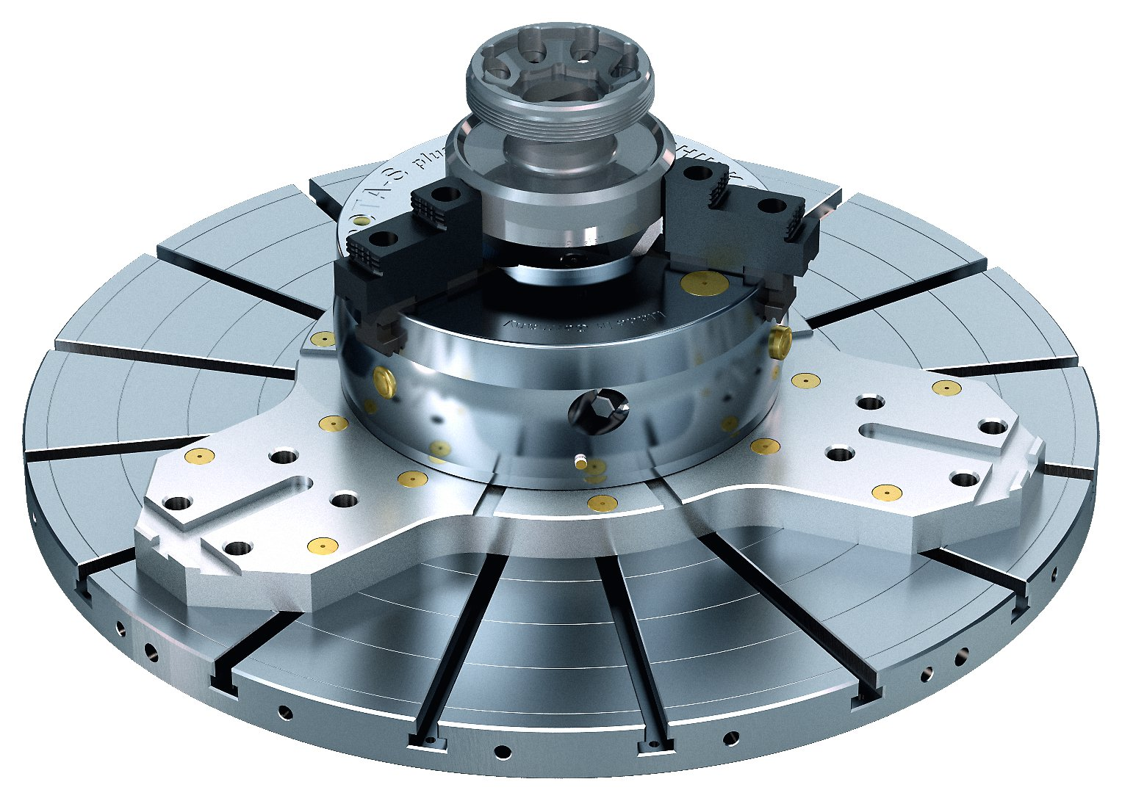
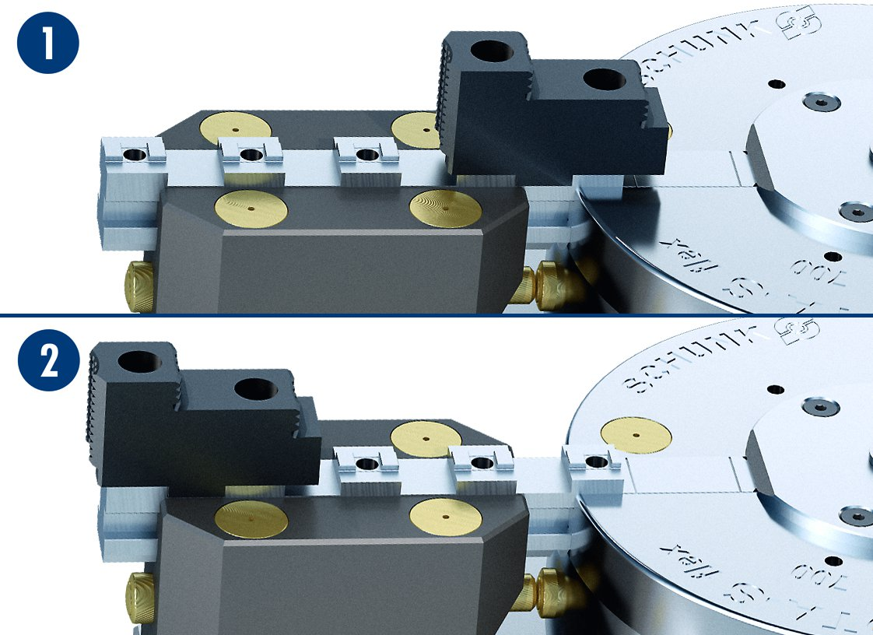
ROTA-S flex
ROTA-S flex with extended guideways
ROTA-S flex without extended guideways
Clamping range of the ROTA-S flex
1
1
Hard stepped jaws at minimum clamping range
Hard stepped jaws at maximum clamping range
2
2

Slide 10
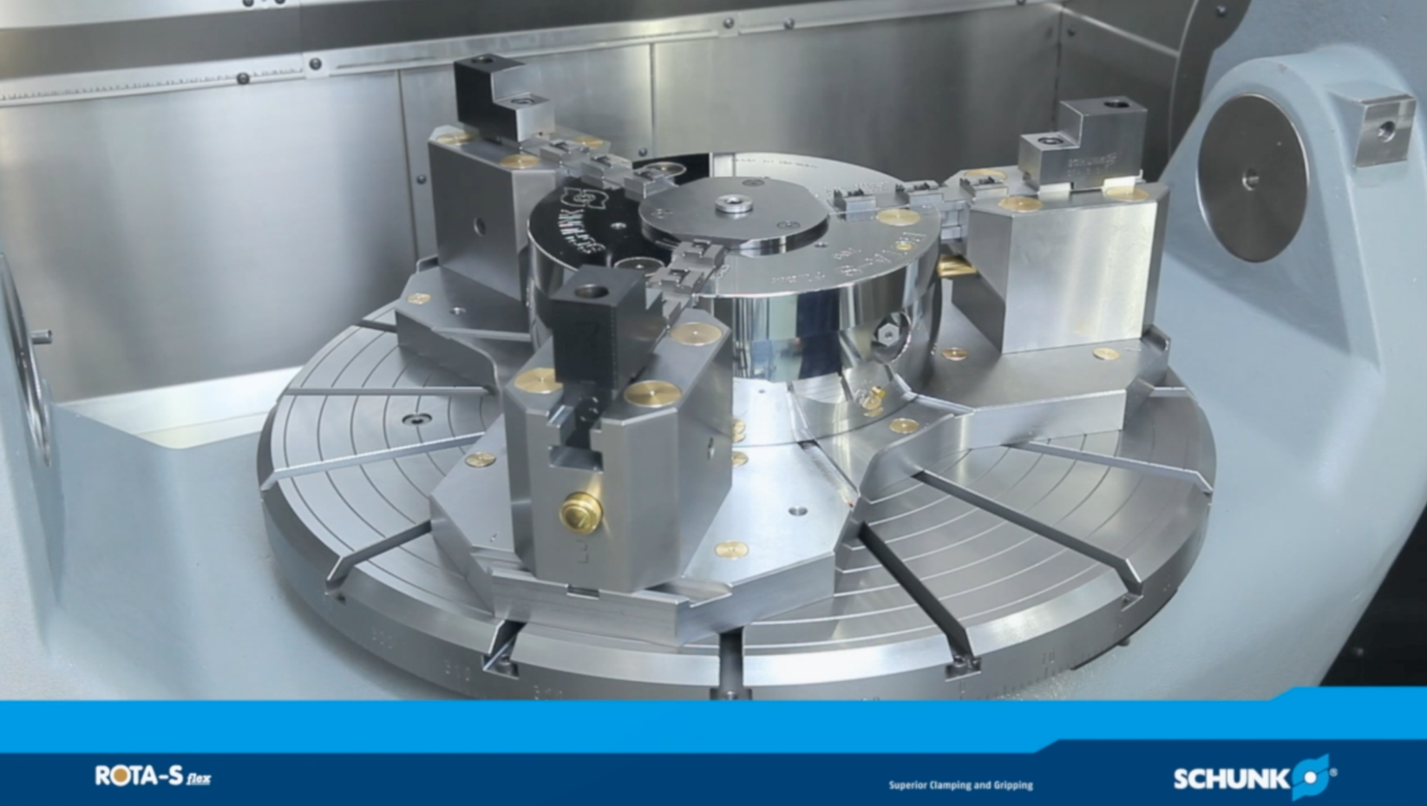
ROTA-S flex
Application

Slide 11
Variants ROTA-S flex
Technical data | Max. RPM [min⁻¹] | Max. clamping force [kN] | Max. torque [Nm] | Stroke/jaw [mm]
ROTA-S flex 550 | 1000 | 100 | 120 | 7
ROTA-S flex 700 | 800 | 180 | 220 | 9.7
ROTA-S flex 1000 | 500 | 230 | 280 | 12
ROTA-S flex 1200 | 500 | 270 | 320 | 12
ROTA-S flex 1400 | 400 | 270 | 350 | 15

Slide 12




SCHUNK Services
Engineering
Dimensioning of special plates designed to the manufacturing specifications
Development of special solutions together with the customer
FEM analysis for critical components
Testing
Endurance tests with all new developments
Abrasion checking
Measurement of accuracy
Service
Initial operation of customer´s solution
Inspection and maintenance
Repairs

