Slide 1


ROTA NCM
Hybrid Chucks

Slide 2













Product overview
Gripping Systems
Clamping Technology
Chuck Jaws
Stationary Workholding
Lathe Chucks
Toolholders
Hydraulic Expansion Technology
Manual Lathe Chucks
Power Lathe Chucks with Jaw Quick-change System
Power Lathe Chucks with Through-hole
Power Lathe Chucks without Through-hole
Pneumatic Power Chucks
Steady Rests
Quick-change Systems
Customized Solutions

Slide 3






ROTA overview
Customized Solutions
ROTA NCM
ROTA NCM-L
ROTA HSA
ROTA DFF
ROTA BEV
ROTA 4B
ROTA HSH

Slide 4
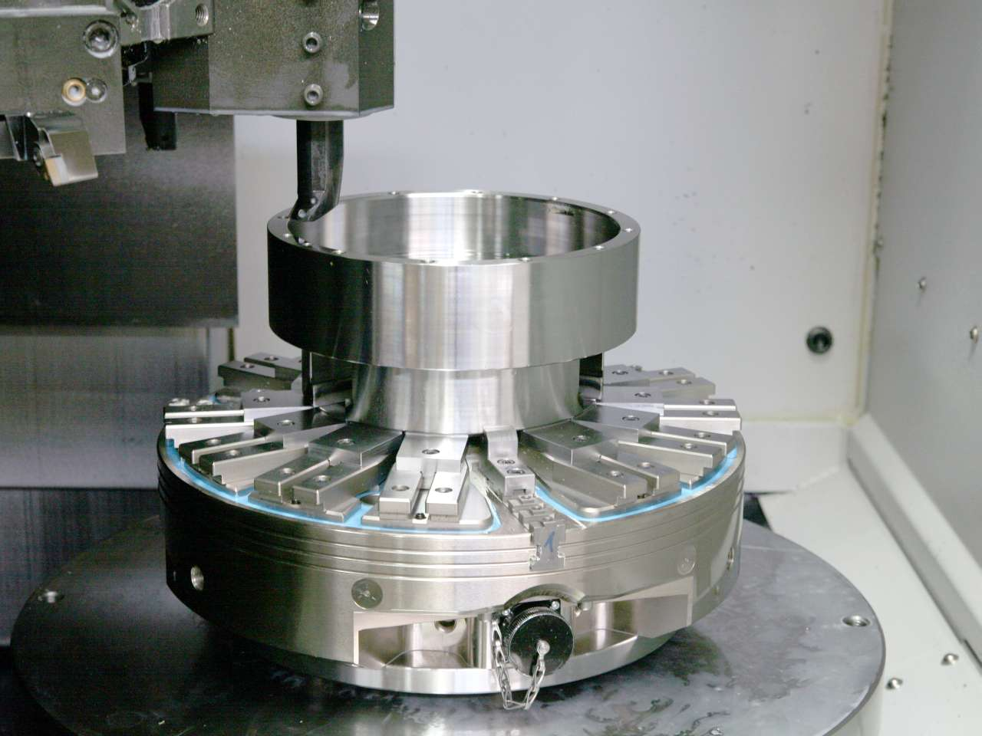
ROTA NCM
Example of application
Clamping device:
Hybrid chuck ROTA NCM 400.
Features/Application:
Three centering jaws center the workpiece fully automated within seconds.
Workpiece: pneumatic cylinder
Processing: finishing of piston surface.

Slide 5
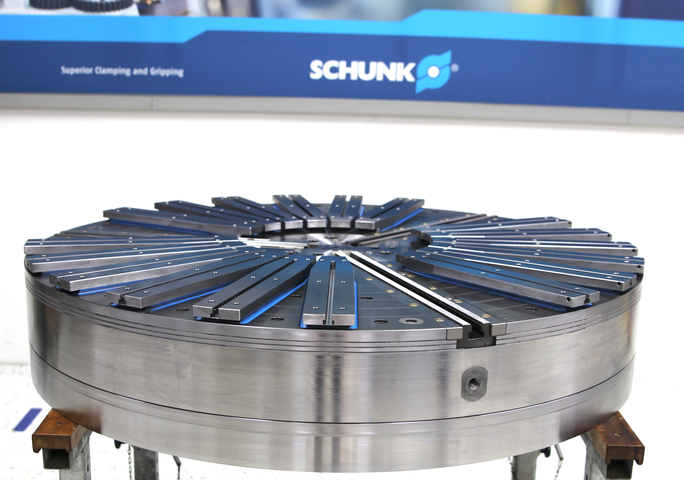
ROTA NCM
Example of application
Clamping device:
Hybrid chuck ROTA NCM 1300.
Features/Application:
Three centering jaws center the workpiece fully automated within seconds.
Centering chuck ROTA NCO.

Slide 6
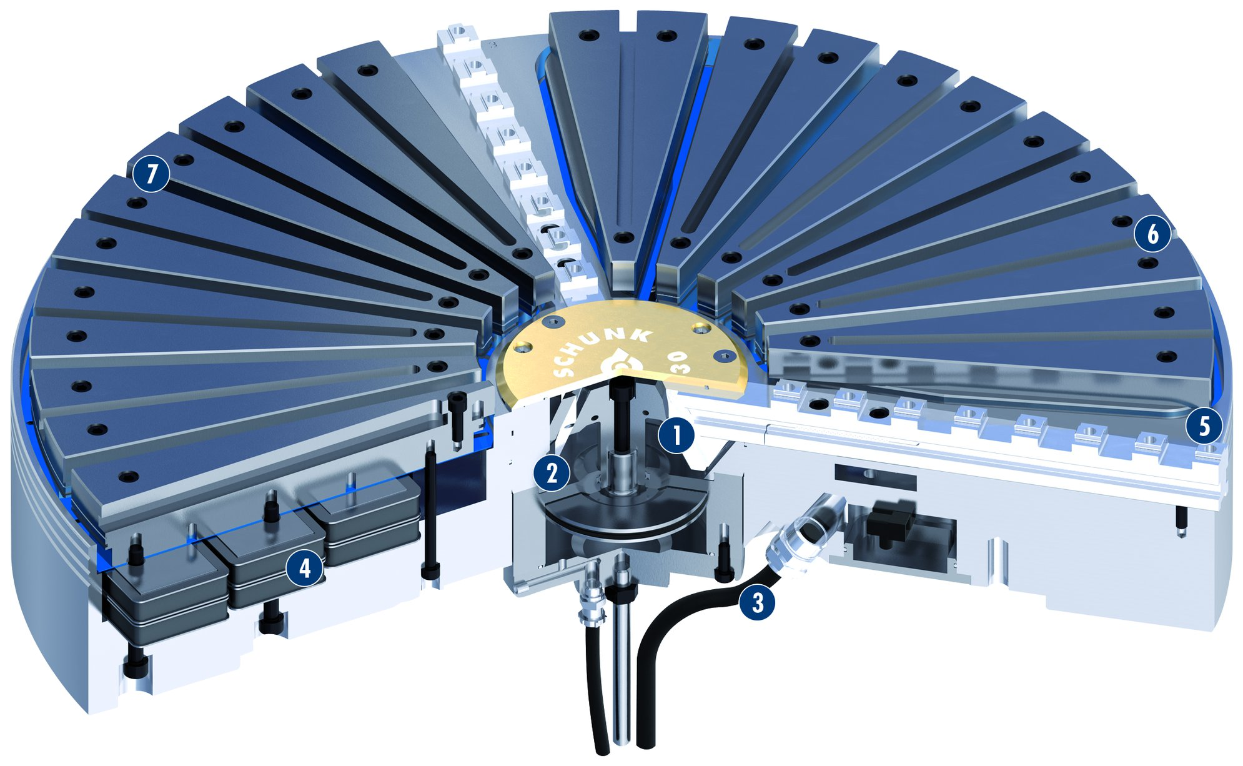
ROTA NCM
1
Encapsuled centering chuck
Integrated actuation cylinder
Power supply
Magnet system
Base jaws
Overwound/exchangeable pole shoes
T-slots
7
6
2
3
4
1
5
5
2
6
4
7
3

Slide 7
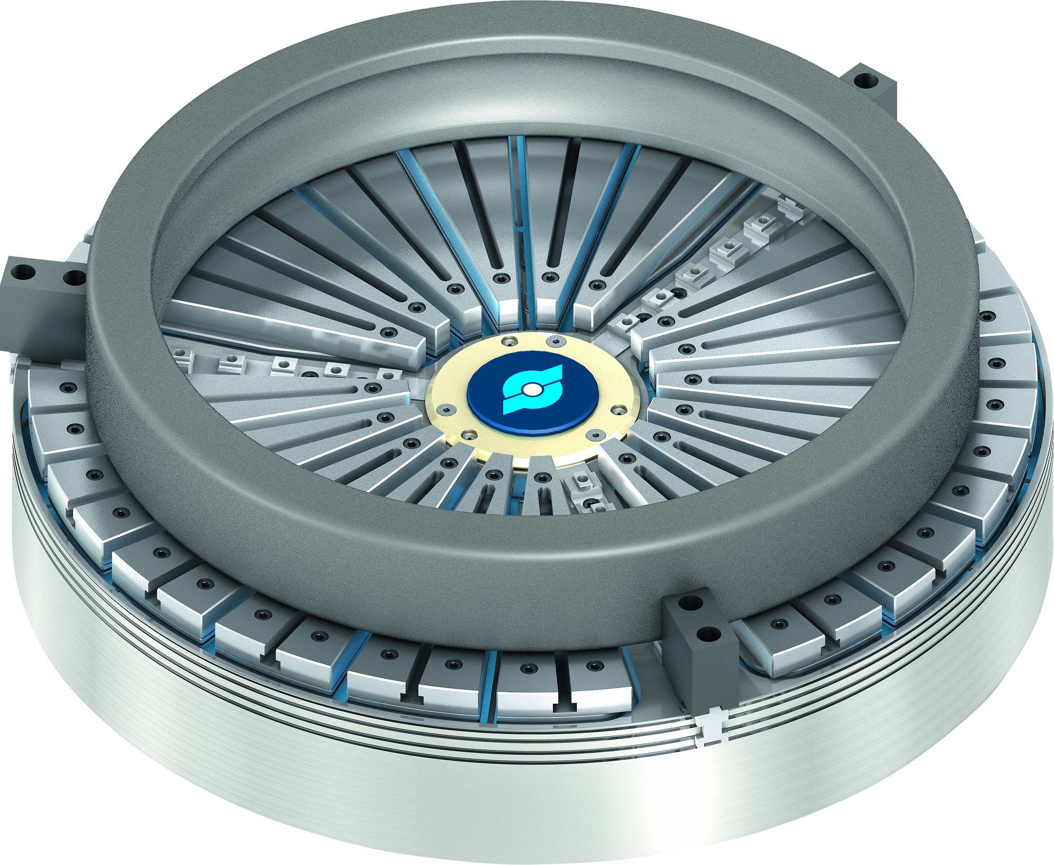
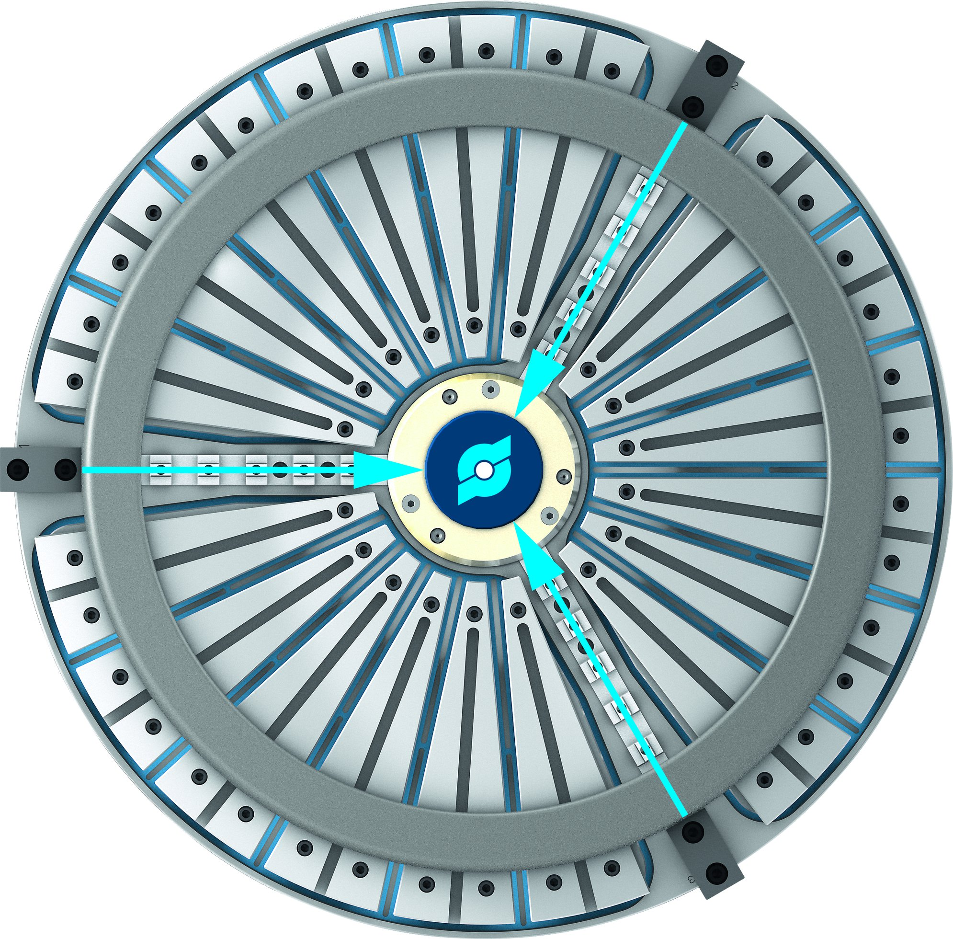
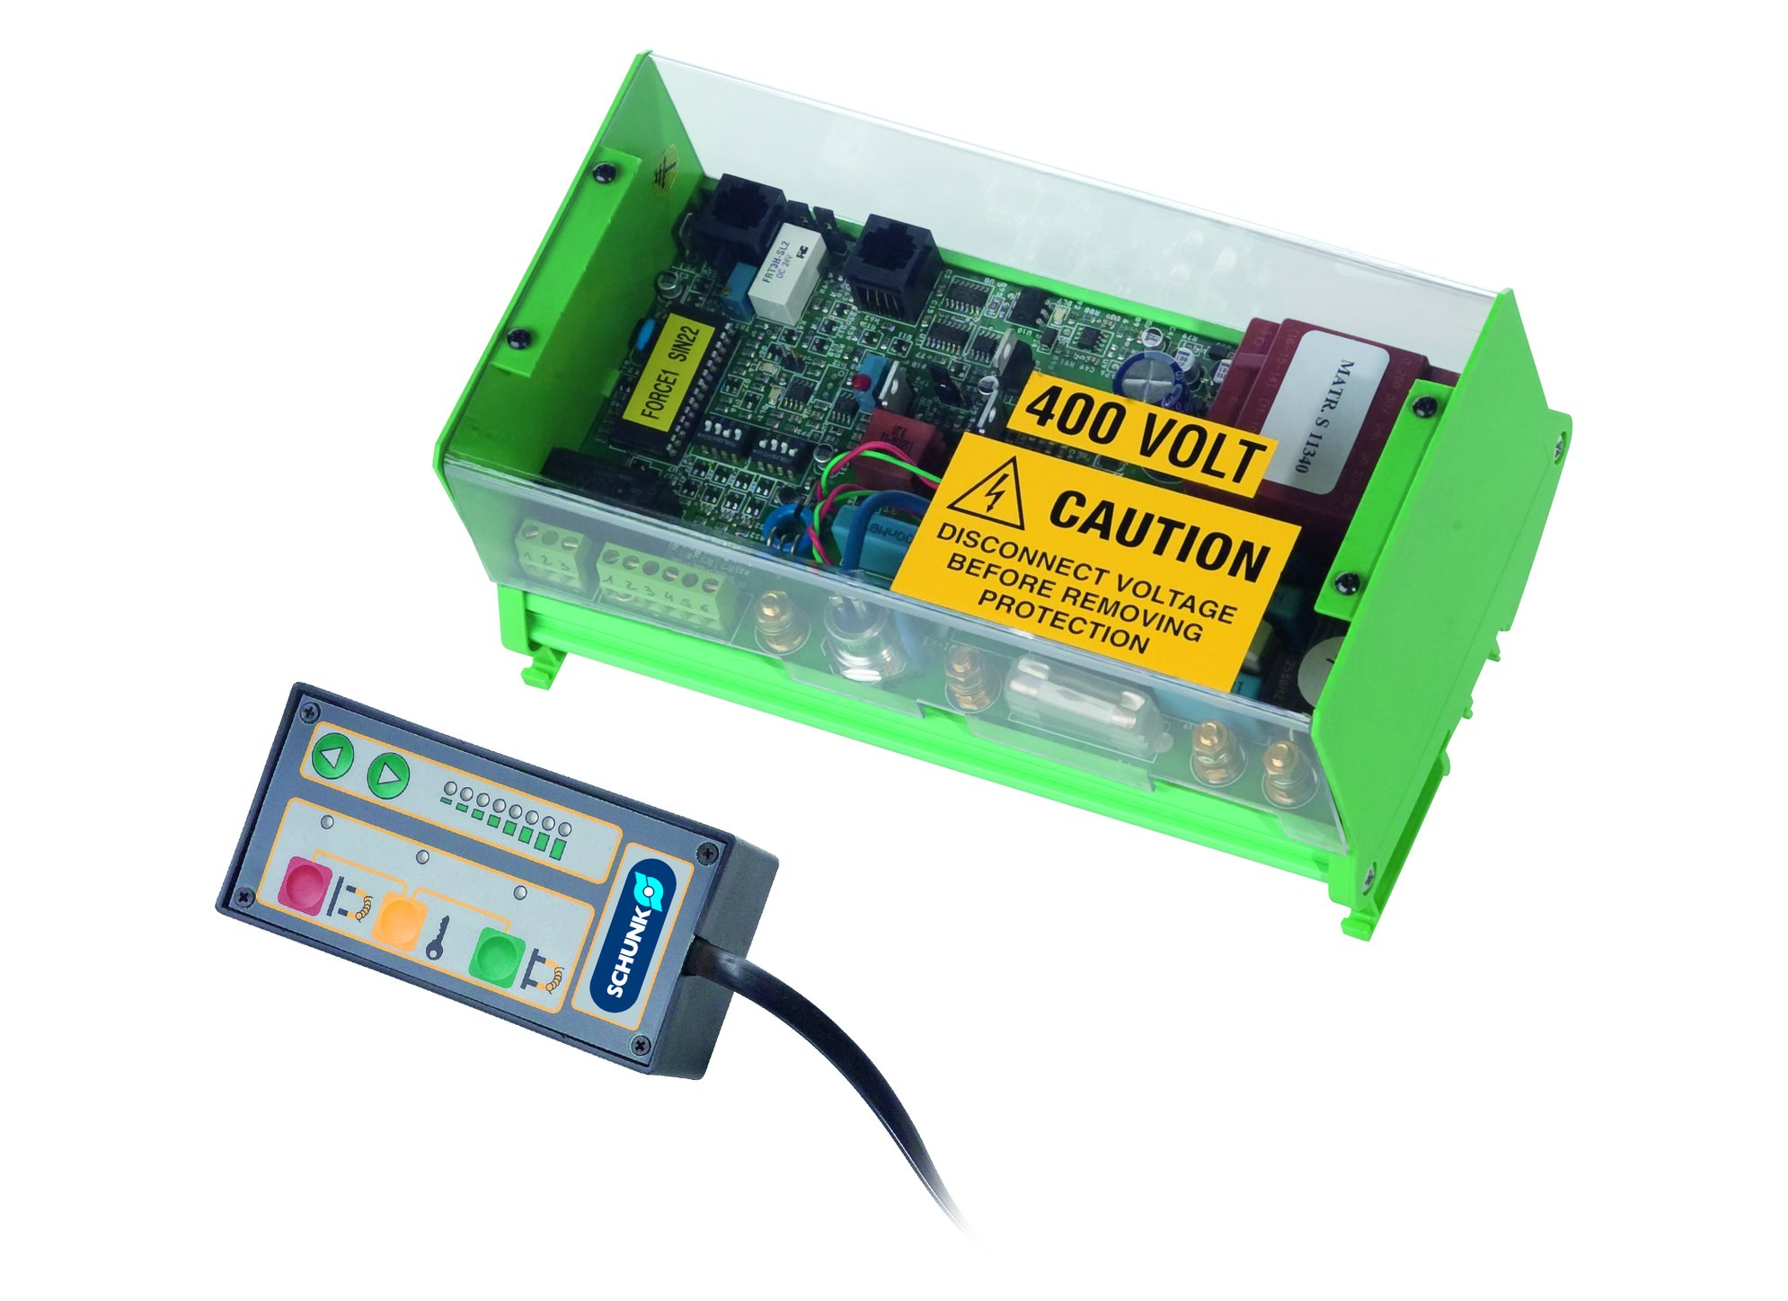
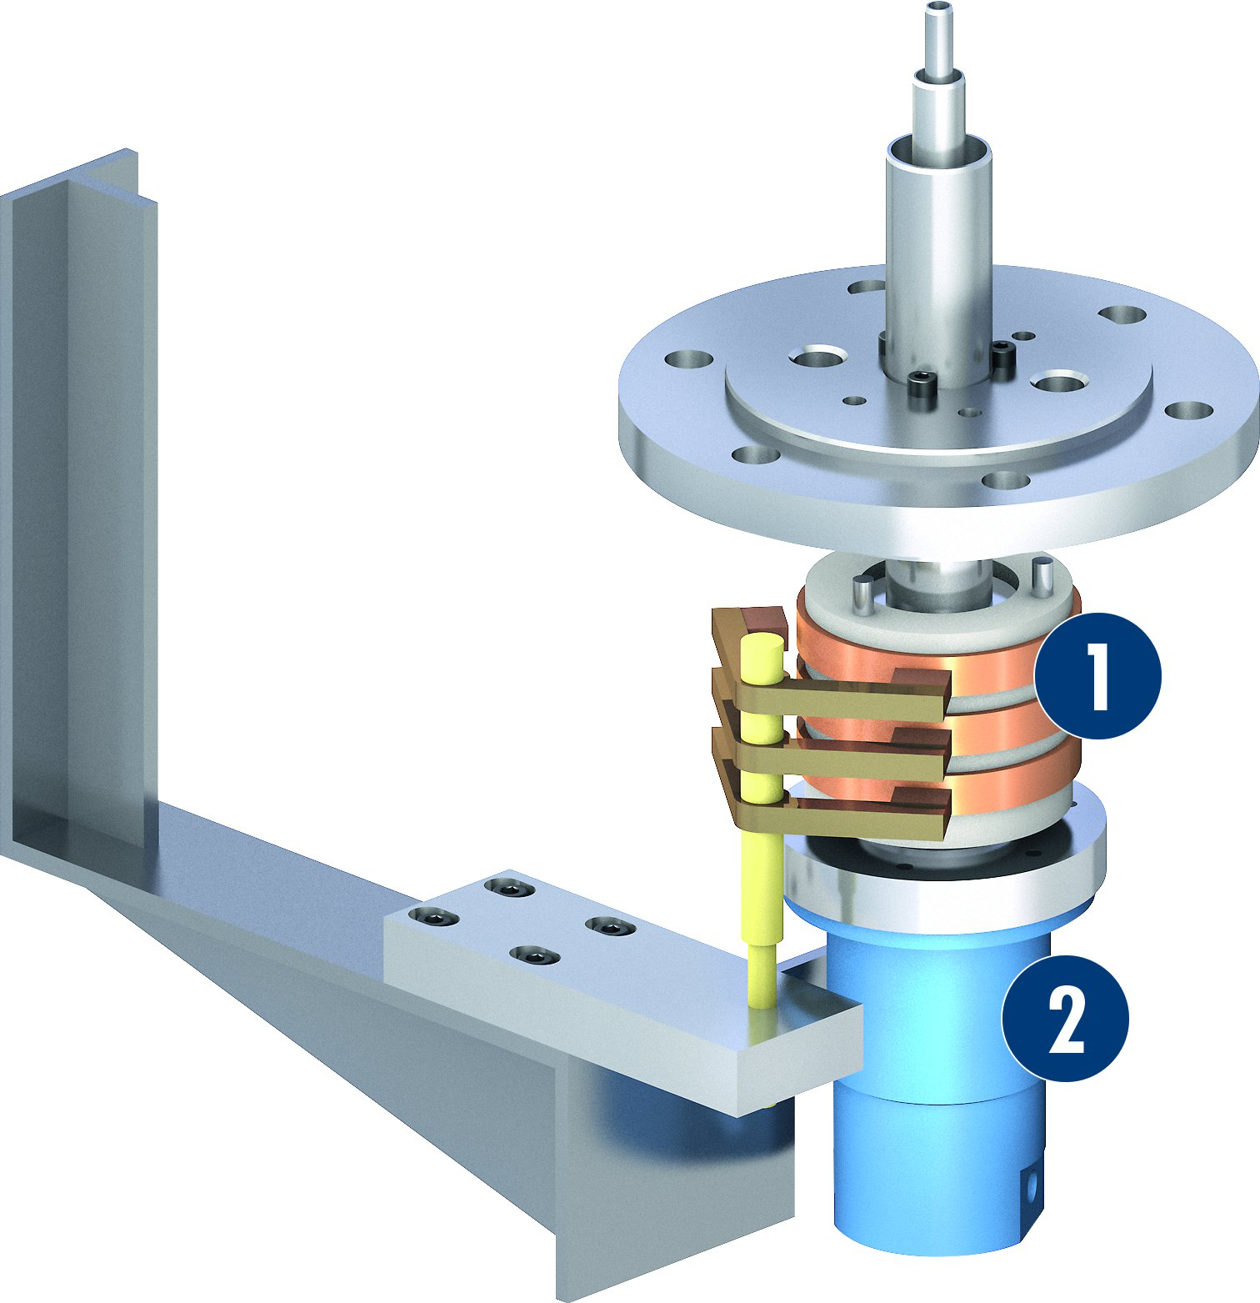
ROTA NCM
Secure hold due to permanent magnets
Centered in seconds
Control unit (internal)
Energy transmission
1
Slip ring
2-fold rotary distributor
1
2
2

Slide 8
Variants ROTA NCM
Technical Data | Centering force [kN] | Magnet clamping range [mm] | Number of centering jaws [Nm] | Height [mm]
ROTA NCM 400 | 10 | 150-400 | 3 | 120
ROTA NCM 630 | 20 | 200-630 | 3 | 120
ROTA NCM 800 | 20 | 250-800 | 3 | 170
ROTA NCM 1000 | 30 | 250-1000 | 3 | 170
ROTA NCM 1400 | 30 | 300-1400 | 3/6 | 155
ROTA NCM 2000 | 50 | 500-2000 | 3/6 | 190
ROTA NCM 2500 | 80 | 500-2500 | 3/6 | 190

Slide 9



SCHUNK Services
Engineering
Dimensioning of special plates designed to the manufacturing specifications
Development of special solutions together with the customer
FEM analysis for critical components
Testing
Endurance tests with all new developments
Abrasion checking
Measurement of accuracy
Service
Initial operation of customer´s solution
Inspection and maintenance
Repairs

