Slide 1


Toolholding Systems
TRIBOS Polygonal Clamping Technology

Slide 2
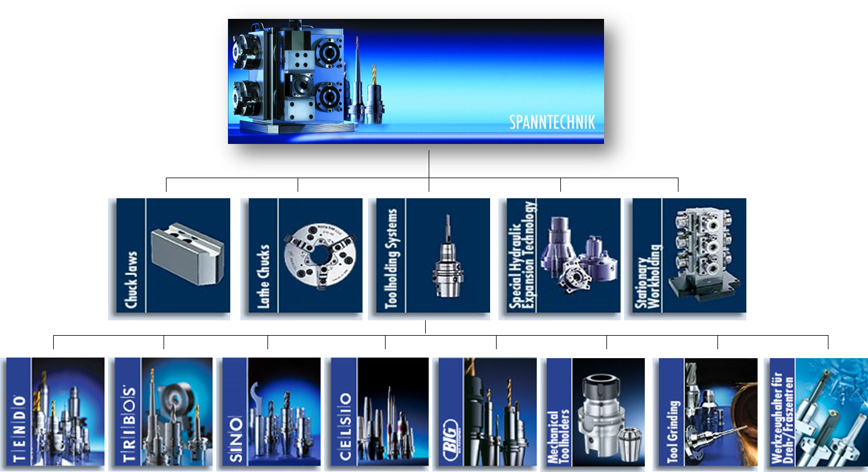
Product overview

Slide 3
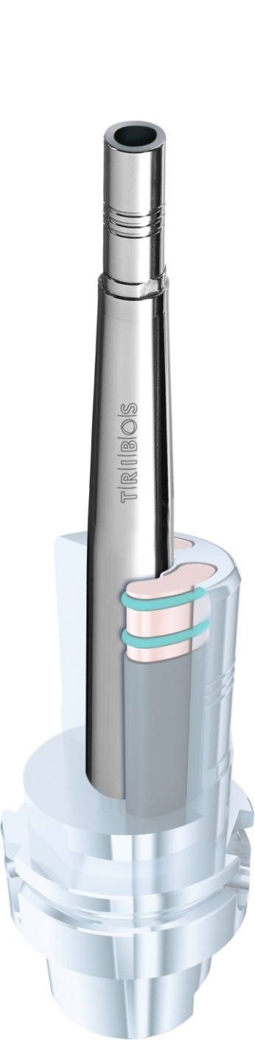
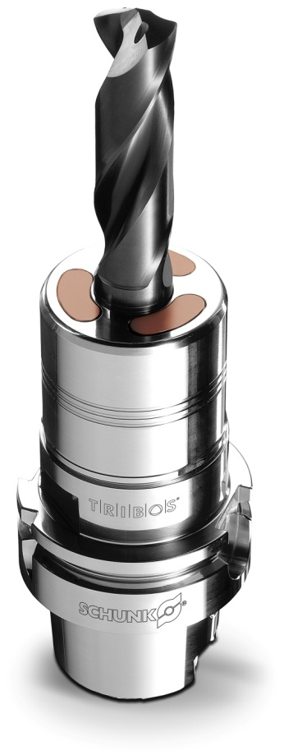
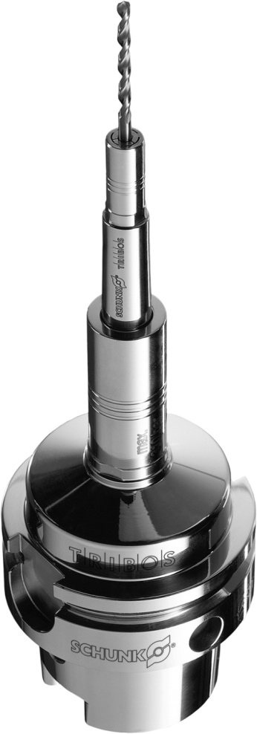
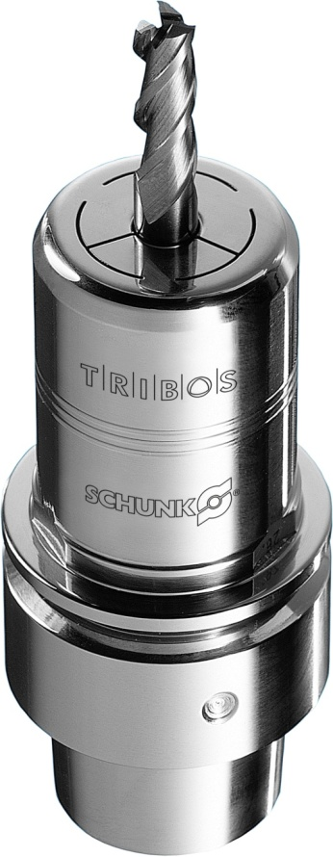
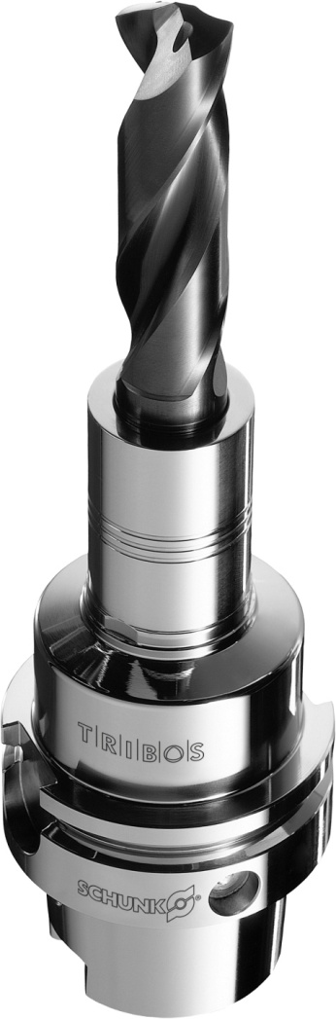

TRIBOS

Slide 4
TRIBOS Polygonal Clamping Technology
Optimal surfaces! Through excellent dynamic concentricity properties < 0.003 mm
Constantly further-developed, patented TRIBOS Polygonal Clamping Technology Program with a versatile and extensive range of application
From precision micromachining to powerful volume machining
Excellent concentricity properties of < 0.003 mm lead to longer service lives and the best surfaces
Suited to highspeed machining
HSC-tauglich

Slide 5
Advantages
Ultimate run-out accuracy < 0.003 mm
Rotationally symmetric design
No moving parts, making it maintenance-free
Versatile clamping range due to intermediate sleeves
Comprehensive range – from micromachining to volume machining
Optimal vibration damping by virtue of the polygonal honeycomb structure

Slide 6
Technical highlights
For over 10 years
Has stand out through consistant run-out accuracy and outstanding vibration damping
The TRIBOS SVP clamping devices enable the polygonal clamping diameter of the toolholder to run true, the tool shank can be easily inserted
If the pressure on the clamping diameter eases off , then it will assume its polygonal shape again and clamps the inserted tool shank process reliably and with high repeat accuracy
The polygonal clamping shape and especially, with TRIBOS-R, the additional vibration damping inserts in the hollow chambers lead to an optimal running smoothness for the tool
The damping property in polygonal clamping technology prevents micro-blowouts on the cutting edge of the tool, thus increasing the service life of the tool and enhancing the performance of the spindle
The machining process improved by the dampening is clearly demonstrated in the result of the excellent workpiece surfaces

Slide 7
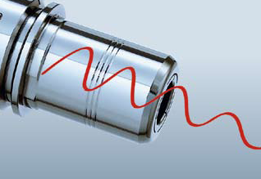
Features
More efficiency through vibration damping
Excellent vibration damping
Guarantees best cutting actions
Prevents micro-blowouts on the cutting edge of the tool
Increases the tools‘ service life considerably
Leads to a reduction in costs

Slide 8
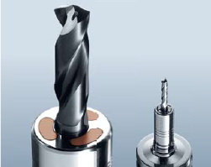
Features
Versatility through the clamping range from
0.3 – 32 mm
All tools with commercially available shank types in the 0.3 – 32 mm diameter range can be clamped
Versaility in production
Significant reduction in tool acquisition costs

Slide 9
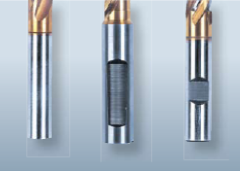
Features
All commercially available tool shank types can be clamped
Tools with both smooth cylindrical shanks in accordance with DIN 6535 Type HA up to Ø 32 mm and also those with recesses in accordance with: DIN 1835 Form B, E DIN 6535 Form HA, HB, HE can be clamped directly and without the use of an intermediate sleeve

Slide 10
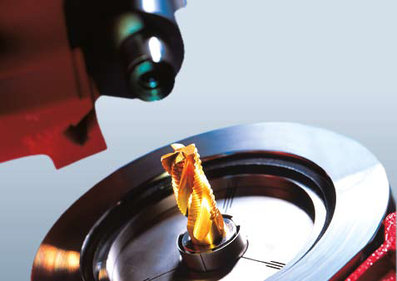
Features
Axial length adjustment
The length can be adjusted in a 0.01 mm precision range – an essential advantage over thermal shrink fit holders
Adjustment travel: 10 mm

Slide 11
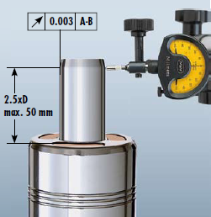
Features
Optimal dynamic concentricity properties for excellent surface quality
Excellent dynamic run-out properties < 0.003 mm
Best results for:
  Shape accuracy
  Surface finish
  Shape and positional tolerance

Slide 12

TRIBOS-R

Slide 13
TRIBOS-R
Process reliable! Dampening and radial rigidity combined in one toolholder
Offers through its unique polygonal honeycomb structure and increased outer diameter, an optimal ratio between radial rigidity and dampening
Provides the best dynamic run-out properties
Optimal running smoothness and excellent shape and positional tolerances
For process reliable machining of the highest level
Maximum radial rigidity
Very good vibration damping
Run-out accuracy and repeat accuracy < 0.003 mm
Ultimate dynamic true run-out properties

Slide 14
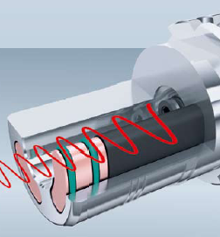
TRIBOS-R
Unique! Honeycomb structure for stability
Two technical features combined in one toolholder: vibration damping and radial rigidity
Excellent vibration damping provides stability for the entire system: spindle – toolholder – cutting tool
Optimal radial rigidity is achieved through the even distribution of forces from polygonal clamping
Rigidity prevents lateral deflection during the cutting process
Guarantees stable and precise machining

Slide 15
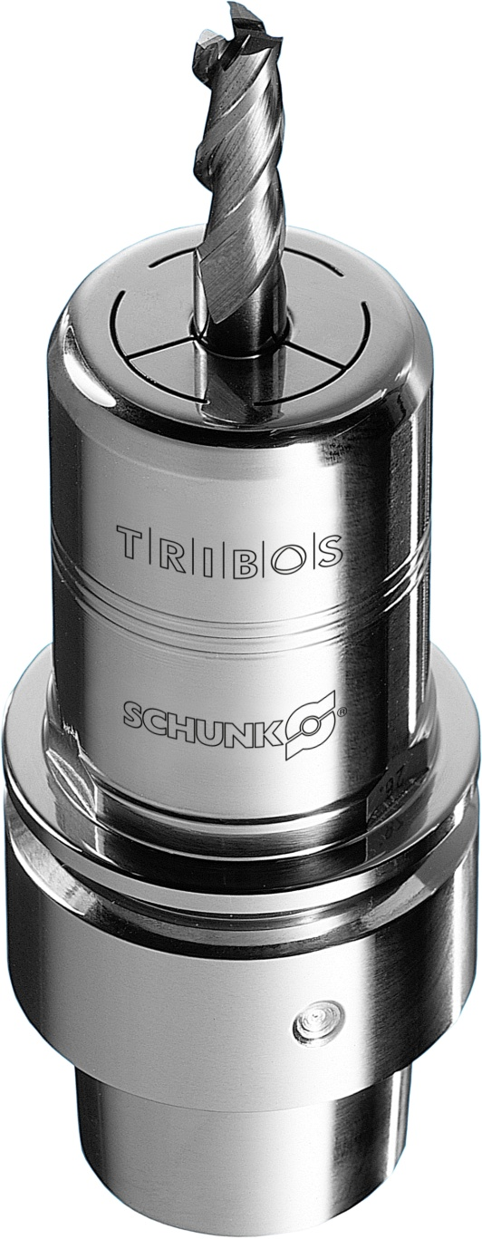
TRIBOS-RM

Slide 16
TRIBOS-RM
The small one! For powerful high-speed machining in micromachining up to over 80000 rpm
Suitable for precise machining in high speed ranges to over 80000 rpm
Run-out accuracy of < 0.003 mm
Stability is gained from the honeycomb structure
Extremely compact toolholder tapers
Ensures precise and process-capable machining
Sizes HSK-E 25, 32, 40 and HSK-F 32 are perfectly suitable for small, highly dynamic machining centers
Small and compact design
High radial rigidity

Slide 17
TRIBOS-RM
Stability through high radial rigidity
The honeycomb structure allows TRIBOS-RM to remain stable during loads caused by high cutting forces
The clamping forces suffice to reach the limits of the loads generated by high-speed machining centers
High machining performance paves the way for quicker machining times and thus increases the productivity

Slide 18
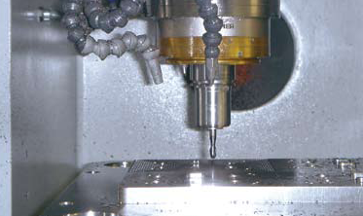
TRIBOS-RM
Compact design for the highest demands in high-speed cutting
Compact and short design makes speeds of over 80000 rpm possible
Thanks to the rotation symmetry, the residual imbalance lies under 2 gmm
Solution for extreme and diverse demands in high-speed machining
E. g. in tool and mould making for high-speed HSK-E 40 spindles

Slide 19

TRIBOS-S

Slide 20
TRIBOS-S
Extremely slim design! Accurate in the tightest machining conditions
Extremely slim design
The optimal continuous run-out and repeat accuracy of < 0.003 mm ensures a more even cutting action and thus improves the tool service life by four times over
High feed rate through the light design
Speed range up to 85000 r pm (high-speed cutting)

Slide 21
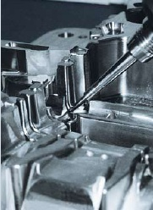
TRIBOS-S
Unsurpassed slim design for narrow interference contours
Through ist unsurpassed slim design, offers TRIBOS-S ideal prerequisites for precision machining tasks in or on difficult-to-access workpiece areas

Slide 22
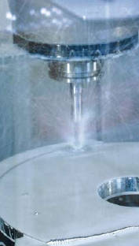
TRIBOS-S
Up to 85000 rpm – predestined for high-speed machining operations
Owing to its rotationally symmetric and light design, the TRIBOS-S can be used in speed ranges up to 85000 rpm

Slide 23
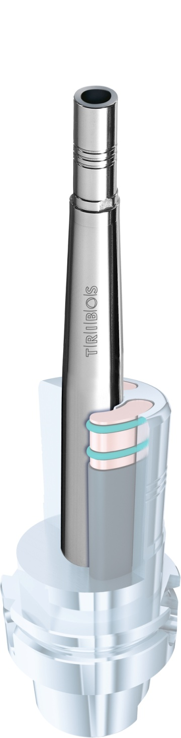
TRIBOS SVL

Slide 24
TRIBOS SVL
Universal! Super-slim tool extension
The use of TRIBOS SVL extensions makes it possible to use standard machining tools instead of expensive special tools
Extension with run-out accuracy of < 0.003 mm
Particularly slim-design interfering contour
Used in combination with various SCHUNK toolholders

Slide 25
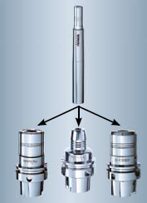
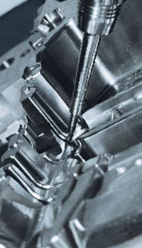
TRIBOS SVL
Quickly combined – saves costs
Can be combined with various toolholder systems
Modular design – the synergy effect
The TRIBOS extensions complement each other in combination with our TENDO hydraulic expansion toolholders or the TRIBOS-R polygonal toolholders
Both systems have a damping effect on the entire system and reduce vibration

Slide 26

TRIBOS-Mini

Slide 27
TRIBOS-Mini
SCHUNK: The Pioneer for micr omachining, with the smallest shank diameter starting with a 0.3 mm
Sets standards in micromachining
Is used in filigree machining operations for housings, molds, electrodes, and engravings in medical technology and electrotechnology, as well as in the watch and clock making industry, or in the precision die construction industry
Extremely small shanks can be clamped
Timeconsuming and cost-intensive manufacture of special tools is no longer needed
For the smallest diameters starting from 0.3 mm
Economical for filigree machining operations without special tools
Quick and easy tool changes

Slide 28
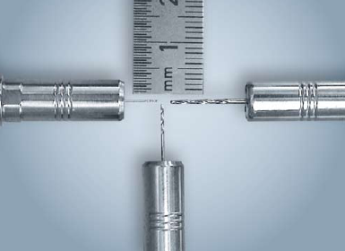
TRIBOS-Mini
Top performance with the smallest diameter
All tool shanks with h6 tolerance can be clamped as from Ø 0.3 mm

Slide 29
TRIBOS SVP
Clamping device for a safe and q uick tool change
To clamp tools quickly and evenly

Slide 30
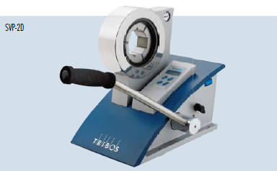
TRIBOS SVP-2
The clamping device with a hand pump
Offers fast actuation for frequent tool changes
The desired clamping pressure can be built up exactly and quickly with the hand pump and the fitted pressure gauge comes standard

Slide 31
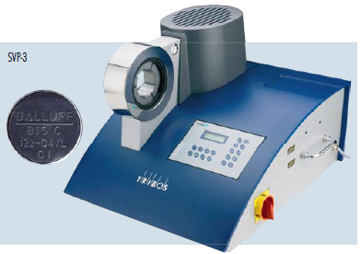
TRIBOS SVP-3
The automatic clamping device
Offers maximum ease of use and process reliability trough an integrated hydraulic unit for applying pressure, a mount for a length measuring system for tool presetting, as well as an operator display*
* an opt. Data matrix code reader can be used to preset the clamping pressure accurately

Slide 32
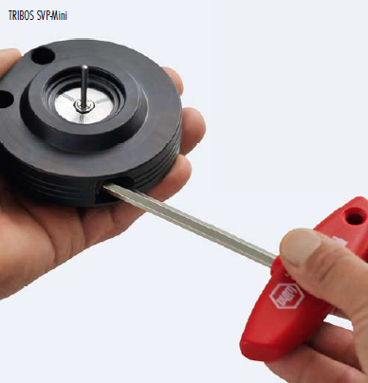
TRIBOS SVP-Mini and TRIBOS SVP-RM
Quick and easy tool changes reduce set-up times
Change tools in a matter of seconds
Attach the clamping device to TRIBOS-Mini or TRIBOS-RM, insert the tool, clamp to dead stop – finished
Thanks to the present pressure, the tool is clamped quickly and process-capably
This saves time and significantly reduces set-up costs

Slide 33
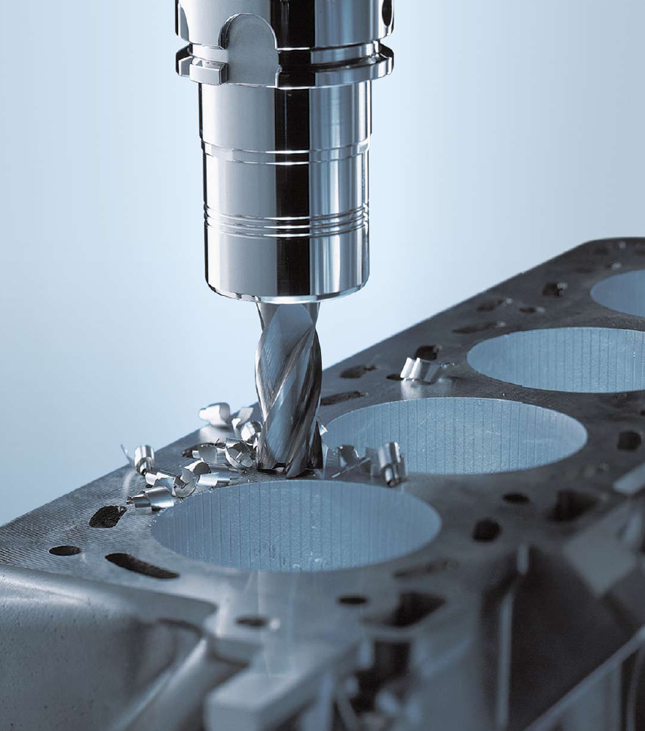
Applications
Milling in the automotive industry with TRIBOS-R

Slide 34
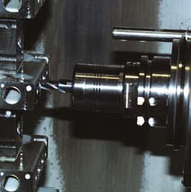
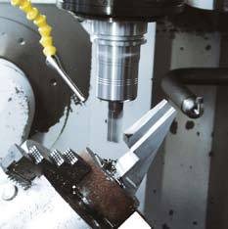
Applications
Thread-milling of mobile hydraulic valve bodies with TRIBOS-R
Milling for roughing of housing parts with TRIBOS-R

Slide 35
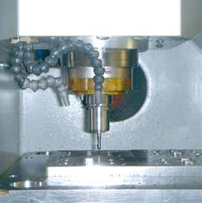
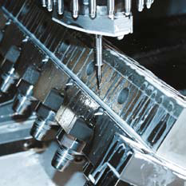
Applications
HSC circular milling of pockets in mould making wit h TRIBOS-RM
Drilling in tool making wit h TRIBOS-S

Slide 36
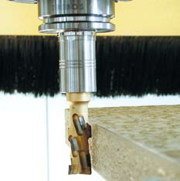
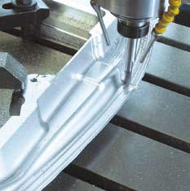
Applications
Lateral milling of kitchen countertops with TRIBOS-S (wood working)
Profile-cutting in finishing of hardened steel with TRIBOS SVL

Slide 37
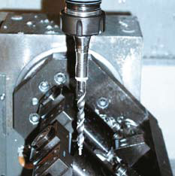
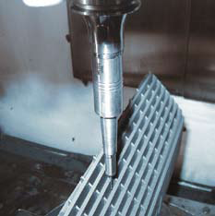
Applications
Drilling of aluminium supports on hydraulic brake units for bicycles with TRIBOS SVL
Electrode-milling with small diameters with TRIBOS-Mini

