Slide 1
Competitive comparison
3-jaw-centric gripper with large stroke
Schunk PZH+ / Sommer GD-series

Slide 2
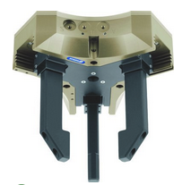
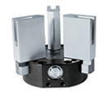
Manufacturer |  | Schunk |  |  |  | Sommer
Description |  | PZH+ |  |  |  | GD
Size |  | 20 | 30 | 50 | 75 | 530 | 540 | 560
Stroke | [mm] | 20 | 30 | 50 | 75 | 30 | 40 | 60
Gripping force | [N] | 375 | 900 | 2000 | 4200 | 1300 | 2480 | 2480
External diameter | [mm] | 168 | 230 | 360 | 518 | 248 | 340 | 420
Housing height | [mm] | 44,5 | 59,3 | 85,5 | 119,1 | 71 | 100 | 100
Net mass | [kg] | 1,5 | 3,9 | 12,5 | 33 | 7,4 | 19 | 29
Center bore |  | ja | ja | ja | ja | nein | nein | nein
Synchronisation |  | toothed belt |  |  |  | cam disk
Performance index (in relation to mass) | force x stroke / mass | 5,00 | 6,92 | 8,00 | 9,55 | 5,27 | 5,22 | 5,13
Performance index (in relation to volume) | force x stroke / volume | 7,6 | 10,96 | 11,49 | 12,55 | 11,37 | 10,93 | 10,74
Sales arguments PZH+ :
flat version
lower mass
center bore
higher power density
multi-tooth guidance

