Slide 1
Short presentation
MPG-plus Precision Version

Slide 2
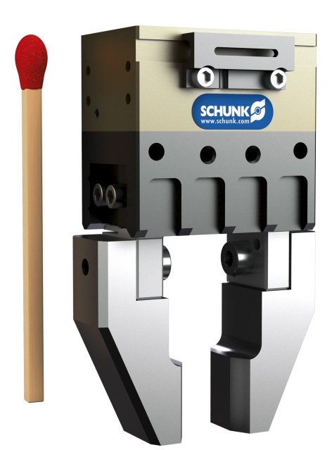
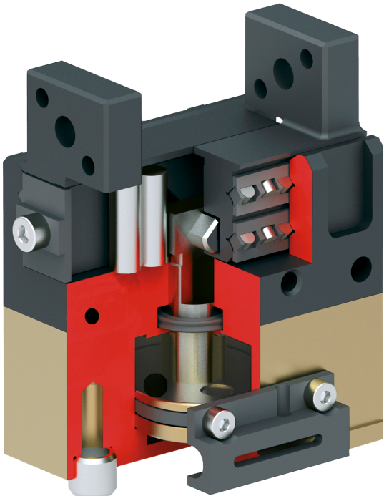
MPG-plus Precision Version
#1: The new standard in small parts handling
New Product
Sucessor product
New Sizes
Unique selling points:
Replacement accuracy
Clamping center – eccentricity
Equal height – gripper height
Base jaws offset from one another
Further product features:
See MPG-plus basic version

Slide 3
MPG-plus Precision Version
#1: The new standard in small parts handling
New Product
Sucessor product
New Sizes
Customer value/selling points:
See MPG-plus
Plug-in and Play at max. accuracy
Equal height if several grippers are fastened next to each other on a plate
Reduced eccentricity when rotating a gripper due to a more precise clamping center
Parallelism of the fingers to the mounting surface therefore no/lower maintenance, retrofitting, and product launch costs, if the grippers are replaced

Slide 4
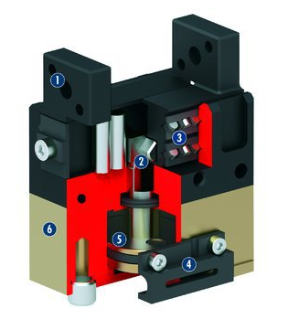
MPG-plus Precision Version
#1: The new standard in small parts handling
New Product
Sucessor product
New Sizes
  Basic technical functions:
  Sizes: 16, 20, 25, 32, 40, 50, 64
  Weight: 0.03 kg ... 0.7 kg
  Gripping force: 25 N ... 350 N
  Stroke per finger: 1.5 mm ... 10mm
  Workpiece weight: 0.13 kg ... 1.25 kg
  Complementary products:
MMS- P Magnetic switch
OAS – Optical distance and presence recognition sensor
INS Inductive monitoring
FPS Flexible position sensor
Valve box for MPG-plus
Base jaw
Wedge-hook design
Cross roller guide
Sensor system
Oval piston drive
Housing

Slide 5


