Slide 1
Short presentation
CGH

Slide 2
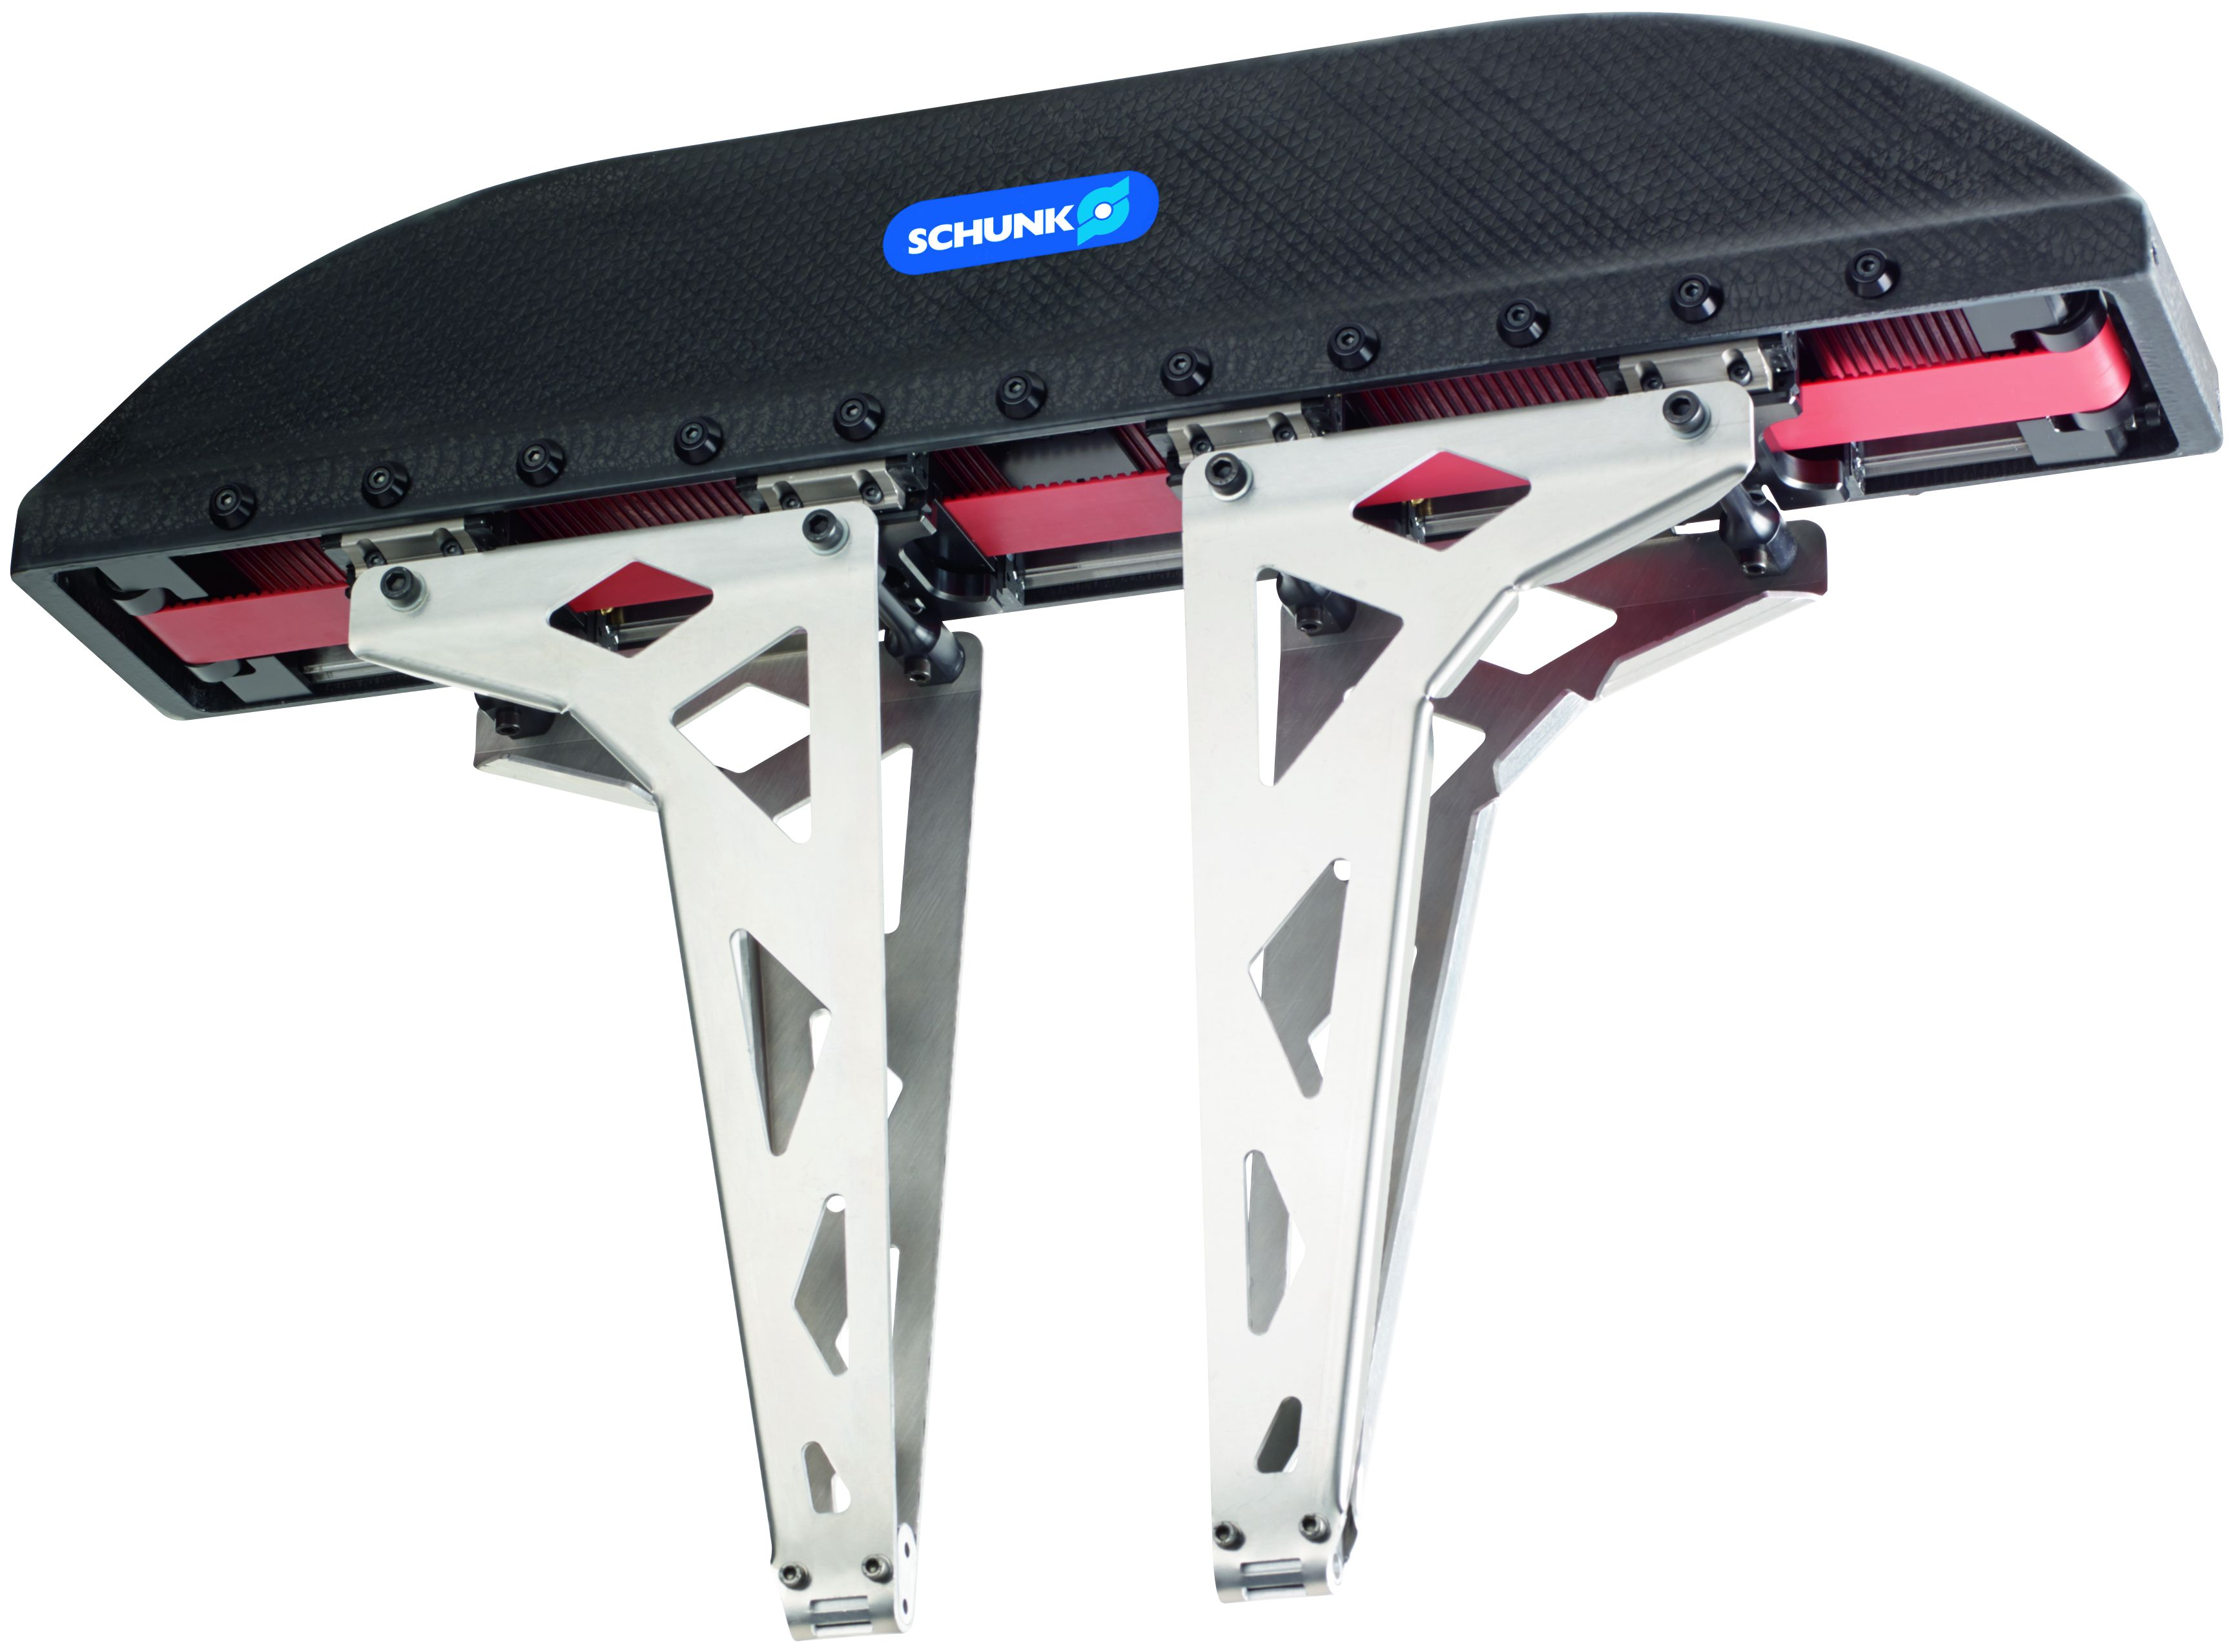
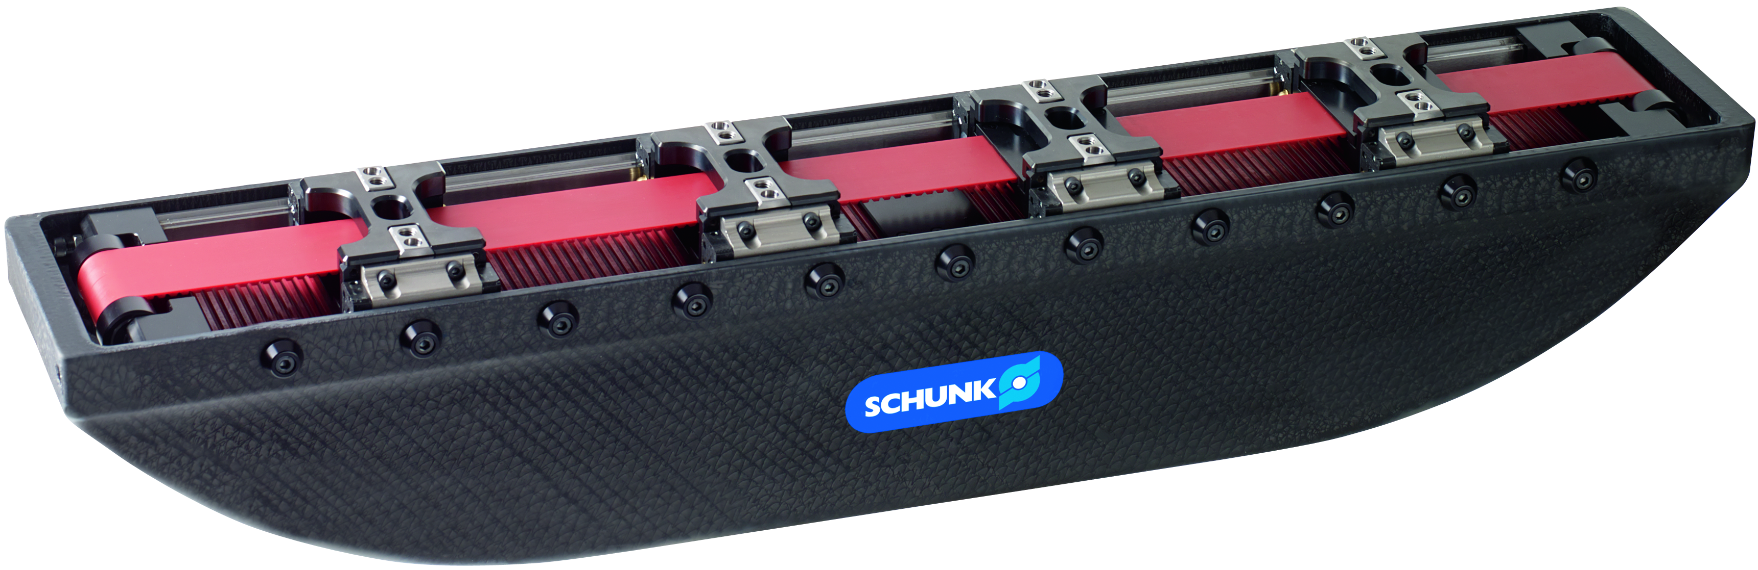
CGH
#1: First standardized lightweight gripper with carbon-fiber reinforced plastic
New Product
Sucessor product
New Sizes
Product Features:
Pneumatic long stroke gripper with rolling element guidance, toothed belt synchronization, and integrated end position damping
Due to the higher E-module, it achieves a higher bending and torsional stiffness than aluminum
The housings is made of carbon-fiber reinforced plastic,
and is manufactured in an RTM process
Stress-related fiber orientation (no fiber mats)
Combination of low weight and high mechanical strength
Moment decoupling due to pivot bolts in the base jaw

Slide 3
CGH
#1: First standardized lightweight gripper with carbon-fiber reinforced plastic
New Product
Sucessor product
New Sizes
Customer value/selling points
Higher dynamics is achieved than with aluminum housings for shorter cycle times, smaller robots, and a higher productivity.
Use of very long fingers possible
Approximately constant gripping force along the finger length
The stroke can be separately adjusted for opening and closing. It is used for reducing cycle times, and helps to save compressed air
With the ISO flange, it can be directly adapted to the robot flange

Slide 4
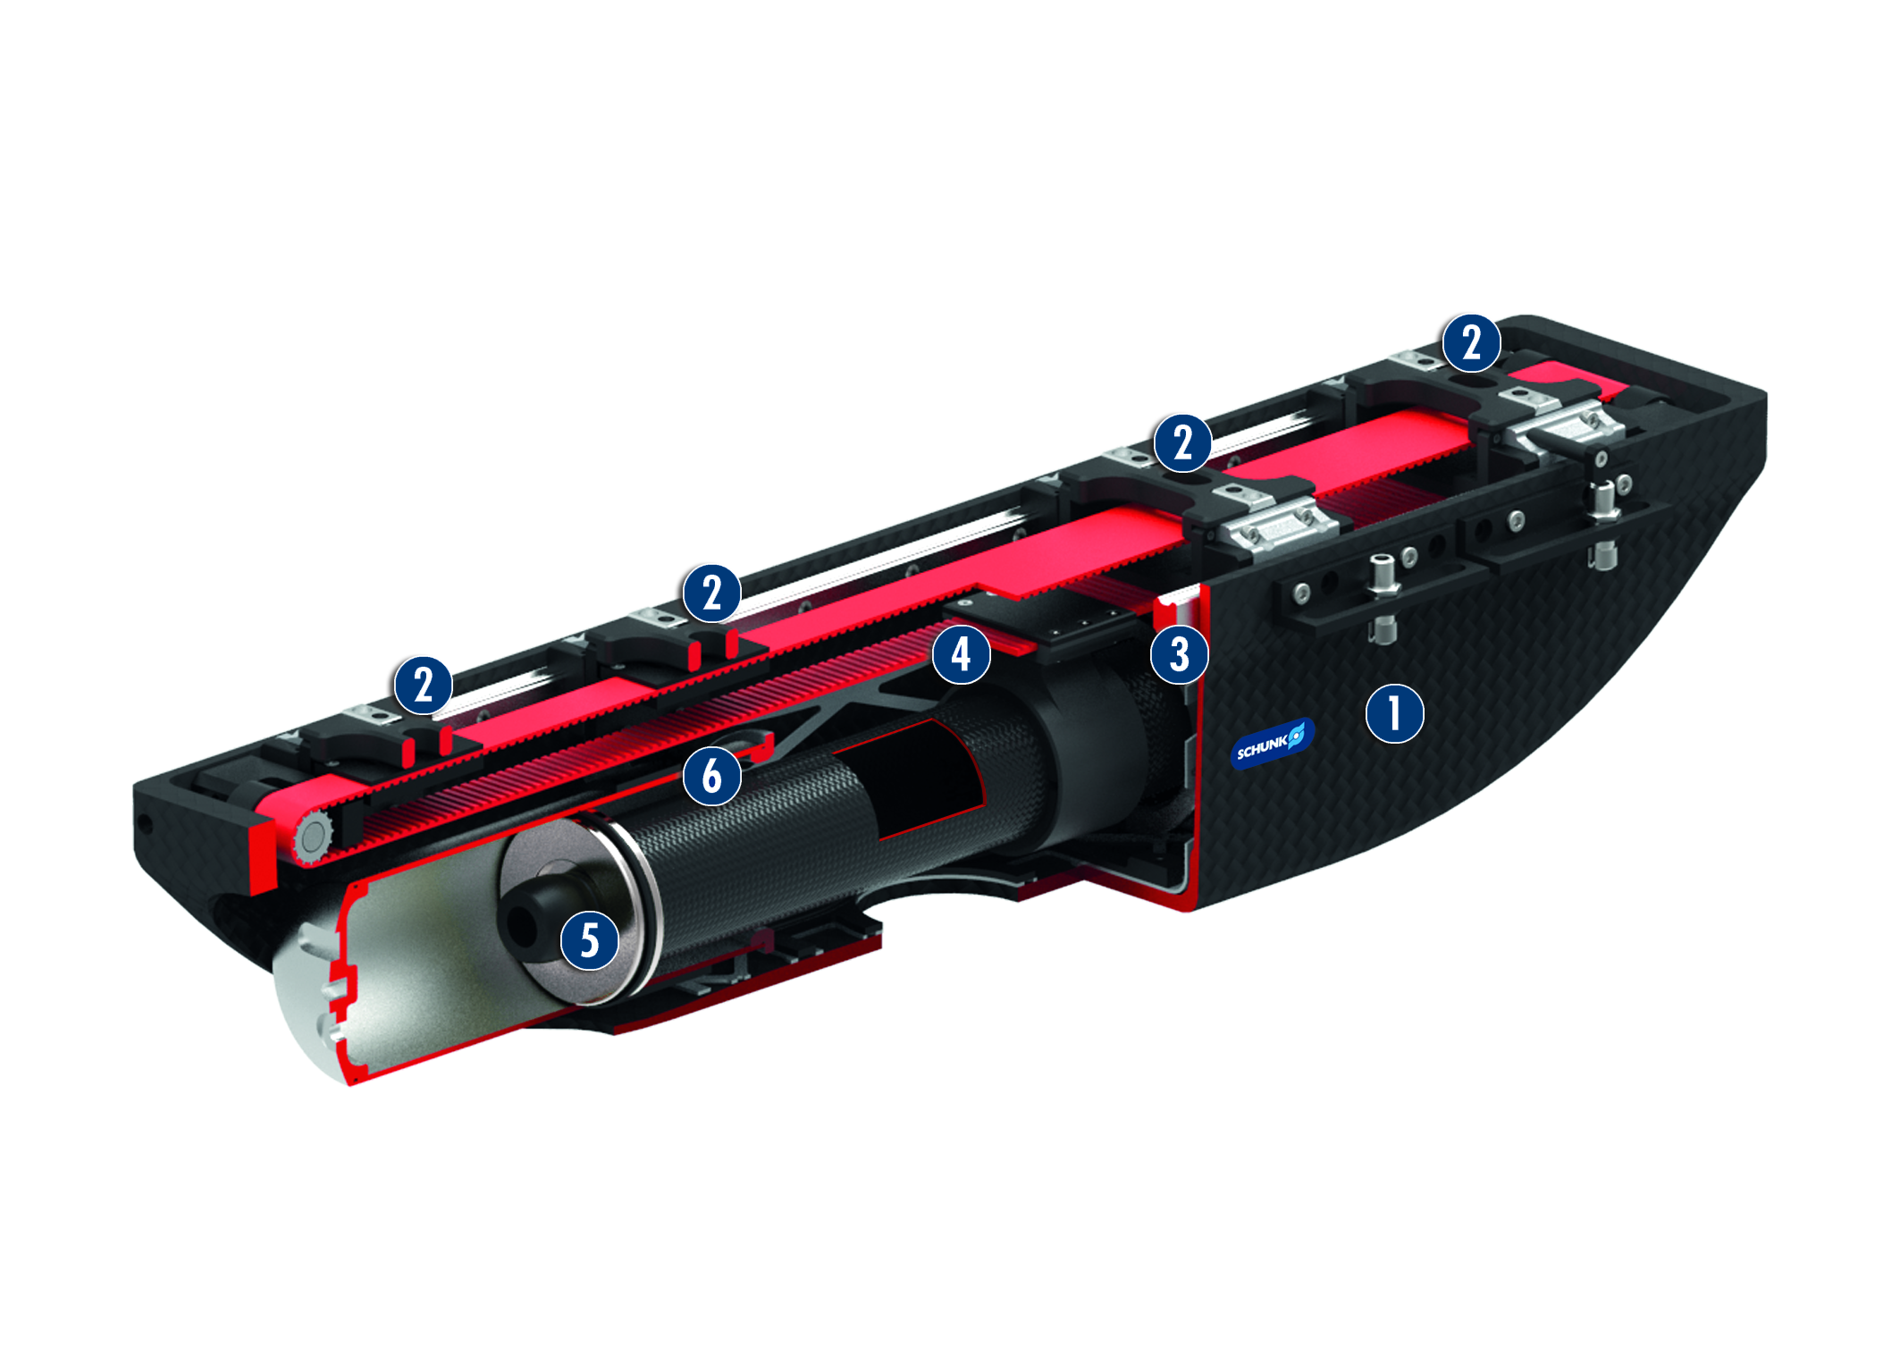
CGH
#1: First standardized lightweight gripper with carbon-fiber reinforced plastic
New Product
Sucessor product
New Sizes
  Basic technical functions:
Size: 80
Mass: 11,65 kg
Gripping force: 2500 N
Stroke per finger: 0…160 mm
Workpiece weight: 12,8 kg
Finger length up to 1000 mm
  Complementary products:
Adapter flange ADF (similar to LEG,
PZH-SF 350, etc.)
Quick-Change System SWS
Rotary Feed-Through DDF
Sensors IN
Housing
Base jaw
Roller guide
Belt drive
Profile damper
Stroke adjustment

Slide 5


