Slide 1
Short presentation
FTL

Slide 2
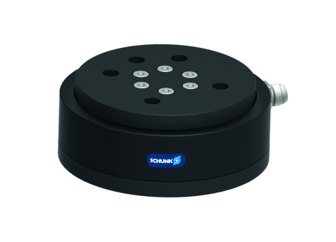
FTL -75
#1: Force-torque sensor for simple applications
New Product
Sucessor product
New Sizes
Unique Selling Points:
Electronics integrated in the sensor
3x overload protection
Further Features:
Measurement range Fxyz: 150 N
Measurement range Mxyz: 3 Nm
Communicaton: CAN-Bus or RS232
6 independent load ranges
Power: 12 - 24 V DC
Price on request

Slide 3
FTL -75
#1: Force-torque sensor for simple applications
New Product
Sucessor product
New Sizes
Customer value/selling points
The proper bus connection for a variety of applications
6 independent load ranges for full comprehensive sensor
Real-time measurement / data output for highly dynamic control concepts
Easy implementation via CAN-Bus
overload protection for safe functionality
temperature compensation for reliable measurement results

Slide 4
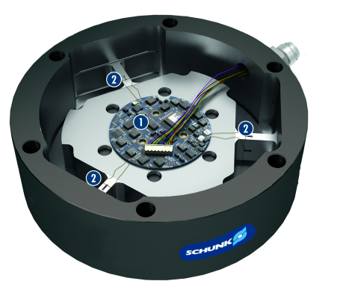
FTL -75
#1: Force-torque sensor for simple applications
New Product
Sucessor product
New Sizes
  Basic technical functions:
Size: 75
Measurement range Fxyz: 150 N
Measurement range Mxyz: 3 Nm
Sampling rate (internal / Bus): 1.5 kHz / 100 Hz
Resolution of AD converter: 12 bit
Power supply: 12 – 24 V DC
Electronic
High signal-to-noise ratio

Slide 5


