Slide 1


SRU-MINI
Short Presentation
Superior Clamping and Gripping

Slide 2
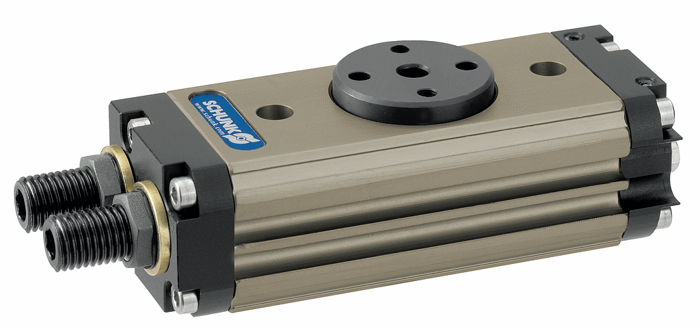
SRU-mini

Slide 3
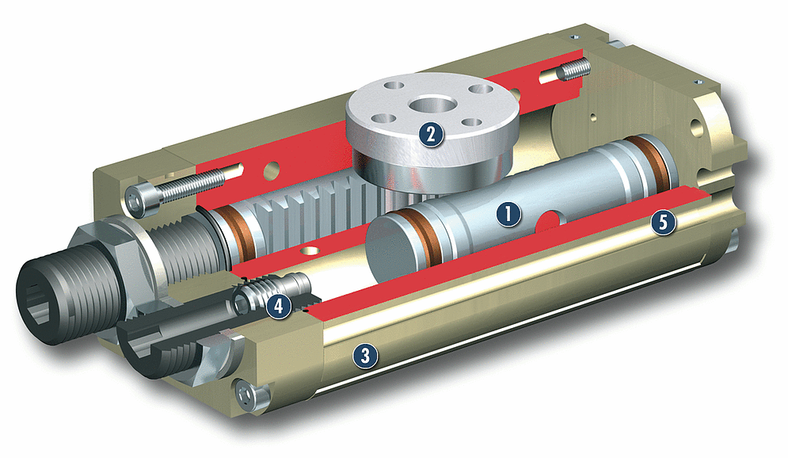
SRU-mini
Powerful, double pistion pneumatic drive
Robust pinion to output rotary motion
Hard anodized, light-weight aluminum alloy housing
Economical elastomer dampers or high performance hydraulic shock absorbers
Simple and secure position monitoring via MMS magnetic sensors

Slide 4
SRU-mini
Unique Selling Points | Your Value
Zero backlash at the end position Hydraulic or elastomer dampening Pneumatic middle position | Clearly graduated series with uniform torque increases Large end position adjustability (90 degrees) Fluid feed-through for gas, liquids or vacuum High accuracy from zero backlash

Slide 5
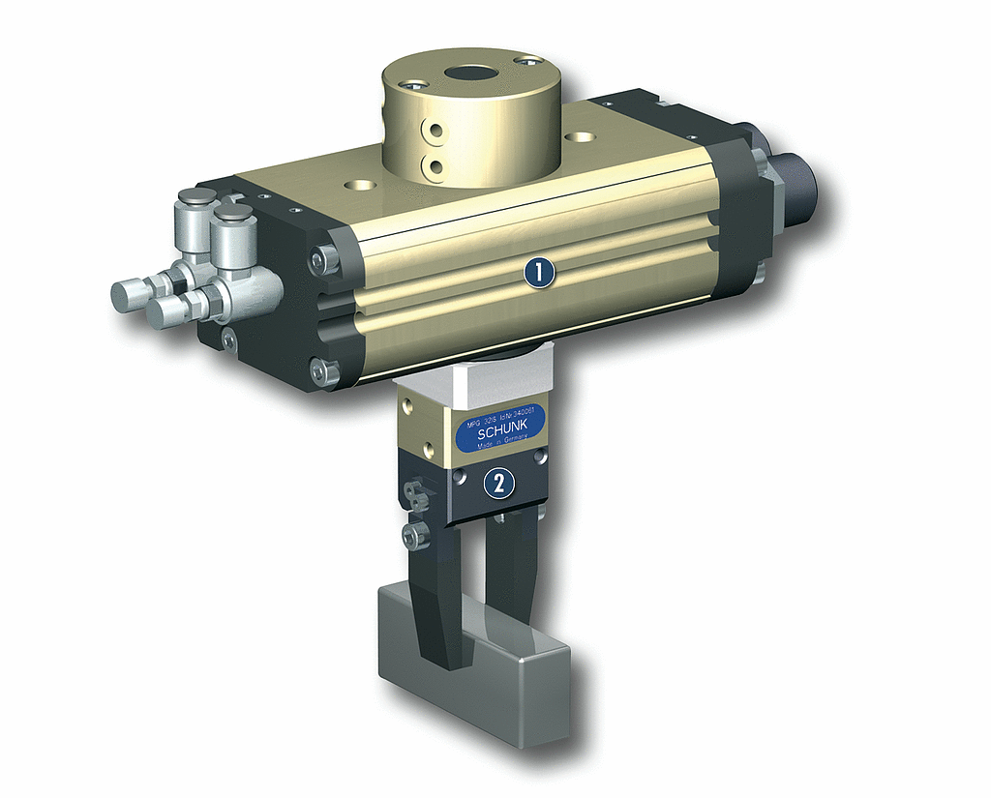
Application Example

Slide 6




Jens Lehmann, a German goalkeeper legend,
brand ambassador for SCHUNK since 2012
www.schunk.com

