Slide 1
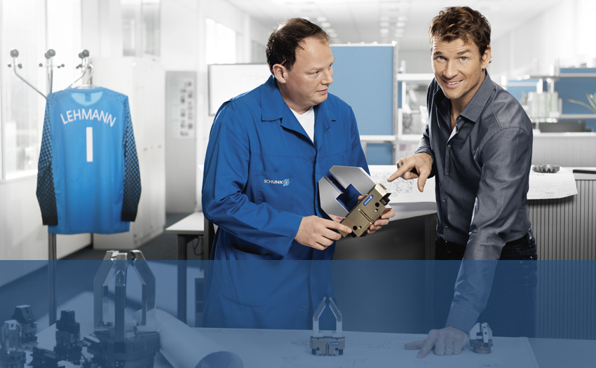

SFL
Detail Technical Presentation
Superior Clamping and Gripping

Slide 2
Contents
Functionality
Sizes
Rotation Angle
Dampening
Sensors
Catalog Pages
Ordering Code
Application Example

Slide 3
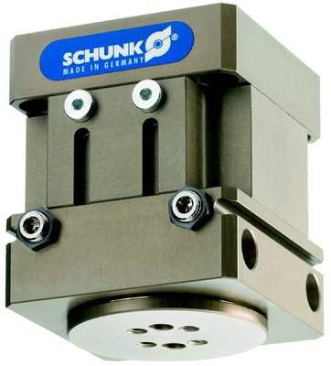
SFL

Slide 4
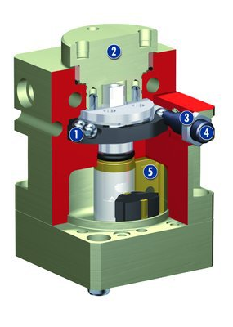
SFL Functionality
Rough Setting of Rotation Angle
preset using steel balls
Rotary Table
for mounting tooling
Fine Adjustment (+/- 3º)
via rotating the stop or shock absorber
Dampening
via shock absorbers or elastomer pads
Rotor
compact, powerful drive

Slide 5
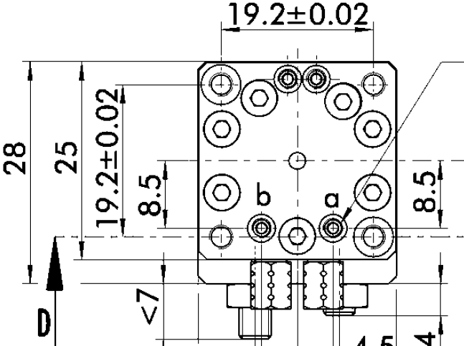
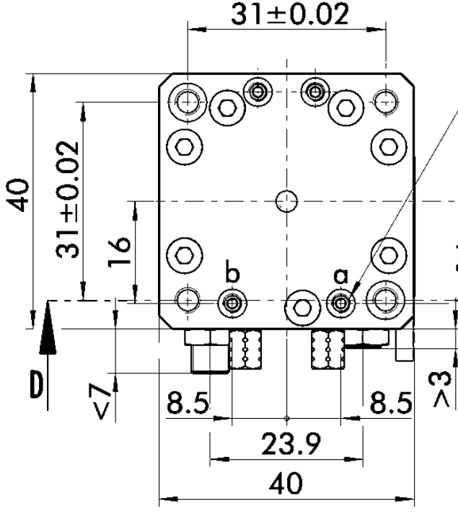
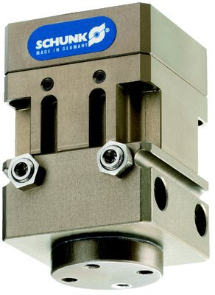
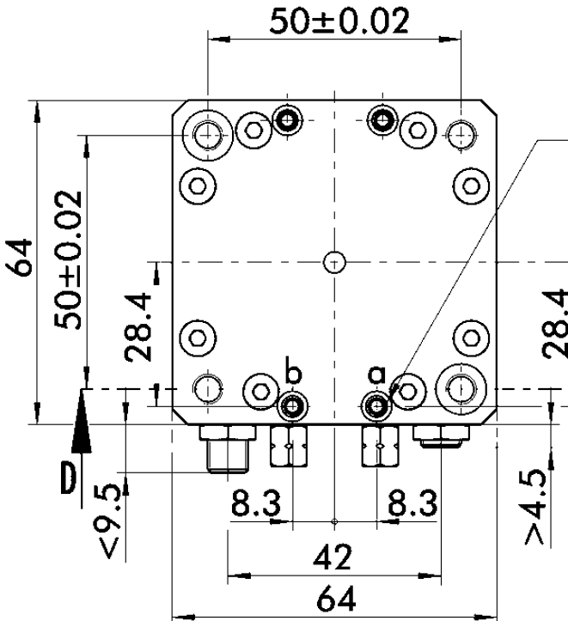
SFL Sizes
SFL 25
SFL 40
SFL 64

Slide 6
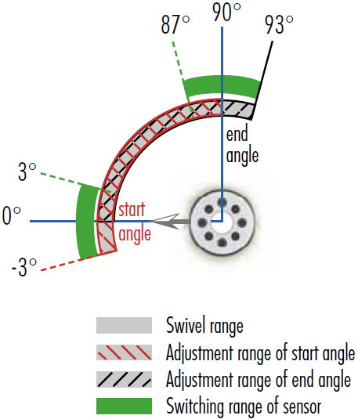
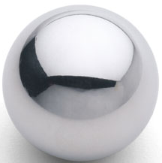
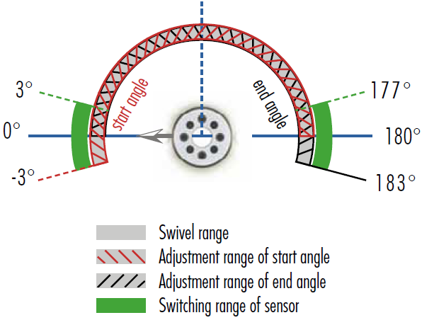
SFL Rotation Angle
90º Unit
= …
SFL 25 | 32º
SFL 40 | 19º
SFL 64 | 13,5º
180º Unit

Slide 7
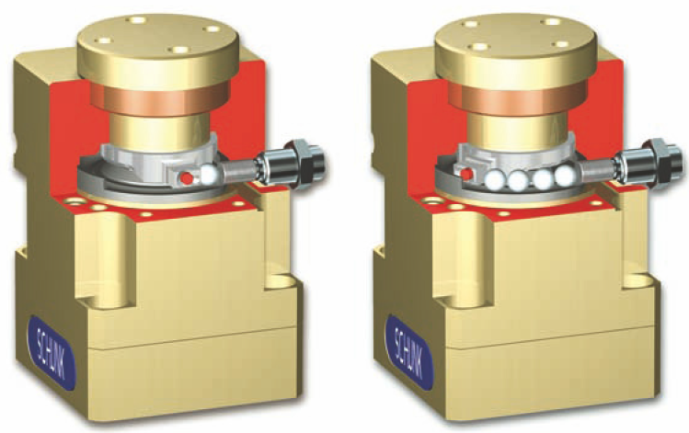
SFL Rotation Angle

Slide 8
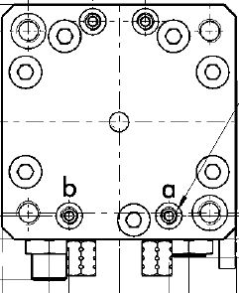
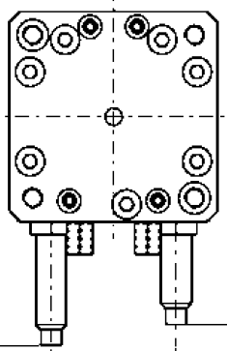
SFL Dampening
Elastomer Version
Shock Absorber Version

Slide 9
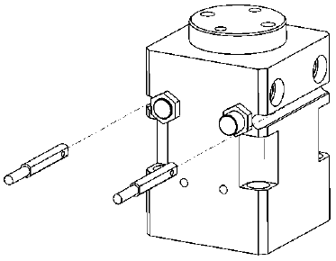
SFL Sensors
Electronic Magnetic Sensors
Magnets on the piston
End position sensing
MMS Sensors
Sensing is only possible at 0º and 90º or 0º and 180º

Slide 10
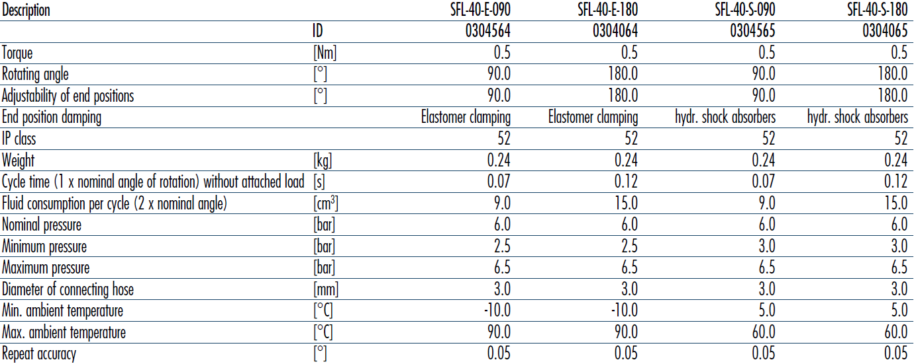
SFL Catalog Pages

Slide 11
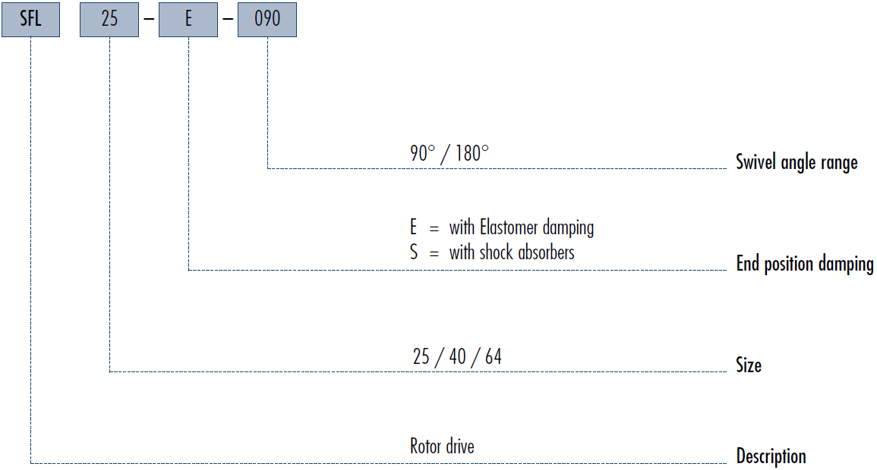
SFL – How to Order

Slide 12
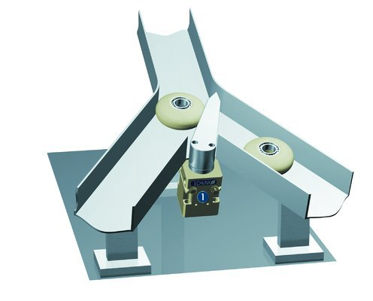
SFL Application Example

Slide 13




Jens Lehmann, a German goalkeeper legend,
brand ambassador for SCHUNK since 2012
www.schunk.com

