Slide 1


GFS
Detail Technical Presentation
Superior Clamping and Gripping

Slide 2
Contents
Functionality
Technical Specifications
Variations
Sensors
Application Example

Slide 3
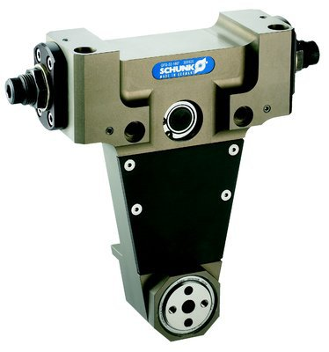
GFS

Slide 4
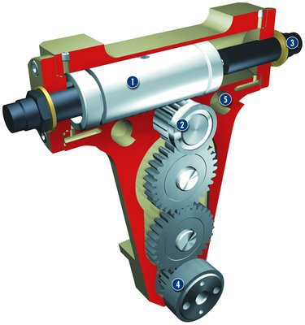
GFS Functionality
Drive
pneumatic, double-acting drive piston
Kinematics
pack and pinion principle with gear transmission to the rotary flange
Damping
powerful, hydraulic shock absorbers for rapid swiveling cycles
Rotary flange
mounted on roller bearings, with center bore
Mounting
  Centering and mounting possibilities
  for universal assembly of the rotary finger

Slide 5
GFS Technical Specifications
Housing material: High-strength, hard-anodized aluminum alloy
Rotary flange, gears and piston: Hardened steel
Zero backlash at end position due to use of hardstop

Slide 6
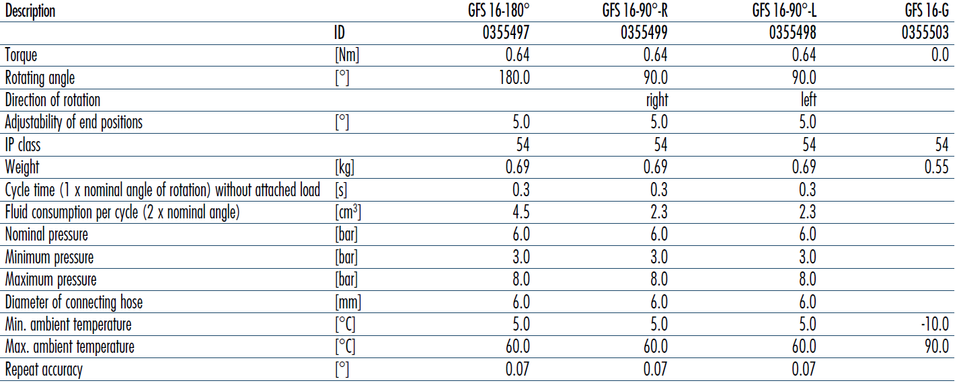
GFS Variations

Slide 7
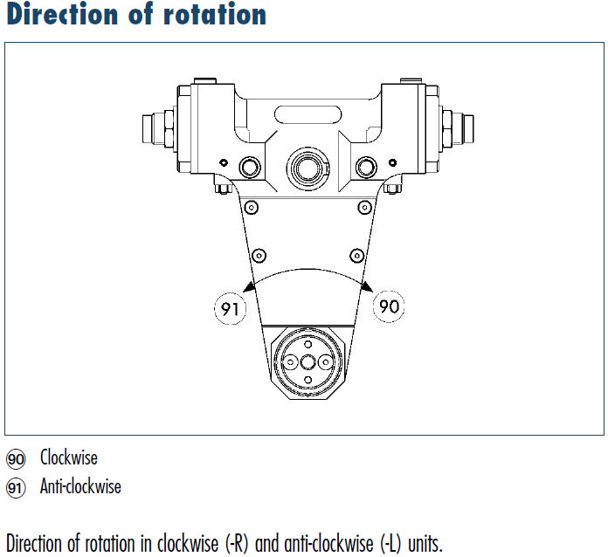
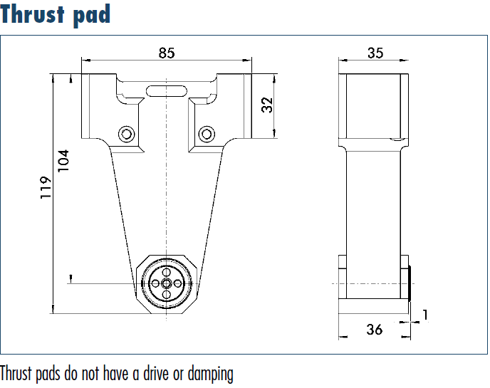
GFS Variations

Slide 8
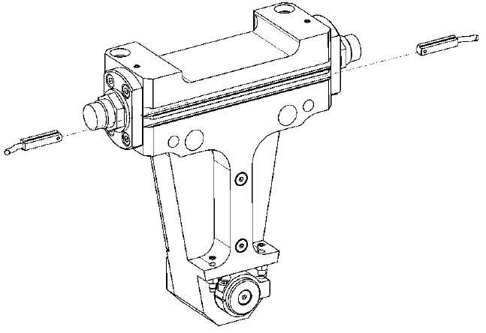
GFS Sensors
Electronic Magnetic Sensors
Magnets on the piston
End position sensing
MMS Sensors

Slide 9
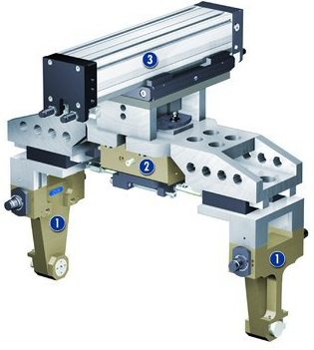
GFS Application Example

Slide 10




Jens Lehmann, a German goalkeeper legend,
brand ambassador for SCHUNK since 2012
www.schunk.com

