Slide 1


SRU-plus
Technical Presentation
Superior Clamping and Gripping

Slide 2
Contents
Video
Functionality
Catalog Pages
Moment of Inertia
Shock Absorber Adjustability
End Position Adjustability
Pneumatic Intermediate Position
Locked Intermediate Position
Fluid Feed-through Option
Electric Feed-through Option
Sensors
Ordering Code
Maintenance

Slide 3
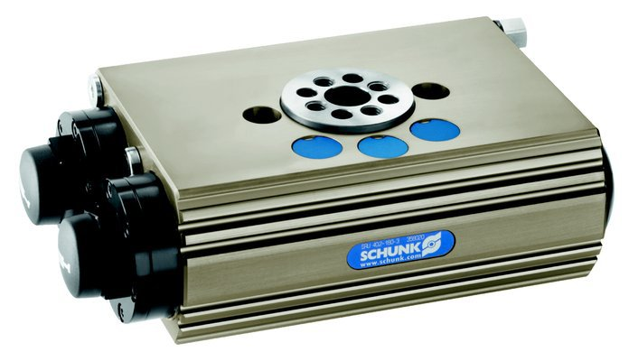
SRU-plus

Slide 4
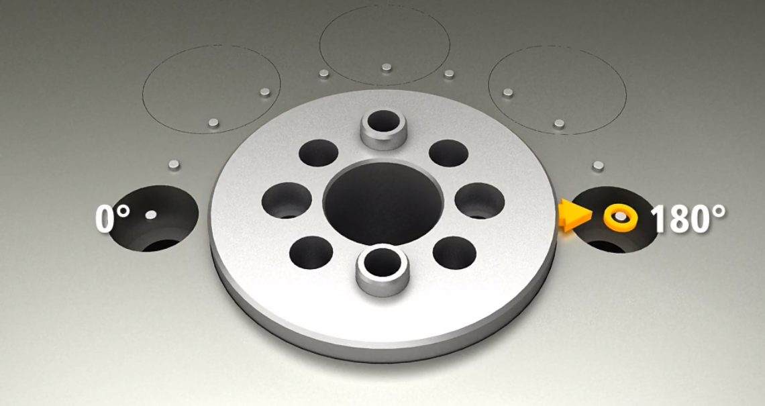
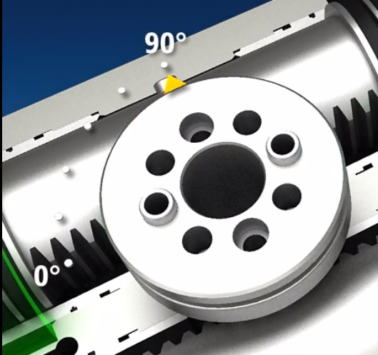
SRU-plus Functionality
90 degrees
180 degrees

Slide 5
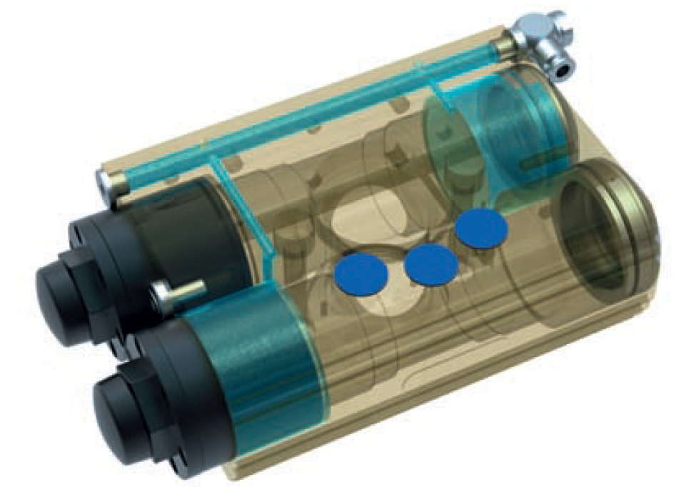
SRU-plus Functionality

Slide 6
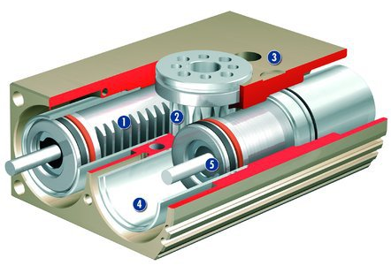
SRU-plus Functionality
Powerful, double piston pneumatic drive
Robust pinion to output rotary motion
Hard anodized, light-weight, aluminum alloy housing
Replaceable sleeves for radial adjustability and easy maintenance
Integrated hydraulic shock absorbers for high energy absorbtion
Middle bore for utility pass-thru

Slide 7
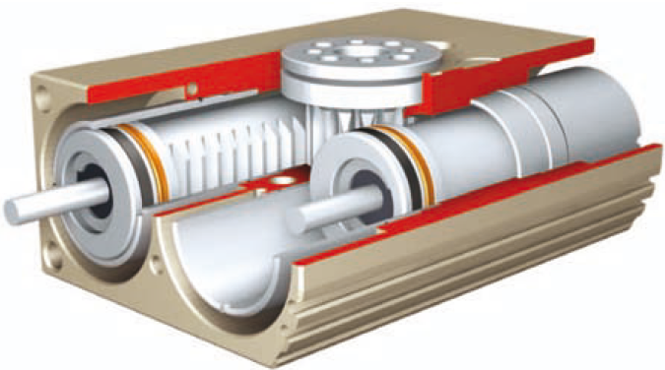
SRU-plus Sizes
SRU-plus 20
SRU-plus 25
SRU-plus 30
SRU-plus 35
SRU-plus 40
SRU-plus 50
Torque range from 3 to 50 Nm

Slide 8
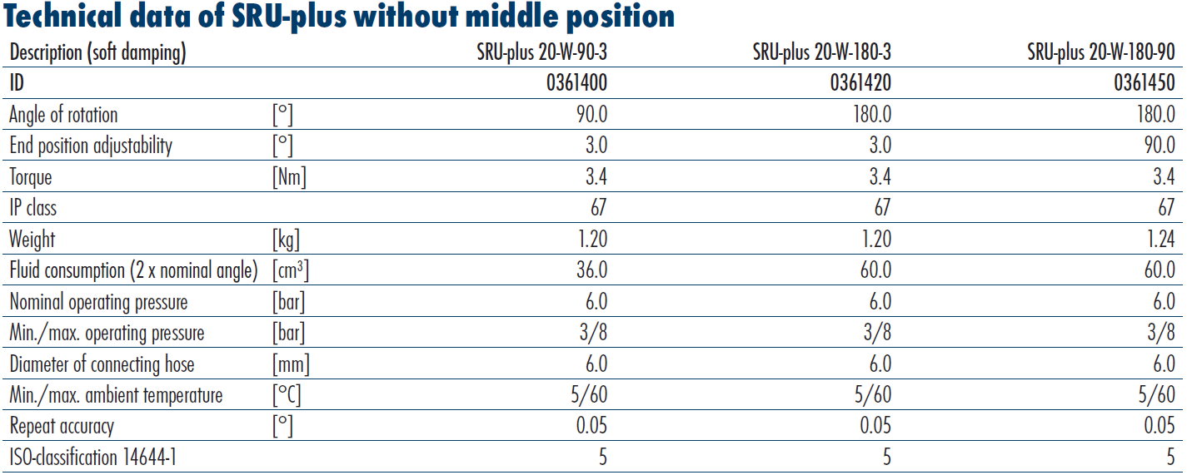
SRU-plus Catalog Pages

Slide 9
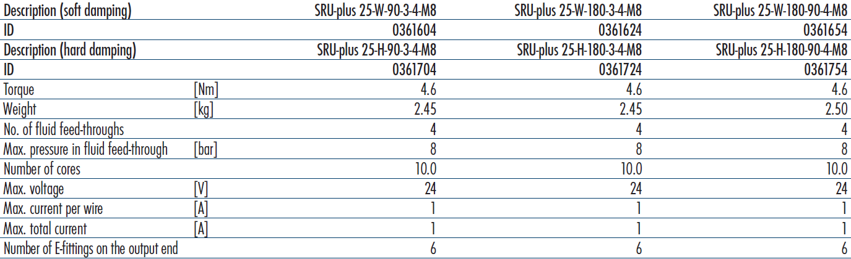
SRU-plus Catalog Pages
W= Soft shock absorbers
H= Hard shock absorbers

Slide 10

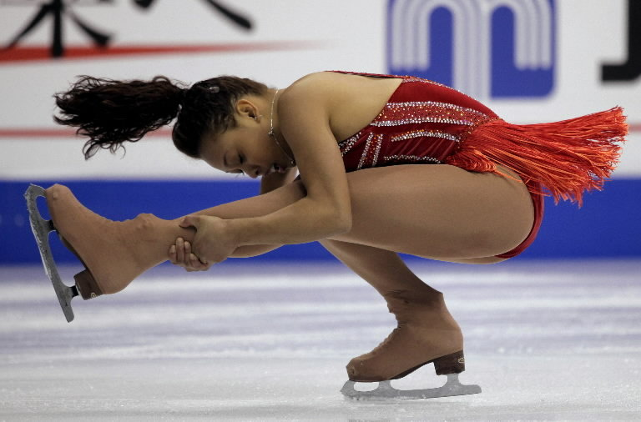
Moment of Inertia
J₁= J₀+m*l²
J₁= Final moment of inertia
J₀= Initial Moment of inertia
m= mass
l= radius
l_{s}
The property of a distribution of mass in space that measures its resistance to rotational acceleration about an axis.
l_{L}

Slide 11
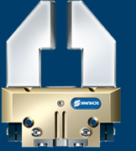
Moment of Inertia
l=200mm
Workpiece = 1 kg
PGN+80-1 with fingers = 0.7 kg
l=0
Assume J₀=0.02
J₁=J₀+m*l²
J₁=0.02+(1+0.7)*0²
J₁=0.02 kg*m²
J₁=J₀+m*l²
J₁=0.02+(1+0.7)*0.2²
J₁=0.02+0.0428
J₁= 0.0628 kg*m²

Slide 12
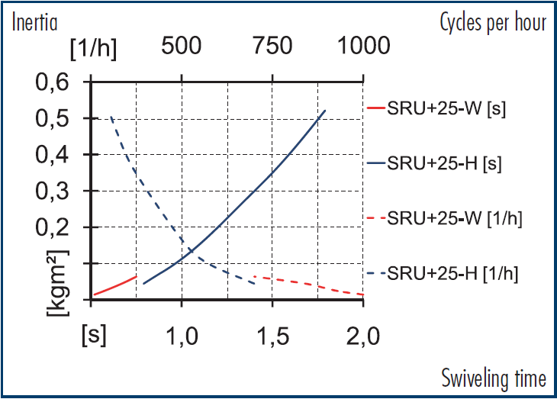
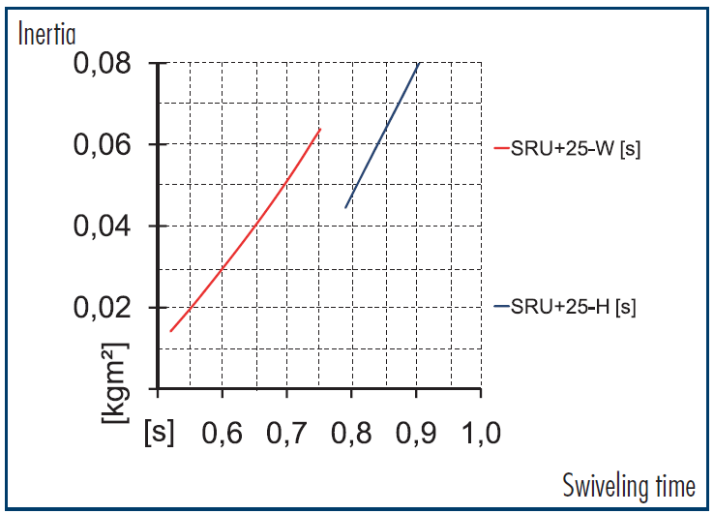
Moment of Inertia
J₁=0.02
J₁= 0.0628
SRU plus 25
W= Soft shock absorbers
H= Hard shock absorbers

Slide 13
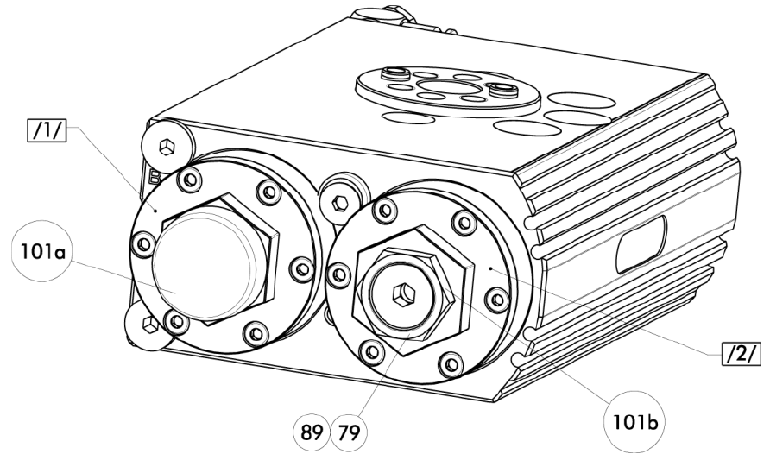
Setting the Shock Absorbers
Remove the shock cover
(Pos. 101a)
Secure stop „A“ (Pos. /1/) with a wrench and loosen the nut
(Pos. 101b)
Secure stop „A“ and unscrew the stop pin A (Pos. 89/79)
Test the unit
Secure stop pin „A“ (Pos. 89/79)
Replace cover
Repeat the process for the opposite side

Slide 14
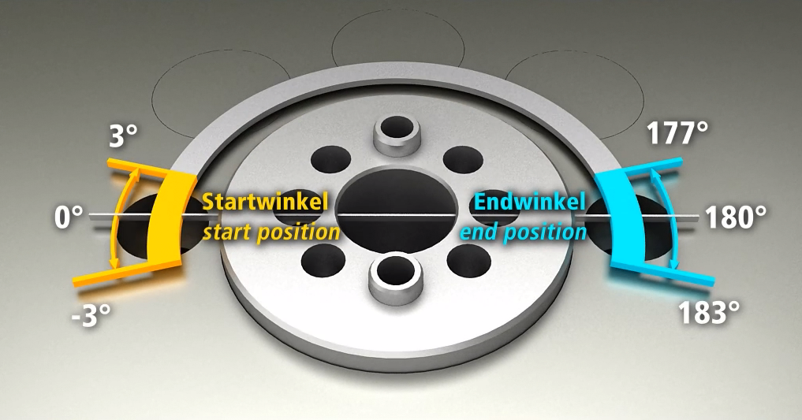
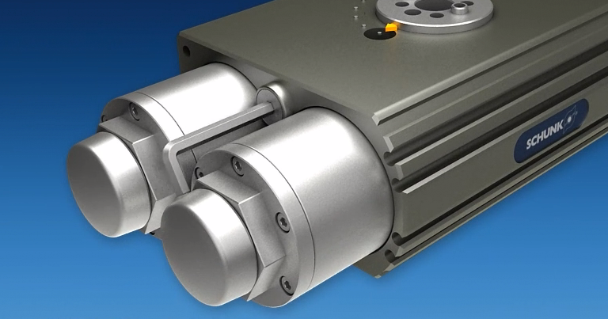
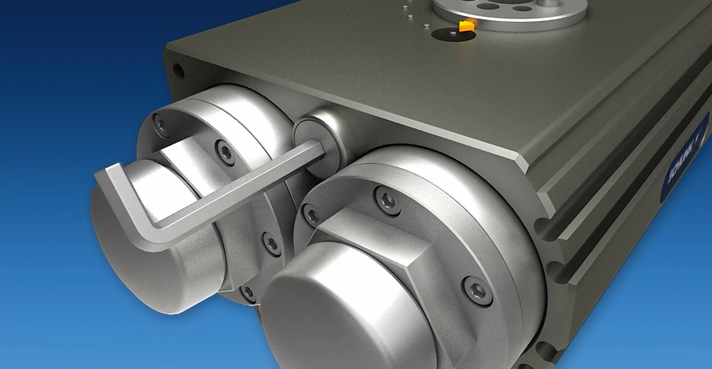
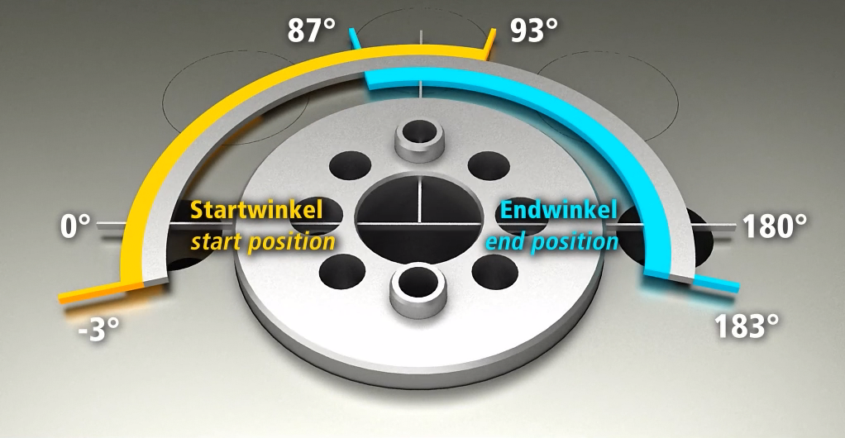
SRU-plus – End Position Adjustability

Slide 15
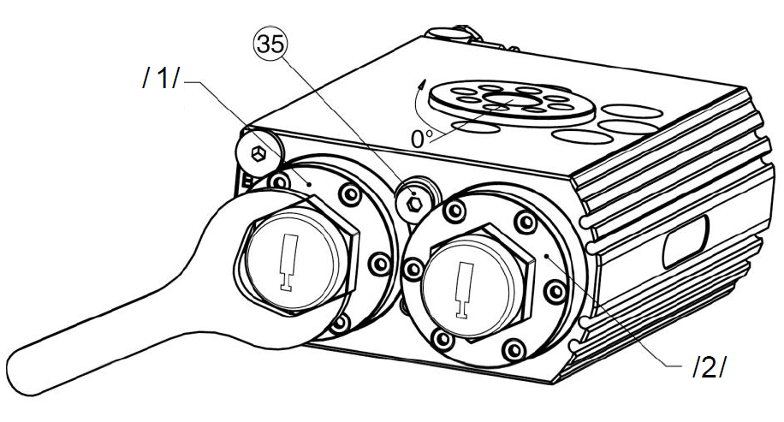
Setting the End Position
Loosen the lock nut (Pos. 35)
Pressurize port „A“
Rotate in/out the end stop „B“ (Pos. /2/)
Tighten the lock nut (Pos. 35)
Verify end position „B“
Ventilate port „A“ and pressurize port „B“
Rotate in/out end stop „A“ (Pos. /1/)
Verify end position „A“
Tighten lock nut (Pos. 35)

Slide 16
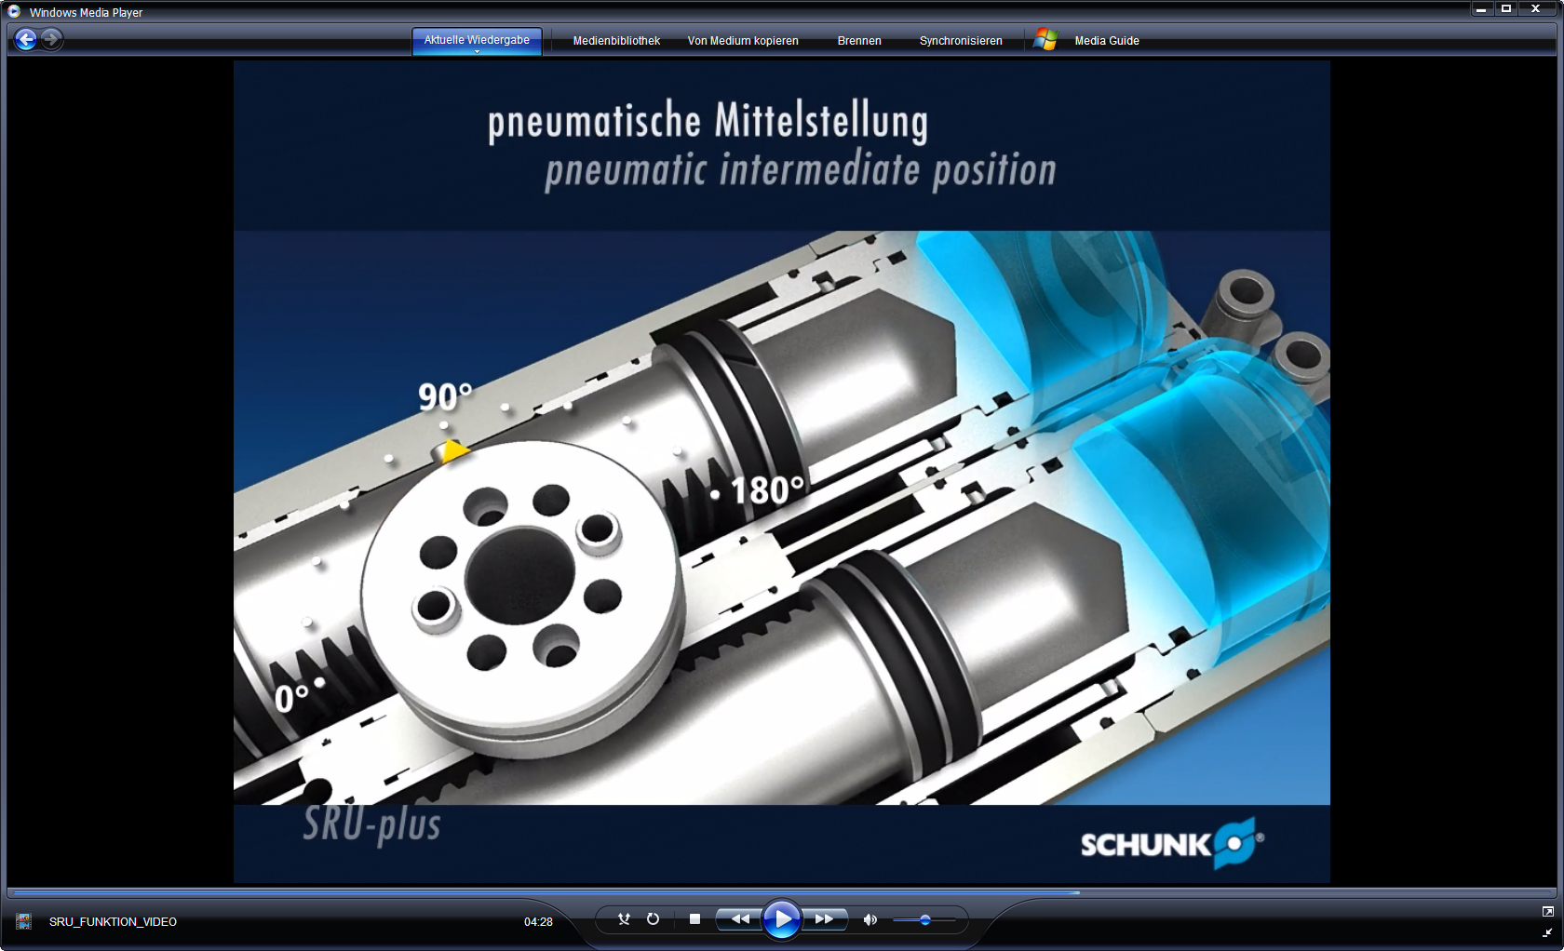
SRU-plus – Intermediate Positions
SRU-plus-M
pneumatic middle position
Advantages
+/- 3º mid-position adjustability
Compensating middle position
Easy Operation

Slide 17
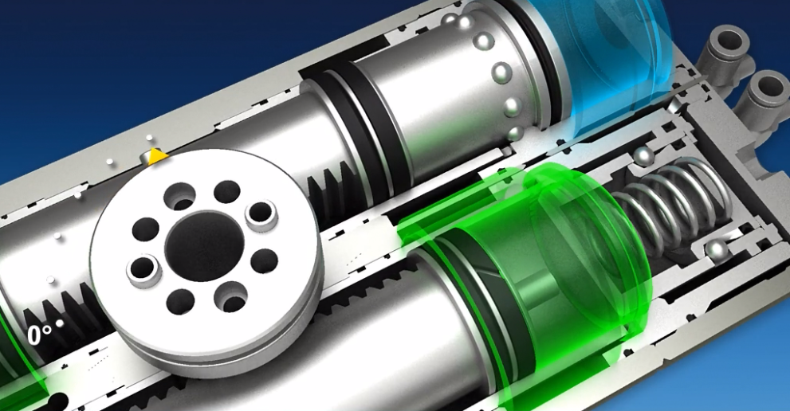
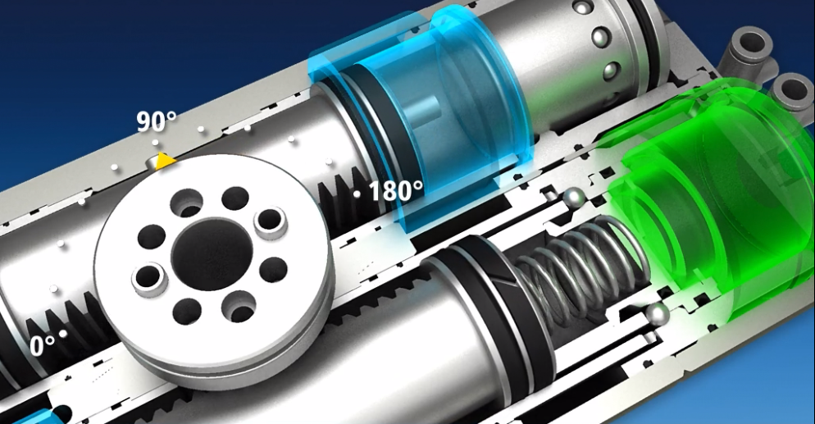
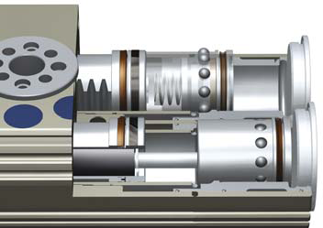
SRU-plus – Intermediate Positions
SRU-plus-VM
locked middle position
Advantages
+/- 3º mid-position adjustability
Locked middle position
No over travel
Can hold against gravity

Slide 18
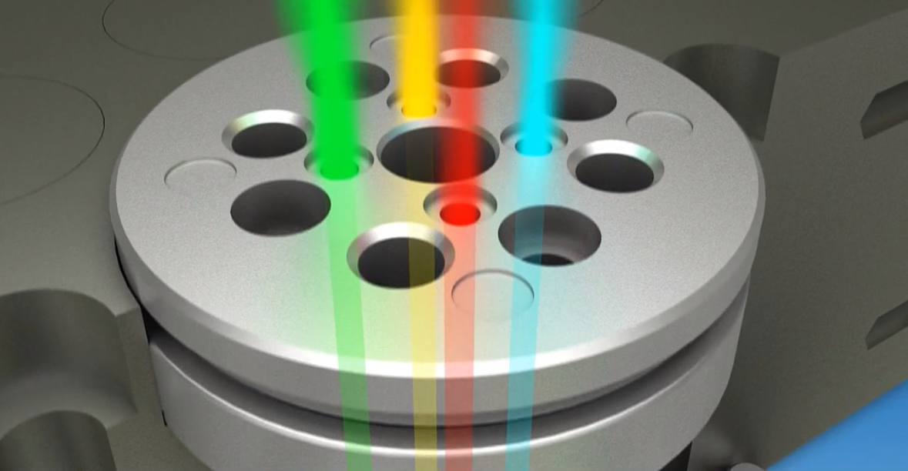
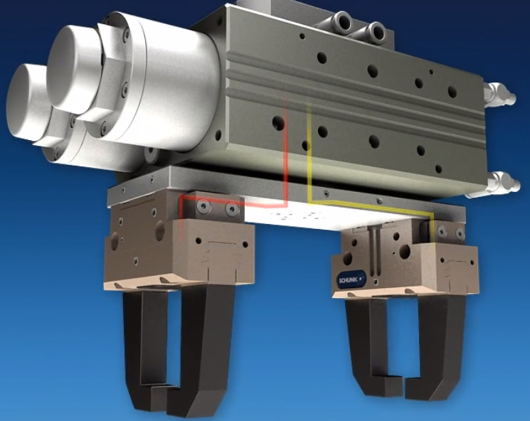
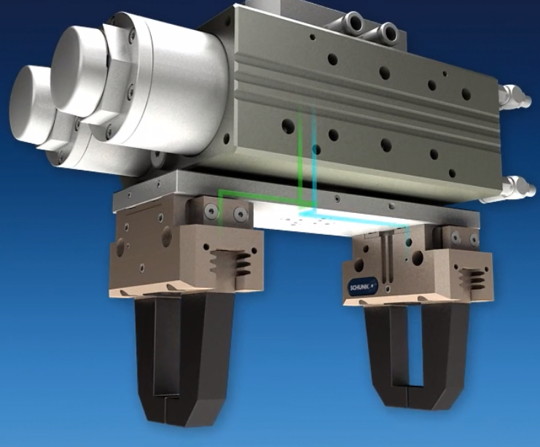
SRU-plus with Fluid Feed-through
Fluid Feed-through
Direct Connection
Gases
Vacuum
Liquids
8 bar

Slide 19
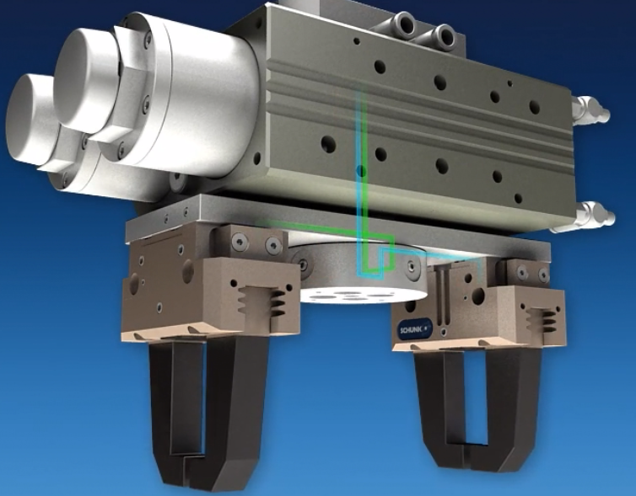
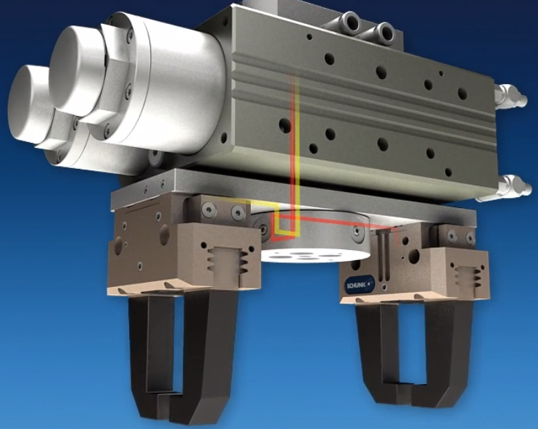
Options for Fluid Feed-through
Pneumatic Distributor
for Fluid feed-through

Slide 20
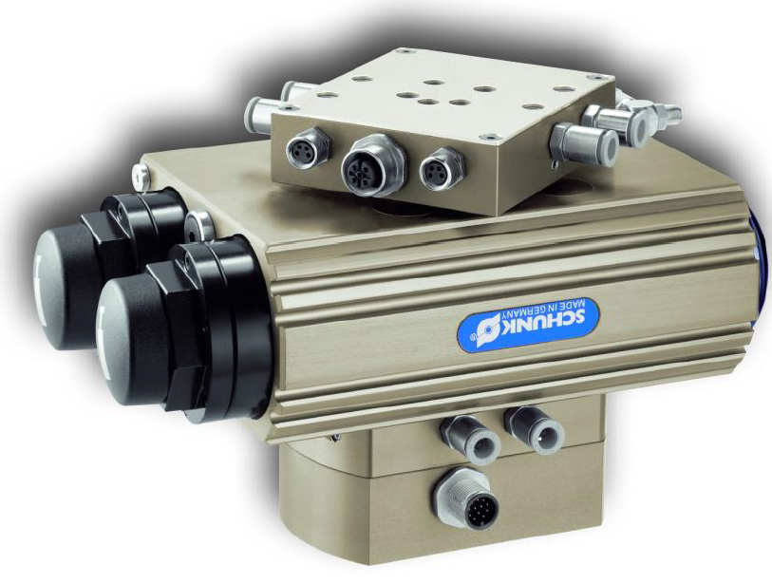
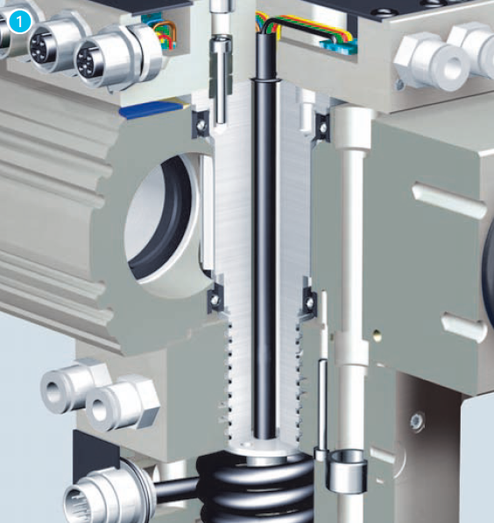
SRU-plus with Electric Feed-through (EDF)
Electric Feed-through
10 leads
24 Volts
1 amp
Ideal for gripper sensors

Slide 21
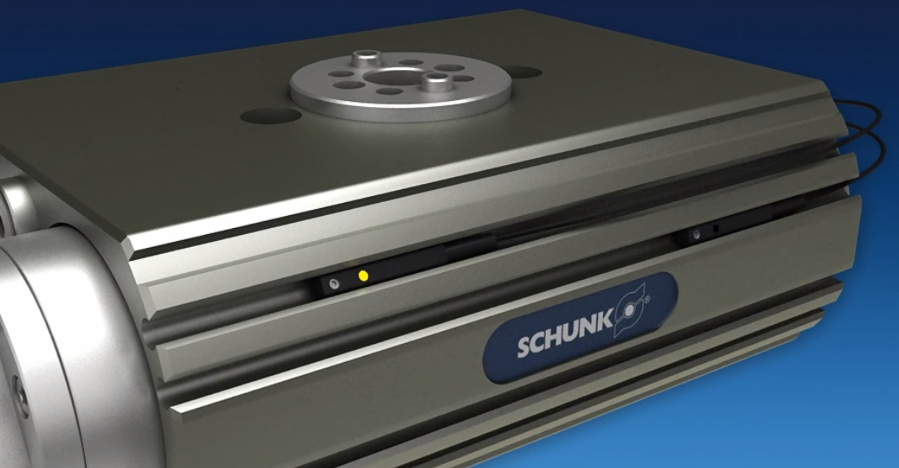
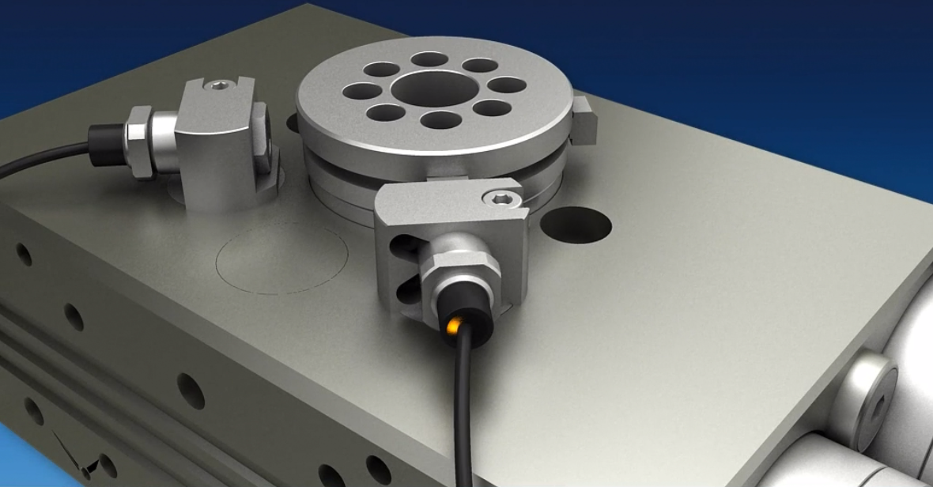
SRU-plus Sensors
Inductive Proximity Sensors
Additional kit required
End position sensing
Middle position sensing
Functional with EDF
Electronic Magnetic Sensors
Magnets on the piston
End position sensing
Middle position sensing

Slide 22
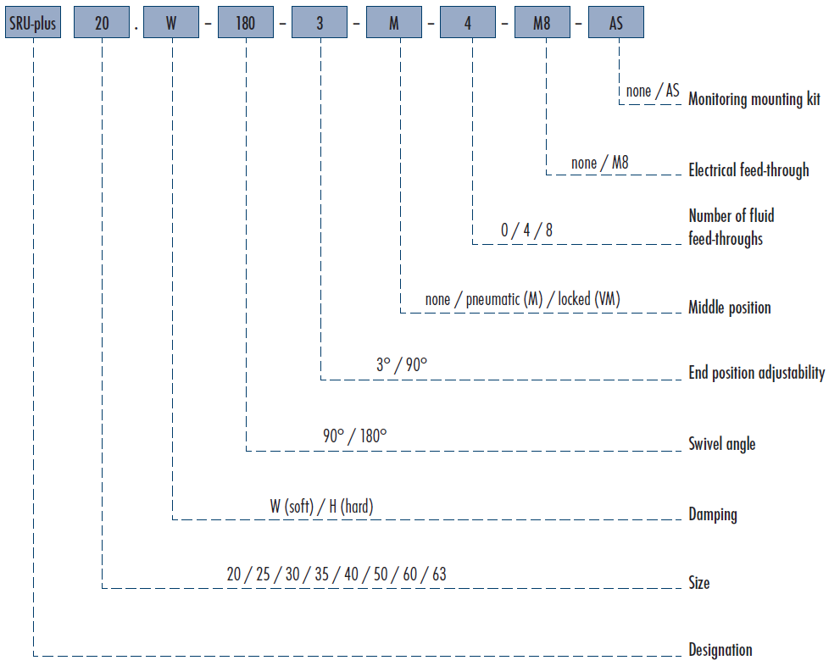
SRU-plus Ordering Code

Slide 23
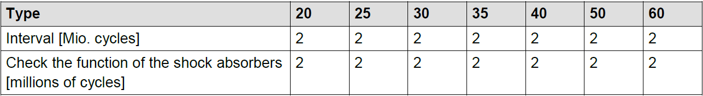
SRU-plus Maintenance Intervals
After 2 million cycles:
Replace and lubricate the seals
Lubricate the SRU-plus → rack and pinion, sleeves
Shock Absorbers:
Regularly check them for wear
If wear is apparent, adjust the shock absorbers
If adjusting does not work, replace the shock absorbers
Lubrication Points | Lubricant
Serrations and pinion | Molykote BR 2 plus
Metal Sliding Surfaces | Renolit HLT 2
All Seals
Consult the Assembly and Operating Manual
shipped with the unit/Sales Tool Box/Internet

Slide 24
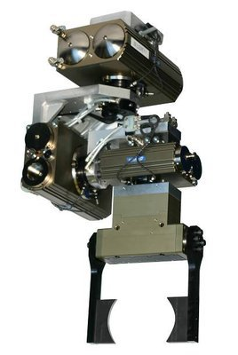
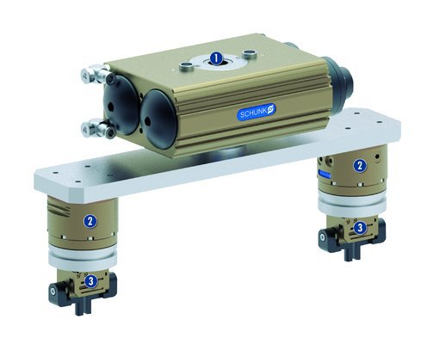
SRU-plus Application Examples

Slide 25


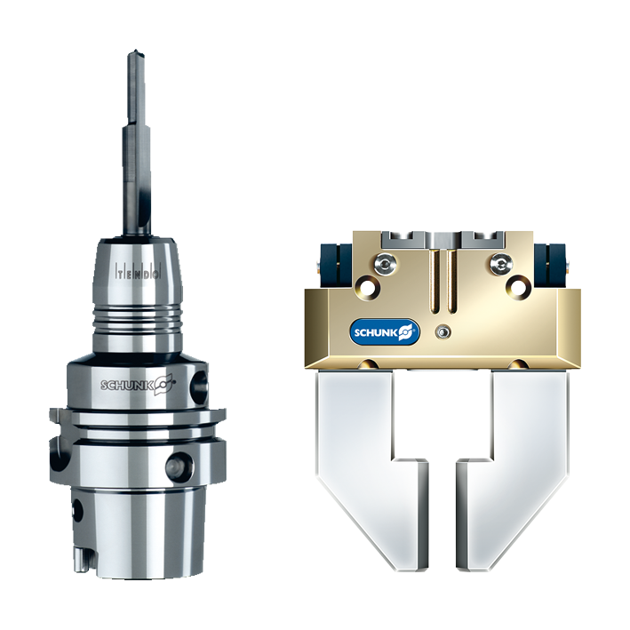

Jens Lehmann, a German goalkeeper legend,
brand ambassador for SCHUNK since 2012
www.schunk.com

