Slide 1
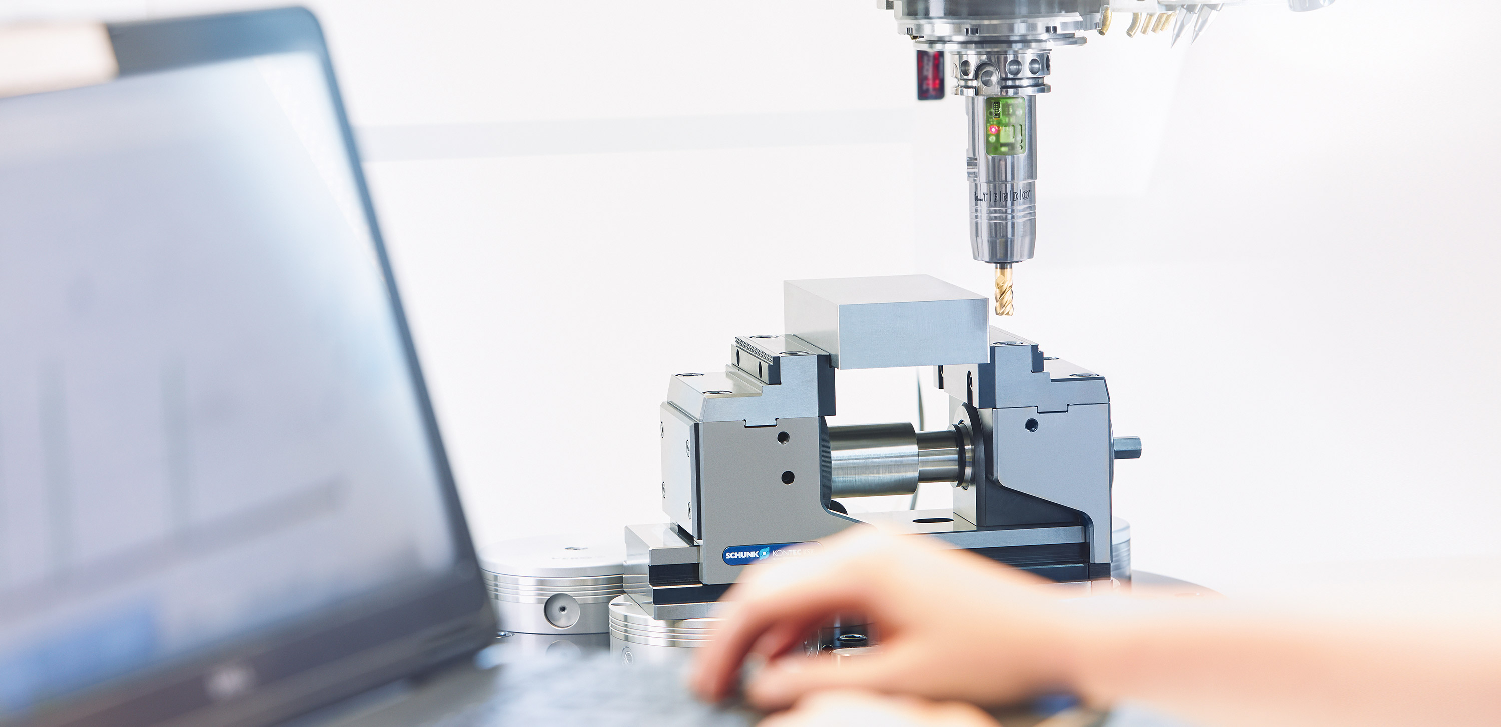

Toolholding Systems

Slide 2
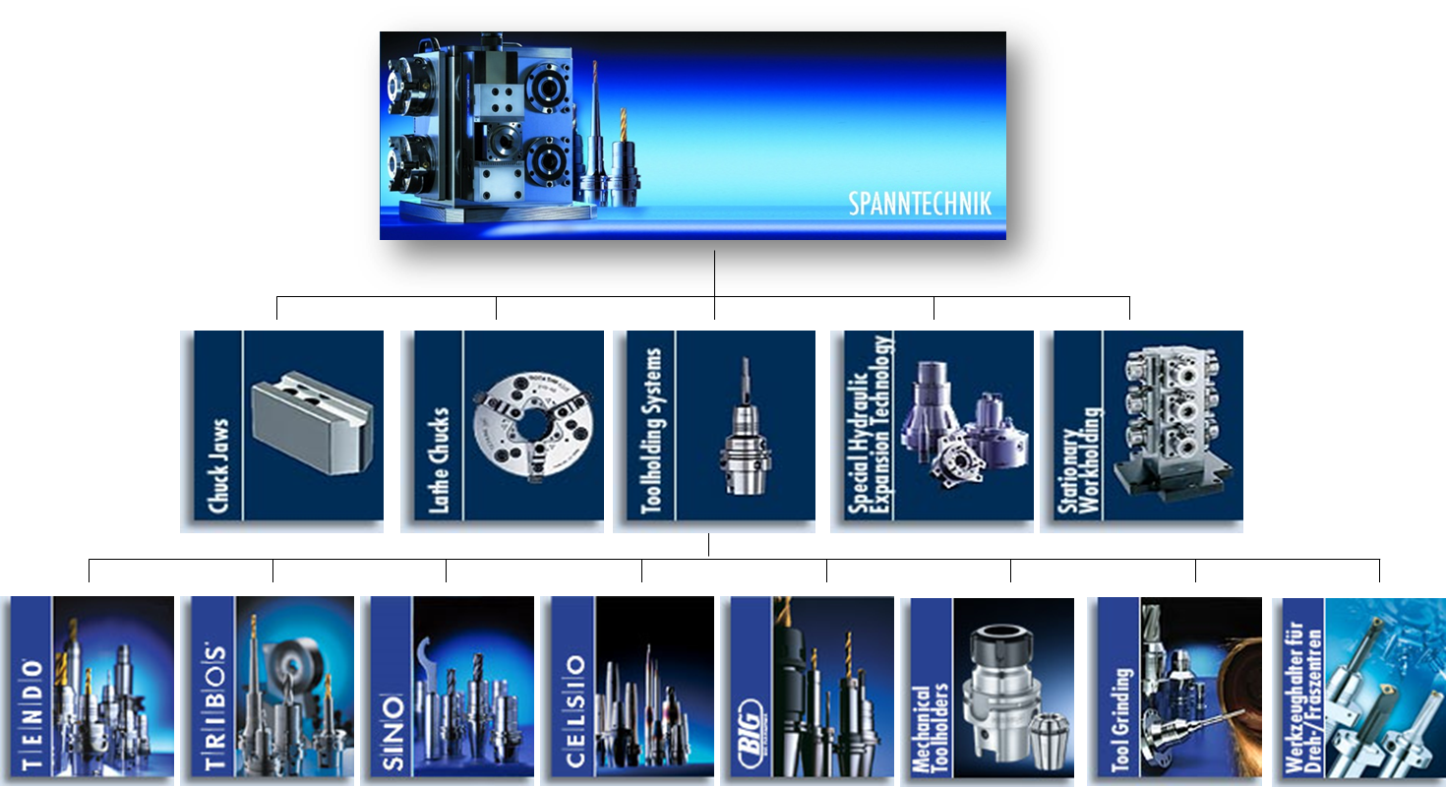
Product overview

Slide 3
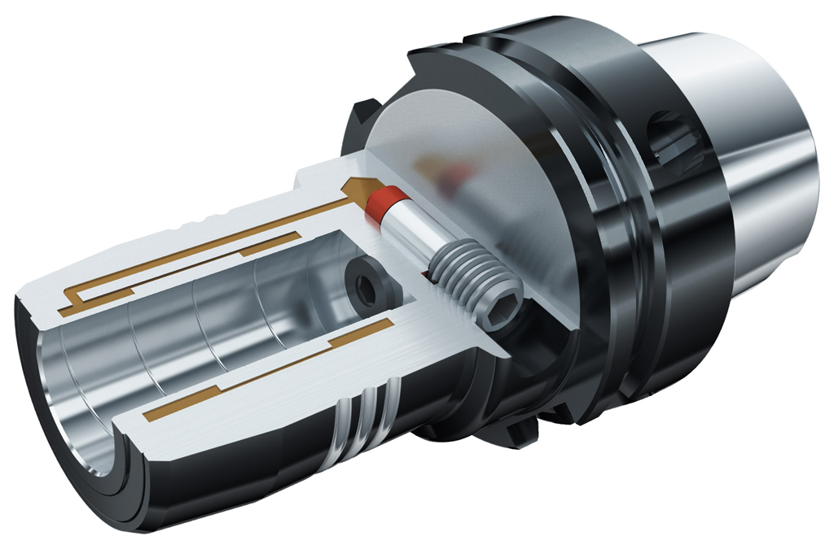
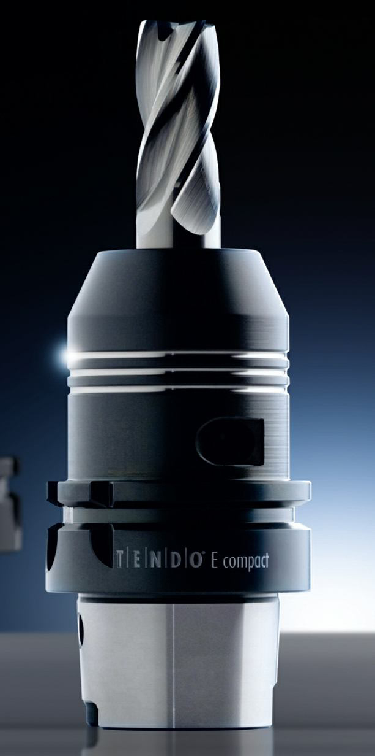
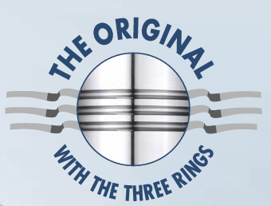
TENDO E compact

Slide 4
TENDO E compact
The toolholder for almost every requirement
Sets completely new standards
A strong performance during:
  Torque transmission
  Damping characteristics
  Rigidity
  Run-out accuracy
Perfect for precise and fast metal cutting – even for roughing applications

Slide 5
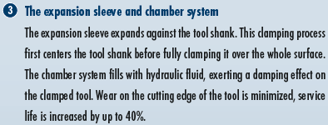
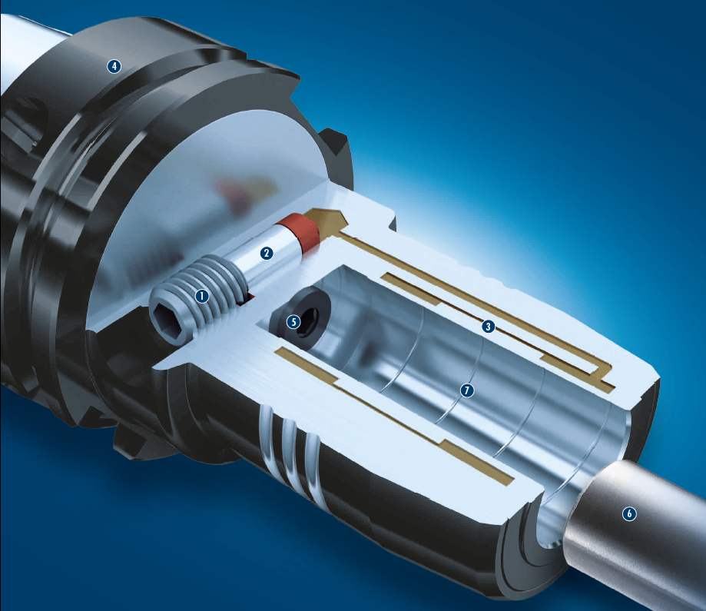





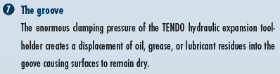
TENDO E compact in detail
17.05.2021

Slide 6
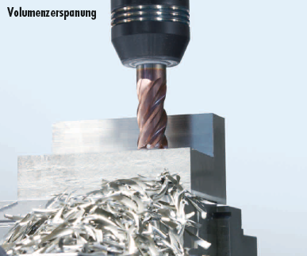
TENDO E compact
The toolholder for almost every requirement
Volume machining
Suitable for volume machining up to 400 cm³/min at 42CRMo4*
* depending on the machine tool and the tool

Slide 7
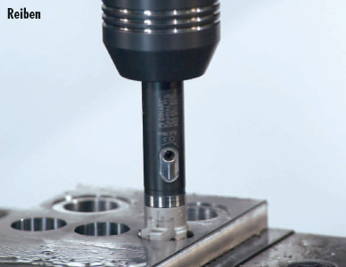
TENDO E compact
The toolholder for almost every requirement
Reaming
Excellent vibration damping assures best workpiece surfaces
Permanent run-out accuracy for an excellent dimensional accuracy

Slide 8
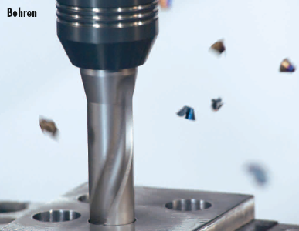
TENDO E compact
The toolholder for almost every requirement
Drilling
Vibration damping and a run-out accuracy of less than 0.003 mm

Slide 9
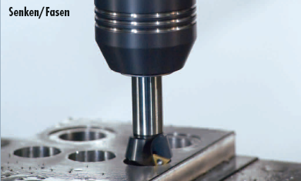

TENDO E compact
The toolholder for almost every requirement
Countersinking/Chamfering
Countersinking and chamfering are defined by precision and excellent run-out accuracy

Slide 10
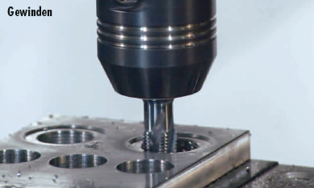
TENDO E compact
The toolholder for almost every requirement
Tapping
High torques (of up to 900 Nm at 20 mm Ø)
Excellent vibration damping
Made for tapping

Slide 11
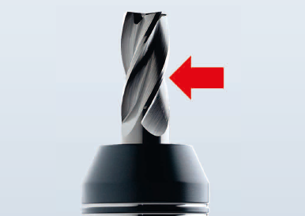
Advantages
High radial rigidity for a better part geometry accuracy
Optimum radial rigidity
Robust toolholder body avoids lateral deflection during metal cutting
Advantage: high part accuracy geometry at the workpiece and the highest material removal rates (e.g. 400 cm³/min at 42CrMo4*)
* depending on the machine tool and the tool

Slide 12
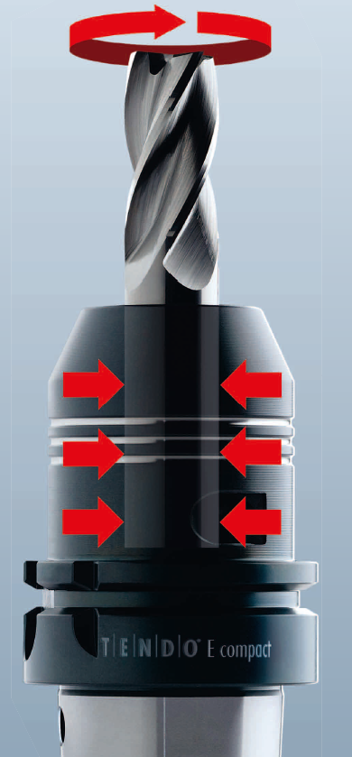
Advantages
High torque of up to 900 Nm (Ø 20) for highest volume machining
Due to the compact design, holding forces and a high torque transmission are guaranteed
Advantage: highest material removal rate

Slide 13
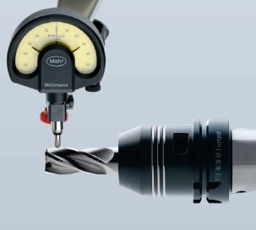
Advantages
Permanent run-out accuracy of less than 0.003 mm – without any fluctuations
Best surface results due to a uniform cutting action and highest reproducibility
Advantage: safe and precise machining

Slide 14
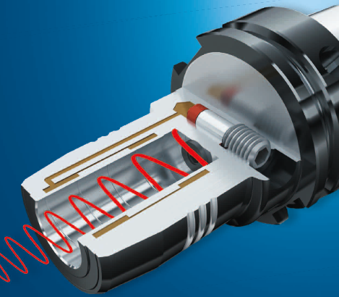
Advantages
Excellent vibration damping
  The hydraulic system absorbs vibrations
  That assures smooth running
  Best workpiece surfaces are assured
  Advantage:
  - High surface quality
  - Machine spindle is protected from damage
  - Service life is increased

Slide 15
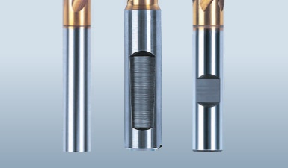
Advantages
All shaft types can be clamped
All customary tools (Ø 3 to 32 mm) with a smooth cylinder shank as well as recesses according to: Din 1835 Form B, E and Din 6535 Form HB, HE can be clamped directly with or without intermediate sleeves
Advantage: no additional costs for new tools

Slide 16
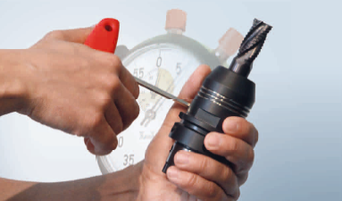
Advantages
Tool change within seconds, micron-precise without peripheral equipment. Just screw to the dead stop
Easy handling
Turn in the actuation screw with an Allen key to the dead stop
The clamping results in a run-out accuracy of less than 0.003 mm without the need for additional peripheral equipment
Advantages:
  Time savings due to reduced set-up times
  No investment costs for additional clamping devices

Slide 17
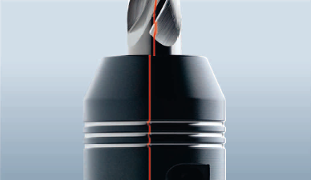
Advantages
Suitable for HSC/HPC machining – precision-balanced as standard
Balancing grade G 2.5 at 25.000 rpm
HSK-A63 version for high speeds
Perfectly suitable for HPC/HSC machining centers
Advantage: perfect for HSK high speed spindles

Slide 18
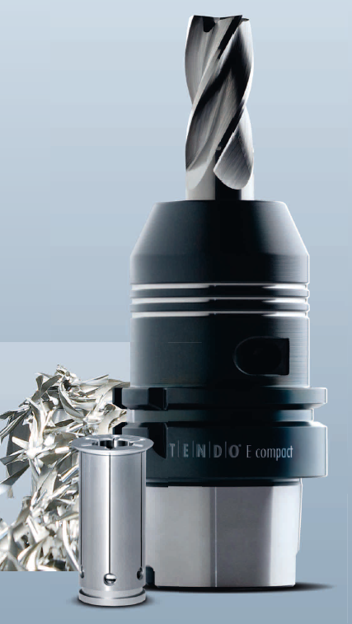
Advantages
Flexible clamping areas through intermediate sleeves
With intermediate sleeves, various shaft diameters from 3 to 32 mm can be clamped with only one toolholder
Advantage:
  Reduction of the purchase cost
  Higher clamping force at shaft diameter

Slide 19
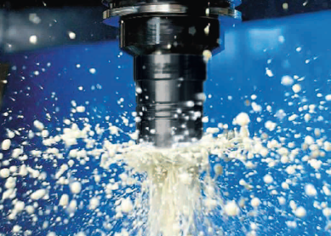
Advantages
Maintenance-free
Sealed system
Blocks the penetration of dirt, coolant, lubricants or chips
Clamping area will not be damaged
Proper function is guaranteed
Advantage: maintenance-free and a long service life

Slide 20
TENDO E compact
Practical hardness tests surprised experts
“I never dared to believe that such holding forces could be achieved by a hydraulic expansion toolholder. Nothing slips during machining, the new hydraulic expansion toolholder holds firmly.”
(Jörg Kleemann, CEO of WKL NC-Technik GmbH, Bad Salzuflen, Germany)
“The TENDO E compact absorbs the vibrations during rough machining. We wish we could have had rough machining like this in the past.”
(Anton Schönfelder, CEO of SLZ Maschinenbau GmbH, Hanau, Germany)
“Compared with a Weldon, service life of the tools increases by 30 to 35% with the TENDO E compact.” “The high clamping force is amazing to watch.“
(Raimund Dinyer, Project Manager, and Andreas Scheuermann, cutting machine operator, Invenio GmbH Engineering Services, Nauheim, Germany)

