Slide 1


Detail Presentation Technical
LOG Hole Gripper
Superior Clamping and Gripping

Slide 2
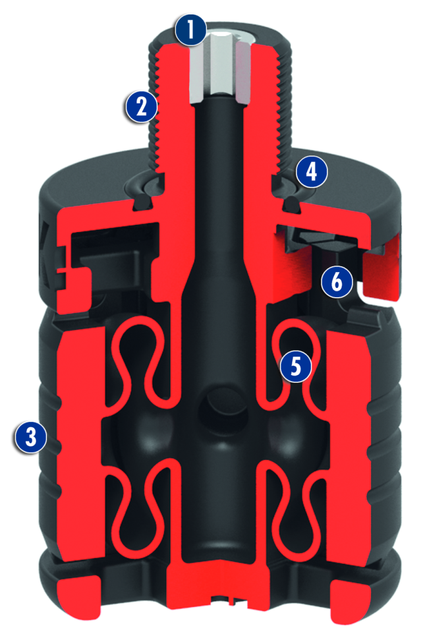
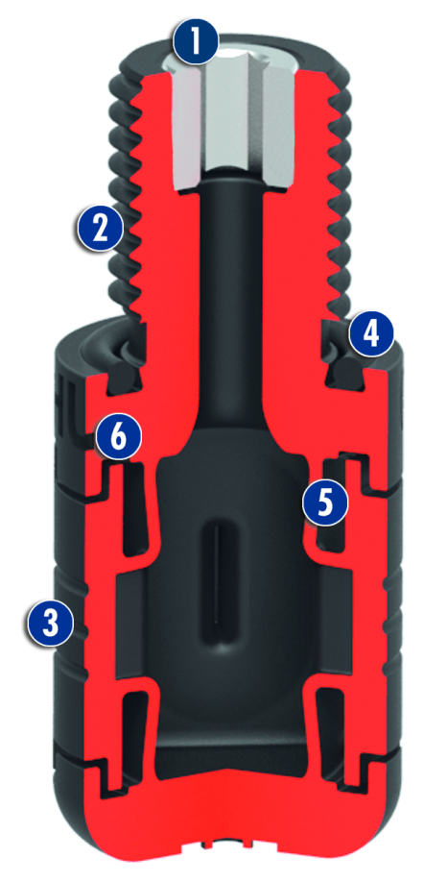
LOG Hole Gripper
Size 20-31
Size 32-40

Slide 3
Standard-LOG
The LOG hole gripper is available from size 20. Holes smaller than 20 mm in diameter are not possible with the LOG.
As “standard" means any size available from Ø 20-40. More Ø40 mm is in principle possible (as "special").
ID numbers are reserved by von 0398920-0398940 (… bis 0398999)
The LOGs s are created only in AS400 when there is
a need behind the respective size is(→ Info to S. Wütherich)

Slide 4
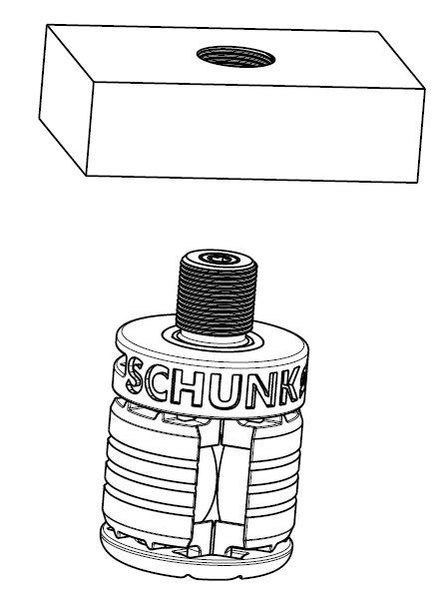
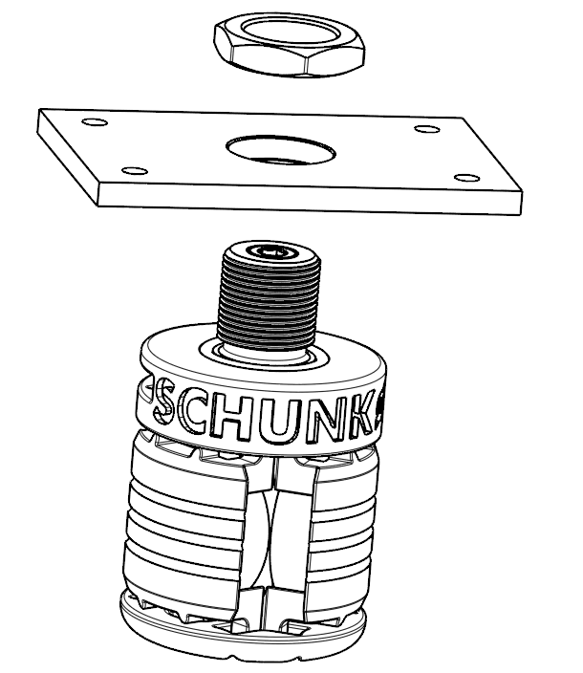
Mounting options
Mounting with threaded hole
Throughbore with locknut

Slide 5
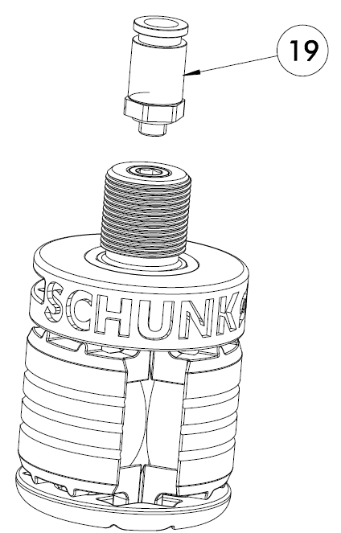
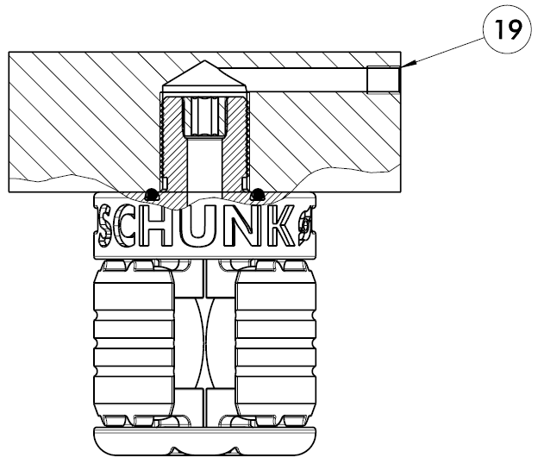
Air connections
Air connection from above
Hose-free direct connection
(Via O-ring seal)

Slide 6
General Information (from BA)
„ The hole gripper LOG is not intended for maintenance. Disassembly for maintenance or repair is not possible. A damaged gripper must be changed completely.“
"It's to prevent the LOG hole gripper remain for a long time (> 1 hour) supplied with compressed air (eg machine breakdown or overnight). In addition, idle strokes should be avoided (opening the gripper wihout tool). “
"For production reasons, it is possible that during operation powder granules on the gripper release (inside and outside). Therefore the use of a filter for the pressurized air is recommended. "→ This note is a precaution. In continuous operation, there were never any problems with the valves or air lines.
„ The module is not considered as defect when it deforms plastically within the specified limits. The permissible deformation is dependent on the workpiece diameter.“
→ comparison creep curves.

Slide 7
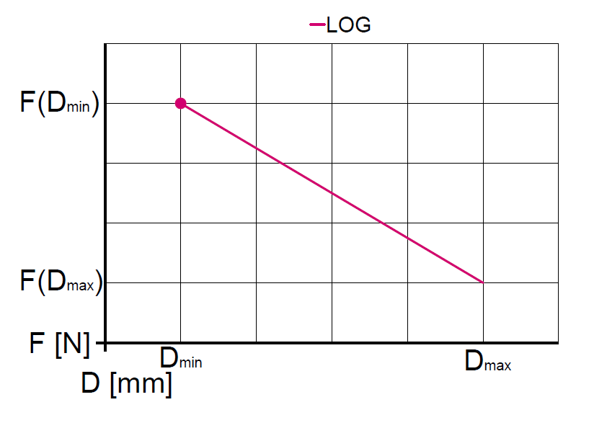
Gripping force diagram
The Gripping force of the LOG decreases with increasing stroke.
In the technical values, the minimum and maximum workpiece diameter indicated and the respective gripping forces. Between them is a nearly linear relationship.
Approximate value coefficient of friction µ:
PA2200 - Aluminium 0,15
PA2200 - Steel 0,18
PA2200 - POM 0,19
PA2200 - Aluminium anodized 0,13

Slide 8
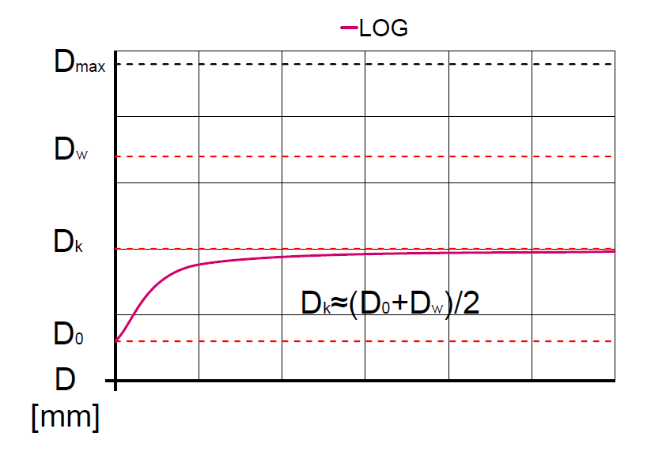
Creep diagram
Over time, the creep of the stroke can be observed in the LOG. This means that after closing, the gripper jaws may not fully return to the open position
It could be formed following relationship (see chart): (We assume that this is the "worst case" and depending on the application to the customer due to a lower frequency, the creep is less)
Example LOG 40:
Dmax: 45,67 mm
Dw: 43,0 mm (tool)
D0: 39,6mm
Dk: 41,3 mm ((39,6+43)/2)
→ The greater the stroke the more creeps LOG

Slide 9
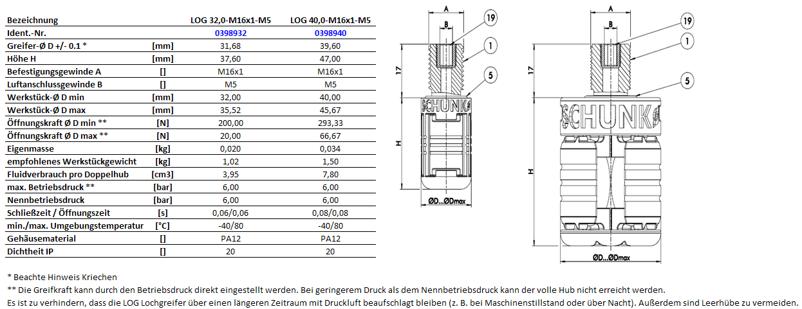
Katalogdaten
As long as the catalog data is not entered into PIM, there is transitional an a Excel data sheet.
You only have to put in the ID number, then the datas will be updated. (0398920-0398940)
p2717_LOG_catalogue datas_transistionaly.xlsx

